Slide 1
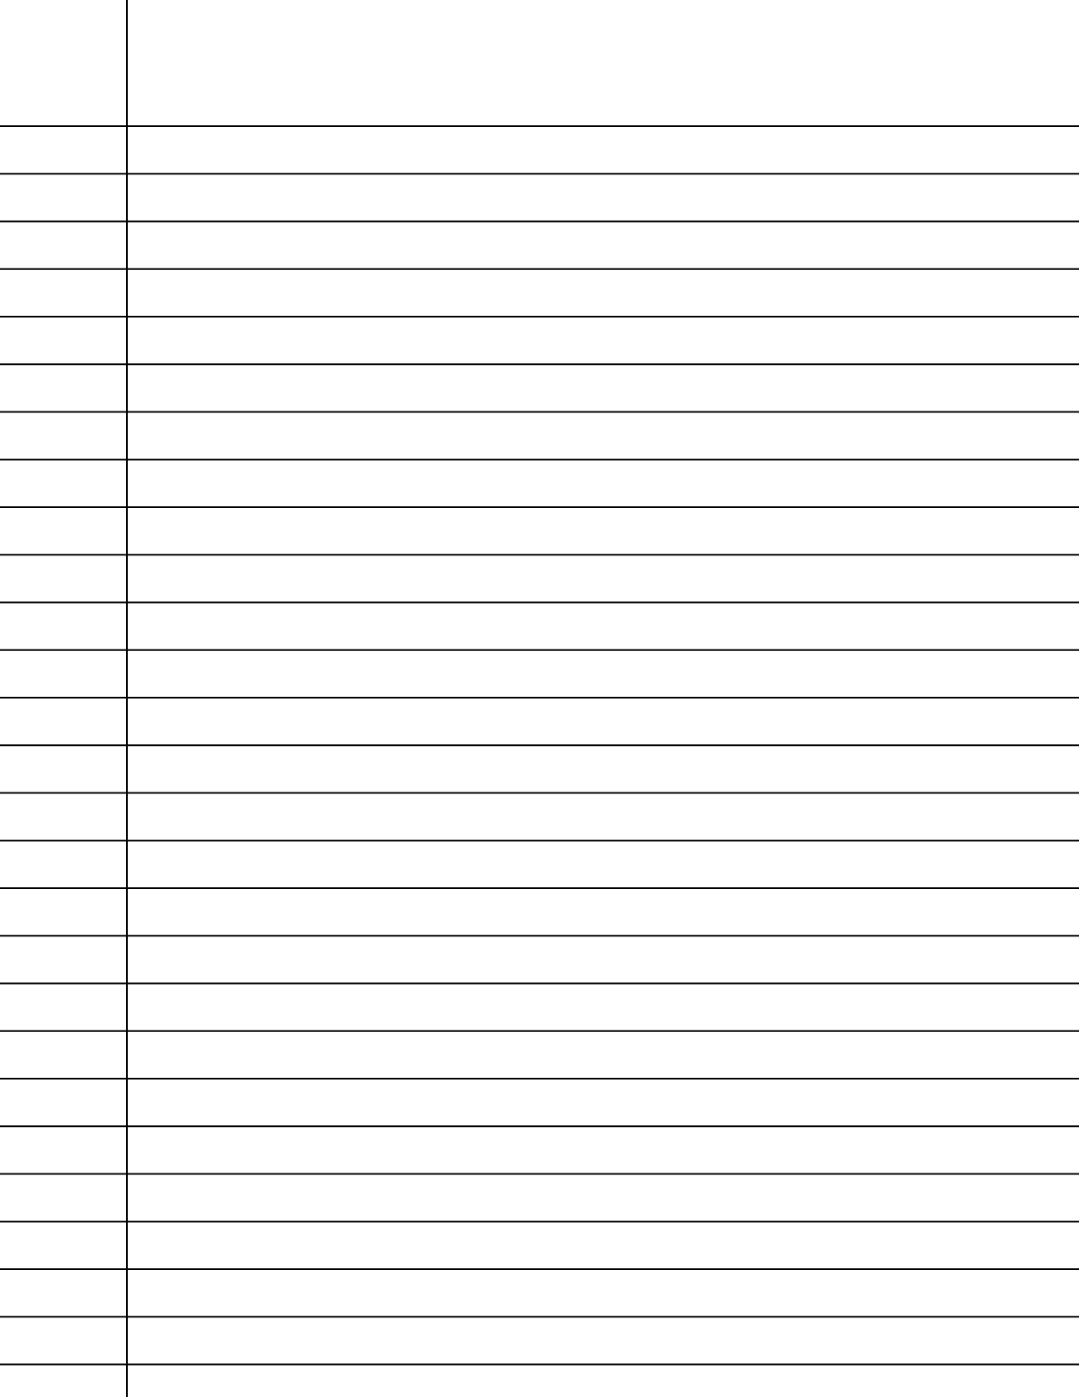
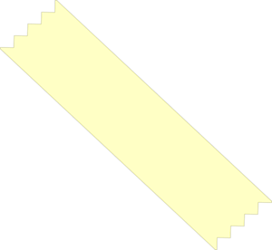
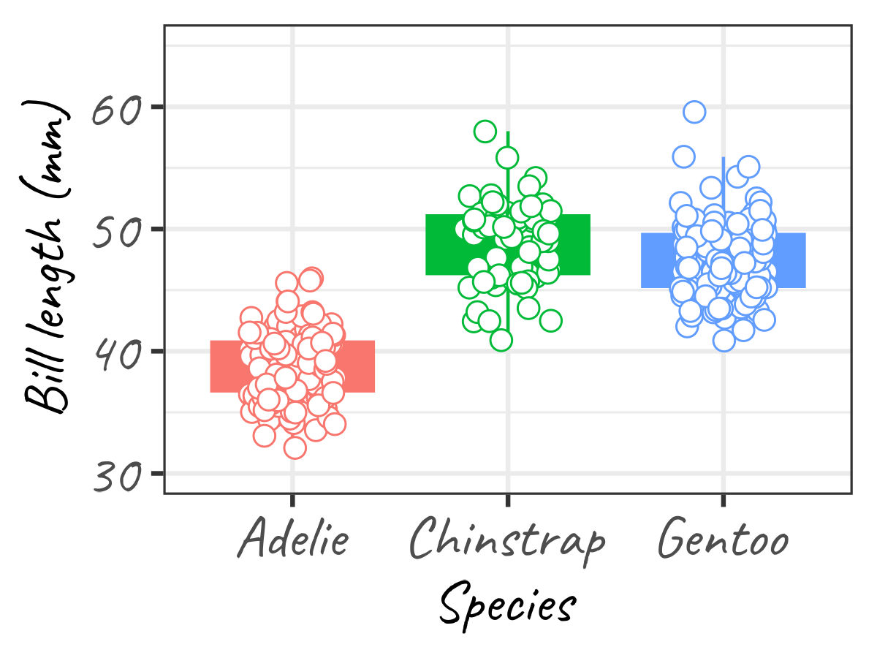


02/03/2023
Making a plot using ggplot2 is much like writing a recipe
Ingredients
- Empty plot
- Boxplot
- Raw data points
- Labels
- Theme
each new step (layer) in the recipe are defined using a '+' in ggplot2
- Axis limits
Recipe
1. Start with an empty plot
Translate recipe to ggplot2 code
2. Place the boxplot on top
3. Sprinkle over raw data points
(1.)
(2.)
(3.)
(4.)
(5.)
(6.)
ggplot(data, aes(x, y)) +
4. Add labels to the outer axes
geom_boxplot() +
5. Alter the axis limits
geom_jitter(width = 0.2) +
6. Add finesse by changing the theme elements
labs(x = 'new label x',
y = 'new label y') +
theme_bw(base_size = 14) +
ylim(c(0, 50)

