Slide 1
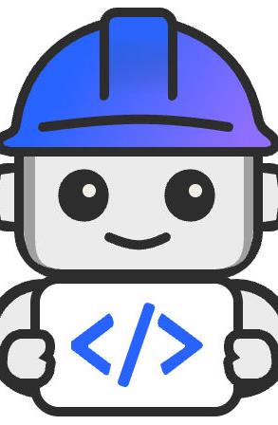
Project Bob – IBM’s AI Developer Partner
Presented by: Salman Shaikh

Slide 2
Context & Motivation
Growing need for AI-assisted software development
Enterprises face challenges in security, data integration, and governance
Modernization of legacy systems remains a major obstacle
Project Bob aims to bridge prototype-to-production gap

Slide 3
Announcement at TechXchange 2025
IBM unveiled Project Bob at IBM TechXchange 2025
Private preview, invitation-only waitlist
6,000 IBM developers using it internally
Part of broader AI/agentic ecosystem including AgentOps and Langflow integration

Slide 4
What is Project Bob?
AI-first Integrated Development Environment (IDE)
Understands intent, codebase, and compliance standards
Supports architecture design, debugging, refactoring, and modernization
Switchable modes: Architect Mode and Code Mode

Slide 5
Key Capabilities & Features
Agentic workflows for complex task decomposition
Multi-model orchestration (Claude, Llama, Mistral, IBM Granite)
Full repository context awareness
Inline vulnerability and compliance scanning
Modernization support for legacy frameworks
Runs across major OS with cloud flexibility

Slide 6
Technical Architecture
Multi-LLM orchestration: routes tasks to best-suited model
Agent orchestration engine for modular workflows
Security & compliance integrated via AgentOps
IDE, CLI, and chat interfaces
Repository context layer for persistent awareness

Slide 7
Enterprise Security & Compliance
Built-in understanding of FedRAMP, HIPAA, PCI
Governance and observability with real-time AgentOps monitoring
Data residency compliance for regulated industries
Emphasis on secure and reliable AI adoption

Slide 8
Results & Early Adoption
6,000 internal IBM developers onboarded
45% productivity improvement
22–43% more code commits
95% usage in task completion rather than raw code generation

Slide 9
Comparisons & Positioning
- Goes beyond Copilot and Cursor via full repo context and compliance
- Enterprise-grade governance and security
- Focus on modernization and legacy system upgrades
- Positioned for large enterprise adoption

Slide 10
Challenges & Risks
Dependence on LLM accuracy; risk of hallucination
Code exposure and security concerns
Complex integration with pipelines
Adoption barriers: developer trust and learning curve
Legal/IP implications of AI-generated code

Slide 11
Roadmap & Future Directions
Expansion beyond private preview
New integrations with additional platforms
More LLM models and enhanced explainability
Stronger observability and governance
Closer integration with watsonx Orchestrate and AgentOps

Slide 12
Literate Coding and Developer Experience
Project Bob transforms coding into a conversation.
Blends documentation and code naturally.
Enables developers to write, edit, and modernize with transparency.
Supports contextual AI guidance and continuous repository insights.
Redefines developer productivity while ensuring explainability and auditability.

Slide 13
Summary / Takeaways
IBM’s Project Bob brings AI deeply into the SDLC
Enterprise-ready focus on context, compliance, and security
Strong potential to revolutionize enterprise modernization
Awaiting real-world adoption and external validation

Slide 14
Bob Meets the World!
"Software development enters a new era with Bob and AI."
No more grumpy developers, puzzled newbies, or frazzled project managers.
With Bob, every role—from designer to engineer—is empowered.
Project Bob makes development not just productive and efficient — but delightful and enjoyable.
Watch this space as Bob evolves into your all-in-one AI partner for building the future.

Slide 15
Acknowledgments & Community Impact
Project Bob was proudly introduced at IBM TechXchange 2025
Special thanks to:
Neel Sundaresan , Dinesh Nirmal
The IBM Project Bob Team – For reimagining the developer experience
Built for developers, by developers — and for the entire software community

Slide 16
Q&A / References
IBM Announcement: https://www.ibm.com/new/announcements/ibm-project-bob
Presented by Salman Shaikh

