Slide 1
Exploratory Data Analysis
AudioDB Music API
Angela Spencer and Clarine Esperance
Notes:
Clarine

Slide 2
API Background
TheAudioDB is a community Database of audio artwork and metadata with a JSON API.
https://www.theaudiodb.com/
Example - theaudiodb.com/api/v1/json/1/search.php?s=coldplay
53,000 artists listed
created a list of randomly generated numbers within the range of available artist IDs
Sample size of 764
All data is categorical
Focused on genre, gender, location, and year formed
Data cleaning
Notes:
Clarine

Slide 3
Questions
What are the top locations that the artist are from?
What is the most popular genre style for artists in this dataset?
Are there more male, female, or mixed artists?
Notes:
Clarine

Slide 4
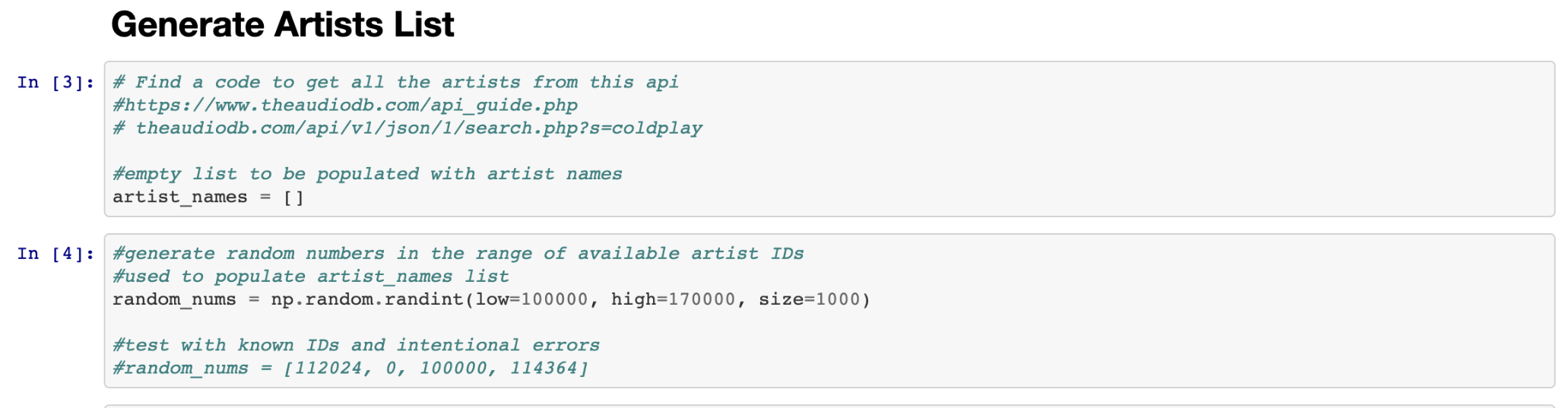
Getting our sample
Generated the artists list using np.random.randint
Notes:
Angela

Slide 5
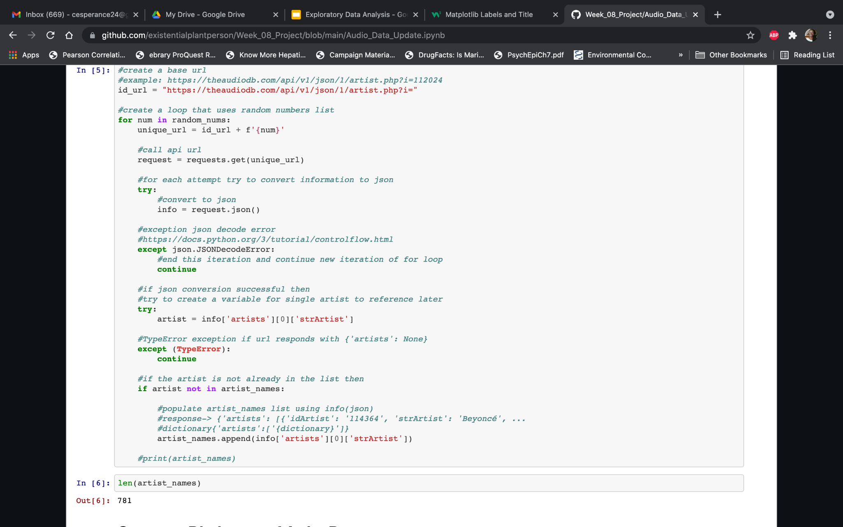
Creating Sample Cont’d
Sample Cont’d
Notes:
Angela

Slide 6
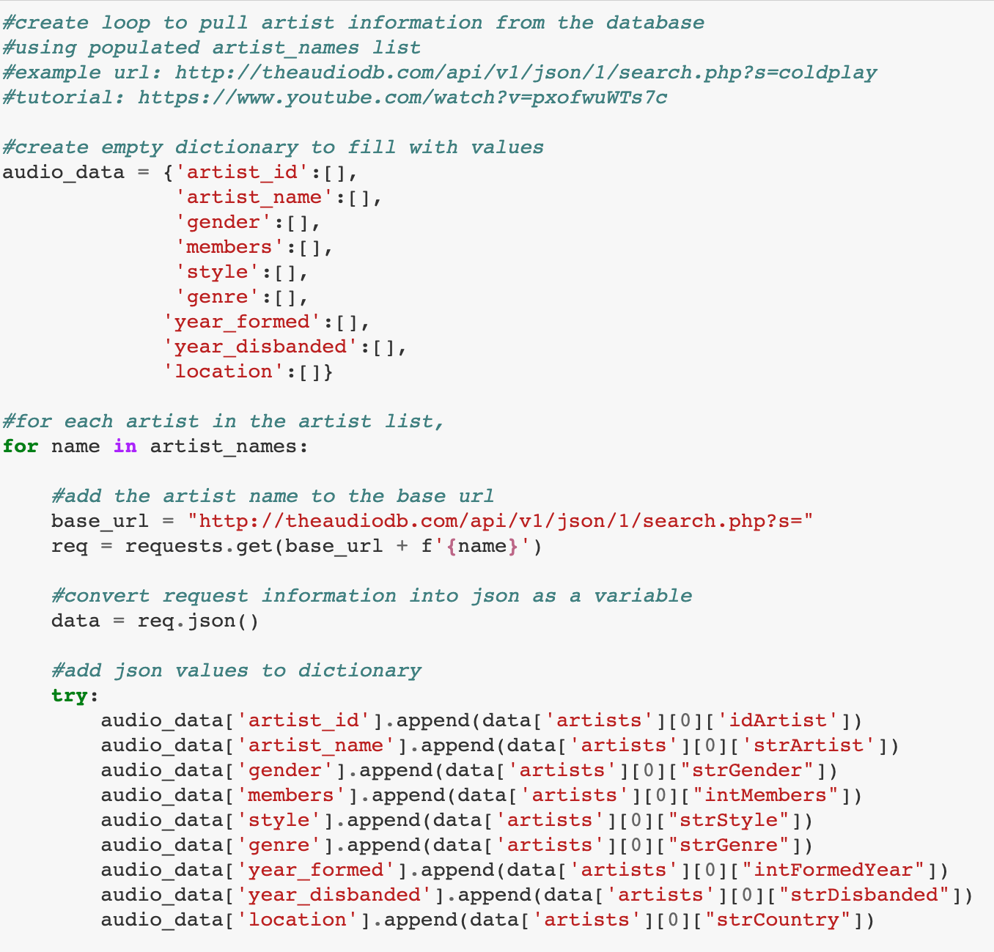
Loop for populating
Notes:
Angela

Slide 7
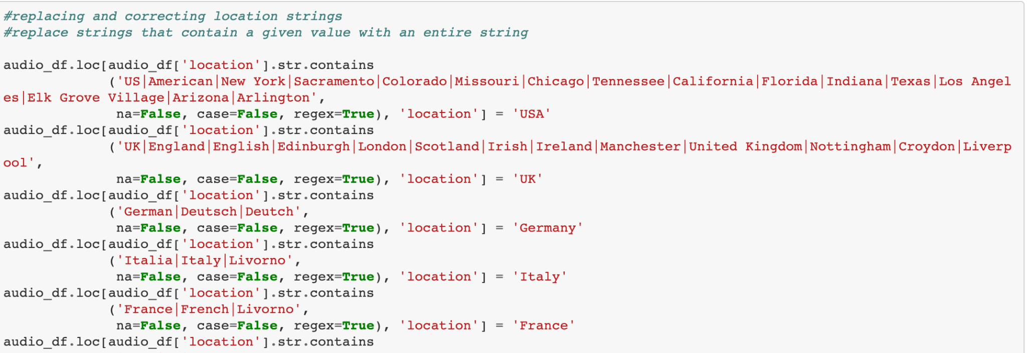
Cleaning the data
1. Main focus: gender, genre, location, year
Replace and dropped missing values for individual columns
Replace and corrected individual strings for location. Location example below:
Notes:
Angela
Did not want to drop missing values for the entire dataset due to that significantly cutting our sample size
Location data in this dataframe has no consistent format, we occasionally found states only, cities only, and variable spelling of countries. This code replaces many possible substrings with a single string.

Slide 8
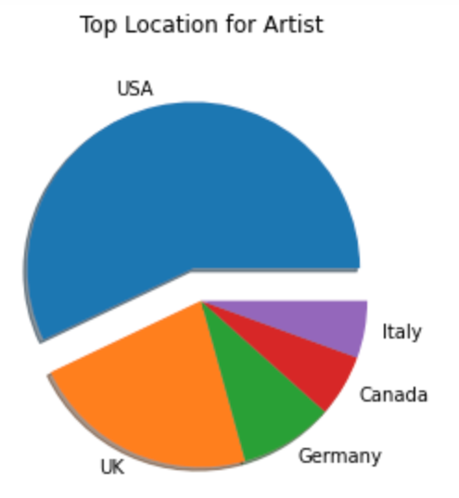
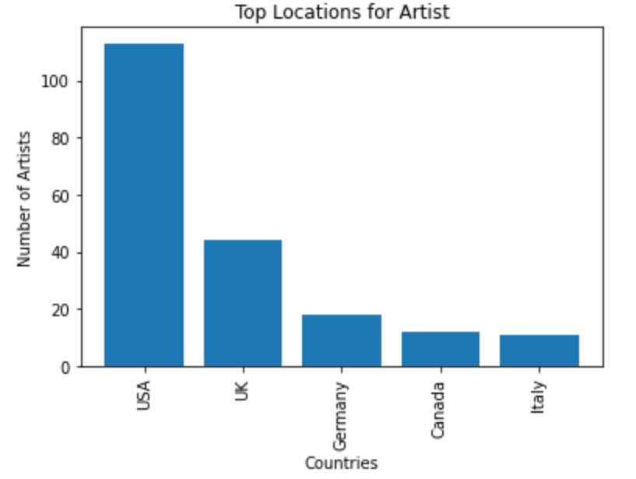
Location
The top locations
Notes:
Clarine
Null values were dropped from the column to analyze
Top location that artist are from is the USA. The UK and Germany are second and third

Slide 9
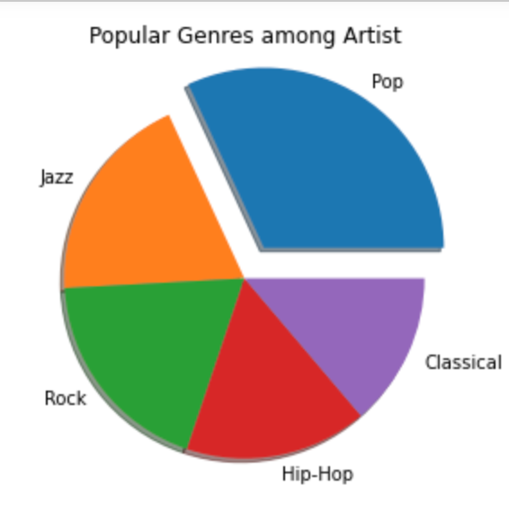
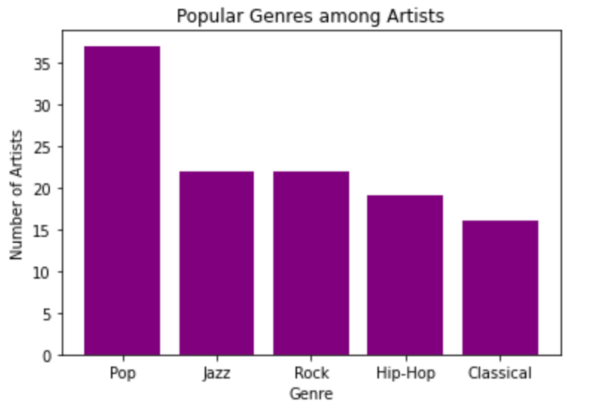
Popular Genre Style
Notes:
Clarine
Pop, Jazz, Hip_Hop, Rock, Folk are the top five genres that artists are in. Pop is the most popular
Performed a value_counts to obtain the most popular genres

Slide 10
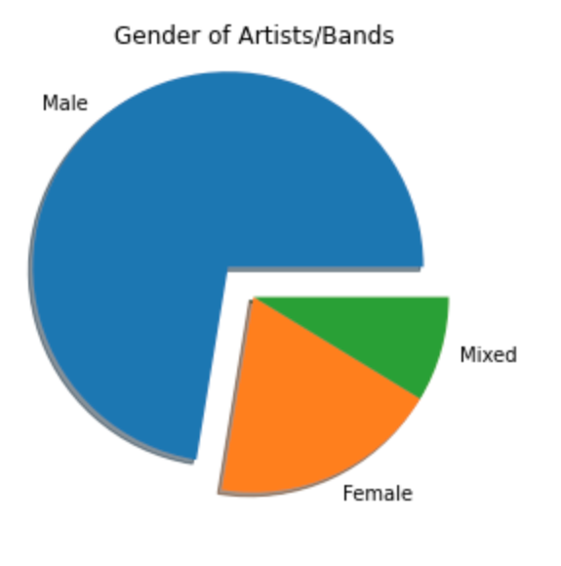
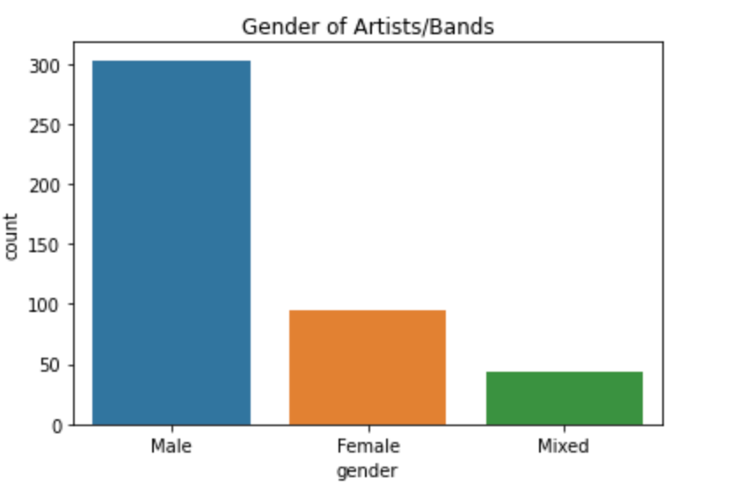
Gender Analysis
Notes:
Clarine
statistics.mode(gender_dropped['gender'])
'Male'

Slide 11
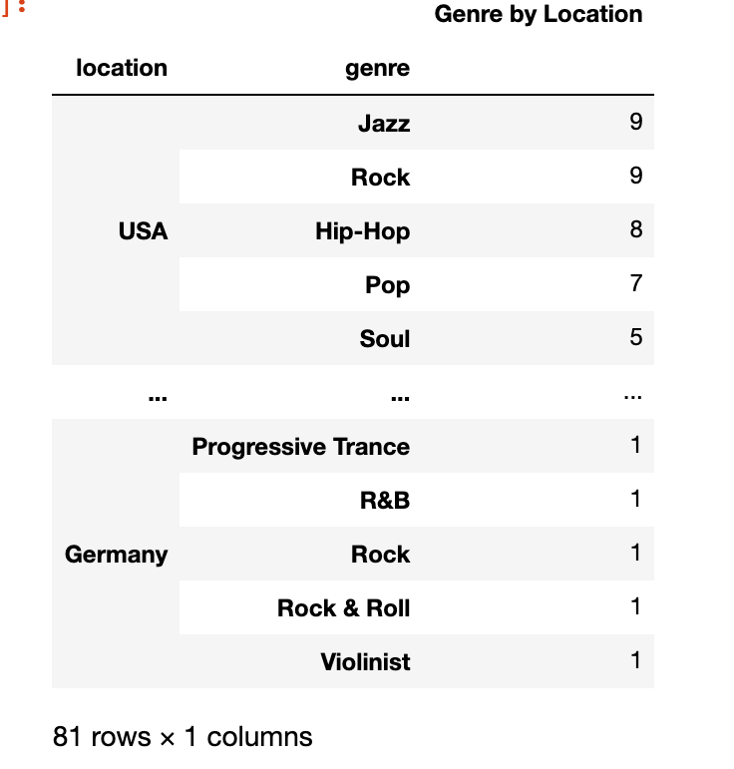
Location and Genre Analysis
Location and genre were grouped to check top genres in the top three locations.
Notes:
Angela
Wanted to do further analysis to check which popularity of genre in the top three countries, but ran out of time to create visuals. This table is the first part for the analysis

Slide 12
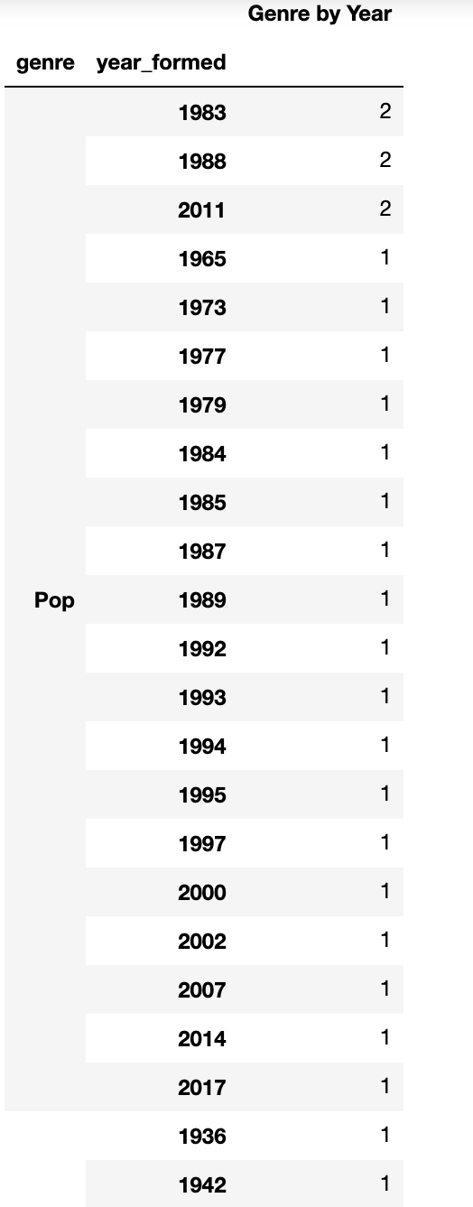
Year and genre
Further exploration possibility: check which years the top 3 genres (pop, jazz, rock) had an increase in creation (year formed).
Bin the years into decades
Notes:
Angela

