Slide 1
EntityG
  The Entity Association Graph Tool
  Eric Kisner
  Rochester Institute of Technology
  Independent Study with Professor Stephen Zilora
  Spring Quarter 20103

Slide 2
Entity Association Graph
What is an entity association graph?
  The graphical view of associations between entities.
What does an entity association graph consist of?
  Nodes and edges

Slide 3
Why EntityG?
Relative ease of data presentation
Displays nodes of data in an aesthetically pleasing way
Nodes are grouped by their relationships, or associations, which allows the user to see a data source's relationships easily

Slide 4
Why EntityG? (cont.)
Made in Java
  Portable
Easily extensible
  Custom colors for different nodes
  Selecting multiple nodes to get more narrow children
  Various data sources
Display data the way a user wants to see it
  Turns data into meaningful information

Slide 5
EntityG Terms
Node
Center Node
Information Node
Node Group
Edge

Slide 6

Node

Slide 7
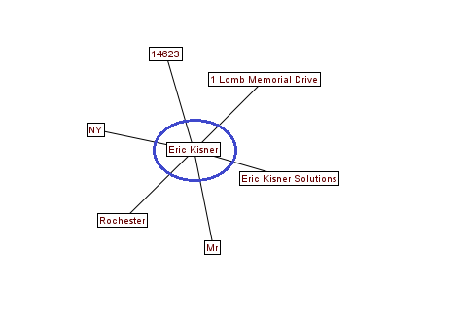
Center Node

Slide 8
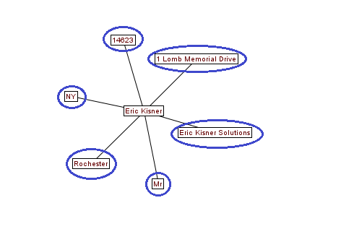
Information Node

Slide 9
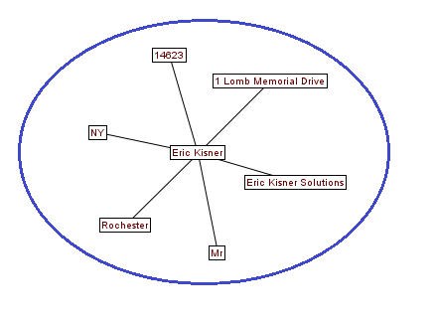
Node Group

Slide 10
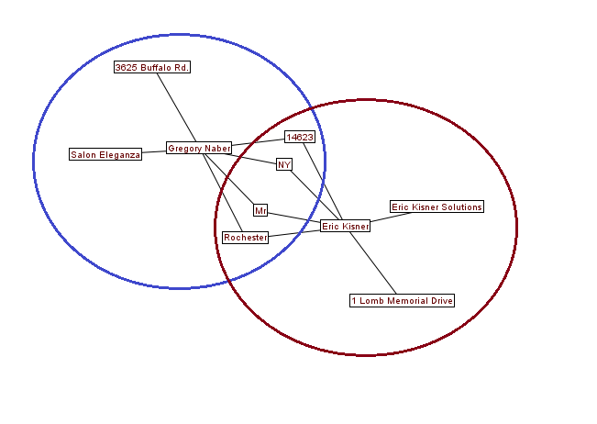
Node Group... x2!

Slide 11
EntityG Layers
Data source / data source loader
Generic Tree Implementation
Presentation layer

Slide 12
Data Source Loaders
Take data from a source, and loads it into an “EntityG-readable” format
A source must have some relationships within it, otherwise, it wouldn't be possible to extract associations from the data.
Organizes data based on user preferences
  What should the first node be?
  What should the information nodes consist of?
  What should a center node consist of?

Slide 13
Generic Tree Implementation
Data source loader creates a root node from user-specified options
  Root node will have child data
Root node passed to EntityG for processing
EntityG builds a graph based on the tree structure

Slide 14
Presentation Layer
Prefuse
ForceDirectedLayout
Node Controller

Slide 15
Prefuse
Third-party library
“Provides a visualization framework for the Java programming language.”
Easily translates a Tree data structure into a visualization

Slide 16
Force Directed Layout
Built into the Prefuse package
Aesthetically pleasing
Automatically positions nodes together if they are connected with an edge
No need for creating complex algorithms

Slide 17
Node Controller
Allows for user-interactions with nodes
Hover
  Tool tip is displayed saying what the node's data represents
Double-click
  Dynamically add that node's children to the graph.
  Or, collapse all children of the node.

Slide 18
Demos
Small (40 rows), Company Database
Somewhat larger (250 rows), “World” Database

Slide 19
Questions or Comments

