Slide 1
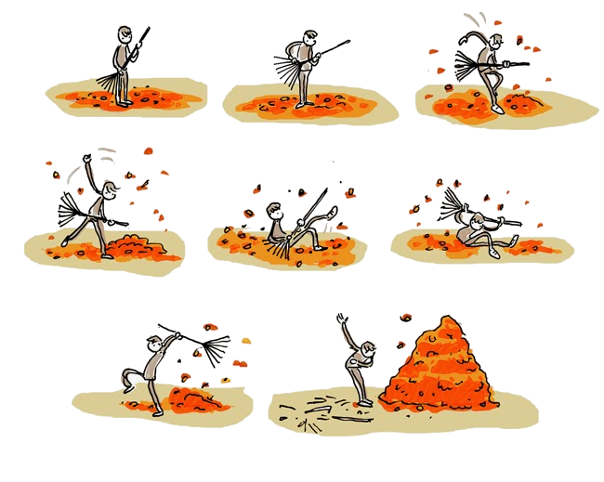
The garbage collector

Slide 2
What to expect
Some history: Memory allocation in C
Go memory allocation
GC in action
What's under the hood
Conclusion

Slide 3

History: the stack
result
allocated for max
#include <stdio.h>
int max(int first, int second) {
int result = first;
if (second > first) {
result = second;
}
return result;
}
int main(int argc, char *argv[]) {
printf("max of %d and %d is %d\n",
2, 5, max(2,5));
}

Slide 4

History: the stack
memory for max deallocated
#include <stdio.h>
int max(int first, int second) {
int result = first;
if (second > first) {
result = second;
}
return result;
}
int main(int argc, char *argv[]) {
printf("max of %d and %d is %d\n",
2, 5, max(2,5));
}

Slide 5

History: the heap
heap
points to
result
allocated at
stack
stack for max
#include <stdio.h>
#include <stdlib.h>
int *max(int first, int second) {
int *result = malloc(sizeof(int));
*result = first;
if (second > first) {
*result = second;
}
return result;
}
int main(int argc, char *argv[]) {
int *myMax = max(2,5);
printf("max of %d and %d is %d\n",
2, 5, *myMax);
free(myMax);
}

Slide 6

Memory allocation in Go
package main
import `fmt`
func max(first, second int) int {
var result int = first
if second > first {
result = second
}
return result
}
func main() {
fmt.Printf("max of %d and %d is %d\n", 2, 5, max(2, 5))
}
Where is result allocated?

Slide 7
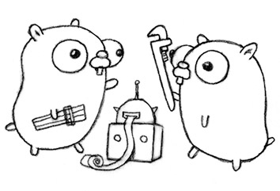
Memory allocation in Go
package main
import `fmt`
type Gopher struct {
Weight int
}
func breed(first, second *Gopher) *Gopher {
return &Gopher{(first.Weight+second.Weight)/2}
}
func main() {
dad := Gopher{200}
mom := Gopher{250}
fmt.Printf("%v plus %v is %v\n",
dad, mom, breed(&dad, &mom))
}
Where is the kid Gopher?

Slide 8
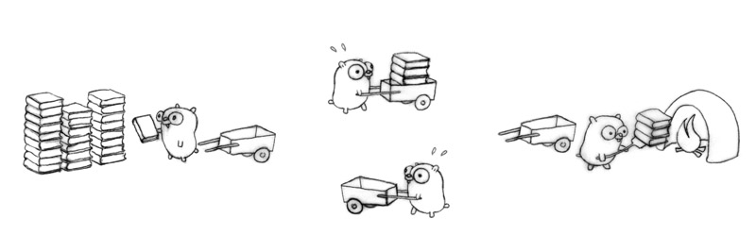
the Garbage Collector
To clean up heap memory that nobody cares about

Slide 9
GC in action

Slide 10
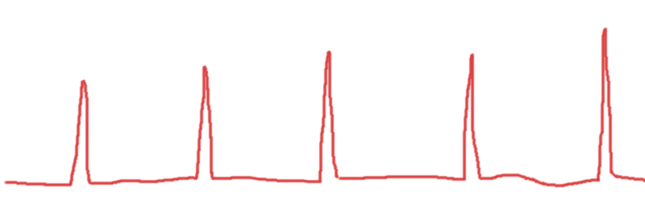
Why should you care?
Go GC is a stop-the-world mark & sweep garbage collector
-> i.e: no code running when GC
-> i.e: slow response or timeout
i.e: timeout spike

Slide 11
Why should you care?
Example: money transfer:
A -> [send money from user X to Y] -> B
A (waiting for ACK)........ -> B (GC. stopped)
A (timeout->failed)........ -> B (ran & ACK)
A (resend before getting ACK) -> B

Slide 12
Tuning
GOGC= X (default = 100)
GOGC=off
runtime/debug/#SetGCPercent.
-gctrace, -gcdead

Slide 13
Questions?

