Slide 1



Slide 2
THE PROBLEM
01.
The importance of the vote
Elections are one of the core pillars of establishing governance in any democracy.
02.
Paper-based voting systems
Current election system heavily relies on paper-based voting systems, which are vulnerable to frauds, human’s errors, and manipulations. current election system heavily relies on paper-based voting systems, which are vulnerable to frauds, human’s errors, and manipulations.
03.
Electronic voting requirements
Electronic voting is widespread in social life. However, it is not clear how to ensure that the outcome will be honored if the decision has a financial or political context. Accuracy, security and privacy are always the most important characters.
04.
What’s the issue?
In voting, many people make decisions, and the decisions they make may be kept secret. Most electronic voting systems require a reliable public bulletin board to provide a consistent view to all voters. However, it is up to the election administrator to prove that a public bulletin board can be completely reliable In voting,

Slide 3


WHY 3VOTING?
Integration of blockchain technology in voting systems can potentially give more security, transparency and restore trust. The most promising application of blockchain in voting system can be the use of Zero-Knowledge Proofs and Soul Bound Tokens.
3lectronic
Web3
Merkle 3
No more need for paper-based elections
Leveraging the power of blockchain
Used in ZKP processes

Slide 4
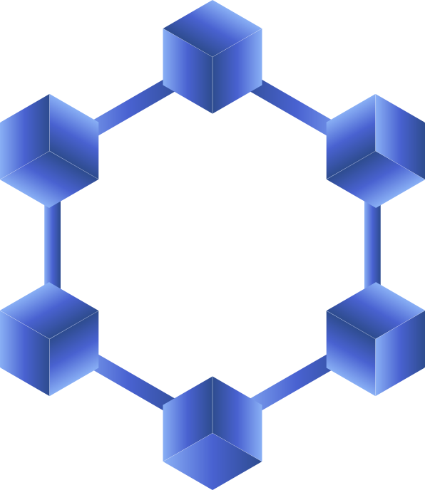

OUR SOLUTION
ZKP
is a form of cryptographic technique that enables a party to prove the knowledge of a secret without revealing the secret itself . This property makes it an ideal solution for verifying the integrity of voting data while maintaining the anonymity of the voter
Soul Bound Token
Deployed on Avalanche
establishes a decentralized identity infrastructure where non-transferable tokens serve as immutable digital credentials, binding user identity data directly to wallet addresses for secure authentication and verification purposes.
The smart contracts deployment on Avalanche local test-net successfully completed, leveraging Avalanche's high throughput and low transaction costs for efficient on-chain operations
React
Circom
The frontend application is built with React, providing a responsive and intuitive user interface
Zero-knowledge circuits built with Circom generate cryptographic proofs that allow users to verify their identity attributes without revealing sensitive personal information on-chain. The circuit logic ensures that identity verification remains privacy-preserving while still providing the necessary cryptographic guarantees for the voting system's compliance requirements. The implementation leverages zk-SNARK to create compact, verifiable proofs that users meet voting eligibility criteria without exposing their personal details. These proofs enable efficient on-chain verification while maintaining user privacy.
ScaffoldETH
The project utilizes Scaffold-ETH as the full-stack development framework, providing a rapid prototyping environment with pre-configured React frontend, Hardhat backend, and seamless wallet integration that accelerates the development.

Slide 5

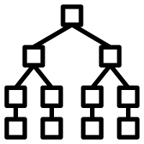









THE ARCHITECTURE
Merkle Server
Send new votation or Merkle root request
Merkle root data
On-chain Backend
React Frontend
Send vote to on-chain contract and
verify vote integrity or SBT handle
User can Vote or
Create votations
Operation result
Operation result
Client Backend
3votingchain L1

Slide 6



DEMO TIME!

Slide 7




Thanks for your attention !
Alberto Petillo
Simone Montella
Valerio Domenico Conte
You can find us on

