Slide 1
About this course

Slide 2
This course
This course will be almost thorough dive into creating GUI with Swing:
Simple applications
Drawing on the GUI
Painting custom components
Setting global Look and Feels
Common code design in Swing

Slide 3

What is Swing?
Swing is a pure-Java desktop GUI creation toolkit
Allows you to create GUI without installing any third party libraries
Very easy to use with its imperative nature
Highly easy to customize/use yet super powerful at its core

Slide 4
Quick aside: Imperative GUI Building
The opposite of declarative GUI building, instead of repainting everything in the GUI when something like a variable changes, we call things like “setMyText” or “setBackground”

Slide 5
Ok, but who uses Swing?
In many modern day Java courses, Swing is covered for their basis (e.g. APCSA)
JetBrains - They build all of their products such as JetBrains, CLion, PyCharm under their own Swing suite
Minecraft - Yes, most Minecraft mods utilize Java Swing for easy configuration.
However, many more applications are very specific…

Slide 6
Setting up your development environment

Slide 7

Java Runtime
Version: 17
Best Recommended Provider:
Adoptium Temurin: https://adoptium.net/temurin/releases/

Slide 8





Editor/IDE
Mostly your choice, but whichever gives you the best development experience:
(I would prefer you to use VSCode and IntelliJ as for uniformity)
VSCode - With the proper Java extensions
IntelliJ - Educational, Community, or Ultimate Edition
Eclipse
VIM/Emacs - not recommended but at your own discretion
Note: some editors may be paid, but this course doesn’t require the paid aspect

Slide 9

VSCode setup
Go to the extensions install page and search for “Extension Pack for Java”. Click install.

Slide 10
IntelliJ Project Setup
Click on “New project” or from Files > “New Project.”
No extra extensions are required for this IDE to work.

Slide 11
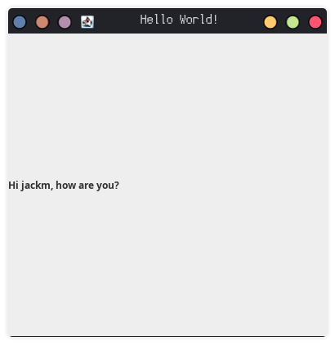
Simple example
import javax.swing.*;
import java.awt.Dimension;
public class TestCode
{
public static class MyWindow
extends JFrame
{
public MyWindow()
{
super("Hello World!");
setPreferredSize(new Dimension(400, 400));
JLabel label_1 = new JLabel("Hi " + System.getProperty("user.name") + ", how are you?");
add(label_1);
}
}
public static void main(String... args)
{
SwingUtilities.invokeLater(() -> {
MyWindow program = new MyWindow();
program.pack();
program.setLocationRelativeTo(null);
program.setVisible(true);
});
}
}

