Slide 1
Swing#1

Slide 2
Last session
import javax.swing.*;
import java.awt.Dimension;
public class TestCode
{
public static class MyWindow
extends JFrame
{
public MyWindow()
{
super("Hello World!");
setPreferredSize(new Dimension(400, 400));
JLabel label_1 = new JLabel("Hi " + System.getProperty("user.name") + ", how are you?");
add(label_1);
}
}
public static void main(String... args)
{
SwingUtilities.invokeLater(() -> {
MyWindow program = new MyWindow();
program.pack();
program.setLocationRelativeTo(null);
program.setVisible(true);
});
}
}

Slide 3
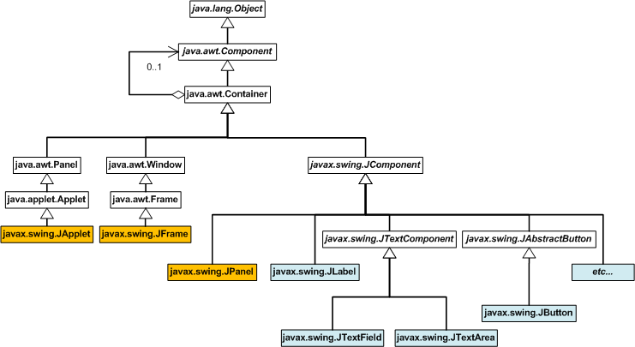
Today
What is AWT?!?!?!
What are Components
Looking at the API
Understanding JComponent and component inheritance tree
Looking at other common components

Slide 4
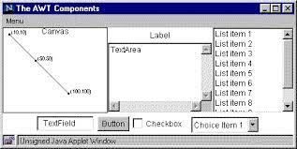
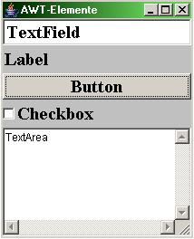
AWT
java.awt.Dimension - What the heck is that?

Slide 5
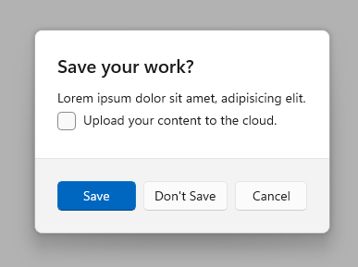
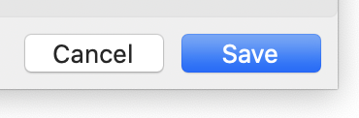
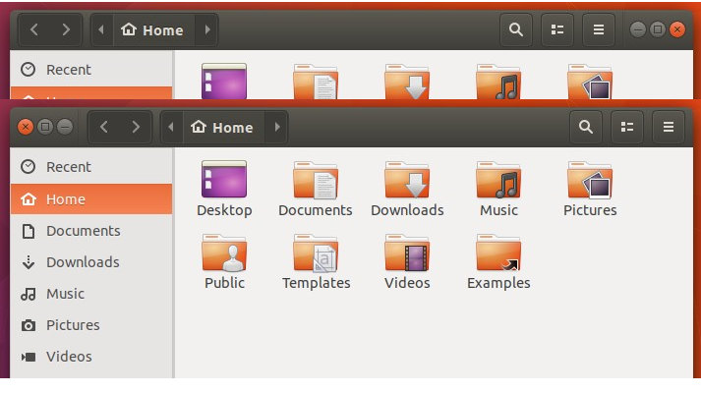
AWT vs Swing
Swing is AWT, but AWT is the old framework
You can make components uniform on different operating systems

Slide 6
Let’s define a COMPONENT
The core parent class of all UI elements (i.e. a button, a text label, a window, etc.); remember inheritance in Java!
In Swing, you can easily identify said component because they are prefixed with a “J”
A component like a button are all blank slates, they are either drawn by you or Java or someone else.

Slide 7
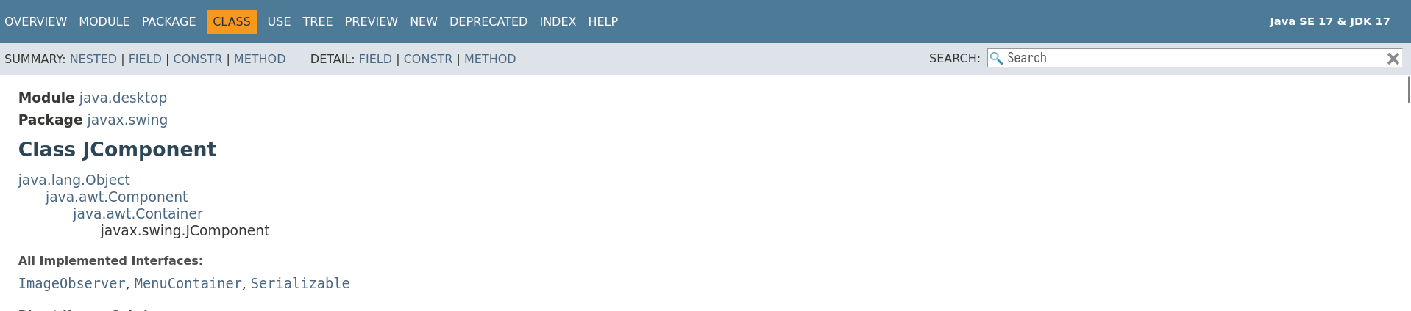
Let’s look at the components we have
Head over to: https://docs.oracle.com/en/java/javase/17/docs/api/java.desktop/javax/swing/JComponent.html

Slide 8
Using the documentation
Don’t be ashamed to refer to the documentations!
You will be using the JavaDocs not just for Swing but for Java
There are hundreds of methods, variables, classes, interfaces, enums, and more that you simply can’t memorize

Slide 9
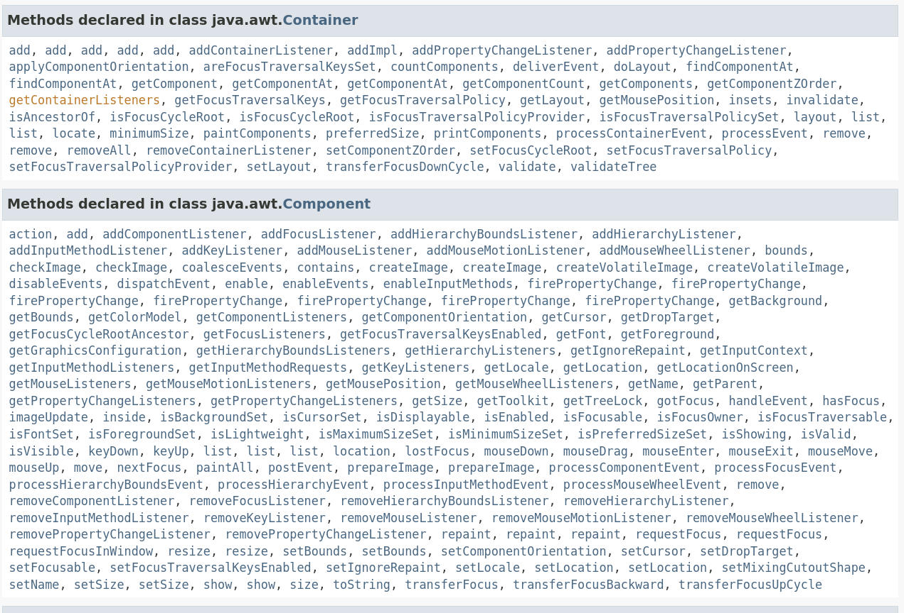

Slide 10
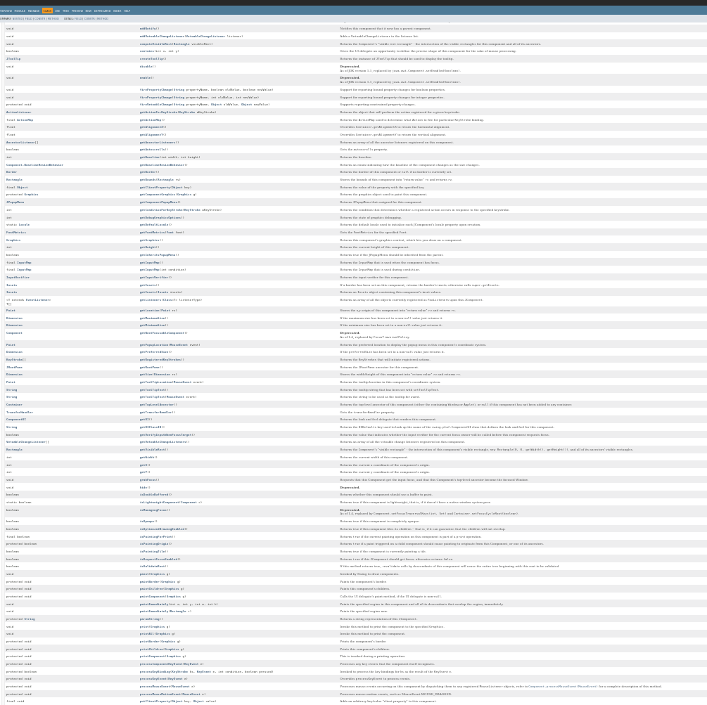
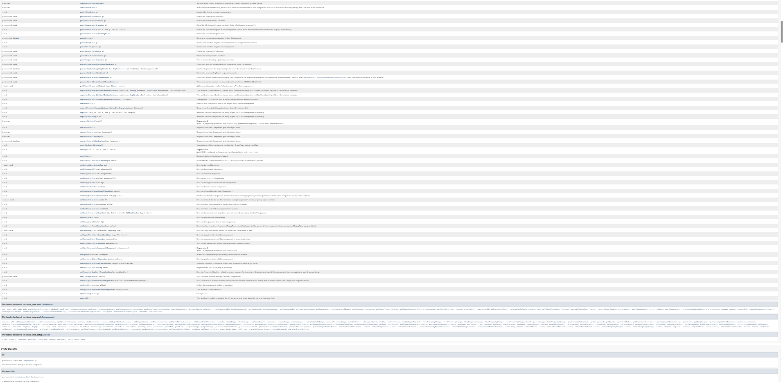

Slide 11
Let’s go back to visualizing them
https://www.falkhausen.de/Java-8/javax.swing/JComponent-Hierarchy.html

Slide 12
Thinking in Swing
Every component is a painting drawn pixel by pixel.

Slide 13
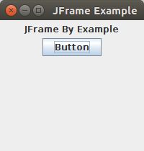
Component #1: JFrame
This is the window
Is the physical parent of all other GUI components

Slide 14
Component #2: JPanel
This is the parent/container of all other GUI Components under the JFrame
By default just a blank slate
“Our canvas”
The JFrame itself has an implicit JPanel which can be retrieved with the “JFrame::getContentPane” method

Slide 15
Component #3: JLabel
Just a text label
Supports formatting with HTML

Slide 16
Component #4: JButton
A simple button
You can attach a text or icon to it or both!

Slide 17
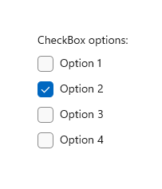
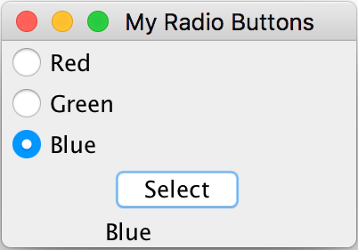
Component #5: JToggleButton/JCheckBox/JRadioButton
A button that can be turned on and off: “toggled”
All of these are similar to a plain JButton but with a toggleable state and different looks

Slide 18
Let’s try it out!
import javax.swing.*;
import java.awt.*;
public class SwingTesting
{
public static class MyComponent
extends JFrame
implements
Runnable
{
public MyComponent()
{
super("Testing Swing");
setPreferredSize(new Dimension(400, 530));
JPanel pane = new JPanel();
pane.setLayout(new BoxLayout(pane, BoxLayout.Y_AXIS));
pane.setPreferredSize(getPreferredSize());
pane.setBorder(BorderFactory.createEmptyBorder(6, 6, 6, 6));
setContentPane(pane);
// start putting your components here
}
@Override public void run()
{
pack();
setLocationRelativeTo(null);
setVisible(true);
}
}
public static void main(String... args)
{
SwingUtilities.invokeLater(new MyComponent());
}
}
Copy this template code

