Slide 1
Network Theory Methods for Improving a Rating Recommendation Algorithm
Daniel Hou, Josh Limon, Zhou Yu, and Dawei Zhao

Slide 2
Abstract
For our project, we see how accurately a variety of similarity metrics can predict what movies a given user would want to watch based on the viewership and ratings of similar users. We also introduce and test the validity of two variations of the Probabilistic Spreading method. The first (unsuccessful) variation involved introducing negative reviews as a consideration. The second variation incorporates trying two new thresholds for determining what reviews get considered in the calculation.
Notes:
Josh

Slide 3

Background
In 2006, up and coming movie rental company Netflix was looking for a way to improve its search algorithm.
To accomplish this, Netflix promised a $1 million prize to the team that could improve the algorithm accuracy the best (1).
A team at AT&T labs in New Jersey won the prize with a 10.06% increase in accuracy in 2009 (several teams submitted their results <20 minutes before the deadline).
New technique that served as a foundation for the algorithm incorporates a new predictor called baseline predictor
Notes:
Zhou

Slide 4
Dataset
Original data: 17,770 movies, 2,649,429 users
Ratings: 1- 5
We randomly picked 5,000 movies, 10,000 users (3 times)
Bipartite graphs: Graph-1, Graph-2, Graph-3
Within each graph, we randomly picked 90% of the data (edges) as training set, and the rest 10% as testing/probing set
Notes:
Zhou

Slide 5
Dataset
For each training set, on average:
user: 1846
movie: 3865
number of edges: 1,001,305
This is because usually 10% most active users contribute 90% of the ratings
Notes:
Zhou

Slide 6
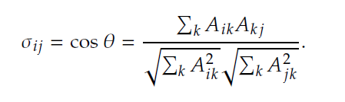
Method 1: Item-based cosine similarity
Structural equivalence
vs. regular equivalence
Comparing exact same movies rather than movies of the same type
Normalization of shared neighbors
Accounts for varying degrees across the network
Weighted network
Notes:
Daniel

Slide 7

Baseline Predictors
One wants to incorporate biases involved in user-item interaction
The team at AT&T tried the idea of a baseline predictor, an algorithm variable that encapsulates the biases of both movies and users.
μ is the overall average rating a user gives a movie.
E.g. Tom is a critical user that prides himself on only the most niche and best movies, so he get a negative b_{u} score (maybe -0.7)
E.g. The Godfather is one of the highest rated movies of all time and so it gets a positive b_{i} score. (maybe +0.5)
Yehuda Koren and the team incorporated more considerations like how many ratings a user gives on a day, how the popularity of a movie changes, etc. (2) We opt for a more simple approach for reasons explained later on.
Notes:
Josh

Slide 8
Method 2: Baseline Predictor
Calculate the Baseline predictor for each user-item relationship and this is the expected rating each user would give an item.

Slide 9
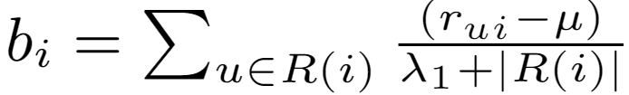
Item Bias:
R(u) denotes the set of items rated by a user, u.
r_{ui} is the actual rating a user, u gives an item, i.
Basically, sum all the distances of ratings given for an item i from the overall average
λ₁ is a “regularization parameter” and we use Koren et. all’s value of λ₁= 25 (2).

Slide 10
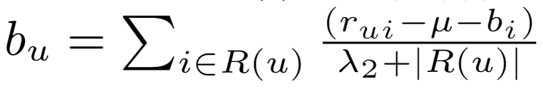
User Bias:
R(i) denotes the set of users who rated an item, i.
r_{ui} is the actual rating a user, u gives an item, i.
Basically, sum all the distances of ratings given for an item i from the overall average
λ₂ is again a “regularization parameter” and we use Koren et. all’s value of λ₂= 10 (2).

Slide 11
Method 3: Probabilistic Spreading (ProbS)
Basically: Take a random walk from a given user going down a given edge, after taking that random walk from item back to another user back to another item, what is the probability you end up at a given item
Repeat this for all edges from that given user
(discluding items that already have an edge to the user).

Slide 12
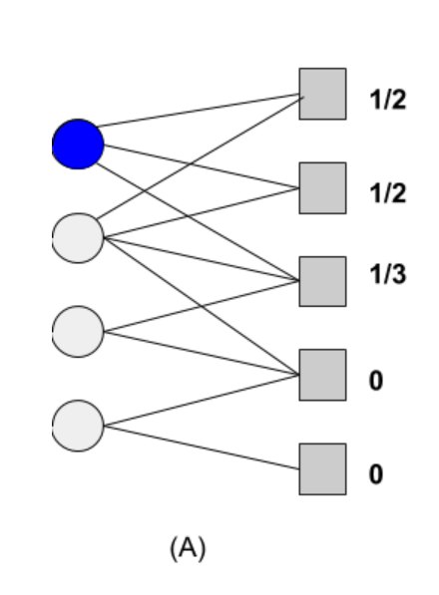
Give each of the items a user is connected to weight 1/k_{i} where k_{i} is the degree of the item.
Give an item weight zero if it is not connected to the user.

Slide 13
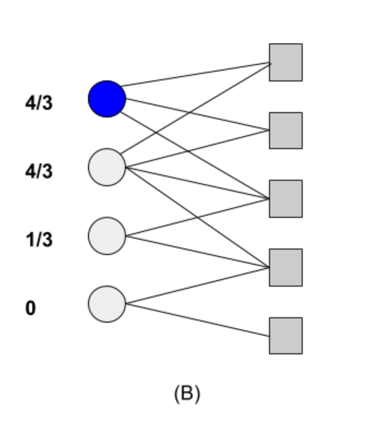
Add all the item weights that are connected to a user and assign that summed value to be the weight of the user.
Repeat this for all users.

Slide 14
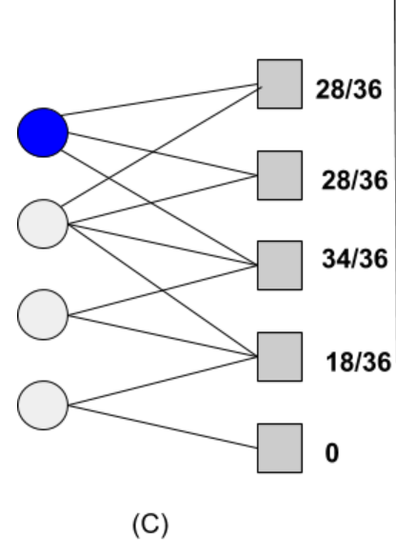
First divide all the user weights after from the last step by the degree of that node.
Then, sum all of these corresponding quantities for users connected to a given item.
Associate this sum with that item and repeat this step for all items. This is the initial recommendation weight (all the weights should sum to the degree of the original user).

Slide 15
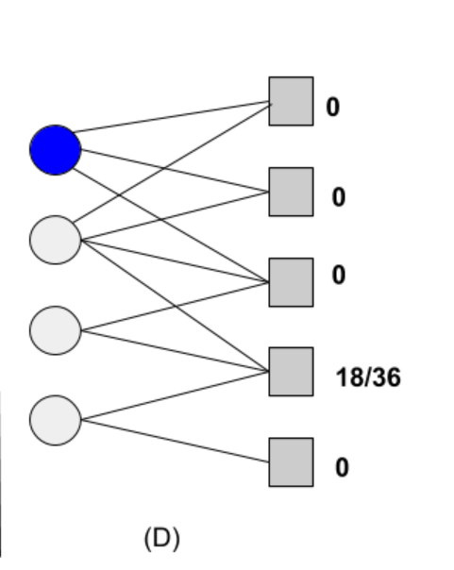
Change the weight of any item the user is originally connected to to zero (we are not interested in predicting if they will purchase, watch or rate a movie again)

Slide 16
Compare thresholds
3
Average
Adjusted average (same as baseline estimator)
Notes:
Daniel

Slide 17
Introducing negativity
Idea: for each user, we have a ranking based on positive reviews.
How would the performance be like if we take negative reviews into consideration?
We obtain our negativity ranking on the graph of all negative reviews
For a user u, the higher movie i ranked on u’s negativity ranking, the more likely that user u would give this movie a bad review. We should not recommend movie i to user u.
Notes:
David

Slide 18
Introducing negativity
For user u:
positive_rank_list = [5, 10, 10000, 90, 2087, …, 400, 20340, 42945, 23, …]
Yellow_highlight: Top L (L = 20)
rank_list = [5, 10, 10000, 90, 2087, …, 400, 20340, 42945, 23, …]
Red_highlight_part ranked among Top L*α of the negative_rank_list
New_rank_list = [5, 10000, 2087, …, 400, 20340, 42945, 10, 90, 23, …]

Slide 19
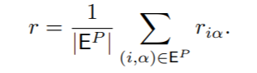

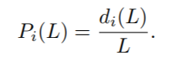
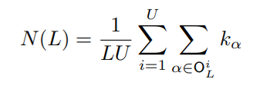
Recommendation Evaluation
Double Division: Training and Probe Set
Ranking score
Precision
Hamming distance
Novelty
Notes:
Daniel

Slide 20
Testing Result: Method #1 (Baseline)
r: R score
P: precision
H: Hamming distance
N: novelty
Method-Threshold |  | r | P | H | N
Baseline |  | 0.2542 | 0.00015 | 0.1782 | 0.2992

Slide 21
Testing Result: Method #2 (Probability Spread)
Before introducing negativity
Method-Threshold |  | r | P | H | N
ProbS-3 |  | 0.2991 | 0.0044 | 0.2289 | 12.1760
ProbS-average |  | 0.3121 | 0.0046 | 0.2395 | 12.8243
ProbS-baseline |  | 0.3456 | 0.0047 | 0.2746 | 13.3570

Slide 22
Testing Result: Method #2 (cont.)
After introducing negativity
 |  | r | P | H | N
ProbS-baseline (w\o neg) |  | 0.3456 | 0.0047 | 0.2746 | 13.3570
ProbS-baseline (L*0.5) |  | 0.3456 | 0.0042 | 0.4032 | 10.7598
ProbS-baseline (L*1) |  | 0.3456 | 0.0040 | 0.4110 | 10.2196
ProbS-baseline (L*2) |  | 0.3456 | 0.0040 | 0.4088 | 10.2051
ProbS-baseline (L*3) |  | 0.3456 | 0.0044 | 0.3185 | 12.1460
ProbS-baseline (L*5) |  | 0.3456 | 0.0040 | 0.4079 | 10.1844
ProbS-baseline (L*10) |  | 0.3456 | 0.0037 | 0.4005 | 9.8915

Slide 23
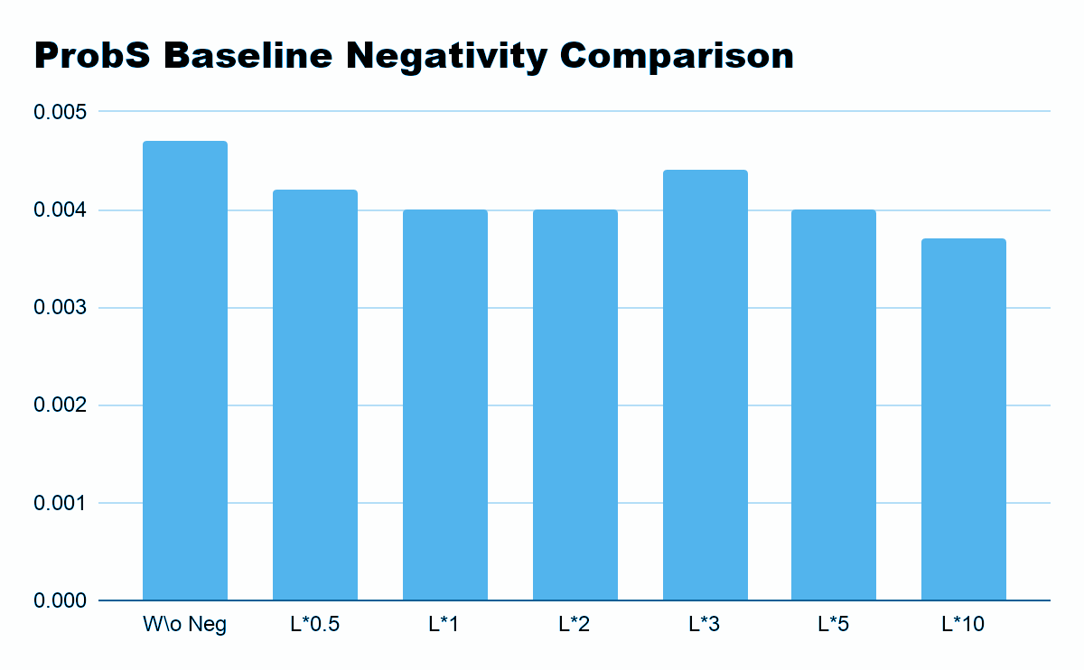
Testing Result: Method #2 (cont.)

Slide 24
Testing Result: Method #3 (Movie-based Cosine Similarity)
Before introducing negativity
Method-Threshold |  | r | P | H | N
Cos Similarity |  | 0.10343 | 0.02682 | 0.53002 | 86.94556
Cos Similarity - average |  | 0.08971 | 0.027892 | 0.58127 | 85.42155
Cos Similarity - baseline |  | 0.05829 | 0.02930 | 0.59698 | 82.91054

Slide 25
Testing Result: Method #3 (cont.)
After introducing negativity
 |  | r | P | H | N
Cos Sim-baseline (w\o neg) |  | 0.05829 | 0.02930 | 0.59698 | 82.91054
Cos Sim-baseline (L*0.5) |  | 0.05829 | 0.02539 | 0.63333 | 82.50014
Cos Sim-baseline (L*1) |  | 0.05829 | 0.02511 | 0.65549 | 82.60719
Cos Sim-baseline (L*2) |  | 0.05829 | 0.02383 | 0.65942 | 83.48264
Cos Sim-baseline (L*3) |  | 0.05829 | 0.02183 | 0.67497 | 80.78595
Cos Sim-baseline (L*5) |  | 0.05829 | 0.02396 | 0.63497 | 83.48555
Cos Sim-baseline (L*10) |  | 0.05829 | 0.02042 | 0.68333 | 80.94571

Slide 26
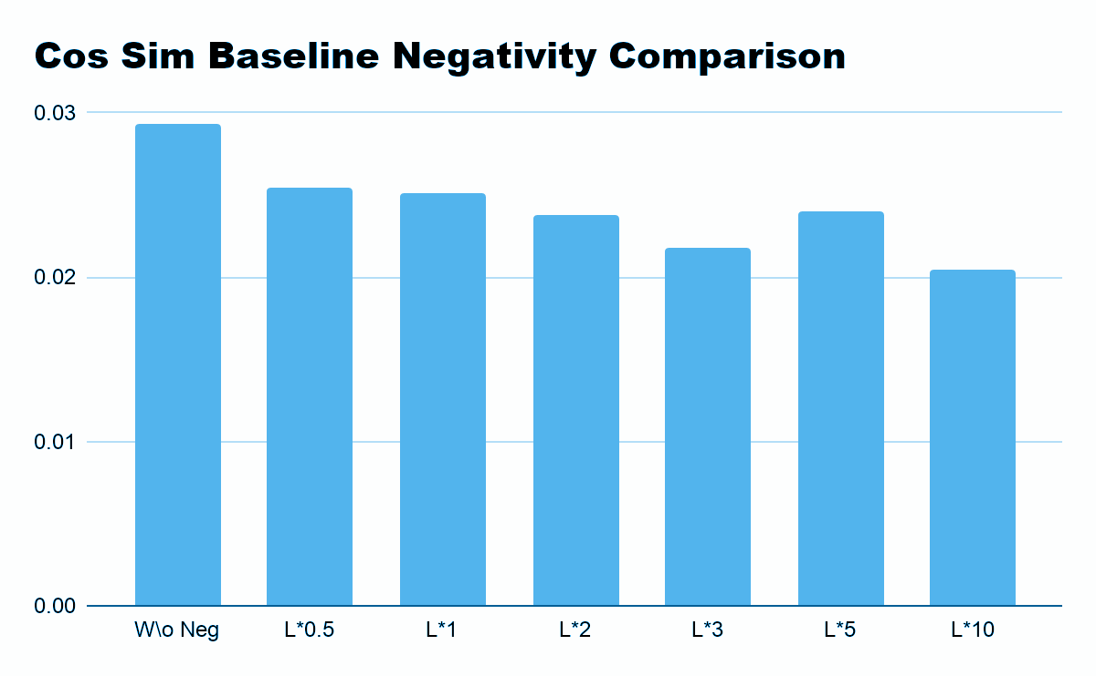
Testing Result: Method #3 (cont.)

Slide 27
Testing Result: Methods Comparison
Now we compare the best performance of each method together
Method |  | r | P | H | N
Baseline |  | 0.2542 | 0.00015 | 0.1782 | 0.2992
ProbS |  | 0.3456 | 0.0047 | 0.2746 | 13.3570
Cos Similarity |  | 0.05829 | 0.02930 | 0.59698 | 82.91054

Slide 28
Conclusion
Using adjusted average (baseline) improves the performance
Introducing negative ranking does not improve the performance
Interpretation: Even though the user gives a movie a bad score, he still picked this movie to watch

Slide 29
References
Netflix, Inc. Netflix prize https://www.netflixprize.com (2009) .
Y Koren, The bellkor solution to the netflix grand prize. (2009).
A Töscher, M Jahrer, The bigchaos solution to the netflix grand prize. (2005).
F Yu, A Zeng, S Gillard, M Medo, Network-based recommendation algorithms: A review.Phys.A: Stat. Mech. its Appl.452, 192–208 (2016)
J. L. Herlocker, J. A. Konstan, L. G. Terveen, J. T. Riedl, Evaluating collaborative filtering recommender systems, ACM Transactions on Information Systems 22 (2004) 5– 53
G. Shani, A. Gunawardana, Evaluating recommendation systems, in: Recommender systems handbook, Springer, 2011, pp. 257–297

