Slide 1


Exokit

Slide 2
Terminology
XR = X reality
Augmented reality
Virtual reality
Mixed reality
Spatial computing
We support all realities.

Slide 3
Multi-user XR today. On any device.
Exokit is an XR engine that enables web based content across any device, with multiplayer co-presence built-in.

Slide 4
The current
XR experience on the web is outdated and slow.

Slide 5


Chrome
Firefox
Today’s solutions

Slide 6
Why it doesn’t work
Slow load times and hard to create experiences.
No central platform for AR/MR/VR web creation.
Current limitations on experiences are numerous and unresolved.

Slide 7
Our solution, Exokit
Not based on legacy like Chrome/Firefox.
It's multi-platform: it binds to Vive, Oculus, Leap Motion, Magic Leap, and desktop for Win/OSX/Linux.
The experience is pervasively multiplayer; every experience is shared. The main interface is "reality tabs", or opening 3D web sites as layers of virtual/augmented reality.
The product runs on web content and standards (HTML, WebXR, WebGL, Unity + Unreal exports).

Slide 8
 | Exokit | Google Chrome | Mozilla Firefox
Supports Web Content and Standards
Multi-Platform
Speed
Multi-User Support
Unity/Unreal in XR
No Legacy Code Format Limit

Slide 9

Demo

Slide 10
Features
2-3x Faster than Chrome/Firefox
Free, Persistent, multi-user content on the web platform.
Ease of Integration (Unity, Unreal, Web)

Slide 11
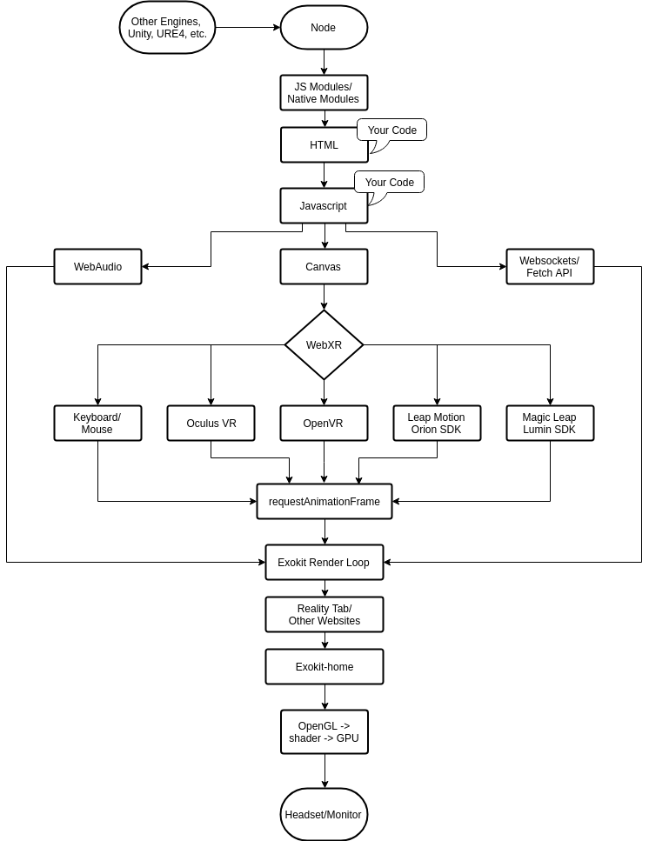
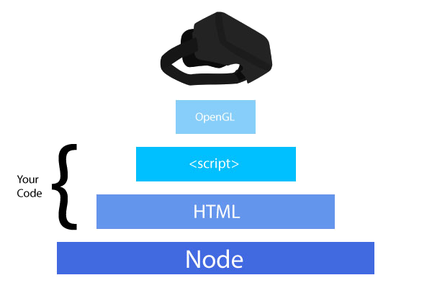
Tech Stack

Slide 12
Value Proposal
Key Features of Exokit
Mixed Reality Consumers
Mixed Reality Developers
Fastest product on market (2-3x Chrome, Firefox engines)
First to implement features
Free, persistent, multi-user content experience on the web platform
Low switching cost
Entertainment
Social product
Costless customer outreach to very large engine/device matrix
Ease of integration (Unity, Unreal, web)
Standard web APIs
Hosting products
Payments platform

Slide 13


Customer Profiles
Web Designer
Code based website dev’s that love to be in on the cutting edge of the next big thing, in our case that's MR/VR/AR web development.
MR/AR/VR Users
Avid Net Surfers, loves new tech and industries that can let them get done what they want in the most tech-friendly setting.

Slide 14
Roadmap
OVR (Rift),
Android (ARCore + Daydream)
Persistent WebXR with Reality Tabs
3D Streaming (Roger/Reality projection)
WebXR Security Team Onboard
Emukit Launch
Exoport Launch
Unity Integration iOS integration
Roger Indexing API (Object detection, time travel)
ExoHub: Geolocated WebXR content
Ads API
Integration

Slide 15

Exokit
New, Fast, and built for the Post-Screen Era.

