Slide 1
What’s new in eXo JCR 1.15?
Notes:
1
1

Slide 2
New Features
2
Notes:
2
2

Slide 3
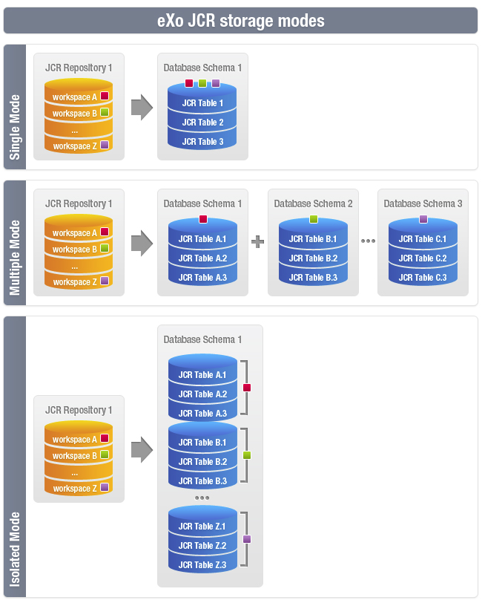
Dedicated tables per workspace
Notes:
* The single mode, where all the data of all the workspaces are stored into the same tables.
* The multiple mode, where each workspace has its own tables but in a dedicated DB schema.
The first mode is easy to set up but is not very scalable and
the second mode is much more scalable but much harder to set up, especially when you have a lot of workspaces and you use a database like Oracle.
A new mode has been added, which provides the benefit of both previous modes without any drawback.
This new mode, called isolated, stores the data of each workspace in dedicated tables within the same DB schema which means that it is as easy as the single mode to set up and as scalable as the multiple mode.

Slide 4
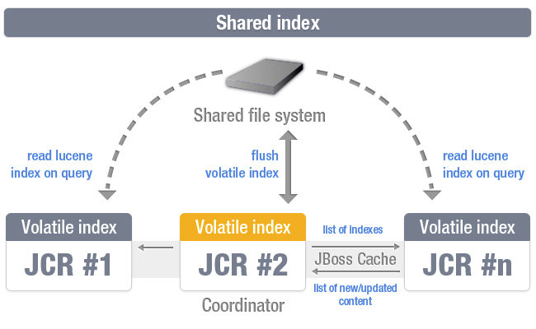
Index replication strategies
Notes:
This indexing strategy combines advantages of in-memory index along with shared persistent index offering "near" real time search capabilities. This means that newly added content is accessible via search practically immediately. This strategy allows nodes to index data in their own volatile (in-memory) indexes, but persistent indexes are managed by single "coordinator" node only. Each cluster instance has a read access for shared index to perform queries combining search results found in own in-memory index also. Take in account that shared folder must be configured in your system environment (i.e. mounted NFS folder). But this strategy in some extremely rare cases can have a bit different volatile indexes within cluster instances for a while. In a few seconds they will be up2date.
Shared index is consistent and stable enough, but slow, while local index is fast, but requires much time for re-synchronization, when cluster node is leaving a cluster for a small period of time. RSync-based index solves this problem along with local file system advantages in term of speed.

Slide 5
Index replication strategies
Pros
Ensures consistency as all nodes read the same index
No index recovery needed when a node joins a running cluster
Only one copy of the indexes is needed (less disc space used)
Cons
Read and Write accesses are slower as they need to access to a remote file system
Relies on a shared file system
Only the master can see the latest changes (no more true since JCR 1.14)
Notes:
Eventual consistency

Slide 6
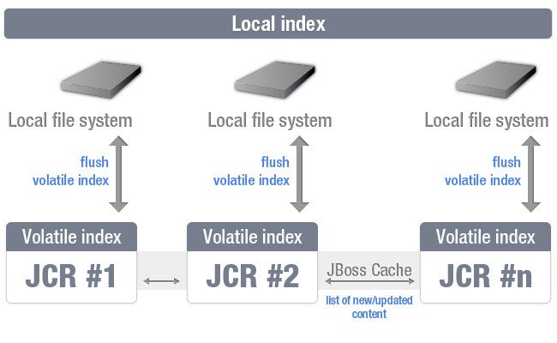
Index replication strategies
Notes:
As this implementation designed for clustered environment it has additional mechanisms for data delivery within cluster. Actual text extraction jobs done on the same node that does content operations (i.e. write operation). Prepared "documents" (Lucene term that means block of data ready for indexing) are replicated withing cluster nodes and processed by local indexes. So each cluster instance has the same index content. When new node joins the cluster it has no initial index, so it must be created. There are some supported ways of doing this operation. The simplest is to simply copy the index manually but this is not intended for use. If no initial index found JCR uses automated sceneries. They are controlled via configuration (see "index-recovery-mode" parameter) offering full re-indexing from database or copying from another cluster node.
For some reasons having a multiple index copies on each instance can be costly. So shared index can be used instead (see diagram below).

Slide 7
Index replication strategies
Pros
Read and Write accesses are faster as they are locals
Cons
Consistency is harder to ensure as each node is responsible for keeping up to date its own copy of indexes, so we can get differences in the indexes content from one cluster node to another.
Index recovery needed when a node joins a running cluster
One copy of the indexes per node

Slide 8
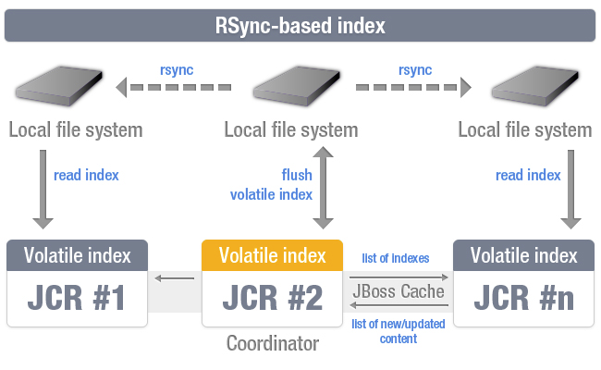
Index replication strategies
Notes:
This strategy is the same shared index, but stores actual data on local file system, instead of shared. Eventually triggering a synchronization job, that woks on the level of file blocks, synchronizing only modified data. Diagram shows it in action. Only single node in the cluster is responsible for modifying index files, this is the Coordinator node. When data persisted, corresponding command fired, starting synchronization jobs all over the cluster.

Slide 9
Index replication strategies
Pros
Read and Write accesses are faster as they are locals
Ensures consistency as each node reads its own copy of indexes based on the indexes of the master
Optimized index recovery when a node joins a running cluster
Cons
One copy of the indexes per node

Slide 10
Use System properties to configure your workspace
The configuration of components that relies on properties such as container, value-storage, initializer, cache, query-handler, lock-manager and access-manager, can be redefined using System properties. For example for the component 'container' and the property called 'foo', the logic will be the following:
If we have a system property called exo.jcr.config.force.workspace.repository_collaboration.container.foo that has been defined, its value will be used for the configuration of the repository 'repository' and the workspace 'collaboration'
If we have a system property called exo.jcr.config.force.repository.repository.container.foo that has been defined, its value will be used for the configuration of all the workspaces of the repository 'repository' except the workspaces for which we configured the same property using system properties defined in #1
If we have a system property called exo.jcr.config.force.all.container.foo that has been defined, its value will be used for the configuration of all the workspaces except the workspaces for which we configured the same property using system properties defined in #1 or #2
If we have a property 'foo' configured for the repository 'repository' and the workspace 'collaboration' and we have no system properties corresponding to rules #1, #2 and #3, we will use this value (current behavior)
If the previous rules don't allow to give a value to the property 'foo', we will then check the default value in the following order exo.jcr.config.default.workspace.repository_collaboration.container.foo, exo.jcr.config.default.repository.repository.container.foo, exo.jcr.config.default.all.container.foo
Notes:
One of the features of the extension mechanism allows you to add or redefine configuration files including the configuration files of your repository/workspace from different war files. The direct consequence of it is the fact that we don’t have anymore one single file containing the whole JCR configuration but several small ones distributed over different war files. Thanks to this new feature, you can now change the configuration of one or all the registered workspaces whatever the location of their related configuration file. This can be done simply using System properties whose name matches with a specific syntax. For example let’s say that I want to set the max-buffer-size to 300k for all the registered workspaces. To do so, I just need to add the system property -Dexo.jcr.config.force.all.container.max-buffer-size=300k to my startup command.

Slide 11
Use System properties to configure your workspace
To enable this feature, you need to configure the SystemParametersPersistenceConfigurator
<component>
<key>org.exoplatform.services.jcr.config.SystemParametersPersistenceConfigurator</key>
<type>org.exoplatform.services.jcr.config.SystemParametersPersistenceConfigurator</type>
<init-params>
<value-param>
<name>file-path</name>
<value>target/temp</value>
</value-param>
<values-param>
<name>before-initialize</name>
<value>value-storage.enabled</value>
<value>container.db-structure-type</value>
</values-param>
</init-params>
</component>
file-path: location of the file where all parameters configured on pervious launch of AS are stored.
unmodifiable: list of parameters which cannot be modified using system properties
before-initialize: list of parameters which can be set only on non initialized workspaces

Slide 12
CND file format support
Here is how we define the node type nt:base with the old XML syntax:
<nodeType name="nt:base" isMixin="false" hasOrderableChildNodes="false" primaryItemName="">
<propertyDefinitions>
<propertyDefinition name="jcr:primaryType" requiredType="Name" autoCreated="true" mandatory="true" onParentVersion="COMPUTE" protected="true" multiple="false">
<valueConstraints />
</propertyDefinition>
<propertyDefinition name="jcr:mixinTypes" requiredType="Name" autoCreated="false" mandatory="false" onParentVersion="COMPUTE" protected="true" multiple="true">
<valueConstraints />
</propertyDefinition>
</propertyDefinitions>
</nodeType>
Here is how we define the same node type with CND:
[nt:base] abstract
- jcr:primaryType (NAME) mandatory autocreated protected COMPUTE
- jcr:mixinTypes (NAME) protected multiple COMPUTE
Notes:
Compact Node Definition
You can now define your node type definition using the “Compact Node Definition” format that has been specified in JCR 2.0 spec. This new format has been designed to be much more natural and easier to read and write than the old XML format. This also helps to significantly reduce the size of your node type definition files.

Slide 13
Others Improvements
The extension mechanism is re-loadable
Exclude nodes from query results
Notes:
The extension mechanism is re-loadable
Developing an extension can be tedious especially because of the extension mechanism that didn’t support hot reloading so far, meaning we would have to restart the server regularly. Starting from this version, in case you are in developing mode, the extension mechanism is able to detect a change and, according to what has been modified, it could decide to automatically reload only one portal container, a set of portal containers or all the containers.
Exclude nodes from query results
Up to now all nodes are indexed automatically but for some reason you may need to exclude some nodes from JCR query results. For example, if you have a folder representing the trash, you may want to prevent any JCR query from returning anything from it. It is now possible to exclude from indexing a subtree of nodes using a path or all nodes of a given node type or both.

Slide 14
Enhancements
14
Notes:
14
14

Slide 15
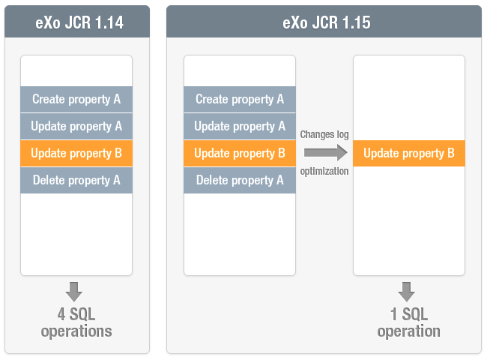
Write operations optimizations
Notes:
In term of performances, we mainly focused on improving write operations by optimizing the change log in order to ease its accessibility and also to get rid of useless operations. For example, if it detects that you asked to update several times the same property, only the last change will be taken into account, mostly to reduce the total amount of queries to be executed by the database. This will help to reduce I/O (network and disc).

Slide 16
Write operations optimizations: Update Batching
Faster in case you do a lot of operations of the same type
Partial support of the JCR spec on Oracle
Enabled when batch-size > 1 (-1 by default)
Notes:
One other interesting improvement is the ability to enable update batching, which can really improve the performances, especially when you do a lot of operations of the same type (CREATE or UPDATE or DELETE) within the same transaction and you have a remote database. Our internal tests showed that we could reduce the first starting time of an eXo Platform by up to 40 % according to the configuration used.

Slide 17
Others Enhancements
Smaller memory footprint
Use JCR Action as validator
Shutdown your cluster easily
Indicates the total amount of remaining nodes while indexing
Sort the result of a JCR query case insensitively
Notes:
Smaller memory footprint
To improve the scalability of a product it is important to reduce the memory footprint, we did it by reviewing our code in order to reuse as many existing objects as we could.
Use JCR Action as validator
The JCR actions allow you to perform actions before and after a JCR operation, but in previous versions when an action fails, the exception is logged but the JCR operation is performed normally. Now it is possible to raise an exception from your JCR action and decide yourself how the JCR should behave in case of an exception. This improvement can help you to implement a data validator that cannot be managed at NodeType definition level. A good example is when you need to validate the value of a property that depends on the value of another property, such as a start date and an end date, we don’t want that the end date to be before the start date and vise versa.
Shutdown your cluster easily
In previous versions, when you had a cluster under load and you wanted to stop it safely, you had to suspend all the running transactions on your cluster using JMX before stopping all your nodes. In this version, we improved the inter-node communication in order to suspend the transactions over the cluster automatically as soon as we detect that you are trying to shut down one or several nodes, this should ease administrator’s life.
Other Interesting Enhancements
The indexing process of a workspace can be long. So, to allow you to have a better idea of what’s left, we get, in a non blocking manner, the total amount of nodes to be indexed and we provide it once we have it.

Slide 18
What’s new in eXo JCR 1.15?
Notes:
18
18

