Slide 1
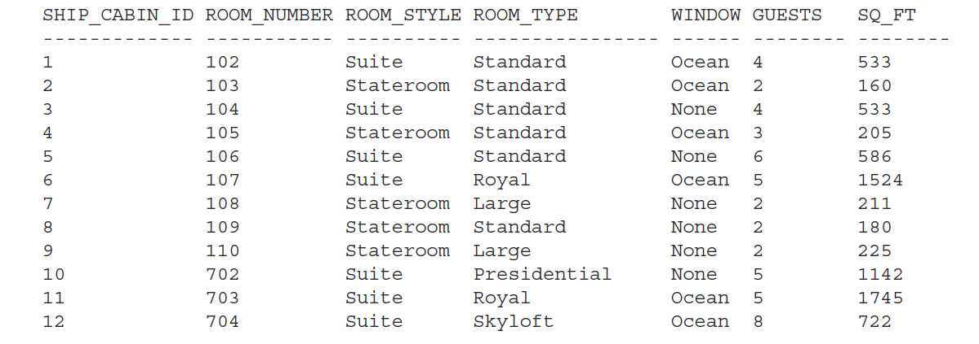
SQL 1 SHIPID

Slide 2
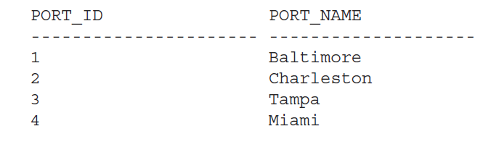
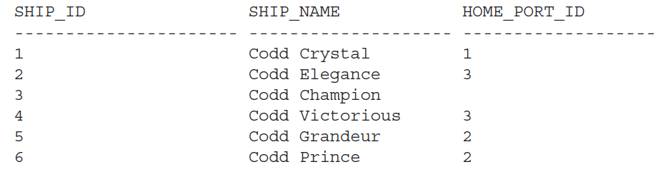
SQL 2
PORTS SHIPS

Slide 3
SQL 3
correlated subquery
create a single query that lists all the cabins in the ship whose size—as measured by the SQ_FT column—is larger than the average cabin for its ROOM_STYLE (refer SHIPID table)

