Slide 1




BANKINSIGHT
Banking Risk & Creditworthiness Analysis
By- ADARSH VERMA

Slide 2

BUSINESS PROBLEM
Develop a basic understanding of risk analytics in banking and financial services and understand how data is used to minimise the risk of losing money while lending to customers.
SOLUTION
With our dashboards which are created using Power BI latest tools helps the company to make a decision based on the applicant’s profile like if the applicant is likely to repay the loan then approving the loan otherwise not.
01

Slide 3
ABOUT DATASET
This dataset basically contains information about bank details ,various client details which consists of multiple tables which are interlinked with each other through keys like primary key and foreign key.
The various tables are Banking Relationship, Client-Banking, Gender, Investment Advisor and Period.
1.
02

Slide 4
IMPORTANT KPI’S
1.
Total Clients
3000
2.
Total Engagement Account
$18.26K
3.
Total CC Account
$135
03

Slide 5




FINANCIAL GOALS
Total Loan
$139.9M
Total Fees
$5.17M
Total Deposit
$111.49M
04

Slide 6
BANK NUMBERS
Bank Loan
$55.5
Business Lending
$83.52M
Bank Deposit
$60.18M
05

Slide 7
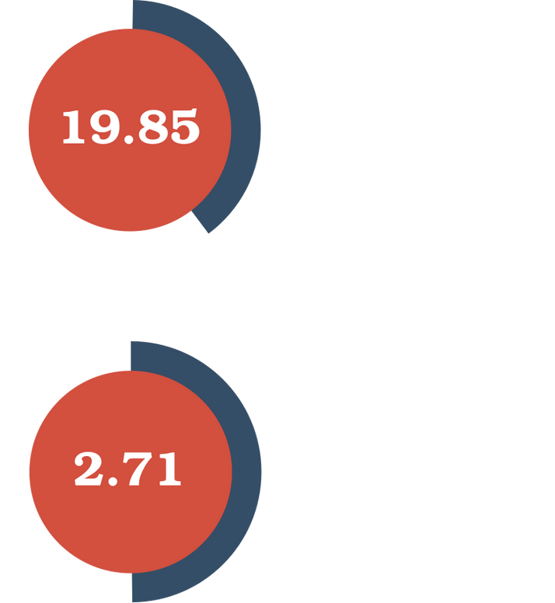
CHECKING AMOUNT AND SAVING AMOUNT
06

Slide 8
$ 2.71 M
FOREIGN CURRENCY AMOUNT
07

Slide 9
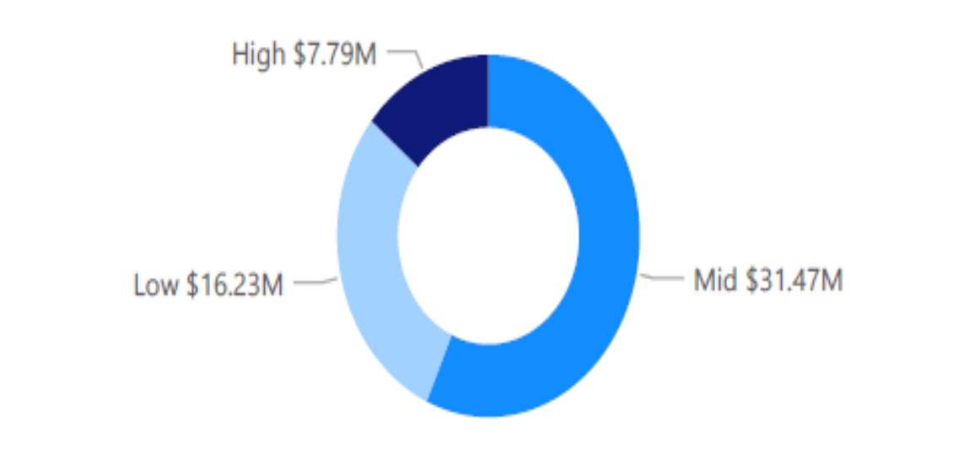
BANK LOAN BY INCOME BAND
What we observe?
Bank loan is highest for Mid Income band and lowest for High Income band.
08

Slide 10
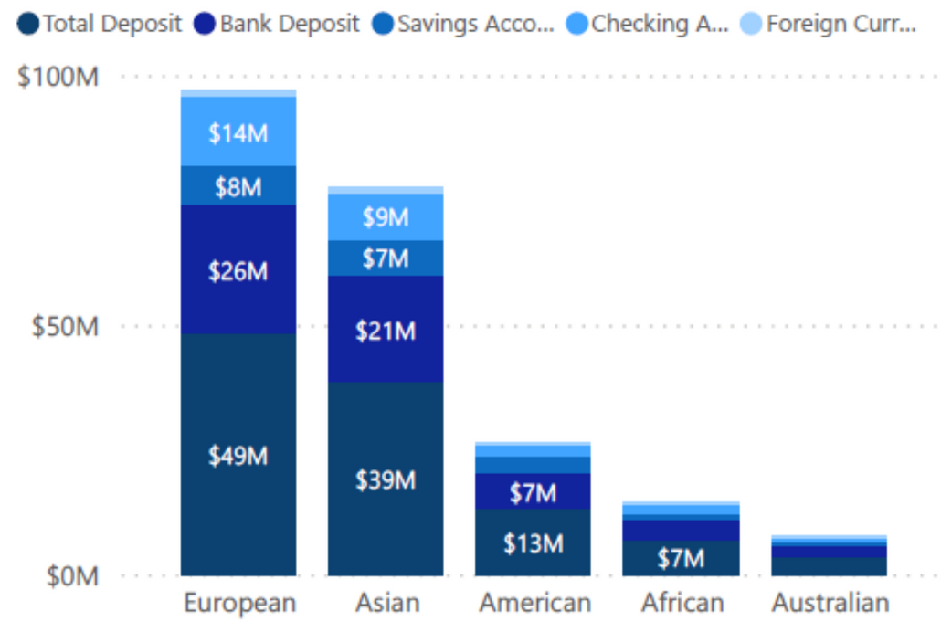
BANK LOAN BY INCOME BAND
What we observe?
Highest features are in the European countries followed by Asian Countries.
Lowest features are in Australian countries followed by African countries.
09

Slide 11
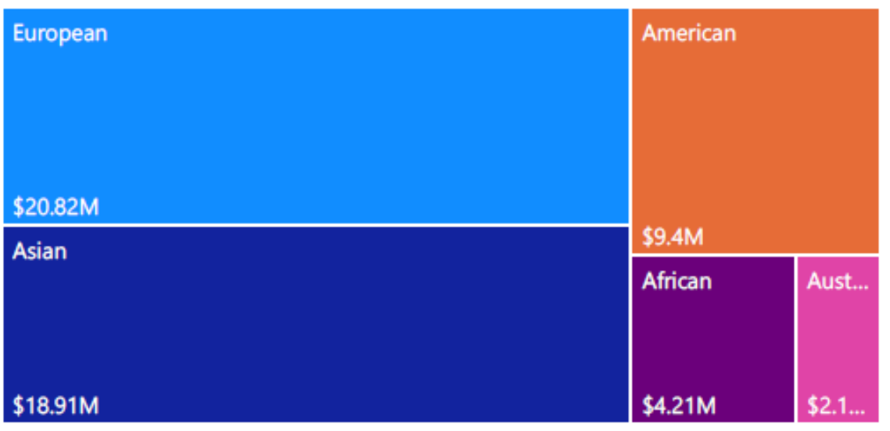
BANK LOAN BY NATIONALITY
What we observe?
Bank loan is highest for European countries and lowest for Australian countries.
10

Slide 12
POWERBI - DASHBOARD

Slide 13
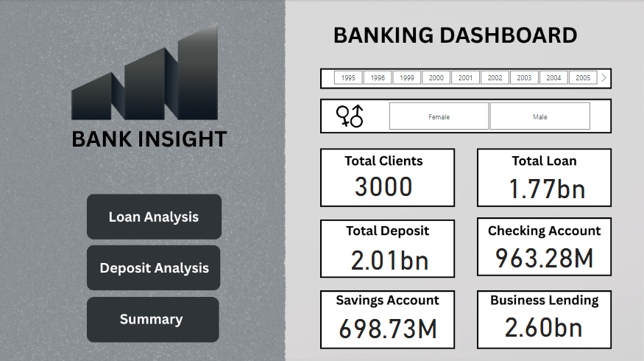
Overview

Slide 14
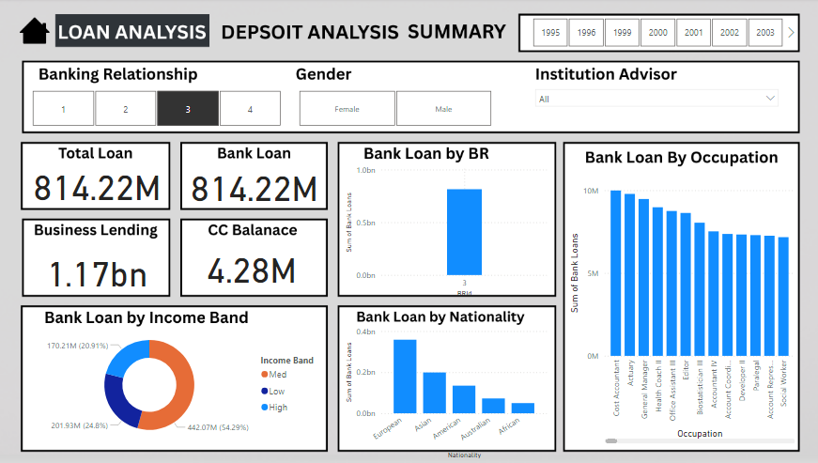
Loan Analysis

Slide 15
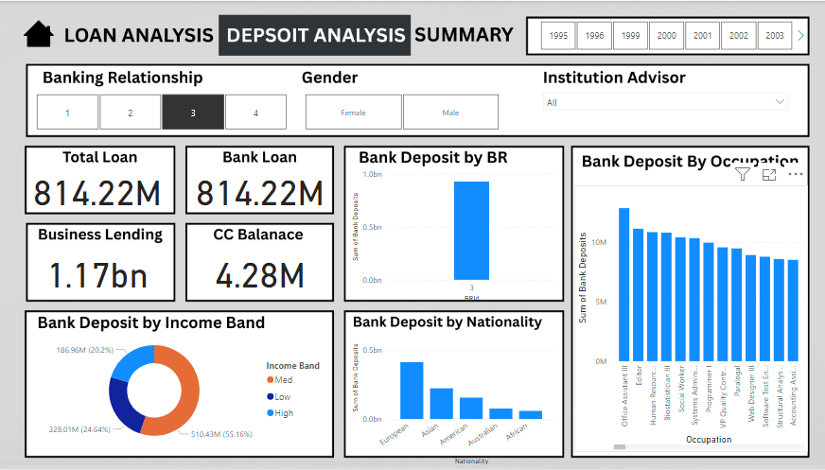
Deposit Analysis

