Slide 1

SALESCOPE
An E-commerce business Analysis
PRESENTED BY ADARSH VERMA

Slide 2

1.
Business Problem Statement
2.
Approach
3.
Data Overview
1
AGENDA
4.
Project Workflow
1
5.
EDA
6.
Key Insights
7.
DASHBOARD-POWERBI

Slide 3
PROBLEM STATEMENT
Sales teams often lack a clear, data-driven understanding of regional performance, making it difficult to identify growth opportunities and optimize resources. This project aims to analyse and visualize regional sales data to uncover trends, evaluate profitability, and support strategic decision-making.
What’s the Business Question?
Inconsistent revenue and profit performance across U.S. regions??
Lack of visibility into seasonal swings, top SKUs, and channel profitability??
Goal: Leverage 5 years of historical data to pinpoint growth levers and optimize strategy

Slide 4
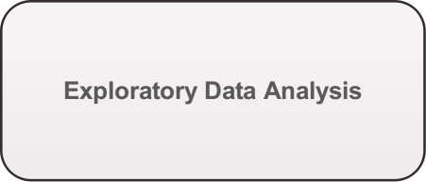
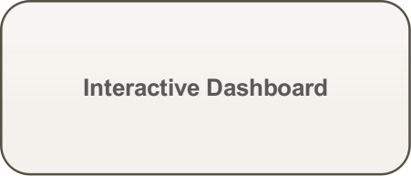

Approach
Dive into historical sales, margins, products, channels, regions
Build a live view for business Users to self serve insights
Surface trend, outliers & relationships

Slide 5
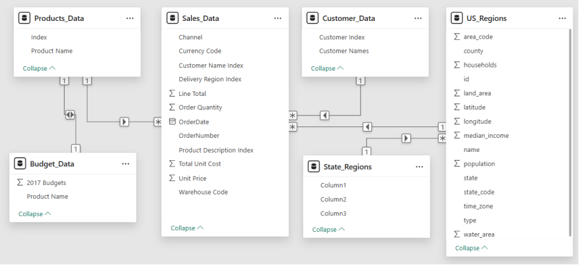
Raw Data
Sales, products, budgets, customers, regions, and states were spread across unlinked tables. No relationships were defined initially— Pre-processing was required to clean, normalize, and join them for analysis.

Slide 6
EDA- EXPLORATORY DATA ANALYSIS
Uncovering patterns, trends, and business insights from historical data !
Understanding the “What, Where & Why” behind the sales numbers
?Exploring data through visuals, aggregations, and comparisons?
Laying the groundwork for informed recommendations

Slide 7
1.
Import Libraries
2.
Load Data
3.
Initial Exploration
1
EDA
4.
Pre-processing & Cleaning
STEP-BY-STEP
1
5.
EDA & Visualization
6.
Key Insights
7.
Recommendations

Slide 8
Pre Processing
The necessary steps applied to prepare this dataset for analysis.
Set header row for state – region table?
Merge Sales, Customers, Products, Regions, State–Region & Budgets tables?
Drop redundant columns?
Standardize column names to lowercase?
Select key columns that are used for that analysis?
Rename columns to more sensible names?
Create profit and profit_margin_pct columns

Slide 9
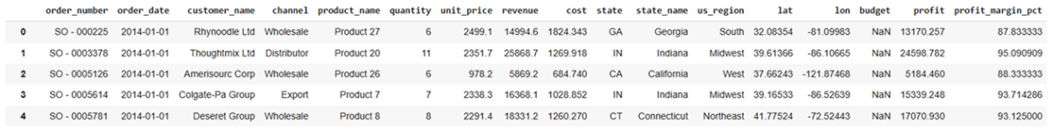
Final Dataset Structure – Ready for Analysis
Identifiers: order_number, order_date, customer_name, channel, product_name
??Financials: quantity, unit_price, revenue, cost, profit, profit_margin_pct
Calendar: order_month_name, order_month_num, order_month
?Geography: state (code), state_name, us_region, lat, lon??

Slide 10
CHARTS AND INSIGHTS

Slide 11
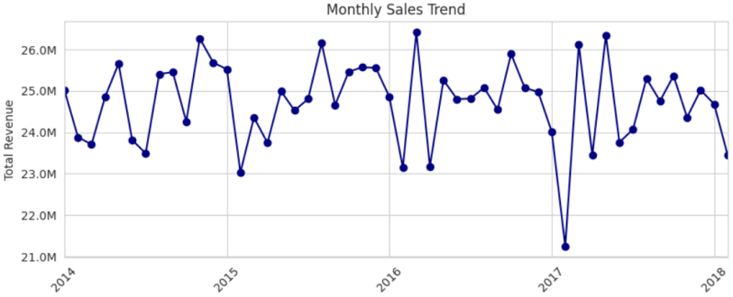
Monthly Sales Trend Over Time
Consistent sales cycle: $24M to $26M.
Seasonal peaks: Late spring/early summer (May-June).
Annual low: January.
Notable outlier: Sharp revenue drop in early 2017.

Slide 12
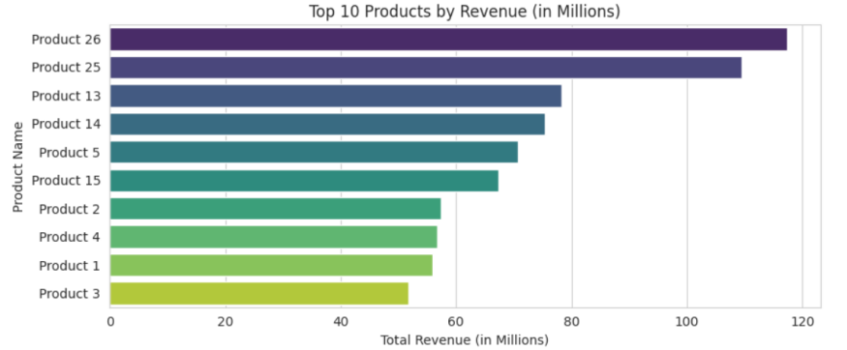
Top 10 Products by Revenue
Revenue leaders: Products 26 & 25 dominate.
Mid-range: Products 5, 13, 14, 15 show similar revenue.
Bottom cluster: Products 1, 2, 3, 4 have the lowest revenue.
Strategy: Grow mid-tier, improve lower performers.

Slide 13
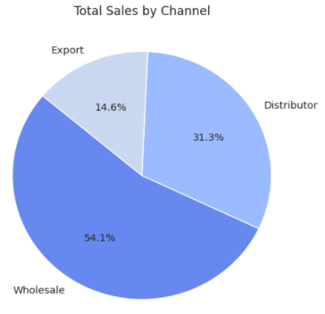
Sales by Channel
Wholesale dominates: Generates the majority of total sales at 54.1%.
Distributor is significant: Contributes a substantial 31.3% to total sales.
Export is a smaller portion: Accounts for 14.6% of the total sales.

Slide 14
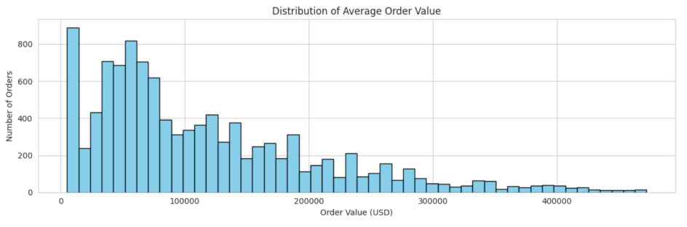
Average Order Value (AOV) Distribution
Low average order values are frequent.
Distribution is right-skewed (long tail of high-value orders).
Multiple order value clusters exist.
Higher order values are less common.

Slide 15
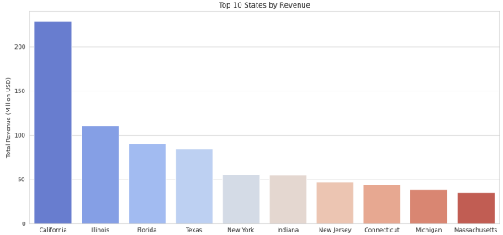
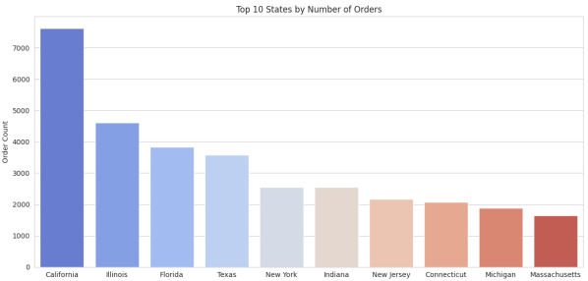
Top State Performance: Revenue vs. Orders
California tops revenue & orders.?
IL, FL, TX: High in both.?
Revenue & orders linked.?
Other top states: Lower contribution.

Slide 16
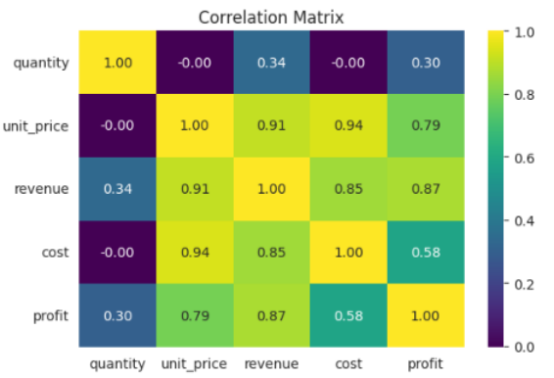
Correlation Heatmap of Numeric Features
Unit price is the primary driver, showing very strong correlations with cost (0.94), revenue (0.91) and profit (0.79).
Revenue & profit maintain a high link (0.87), underscoring direct profitability gains.
Quantity’s impact is minimal (≤ 0.34 vs. financials), indicating volume plays a secondary role.
Cost vs. profit correlation (0.58) is moderate, suggesting margin improvement focus should center on pricing.

Slide 17
KEY INSIGHTS
Pronounced Seasonality: January revenues average $124 M, dipping to $95 M in April.??
SKU Concentration: Products 26 & 25 together drive ~25 % of total sales.??
Channel Trade‑Off: Wholesale captures 54 % of volume; Export leads with ~38 % average margin.??
Geographic Dominance: California alone logs 7.6K orders ($230 M); the West region shows the largest swings.??
Aibox Company and State Ltd are the most valuable customers in terms of Revenue.

Slide 18
RECOMMENDATION
Seasonal Promotions: Launch recovery campaigns in April and amplify January offers to smooth revenue swings.??
SKU Optimization: Double down on top products 26 & 25 and re-evaluate pricing or phase out low‑margin SKUs.??
Channel Expansion: Incentivize Export partnerships for high margins and introduce volume deals in Wholesale.??
Regional Investment: Replicate California’s success in other regions and boost marketing in the Northeast & Midwest.??
Margin Monitoring: Flag orders below 80 % margin and analyse cost drivers to uplift underperforming segments.

Slide 19
DASHBOARD PREVIEW

Slide 20

HOME

Slide 21
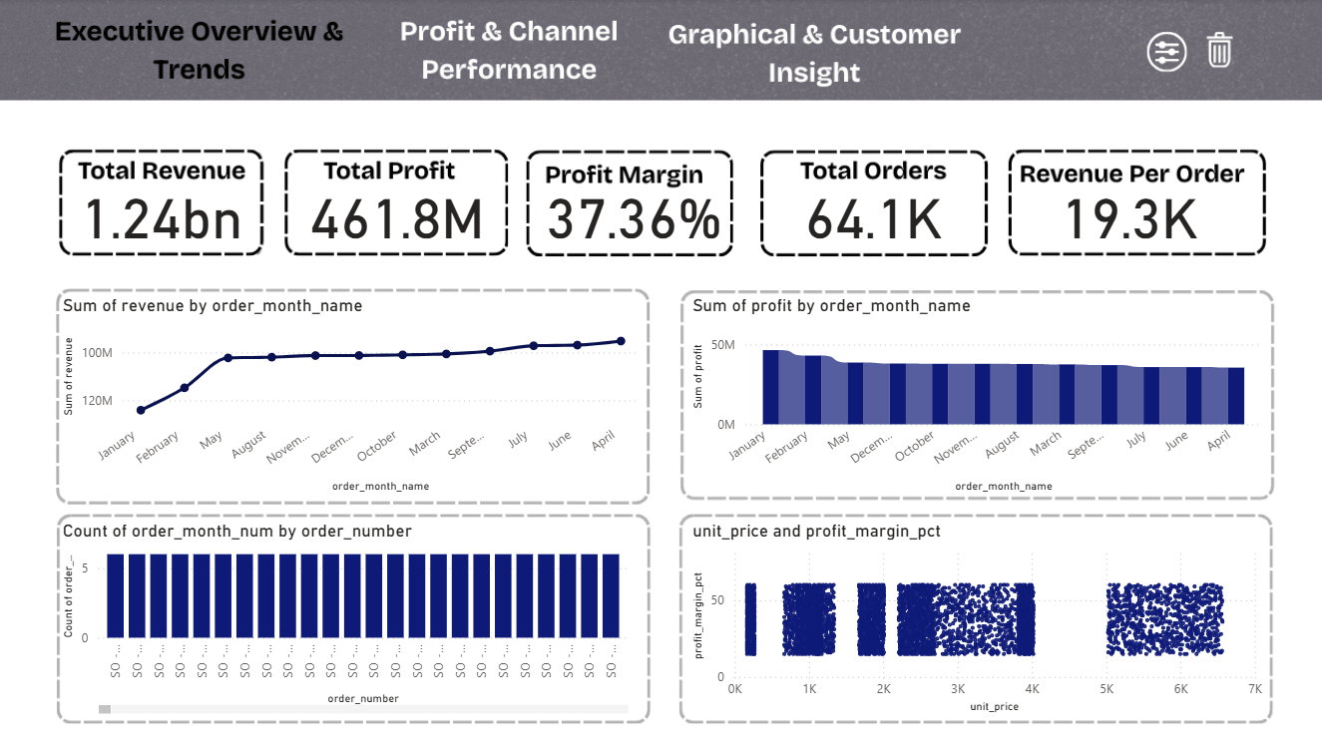
Overview

Slide 22
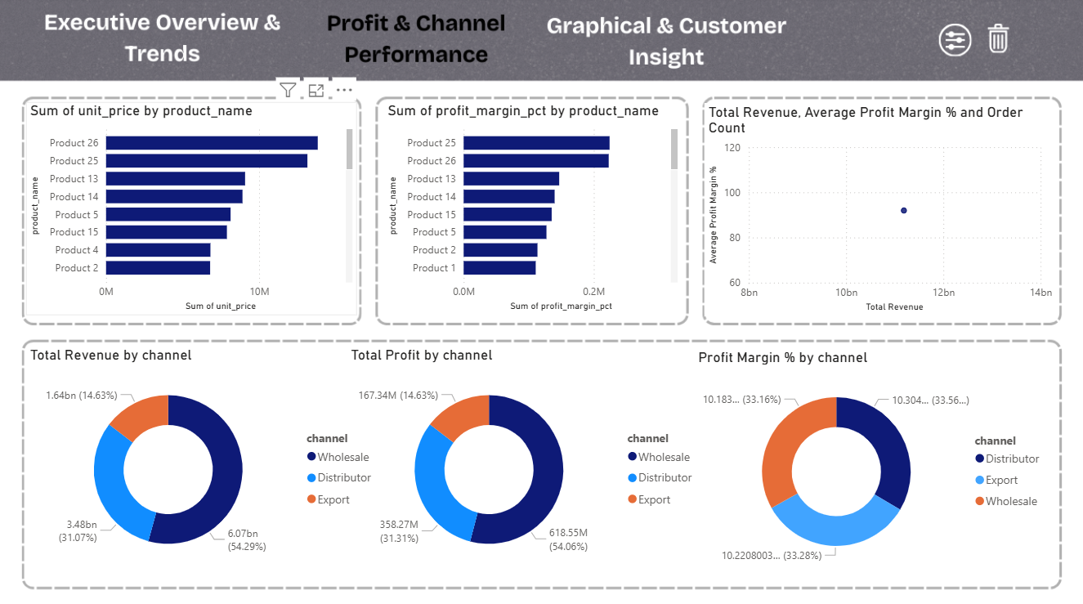
Profit and Channel Performance

Slide 23
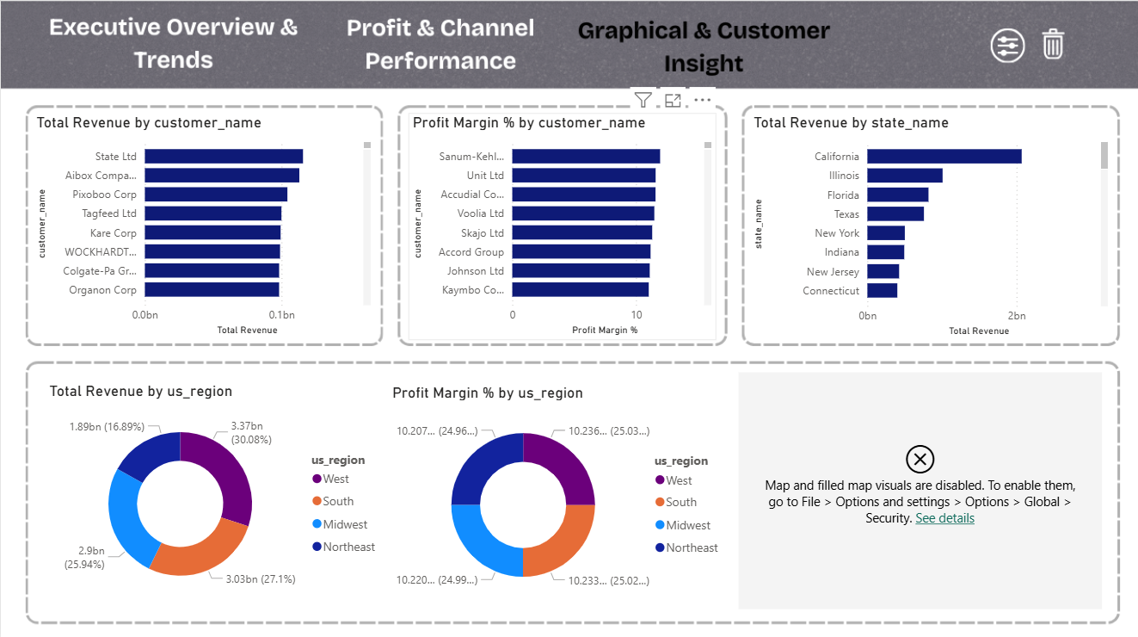
Customer Insight

Slide 24
CONCLUSION
Completed end‑to‑end EDA and interactive Power BI dashboard, surfacing seasonality, SKU, channel & regional insights.
Insights inform sales policies and operational planning (store & warehouse prep aligned with annual trends).??
Stakeholders can self‑serve real‑time analysis and confidently onboard new datasets for additional use cases.

