Slide 1
S&P 500
Análisis por Jesús Alán Olvera Sandoval

Slide 2
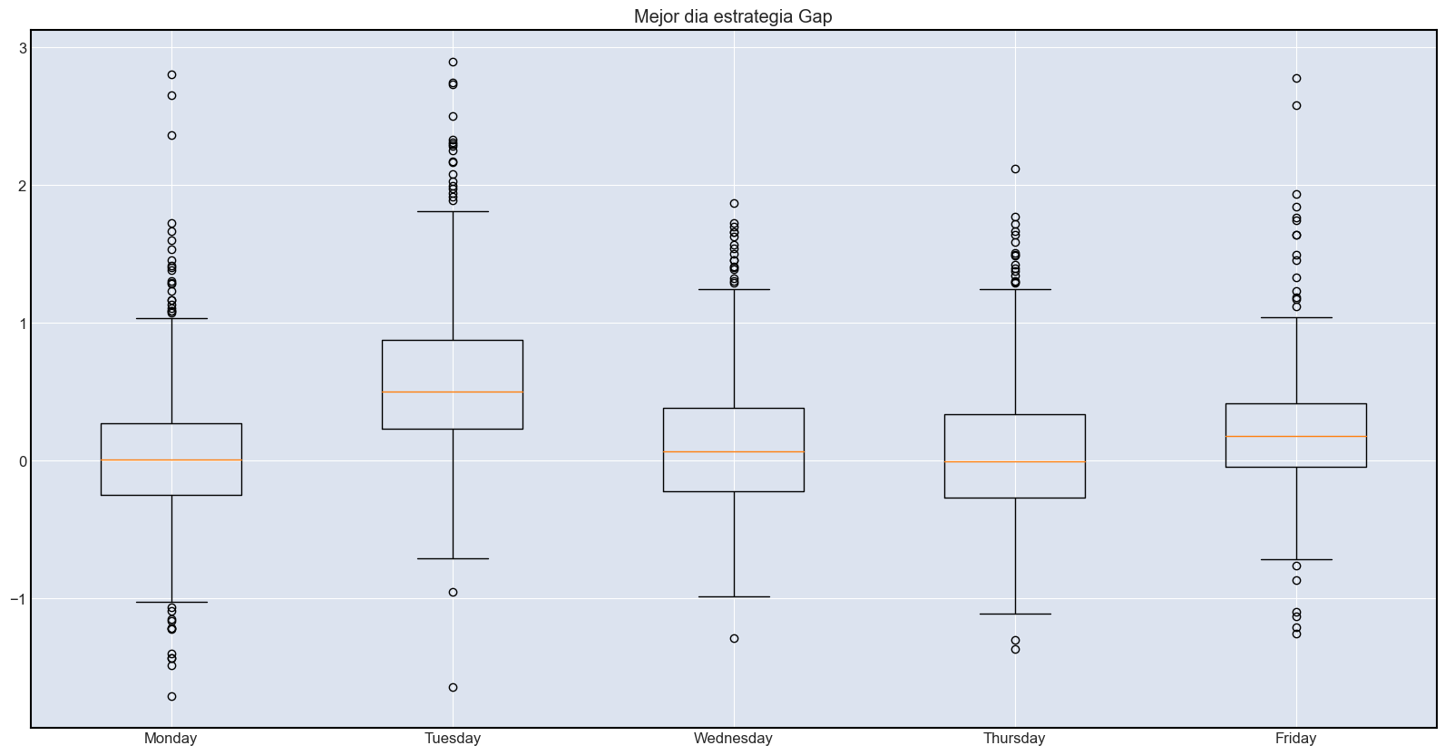

Slide 3
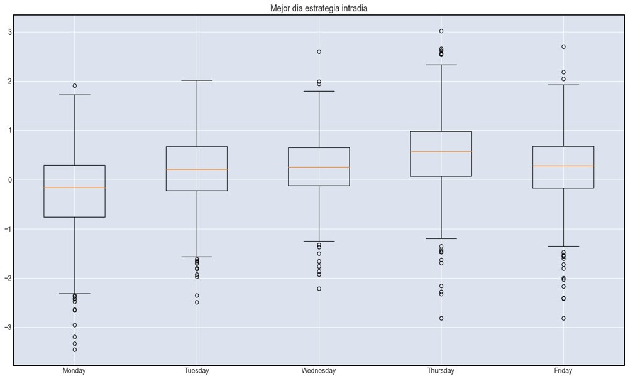

Slide 4
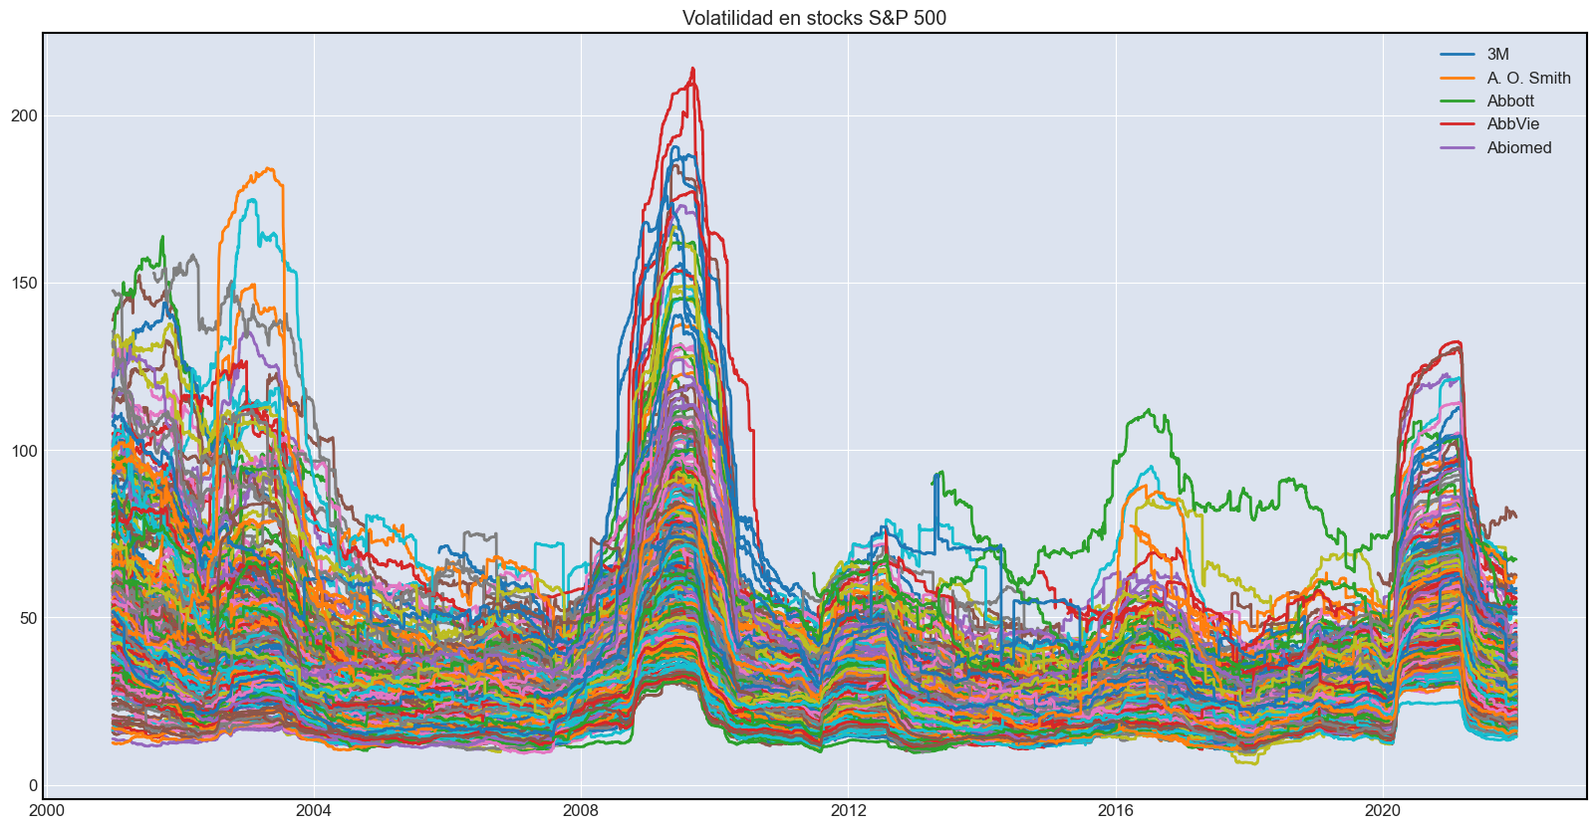

Slide 5
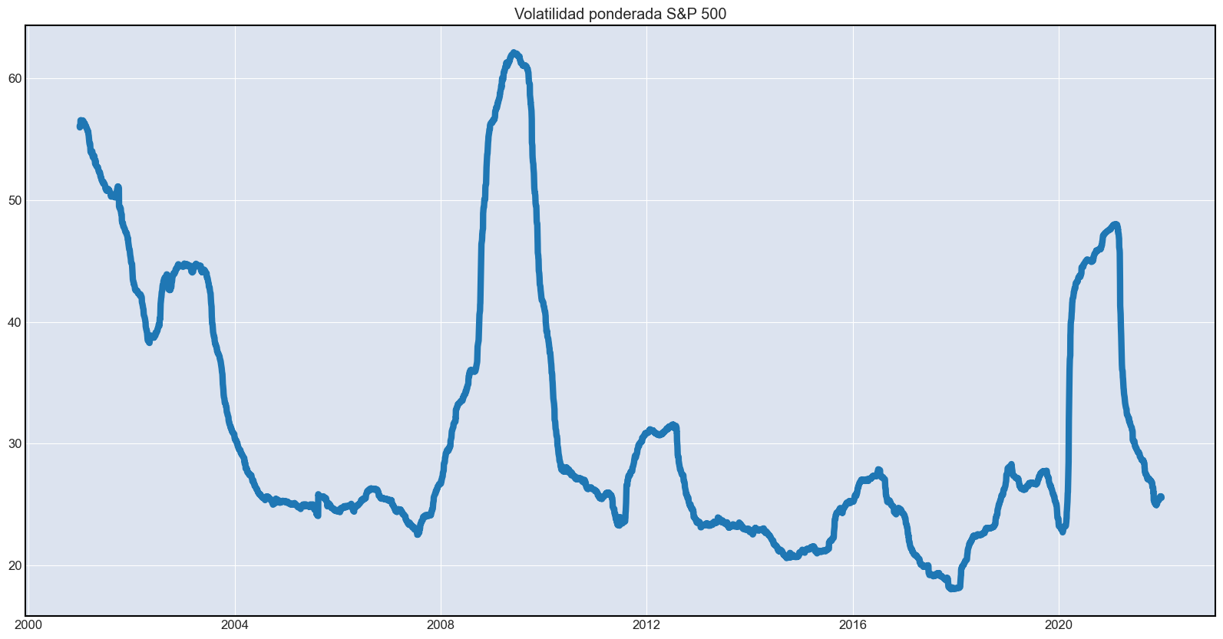

Slide 6
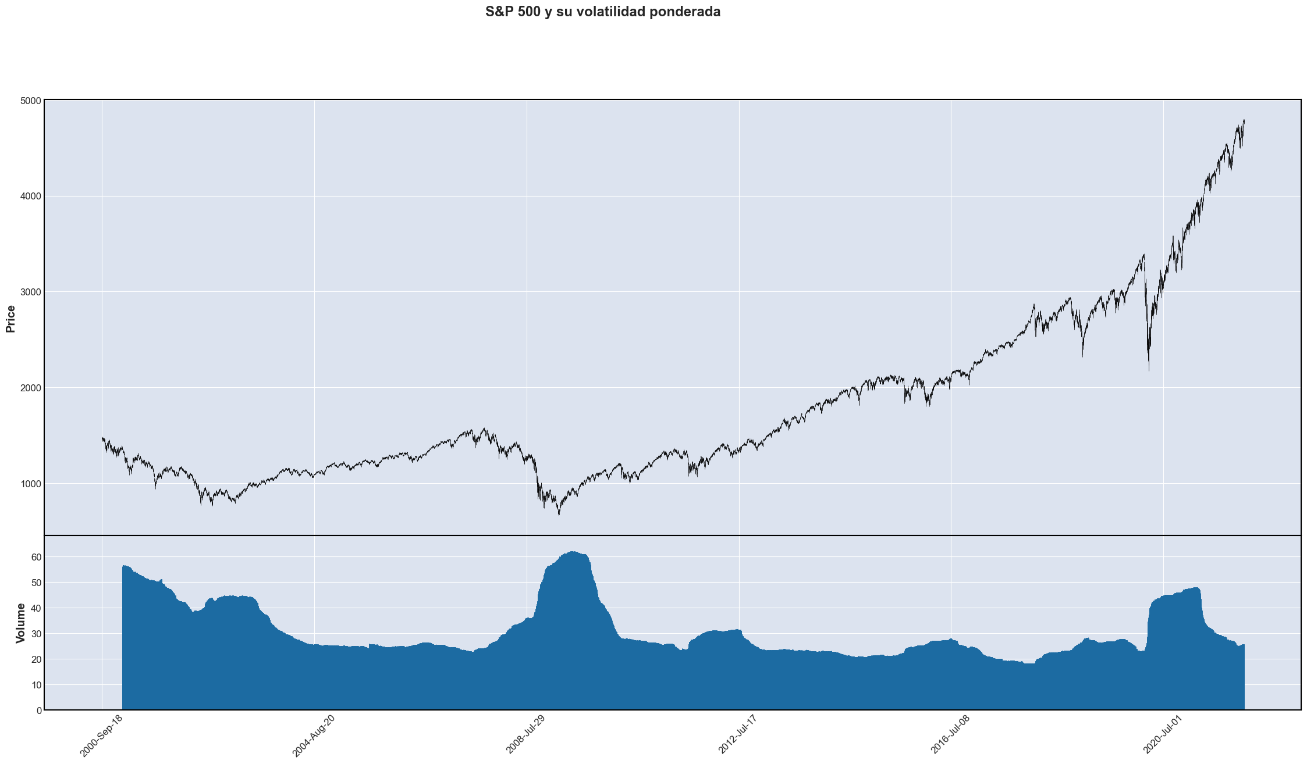

Slide 7
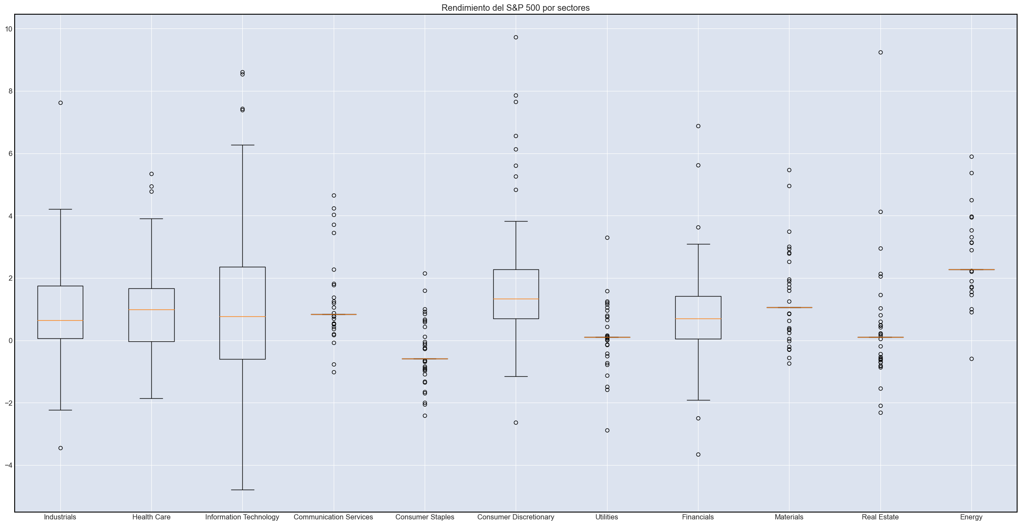

Slide 8
portafolio
Symbol | Security | Sector
MGM | MGM Resorts | Consumer Discretionary
MU | Micron Technology | Information Technology
AAL | American Airlines Group | Industrials
VLO | Valero Energy | Energy
F | Ford Motor Company | Consumer Discretionary
ON | On Semiconductor | Information Technology
C | Citigroup | Financials
AKAM | Akamai | Information Technology
BKNG | Booking Holdings | Consumer Discretionary

Slide 9
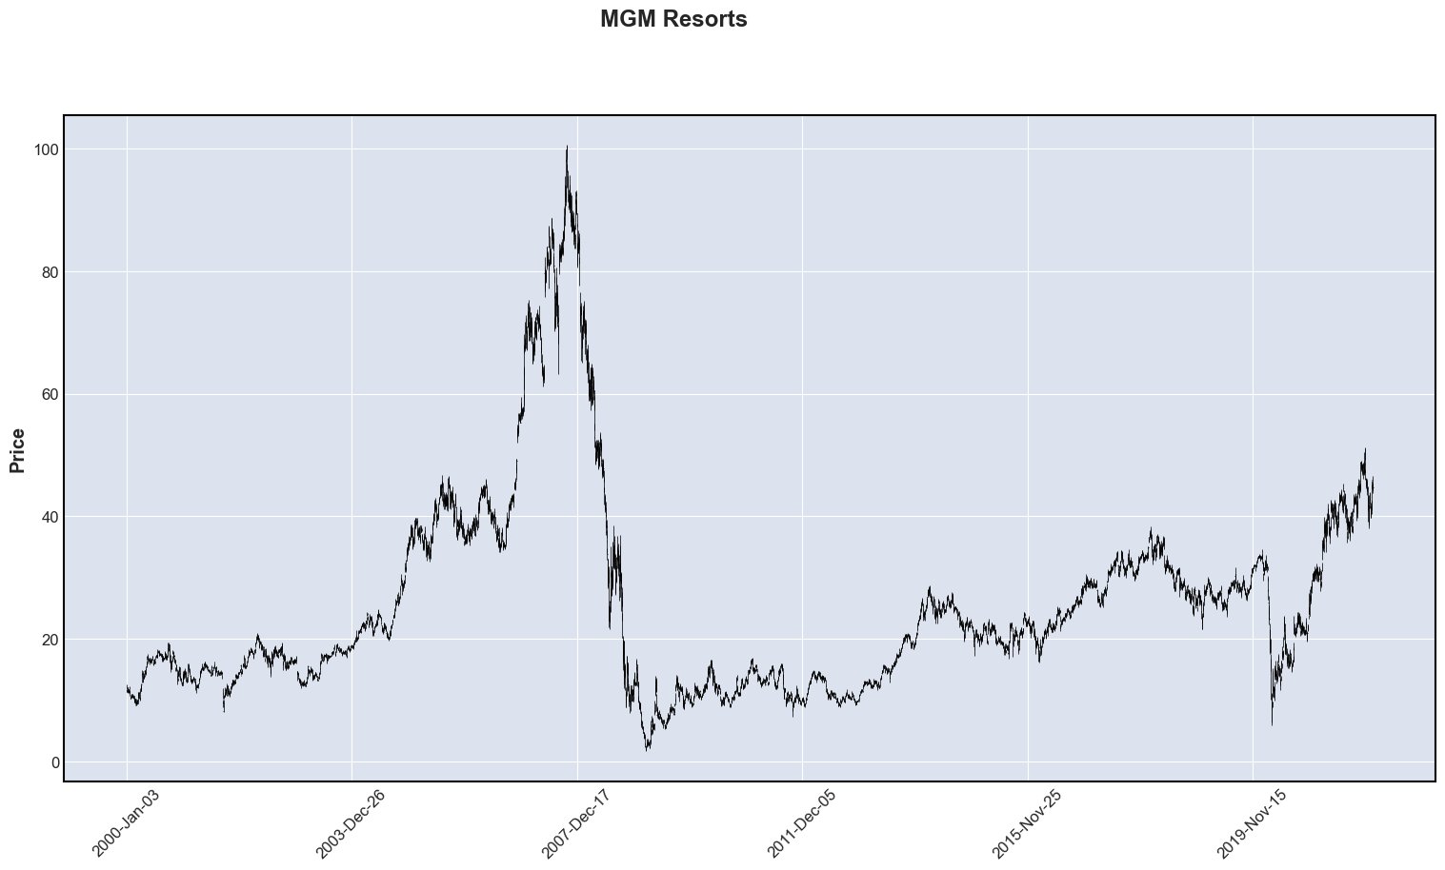

Slide 10
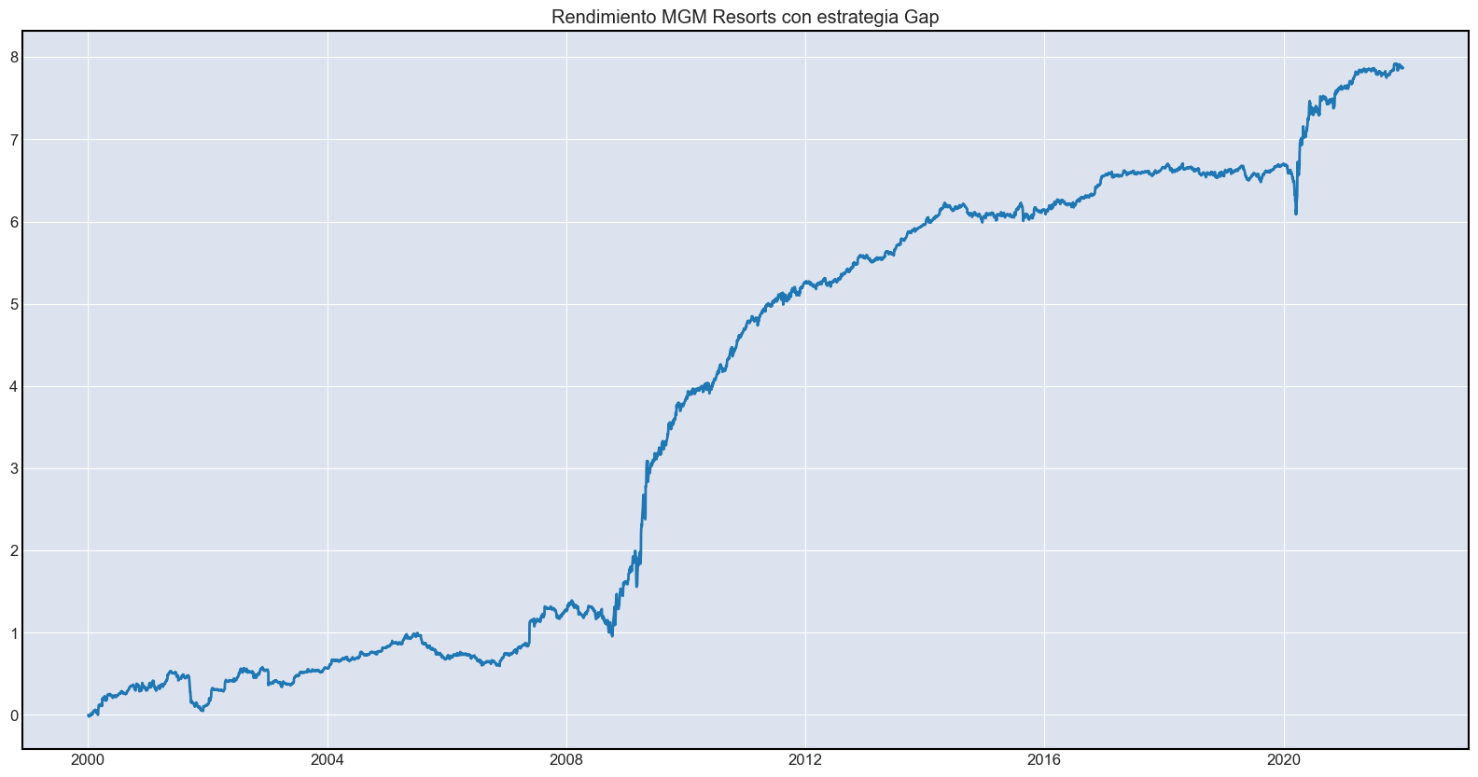

Slide 11
