Slide 1
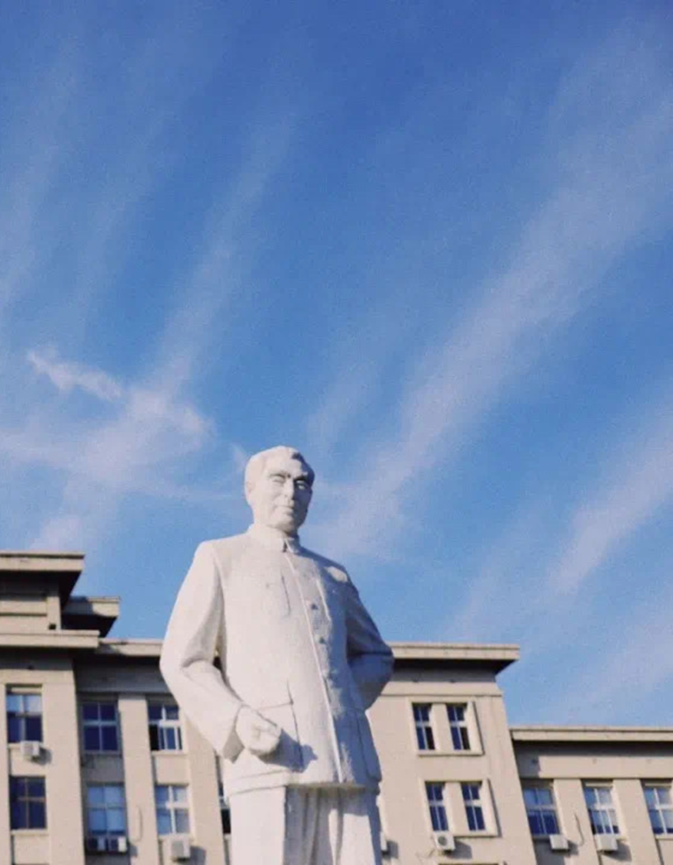


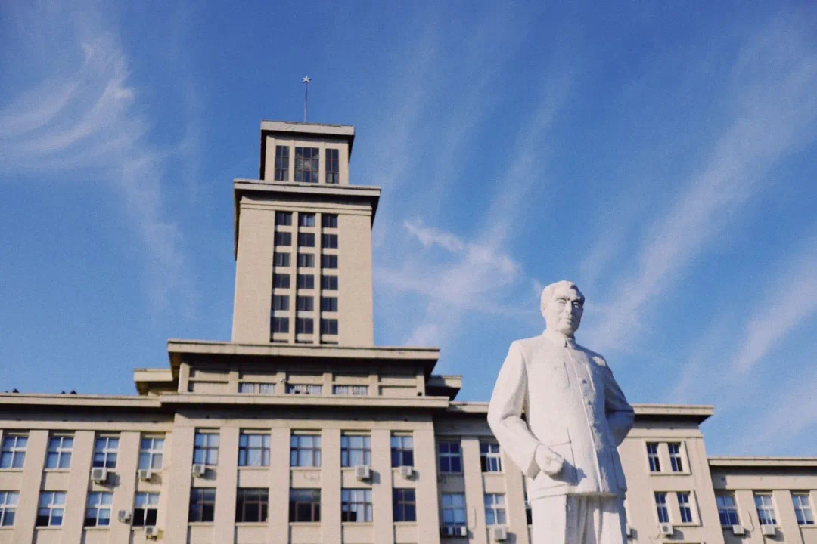
选中图片Delete，点击中间图标即可插入新图片
When Choice Happens
A Systematic Examination of Mouse Movement Length for Decision Making in Web Search
姓名
高祎珂
学号
2011743

Slide 2




目录
Introduction
Experiments
Results
Summary

Slide 3

选中图片Delete，点击中间图标即可插入新图片
01
Introduction

Slide 4

Introduction

Slide 5

Introduction
场景一
noticed an advertisement
场景二
abandoned the page
场景三
became frustrated

Slide 6
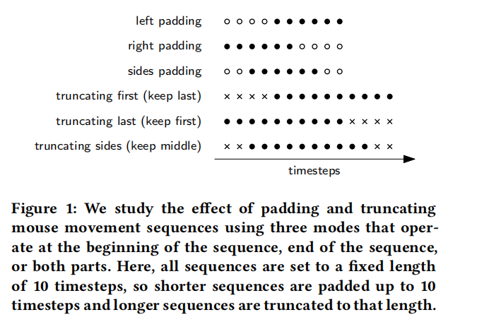
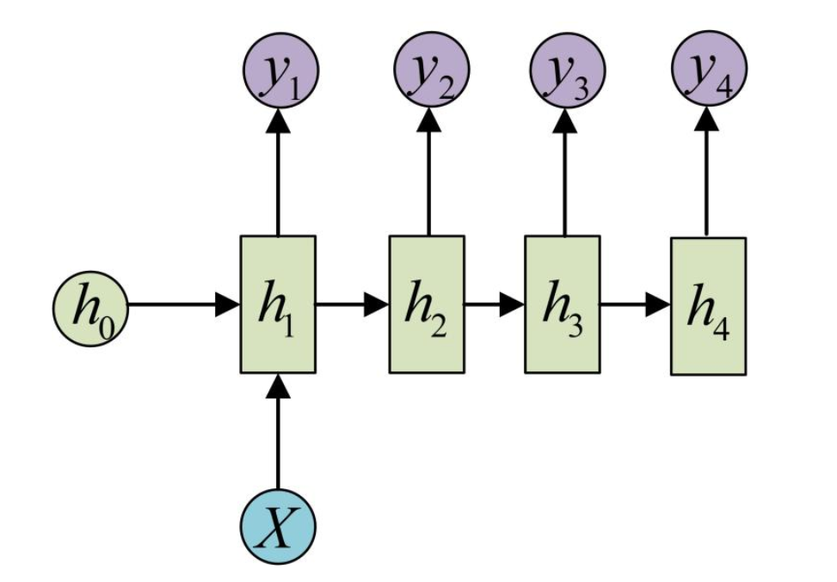
Introduction

Slide 7
选中图片Delete，点击中间图标即可插入新图片
02
EXPERIMENTS

Slide 8
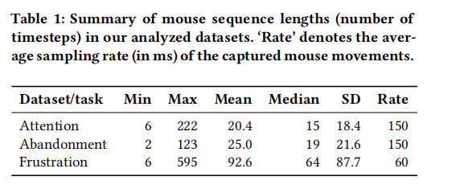
EXPERIMENTS
数据集

Slide 9
EXPERIMENTS
场景一
Predicting Ads Noticeability
We use the same RNN model and settings provided by Arapakis et al. , which outperformed other approaches in this task. The model is a bidirectional long short-term memory (BiLSTM) layer with 0.5 dropout and embedding size of 50 units, followed by a fully connected layer of 1 neuron with sigmoid activation as output. The BiLSTM layer uses hyperbolic tangent as activation function and sigmoid activation in the recurrent step.

Slide 10
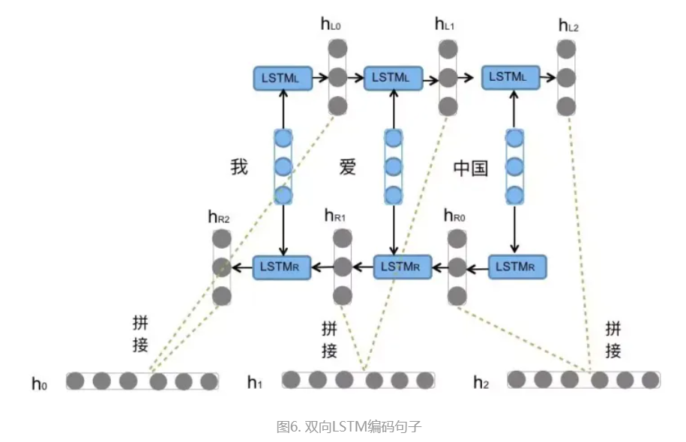
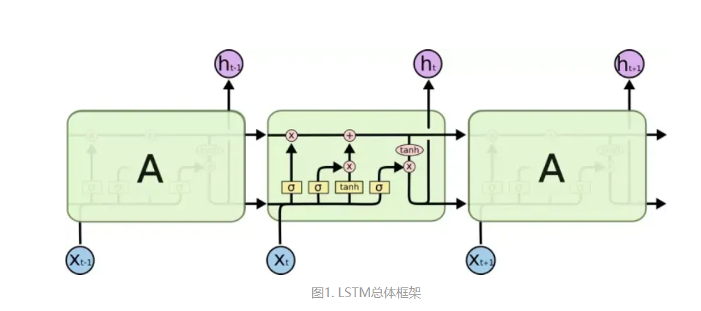
EXPERIMENTS
BiLSTM

Slide 11
EXPERIMENTS
场景二
Predicting Page Abandonment
We use the same RNN model and settings provided by Brückner
et al. , which outperformed other approaches in this task. The
model is a stack of 2 BiLSTM layers with 0.3 dropout, followed by a fully-connected layer of 1 neuron with sigmoid activation as output.The BiLSTM layers use hyperbolic tangent as activation function and sigmoid activation in the recurrent step.

Slide 12
EXPERIMENTS
场景三
Predicting Search Frustration
For this task we use the dataset provided by Feild et al. [10], which
comprises 259 mouse sequences on several SERPs (Google, Ya_x0002_hoo, Bing, Ask.com) with associated ground-truth labels regarding
search frustration on SERPs (either the user was frustrated or not)
while browsing both informational and navigational queries. There
are 30 cases where users felt frustrated (minority class), according
to a self-reported rating ≥ 4 in a scale of 1–5 (1 means no frustra_x0002_tion at all). We deliberately ignore ratings of 2 and 3 because the
goal of this task is to detected truly frustrated users. Since this task
has not been tackled with RNN models before, we use the same
architecture of the abandonment model, because of the similarities
between both tasks.

Slide 13
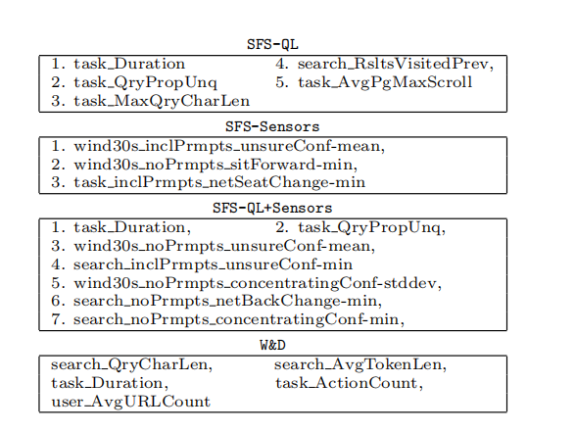
EXPERIMENTS
场景三
Predicting Search Frustration
In this paper, we consider frustration prediction as a binary task. However, multi-class prediction may also be useful, using either regression or a multi-class machine learning method. We also focus on general frustration, but predicting types of frustration may also be useful, e.g., predicting the fifteen types of frustration outlined by Xie and Cool。

Slide 14
EXPERIMENTS
Procedure

Slide 15
选中图片Delete，点击中间图标即可插入新图片
03
RESULTS

Slide 16
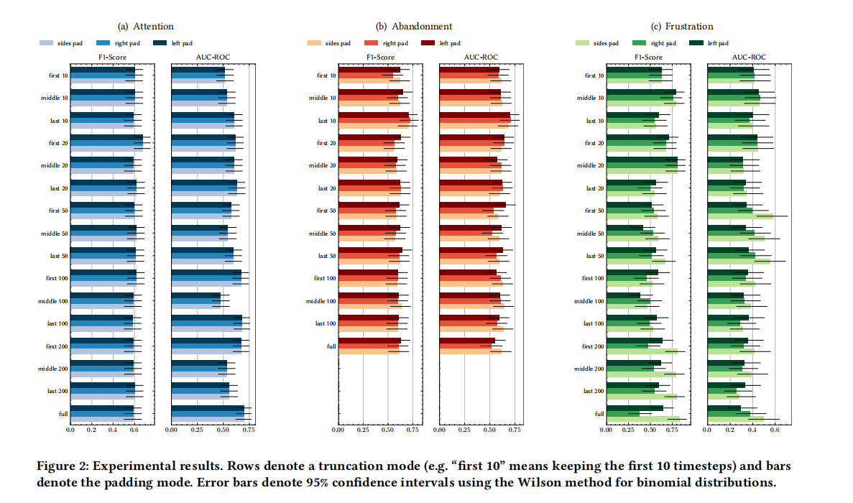
RESULTS

Slide 17
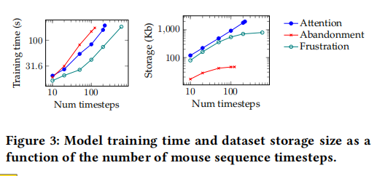
RESULTS

Slide 18
选中图片Delete，点击中间图标即可插入新图片
04
Summary

Slide 19
Summary
Built off cognitive models that propose a dynamic interplay between motor movements and underlying cognition , mouse tracking provides a dynamic window into how a decision unfolds .
Their work is the first to provide empirical evidence for the three paradigmatic SERP scenarios considered: predicting ads noticeability, page abandonment, and search frustration.

Slide 20
Summary
1)
attentional events happen at the beginning of the search session
2)
SERP abandonment decision happens towards the end of the search session
3)
searcher’s frustration can happen at anytime in the search session.

