Slide 1


Calibrating the infrared camera Clio Or how I needed 4 months to generate 1 graph
By Chris Bohlman
Mentor: Dr. Katie Morzinski
Steward observatory, UA

Slide 2
Adaptive Optics 101
Adaptive optics correct for disturbances of the atmosphere in astronomical image taking.
Although it serves as in improvement to data, it’s still not precise enough alone
Using Python, I got to calibrate the images taken

Slide 3
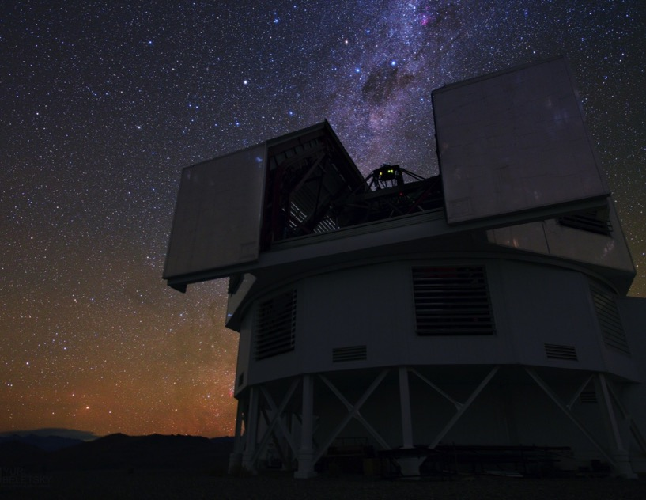
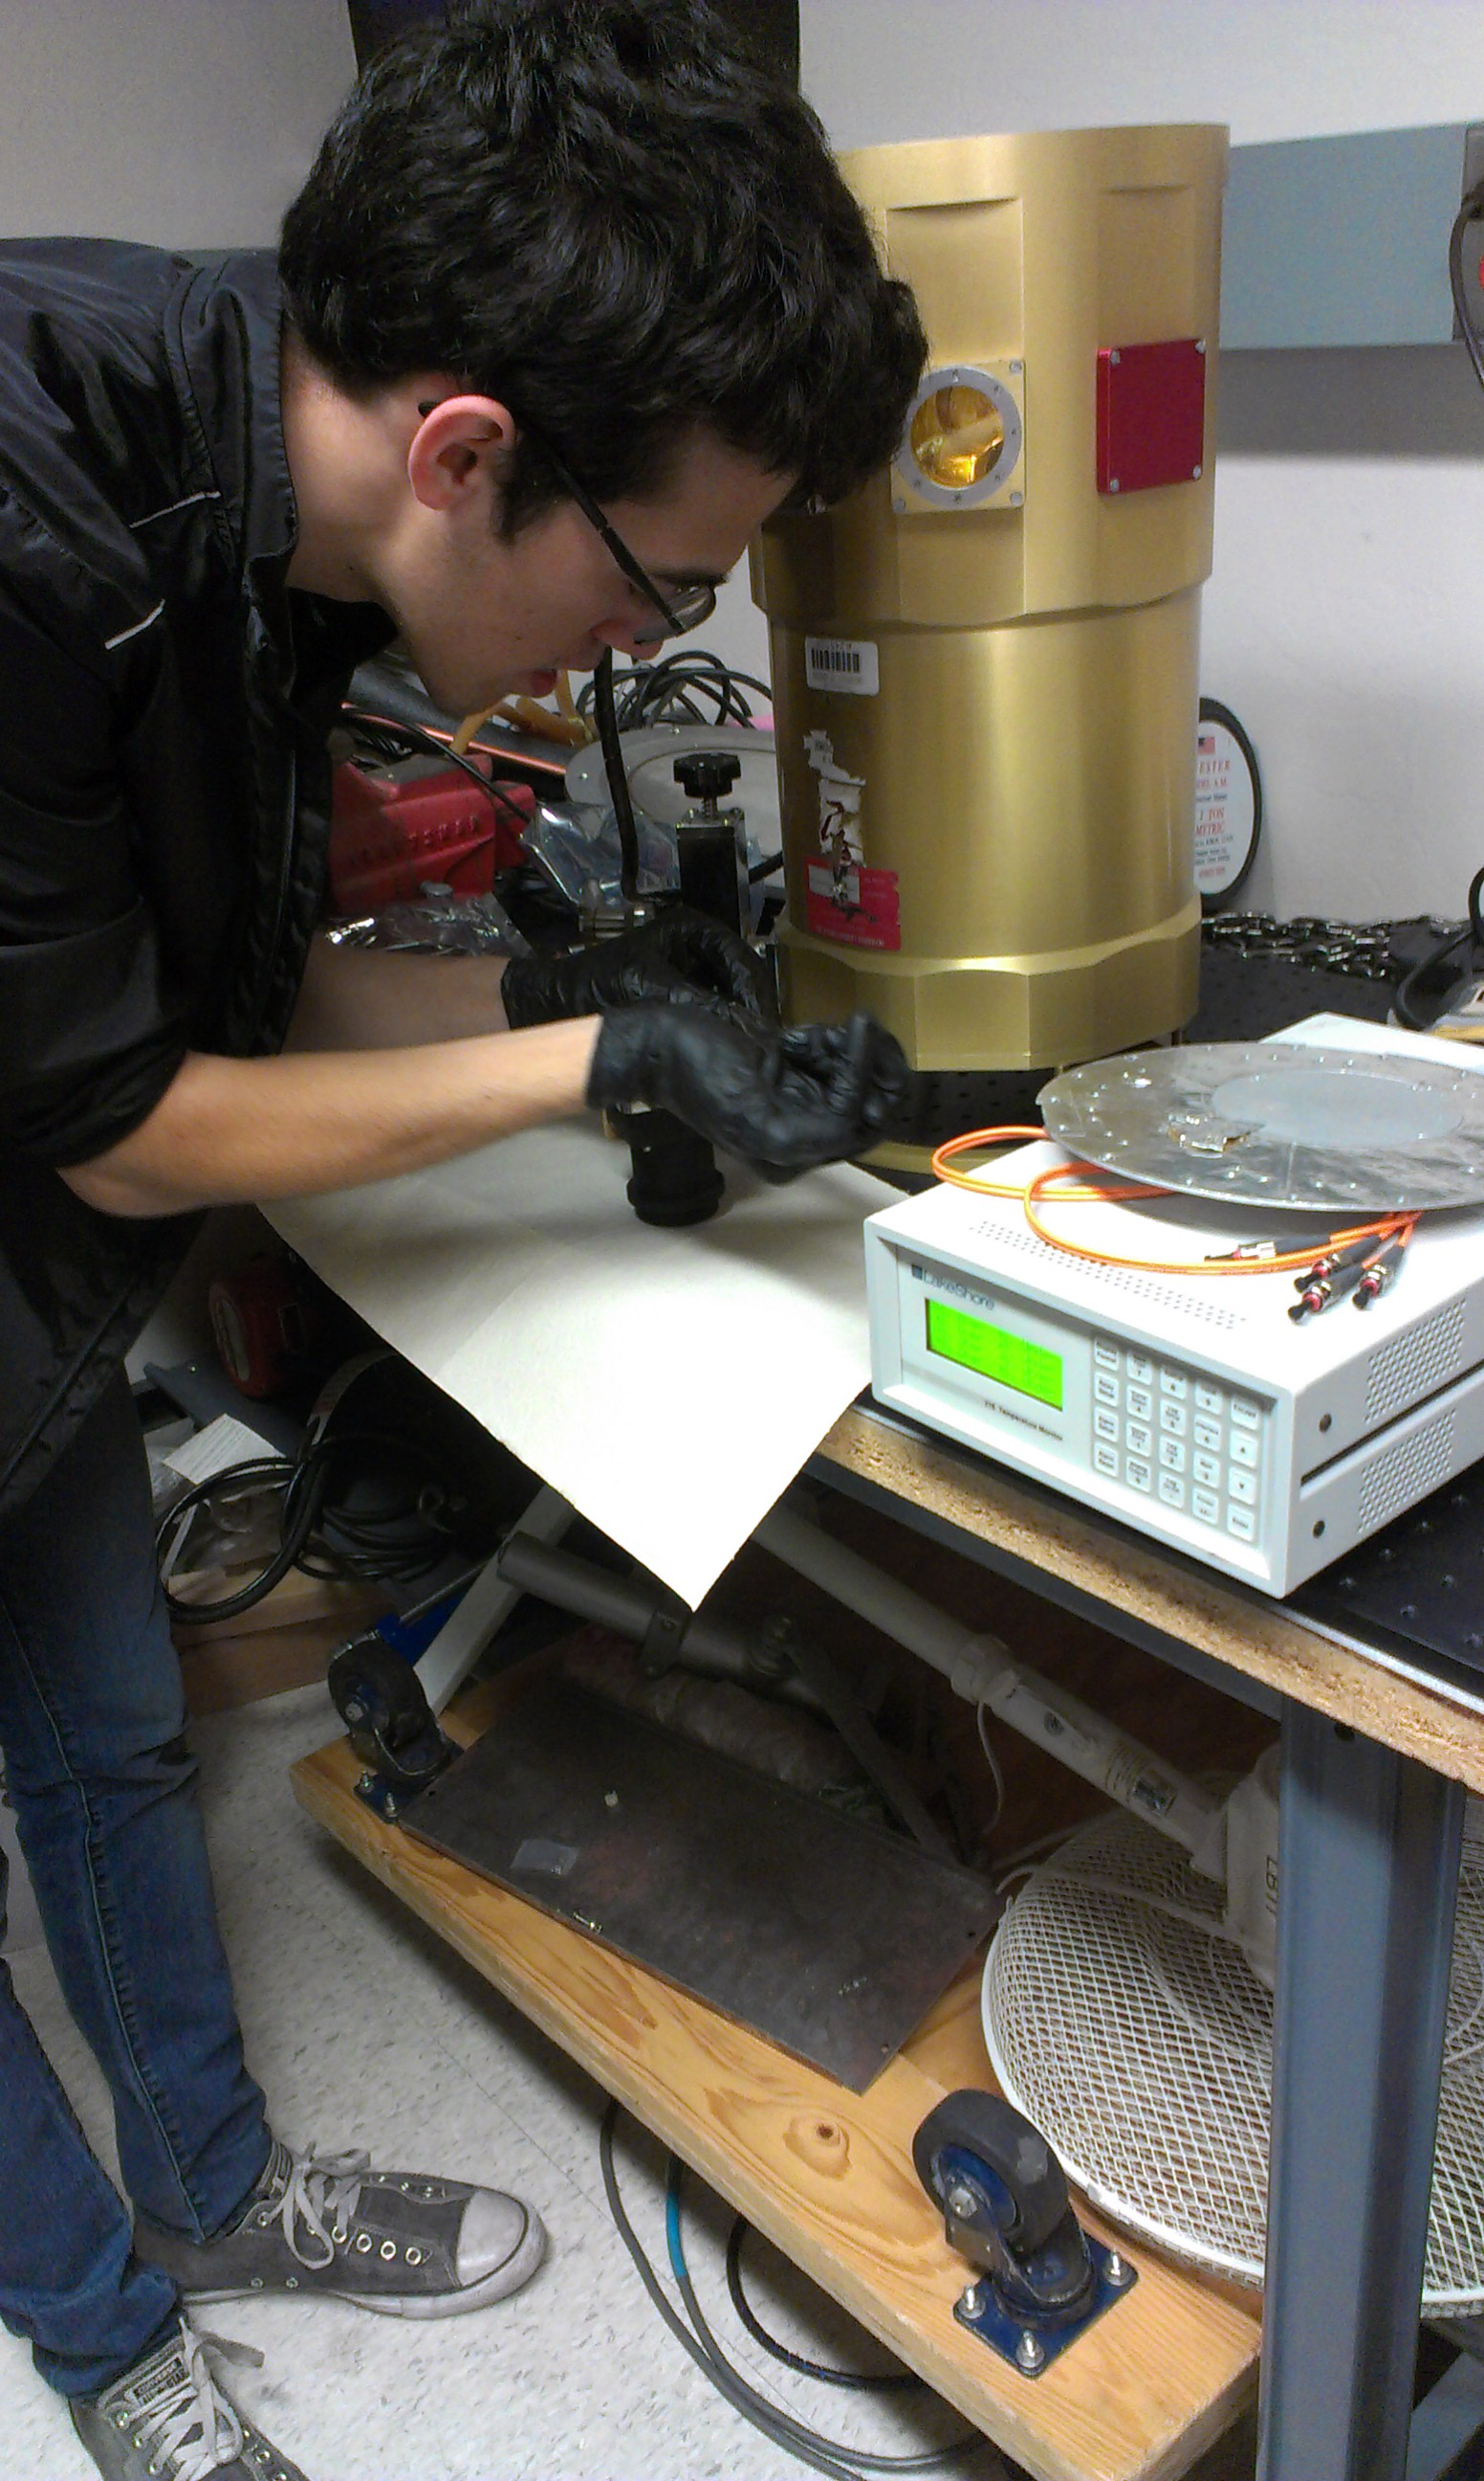
Magellan AO System
Photo by Yuri Beletsky, Las Campanas Observatory

Slide 4
Overview of Internship
Corrected images taken by the Clio instrument
Calibrated one data set, took coefficients from those, applied them to another data set.
Hands on applications of my work

Slide 5
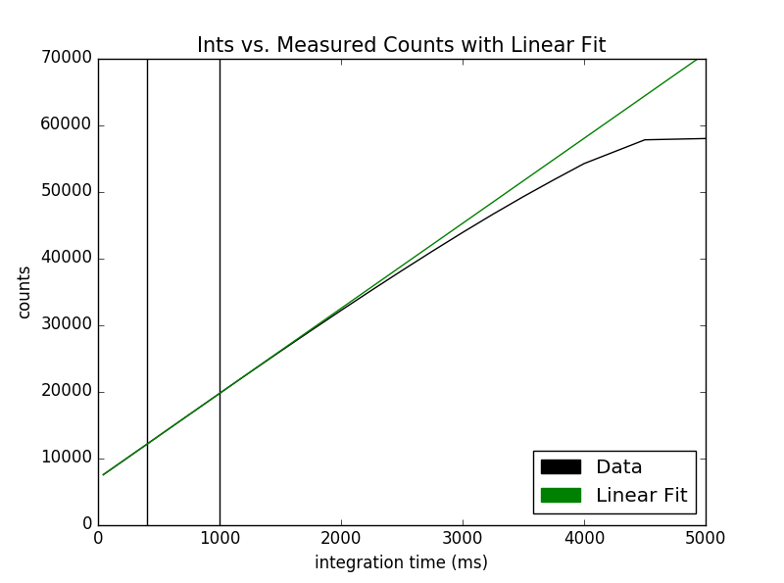
Relevant Terms and Information
Ints & Counts?
Linearity?
Python: Coding language of choice

Slide 6
Explanation of Code (All 400 lines!)
Had to read in every image’s exposure and brightness count, and devised a way to linearize the images to correct them through an equation.
Tested second, third, and fourth order equations to see which fit the data the most
Devised error plots as well to view where fits diverged

Slide 7
Results of Correction
Calibrated the counts to the fourth order
Took coefficients from that and applied to another data set
Therefore, multiple data sets can be calibrated through this method.

Slide 8
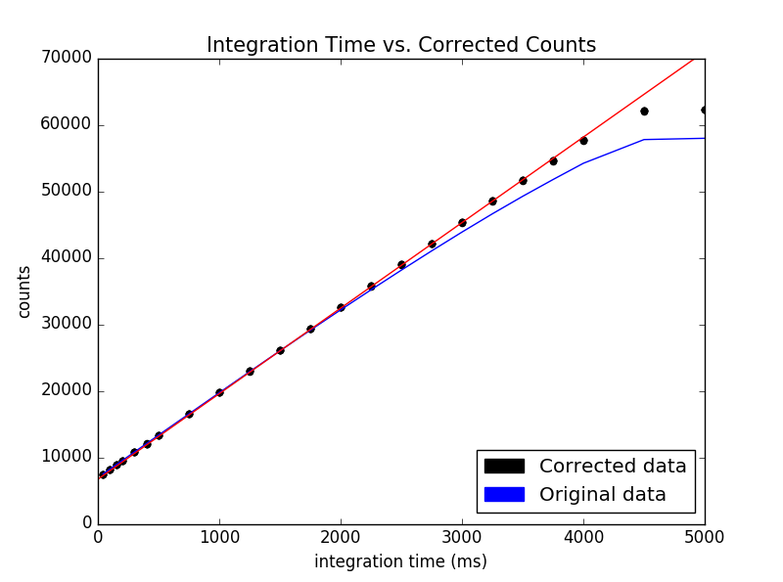
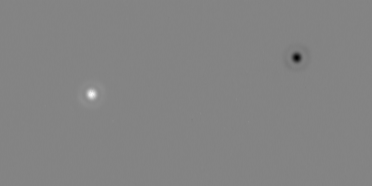
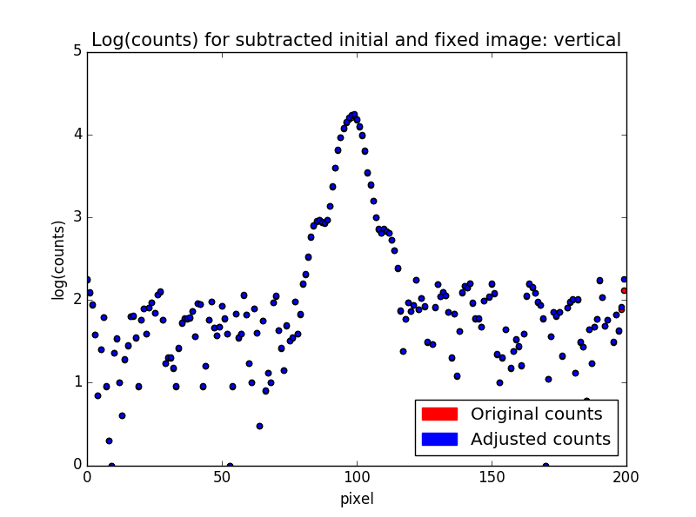
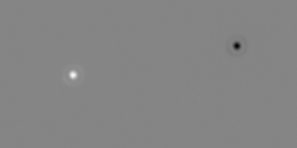
Corrected Data Visualization
Before:
After:

Slide 9
Impact on Modern Astronomy
Exoplanets have be found through linearization due to irregular counts
Can accurately measure the brightness of planets and stars with calibrated data
Leads to energy measurements through luminosity, distance, habitable planets.

Slide 10
Acknowledgements and Questions
Katie Morzinski, my mentor
The Entire MagAO staff
Susan Brew and the Arizona Space Grant Consortium

Slide 11
Reserve Slide
Information that is too complicated for my normal presentation but can come up in questions should go right here.

