Slide 1

Calibrating Clio Or how I needed 4 months to generate 1 graph
By Chris Bohlman
Mentor: Dr. Katie Morzinski
Steward observatory

Slide 2
Adaptive Optics 101
Adaptive Optics corrects for disturbances of the atmosphere in astronomical picture taking.
Generally requires a lot of precise coding and instruments
Using Python, I got to calibrate the pictures taken

Slide 3
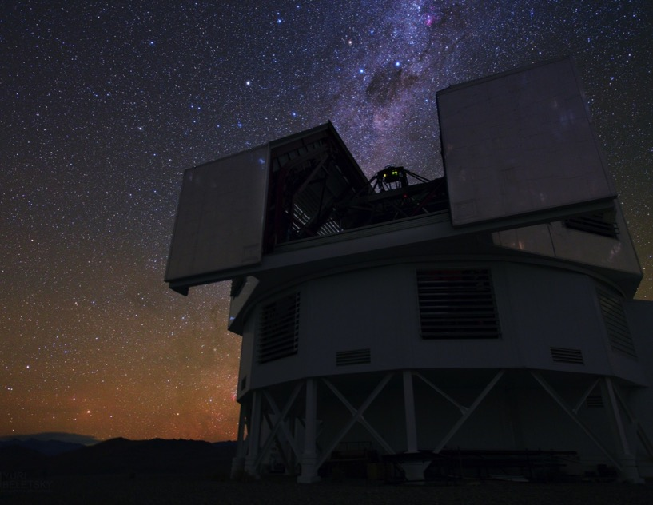
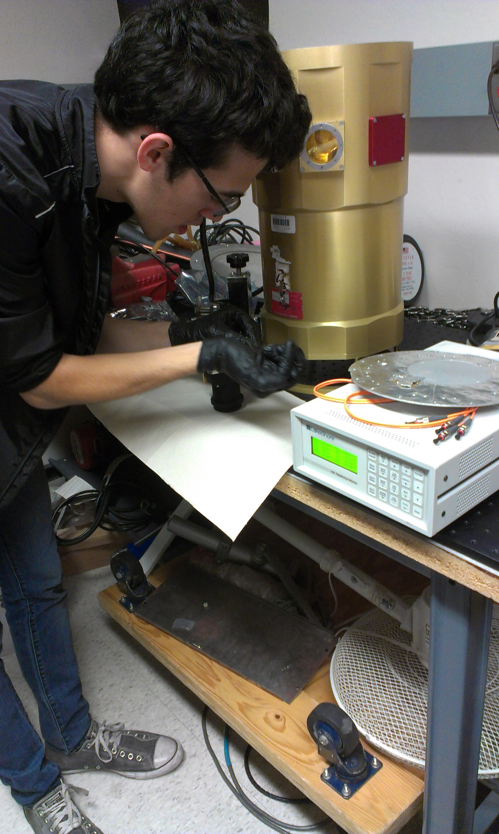
Magellan AO System
Photo by Yuri Beletsky, Las Campanas Observatory

Slide 4
What Did I Spend a Year Doing?
Corrected images taken by the Clio instrument
First corrected one data set, took coefficients from those, applied them to another data set w/ two stars and voila!
Hands on activities as well

Slide 5
Relevant Terms and Information
Ints & Counts?
Linearity?
A linear detector will record 2x the counts with a star 2x as bright or when you integrate for 2x as long
Python: Coding language
I used several external packages in python to assist

Slide 6
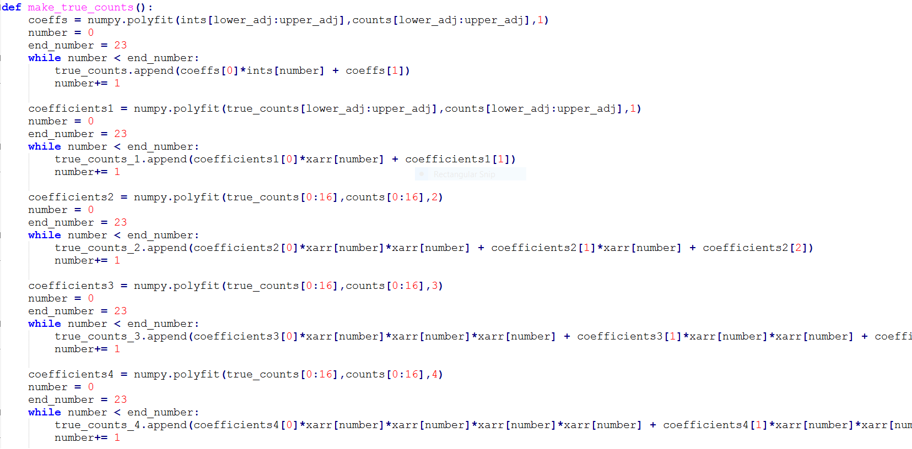
Picture of My Code

Slide 7
Explanation of Code
Had to read in every picture’s exposure and brightness count, and devised a way to linearize the pictures to correct them through an equation.
Tested second, third, and fourth order equations to see which fit the data the most
Devised error plots as well to view where fits diverged

Slide 8
Fruits of My Labor
Calibrated the counts to the fourth order
Took coefficients from that and applied to another data set
Therefore, multiple data sets can be calibrated through this method.

Slide 9
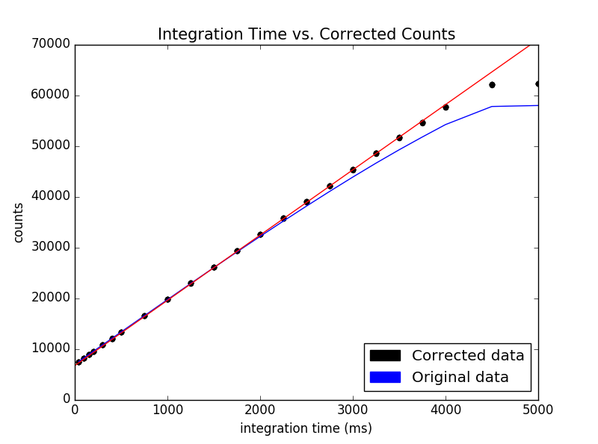
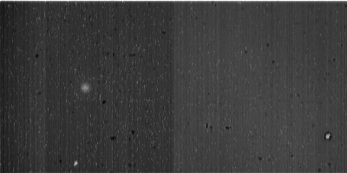
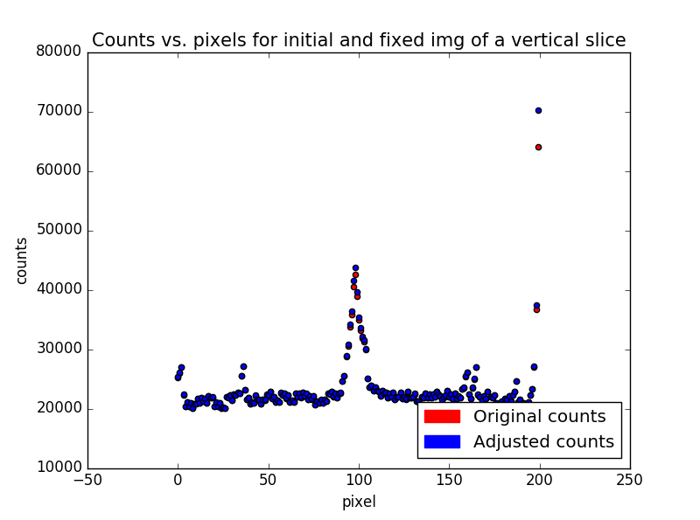
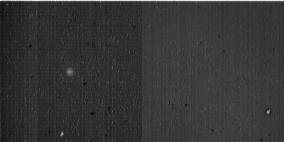
Corrected Data
Before:
After:

Slide 10
Impact on Modern Astronomy
Extrasolar planets are approximately 4 counts.
Can accurately measure the brightness of planets and stars with calibrated data
Leads to energy measurements through luminosity, distance, habitable planets.

Slide 11
Thank Yous and Questions
Katie Morzinski, my mentor
The Entire MagAO staff
Susan Brew and the Space Grant program

