Slide 1


Slide 2
Neural Networks
Notes:
In London

Slide 3
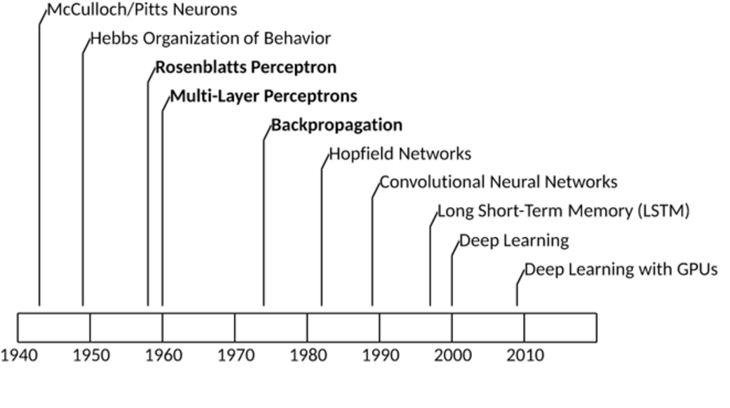
History of Neural Networks
Notes:
In London

Slide 4
Why popular today?
Lot of data around to train
Computing power – Gaming industry producing GPU’s and Moore’s law
Small tweaks – Huge impact as compared to what was there
Assumptions against proved benign – ANN might get stuck in local minimum
Popularity - ANNs seem to have entered a virtuous circle of funding and progress
Notes:
Some theoretical limitations of ANNs have turned out to be benign in practice. For example, many people thought that ANN training algorithms were doomed because they were likely to get stuck in local optima, but it turns out that this is rather rare in practice (or when it is the case, they are usually fairly close to the global optimum).

Slide 5
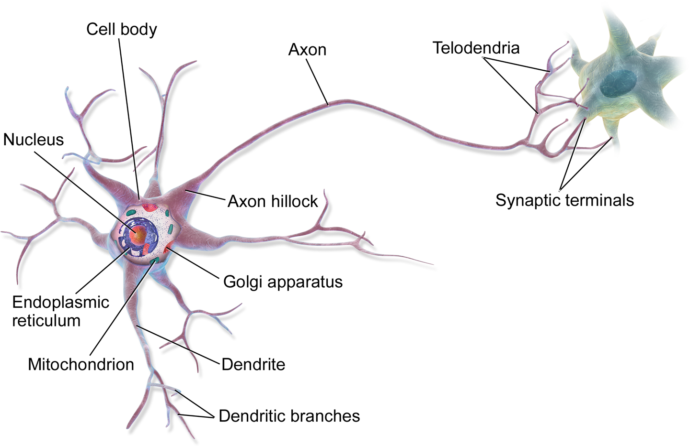
Biological Neurons
Notes:
Some theoretical limitations of ANNs have turned out to be benign in practice. For example, many people thought that ANN training algorithms were doomed because they were likely to get stuck in local optima, but it turns out that this is rather rare in practice (or when it is the case, they are usually fairly close to the global optimum).

Slide 6
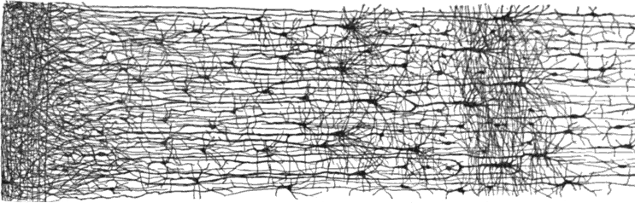
Biological Neurons
Notes:
Some theoretical limitations of ANNs have turned out to be benign in practice. For example, many people thought that ANN training algorithms were doomed because they were likely to get stuck in local optima, but it turns out that this is rather rare in practice (or when it is the case, they are usually fairly close to the global optimum).

Slide 7
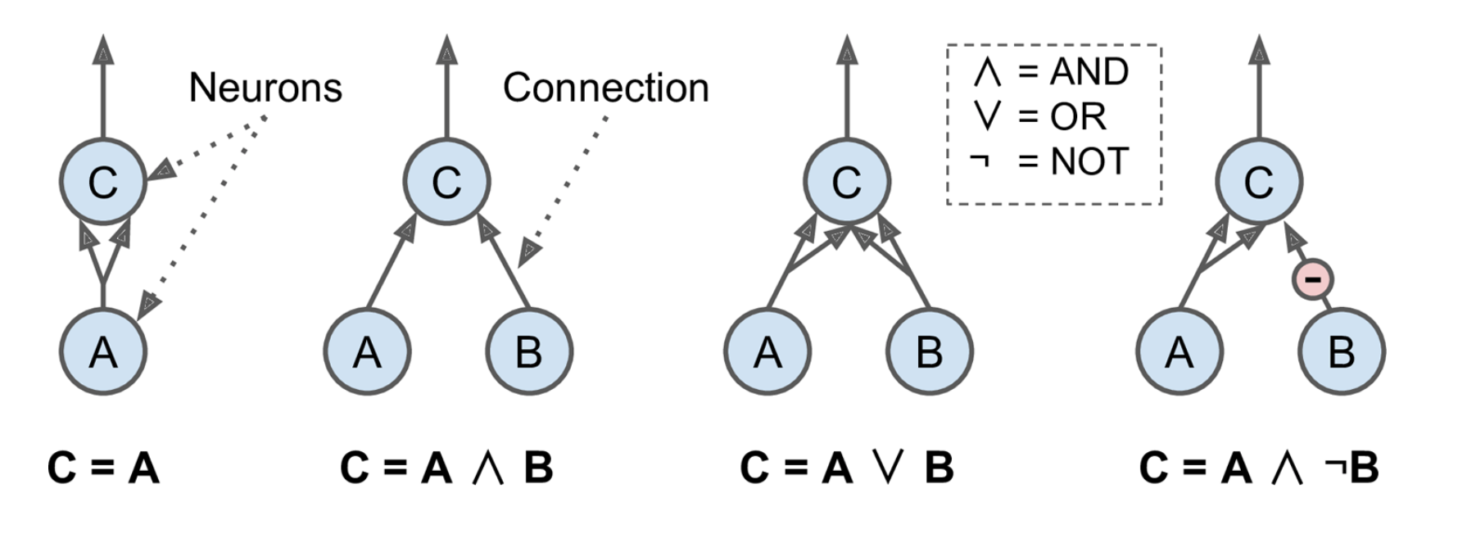
Basic form of ANN
Notes:
The first network on the left is simply the identity function: if neuron A is activated, then neuron C gets activated as well (since it receives two input signals from neuron A), but if neuron A is off, then neuron C is off as well.
The second network performs a logical AND: neuron C is activated only when both neurons A and B are activated (a single input signal is not enough to activate neuron C).
The third network performs a logical OR: neuron C gets activated if either neuron A or neuron B is activated (or both).
Finally, if we suppose that an input connection can inhibit the neuron’s activity (which is the case with biological neurons), then the fourth network computes a slightly more complex logical proposition: neuron C is activated only if neuron A is active and if neuron B is off. If neuron A is active all the time, then you get a logical NOT: neuron C is active when neuron B is off, and vice versa.

Slide 8
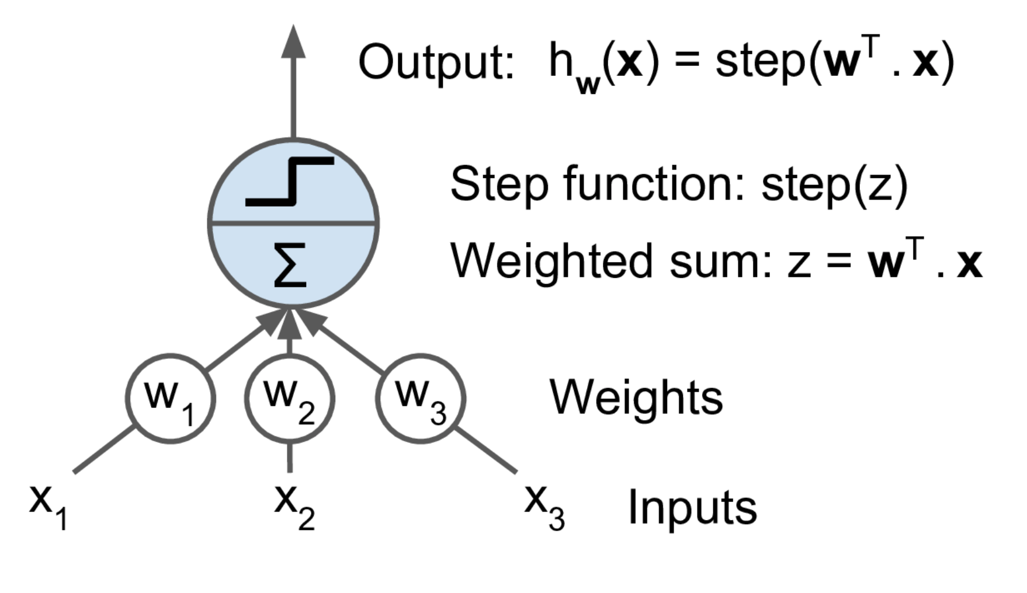
Linear Threshold Unit
Notes:
Step function is the heavy side function :-
Heaviside(z) – 0 or 1 depending on whether Z < 0 or Z>=0

Slide 9
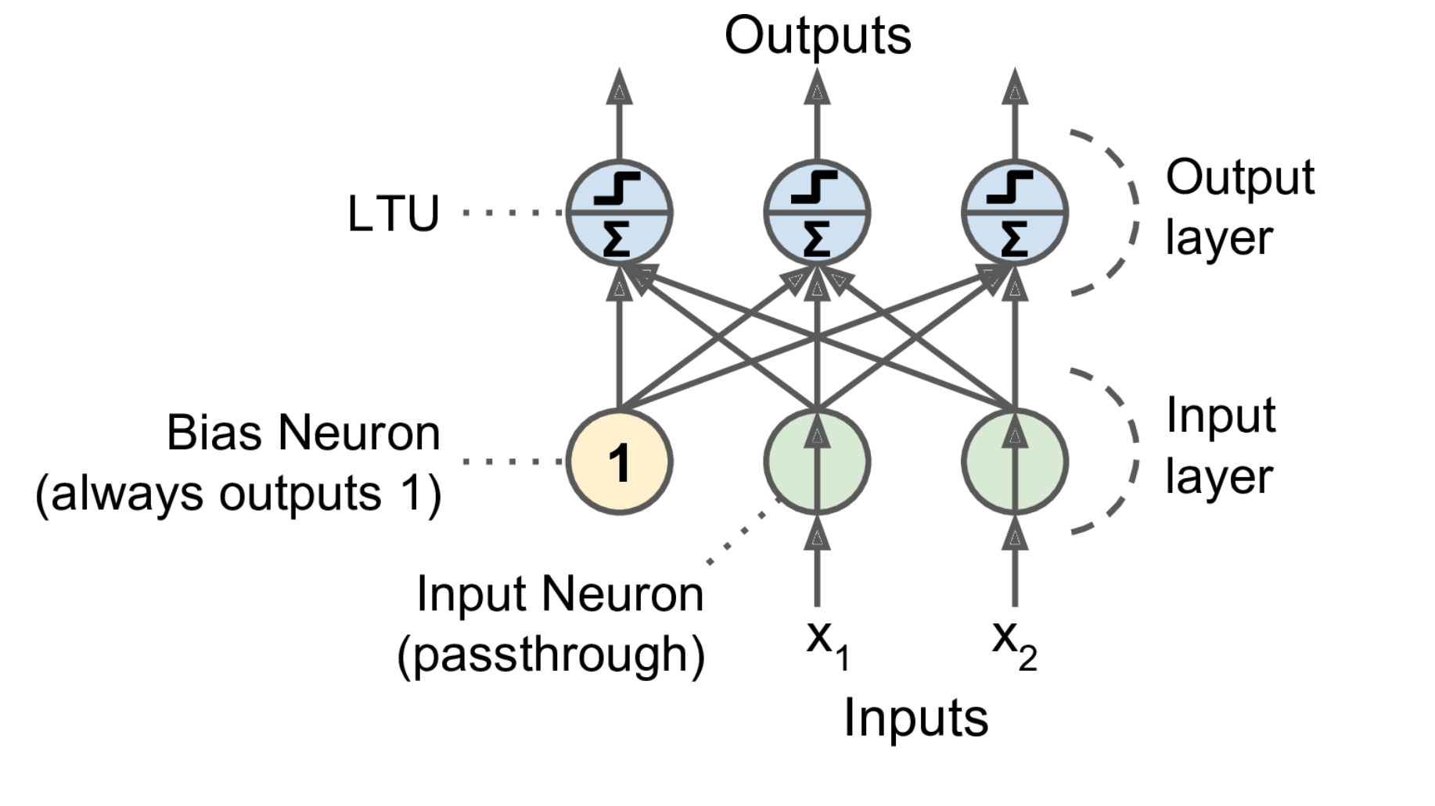
Perceptron
Notes:
Step function is the heavy side function :-
Heaviside(z) – 0 or 1 depending on whether Z < 0 or Z>=0

Slide 10
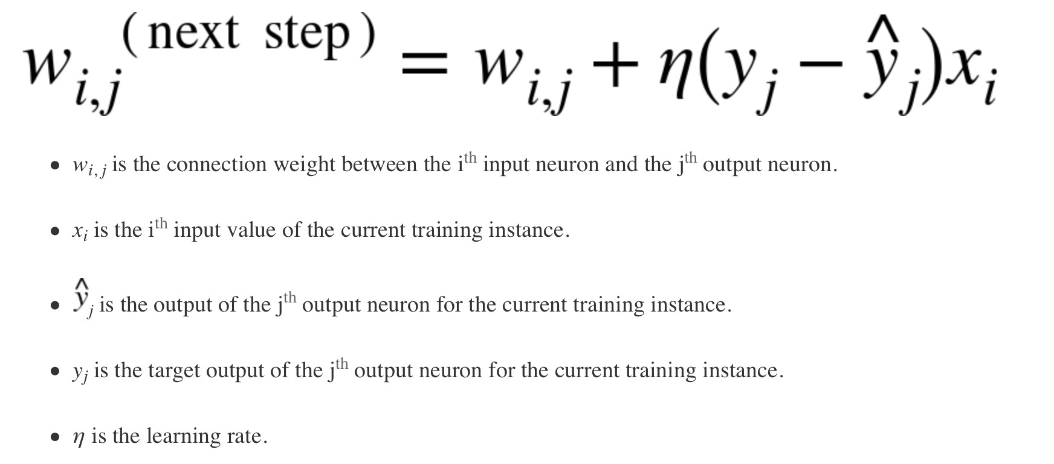
Hebb’s rule - Cells that fire together wire together
Notes:
The decision boundary of each output neuron is linear, so Perceptrons are incapable of learning complex patterns (just like Logistic Regression classifiers). However, if the training instances are linearly separable, Rosenblatt demonstrated that this algorithm would converge to a solution.⁷ This is called the Perceptron convergence theorem.

Slide 11
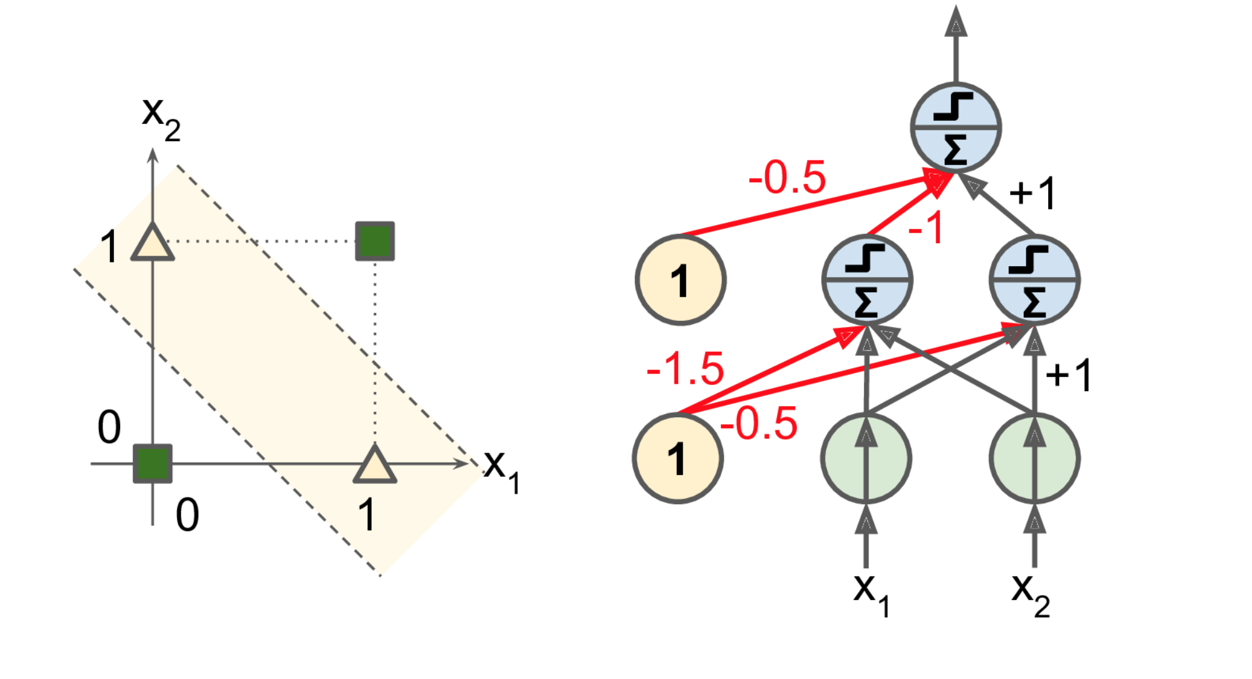
XOR Problem and Multi-Layer Perceptron
Notes:
The decision boundary of each output neuron is linear, so Perceptrons are incapable of learning complex patterns (just like Logistic Regression classifiers). However, if the training instances are linearly separable, Rosenblatt demonstrated that this algorithm would converge to a solution.⁷ This is called the Perceptron convergence theorem.

Slide 12
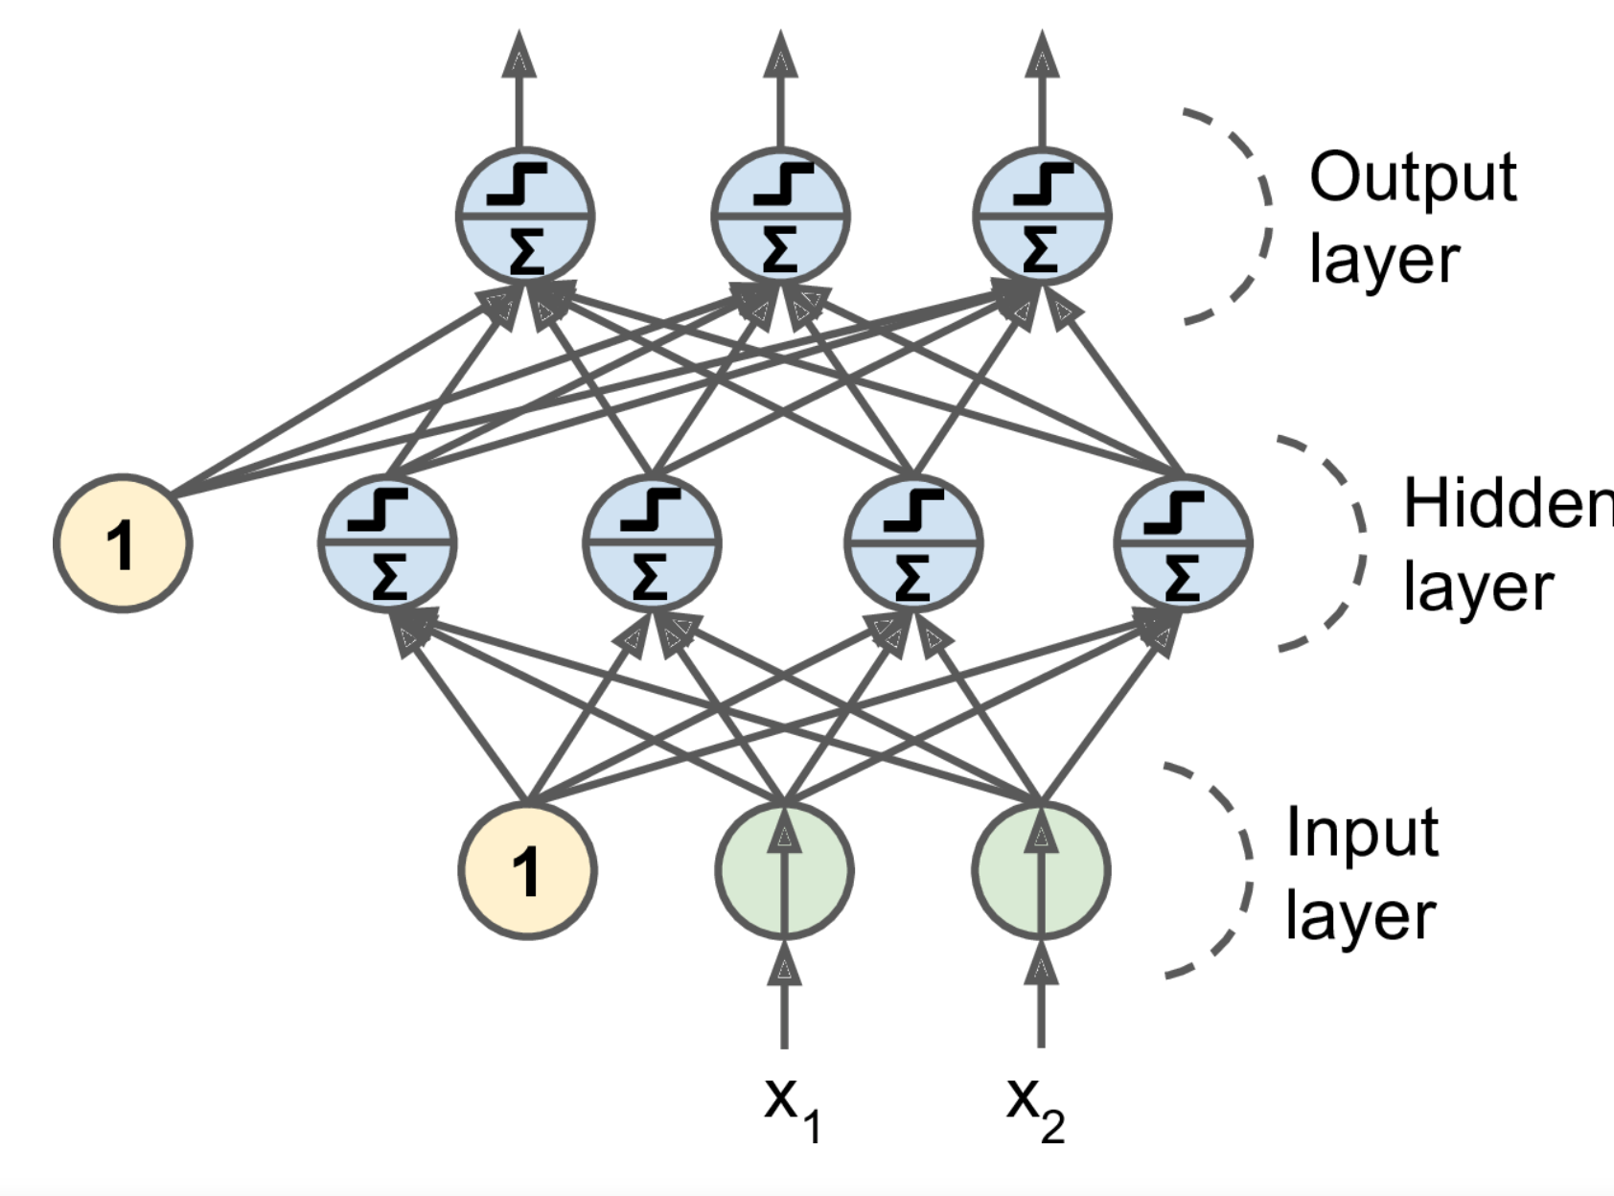
MLP/ANN
Notes:
The decision boundary of each output neuron is linear, so Perceptrons are incapable of learning complex patterns (just like Logistic Regression classifiers). However, if the training instances are linearly separable, Rosenblatt demonstrated that this algorithm would converge to a solution.⁷ This is called the Perceptron convergence theorem.

Slide 13
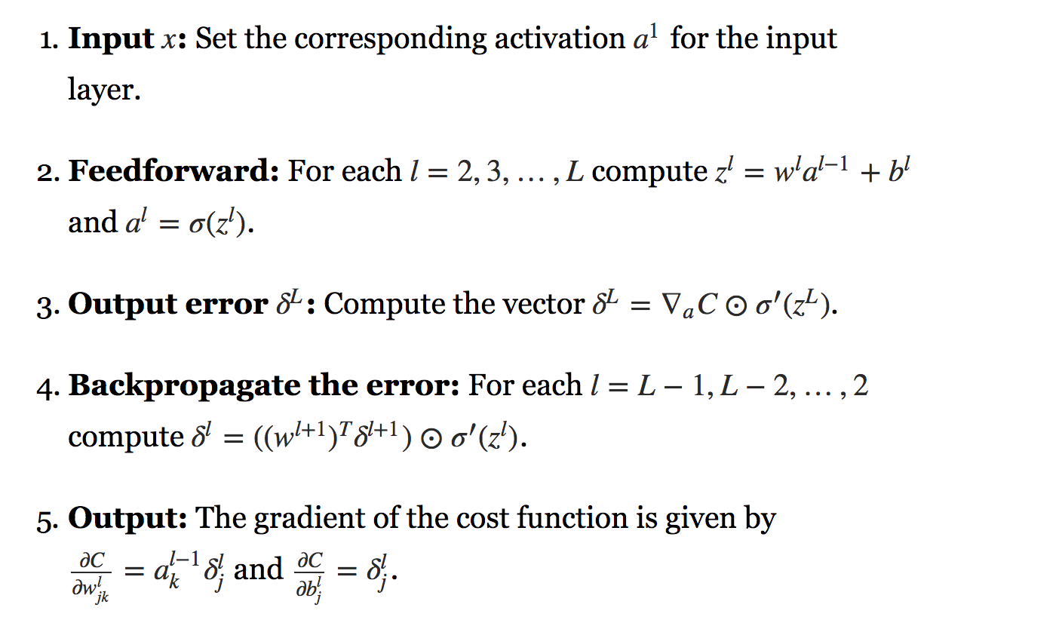
How does it work?
Notes:
The decision boundary of each output neuron is linear, so Perceptrons are incapable of learning complex patterns (just like Logistic Regression classifiers). However, if the training instances are linearly separable, Rosenblatt demonstrated that this algorithm would converge to a solution.⁷ This is called the Perceptron convergence theorem.

Slide 14
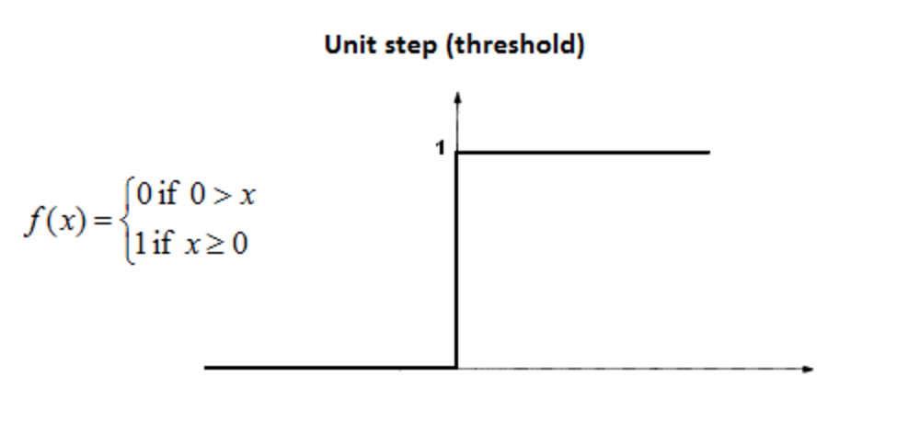
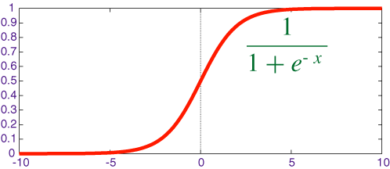
Better activation function?
Notes:
The decision boundary of each output neuron is linear, so Perceptrons are incapable of learning complex patterns (just like Logistic Regression classifiers). However, if the training instances are linearly separable, Rosenblatt demonstrated that this algorithm would converge to a solution.⁷ This is called the Perceptron convergence theorem.

Slide 15
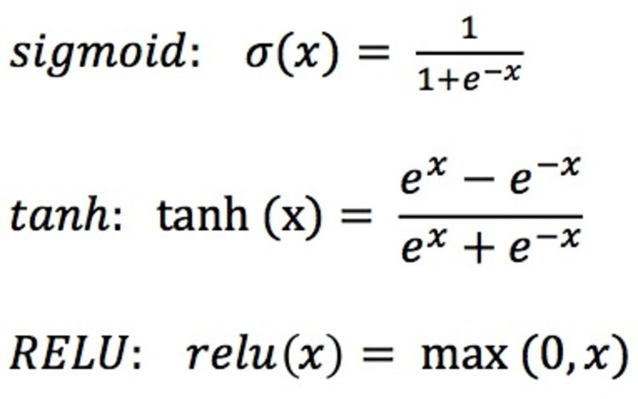
Different type of activation functions
Notes:
The decision boundary of each output neuron is linear, so Perceptrons are incapable of learning complex patterns (just like Logistic Regression classifiers). However, if the training instances are linearly separable, Rosenblatt demonstrated that this algorithm would converge to a solution.⁷ This is called the Perceptron convergence theorem.

Slide 16
Different type of activation functions
Notes:
The decision boundary of each output neuron is linear, so Perceptrons are incapable of learning complex patterns (just like Logistic Regression classifiers). However, if the training instances are linearly separable, Rosenblatt demonstrated that this algorithm would converge to a solution.⁷ This is called the Perceptron convergence theorem.

Slide 17
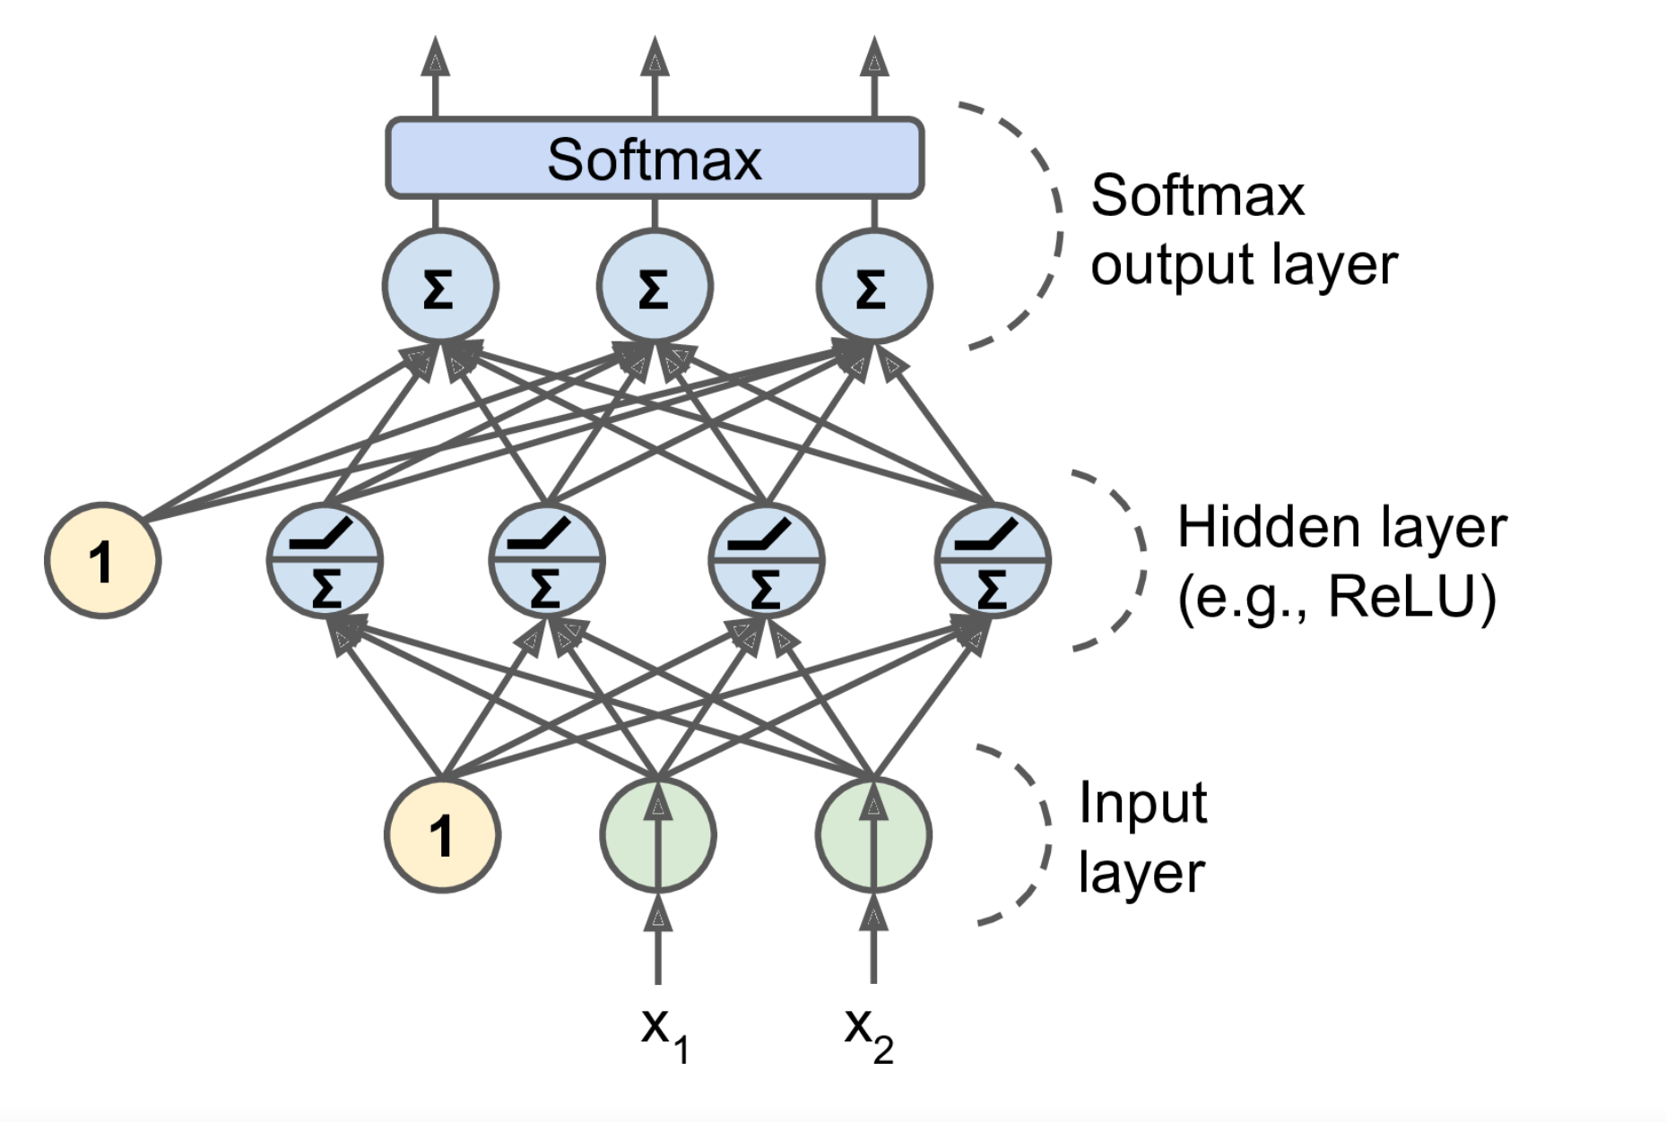
Shared Softmax
Notes:
The decision boundary of each output neuron is linear, so Perceptrons are incapable of learning complex patterns (just like Logistic Regression classifiers). However, if the training instances are linearly separable, Rosenblatt demonstrated that this algorithm would converge to a solution.⁷ This is called the Perceptron convergence theorem.

Slide 18
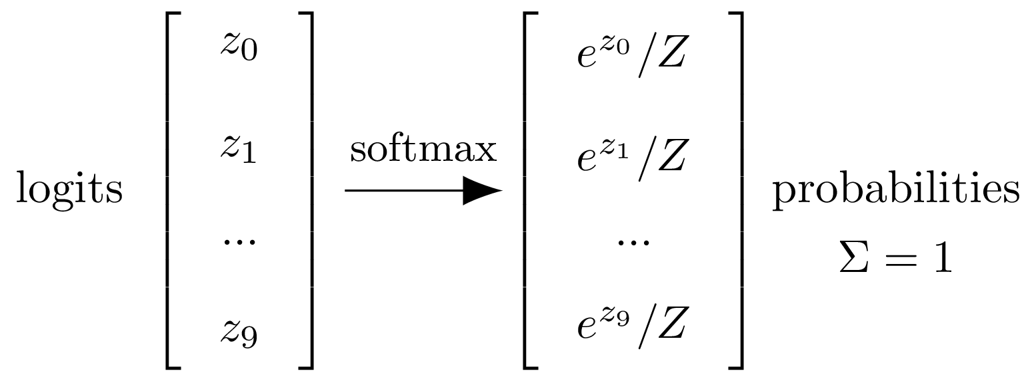
Notes:
For multi class classification ,you would want to apply a softmaz function which is e(x)/1+e(-x)

Slide 19
Why neural networks?
As the number of quadratic, cubic or high order independent variables increase the regression model becomes more computationally expensive. For Ex if we have say 100 features and we want to include the combination of features such as (x1^2,x1.x2,x1.x3..x1.x100,x2^2,...........,x100^x100) then 100 features are now appx. 5000 . Regression is not good with so much quadratic or higher order features.
Notes:
In London

Slide 20
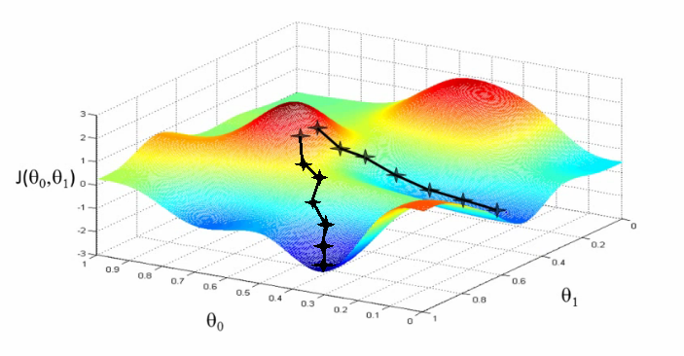
Gradient Descent
Notes:
In London

Slide 21
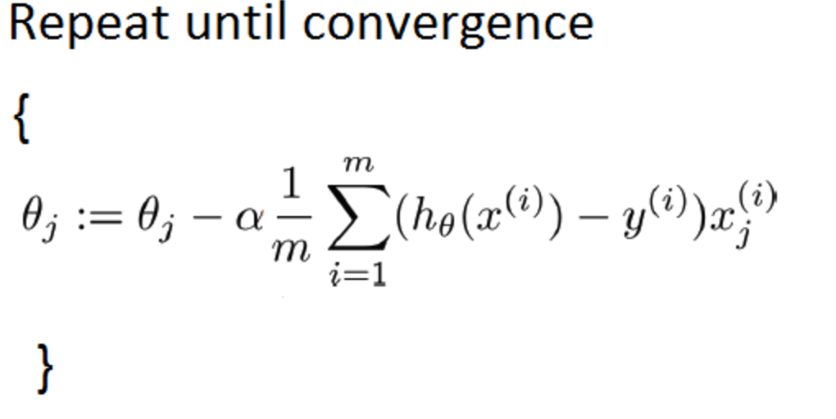
Types of Gradient Descent
Batch Gradient Descent
we use the complete dataset available to compute the gradient of cost function.
batch gradient descent can be very slow and is intractable for datasets that don't fit in memory
Notes:
In London

Slide 22
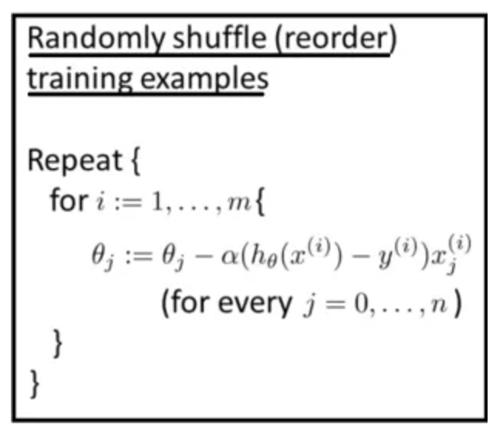
2. Stochastic Gradient Descent
we use the 1 training Example to compute the gradient of cost function.
Stochastic gradient descent is very fast but accuracy is low
Notes:
In London

Slide 23
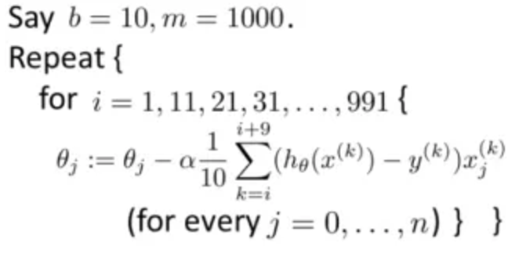
3. Mini Batch Gradient Descent
we use the a batch of m training Example to compute the gradient of cost function.
Mini Batch gradient descent is faster then batch and accuracy is higher than Stochastic
Notes:
In London

Slide 24
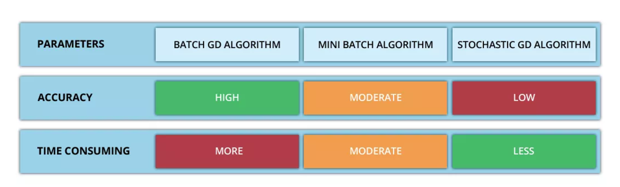
Notes:
In London

Slide 25
Tuning neural network
Random Search/Grid Search/Use Oscar tool
Number of Hidden layer – Most cases 1 or 2 hidden layers suffice
Number of neurons per hidden layer – Common practice to form a tunnel
Choice of activation function – ReLu works most of the time
Notes:
Flexibility of neural network is also their drawback,there are lot of hyperparameter to tweak
lower hidden layers model low-level structures (e.g., line segments of various shapes and orientations), intermediate hidden layers combine these low-level structures to model intermediate-level structures (e.g., squares, circles), and the highest hidden layers and the output layer combine these intermediate structures to model high-level structures (e.g., faces).

