Slide 1


Slide 2
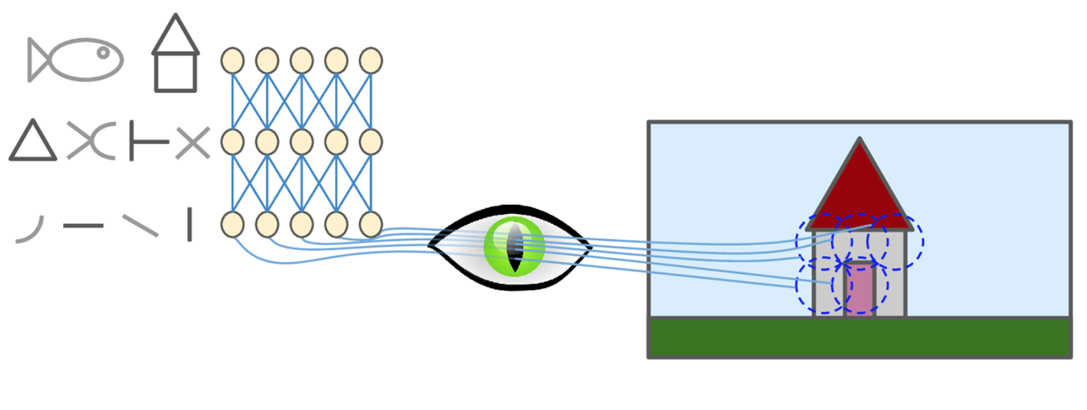
Architecture of visual cortex
Notes:
Neurons have a small local receptive field, . Moreover, the authors showed that some neurons react only to images of horizontal lines, while others react only to lines with different orientations (two neurons may have the same receptive field but react to different line orientations). They also noticed that some neurons have larger receptive fields, and they react to more complex patterns that are combinations of the lower-level patterns.

Slide 3
Why not regular DNN/ANN?
Works fine for small images
Not so for large – For ex 100 X 100 ,with 10000 features.Hidden layer with 1000 layers for ex.What is the number of combinations we are looking at?

Slide 4
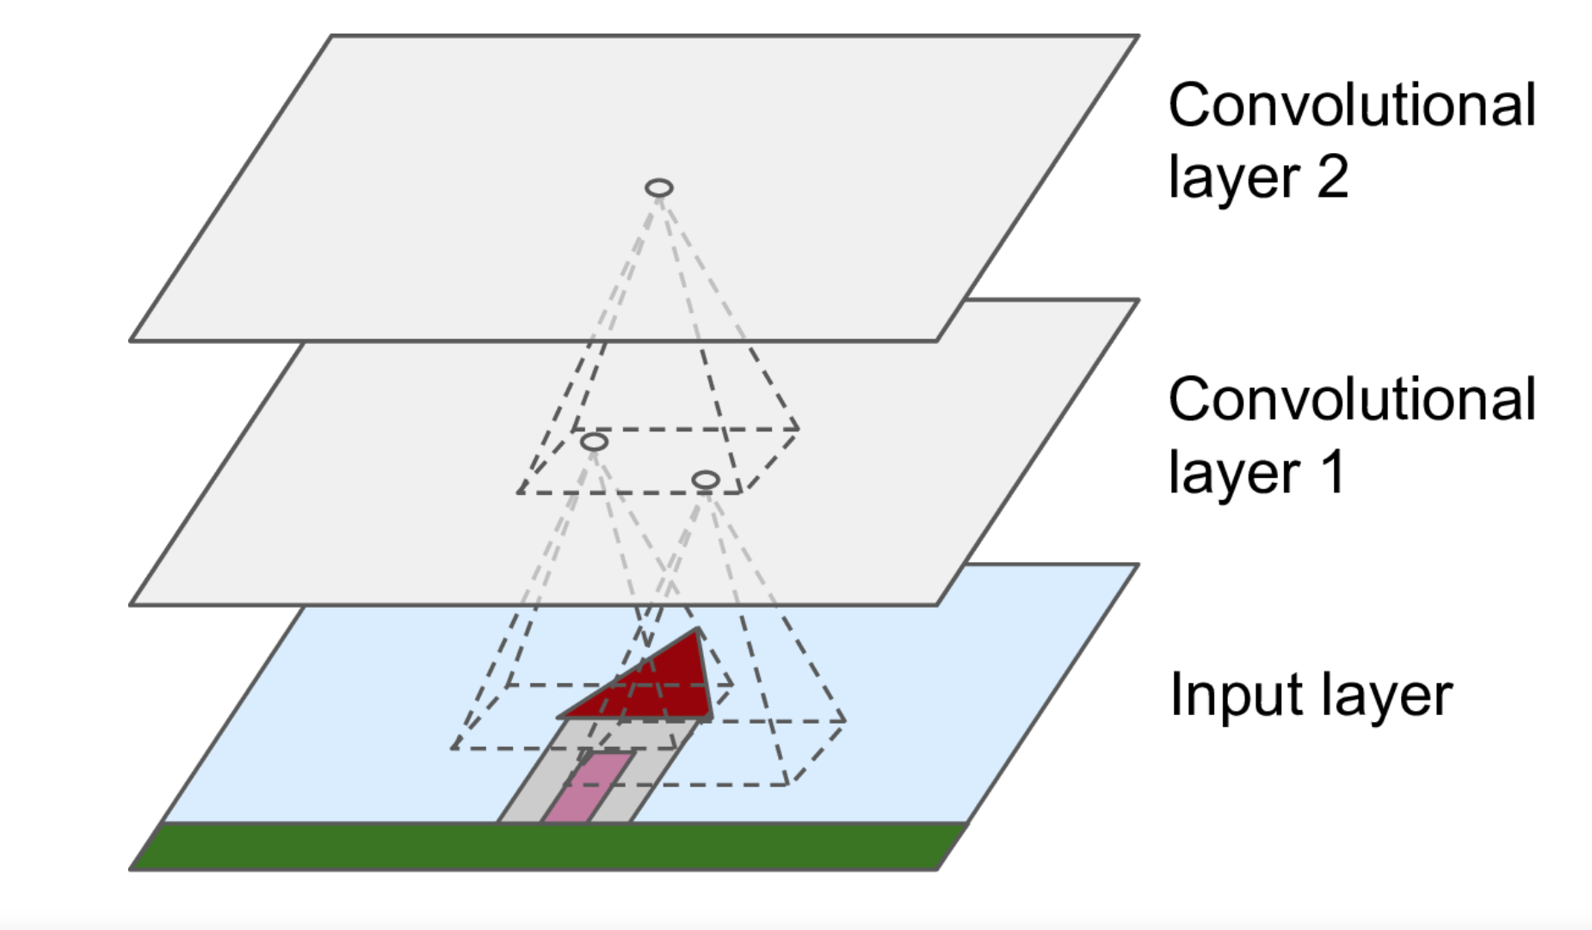
Convolutional Neural Network

Slide 5
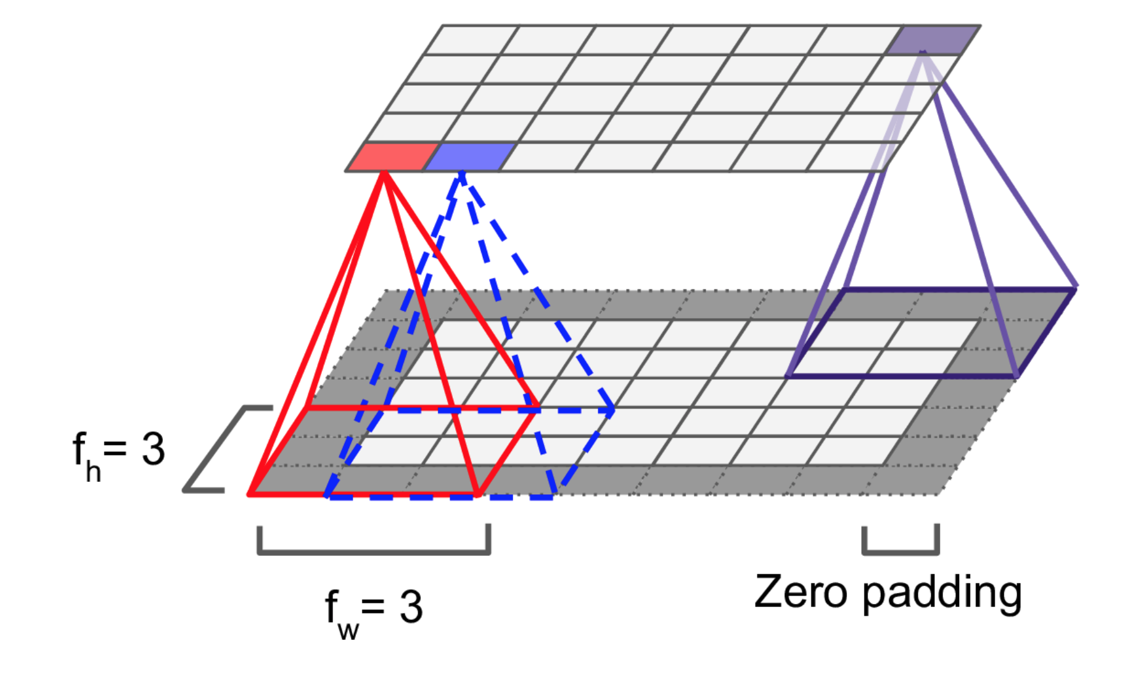
Receptive field and padding

Slide 6
How does padding help?
It's easier to design networks if you preserve height and width and don't have to worry too much about tensor dimensions when going from one layer to another because dimensions will just "work".
It allows us to design deeper networks. Without padding, reduction in volume size would reduce to quickly.
Padding actually improves performance by keeping information at the borders.

Slide 7
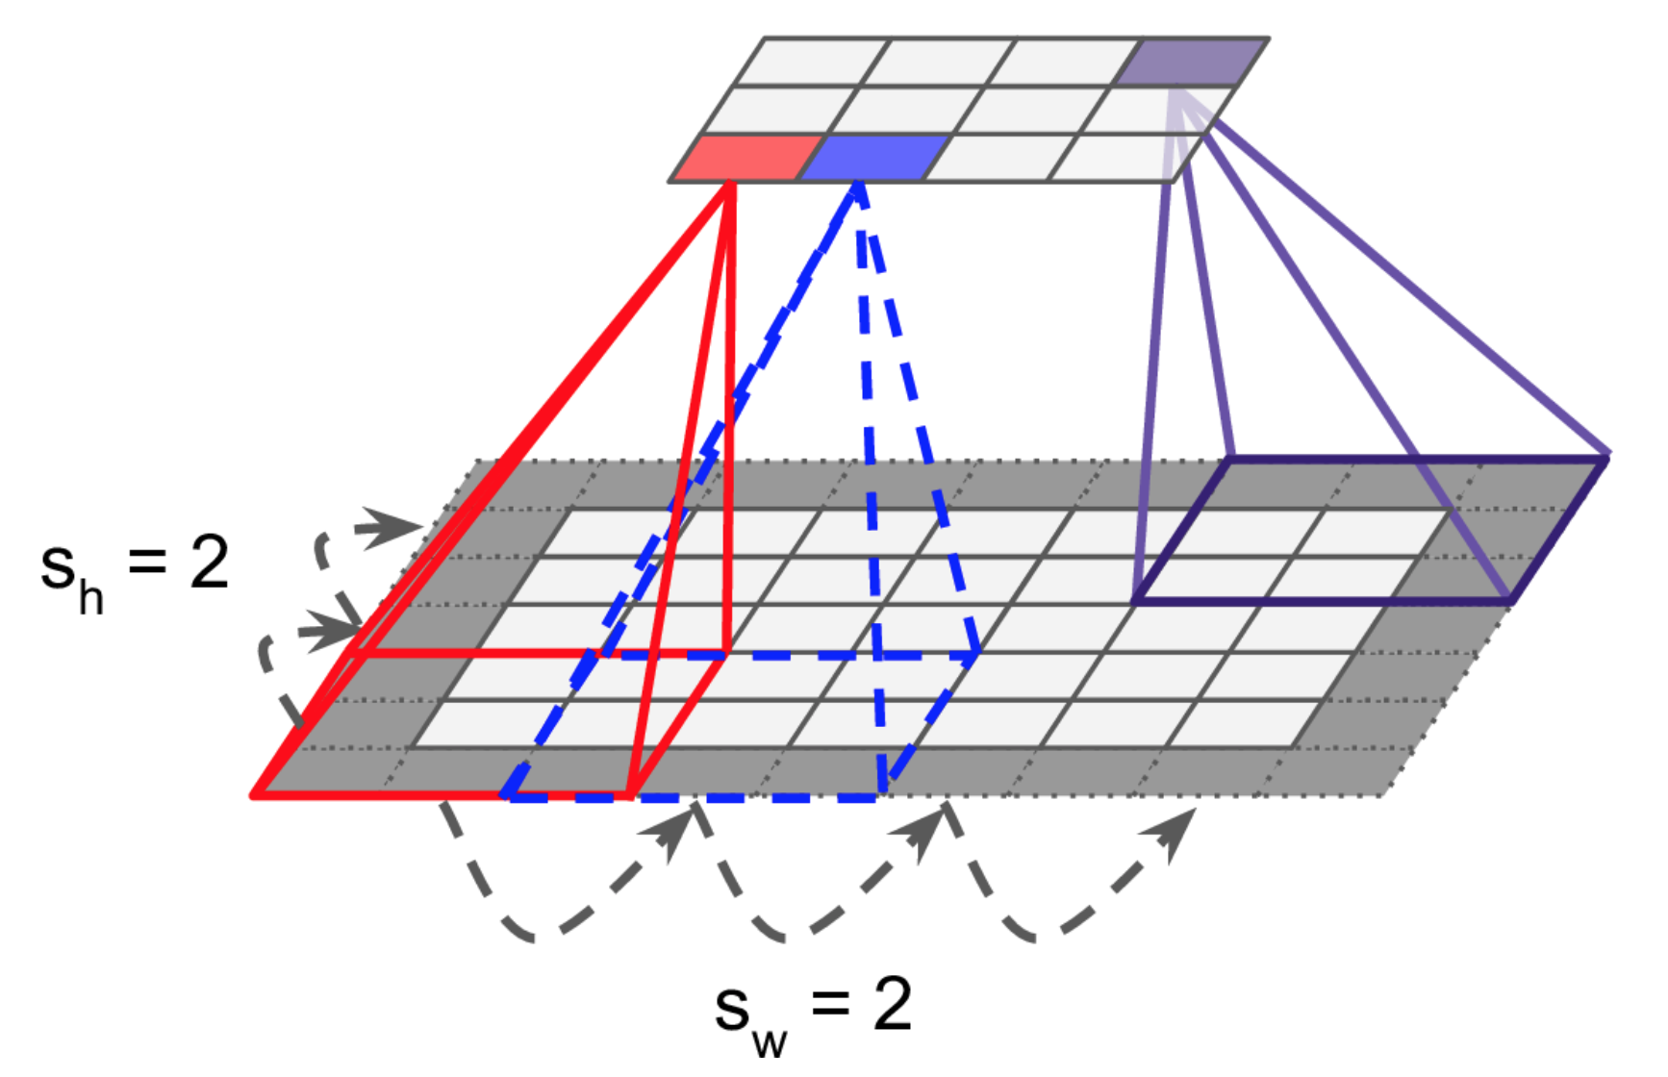
Striding

Slide 8
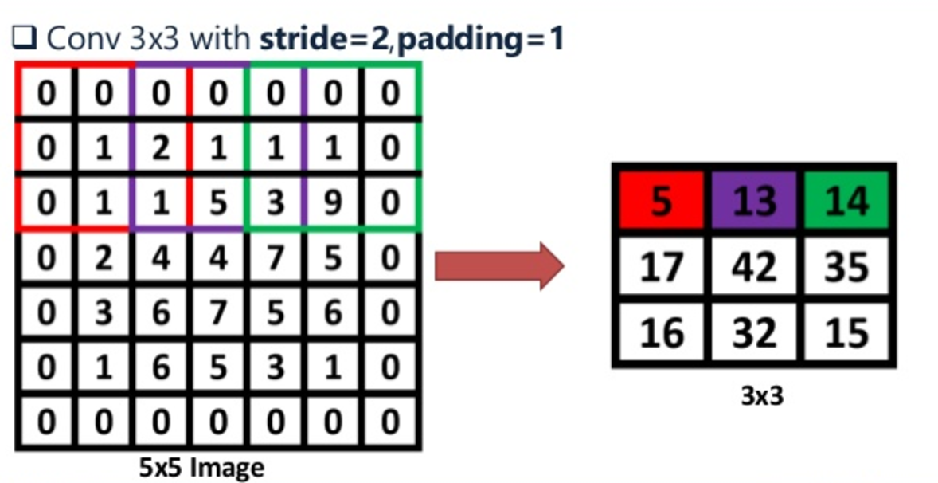
Striding

Slide 9
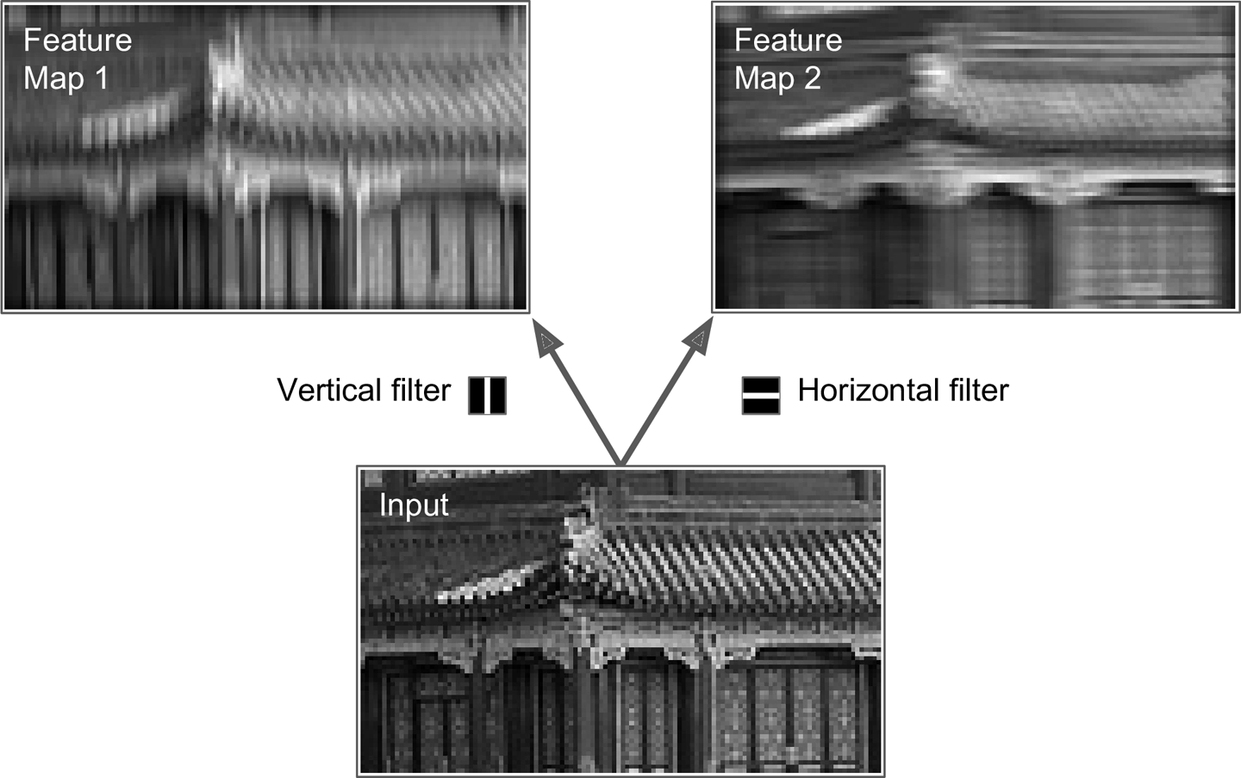
Filters
Notes:
Thus, a layer full of neurons using the same filter gives you a feature map, which highlights the areas in an image that are most similar to the filter. During training, a CNN finds the most useful filters for its task, and it learns to combine them into more complex patterns (e.g., a cross is an area in an image where both the vertical filter and the horizontal filter are active).
The first layer in a CNN is always a Convolutional Layer. First thing to make sure you remember is what the input to this conv (I’ll be using that abbreviation a lot) layer is. Like we mentioned before, the input is a 32 x 32 x 3 array of pixel values. Now, the best way to explain a conv layer is to imagine a flashlight that is shining over the top left of the image. Let’s say that the light this flashlight shines covers a 5 x 5 area. And now, let’s imagine this flashlight sliding across all the areas of the input image. In machine learning terms, this flashlight is called a filter(or sometimes referred to as a neuron or a kernel) and the region that it is shining over is called the receptive field. Now this filter is also an array of numbers (the numbers are called weights or parameters). A very important note is that the depth of this filter has to be the same as the depth of the input (this makes sure that the math works out), so the dimensions of this filter is 5 x 5 x 3. Now, let’s take the first position the filter is in for example. It would be the top left corner. As the filter is sliding, or convolving, around the input image, it is multiplying the values in the filter with the original pixel values of the image (aka computing element wise multiplications). These multiplications are all summed up (mathematically speaking, this would be 75 multiplications in total). So now you have a single number. Remember, this number is just representative of when the filter is at the top left of the image. Now, we repeat this process for every location on the input volume. (Next step would be moving the filter to the right by 1 unit, then right again by 1, and so on). Every unique location on the input volume produces a number. After sliding the filter over all the locations, you will find out that what you’re left with is a 28 x 28 x 1 array of numbers, which we call an activation map or feature map. The reason you get a 28 x 28 array is that there are 784 different locations that a 5 x 5 filter can fit on a 32 x 32 input image. These 784 numbers are mapped to a 28 x 28 array.

Slide 10
Visual Representation – Building feature map

Slide 11
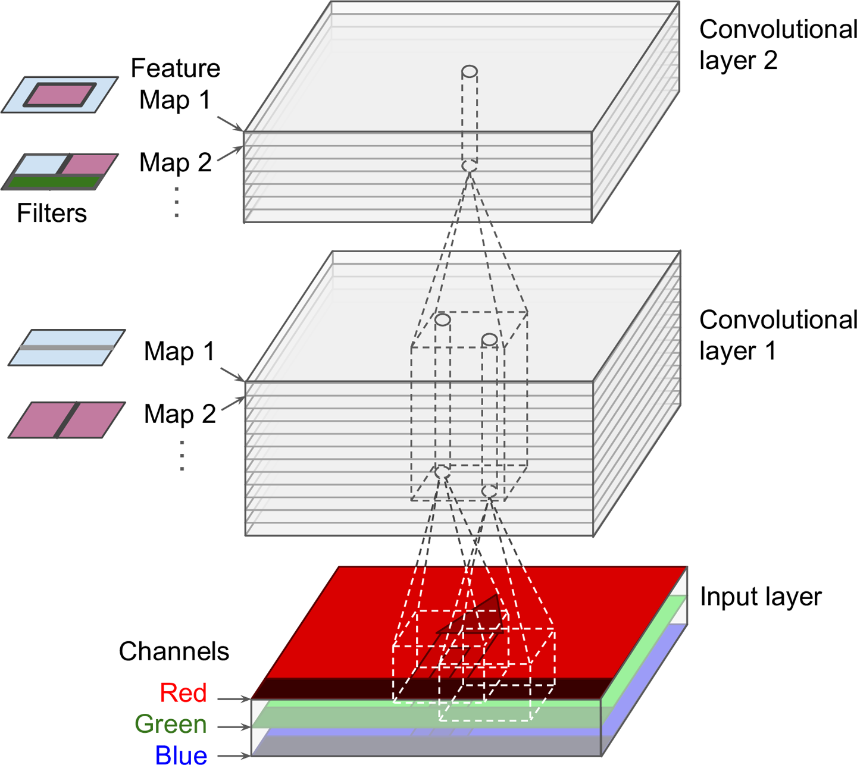
Multiple feature maps and channels

Slide 12
Visual Representation

Slide 13
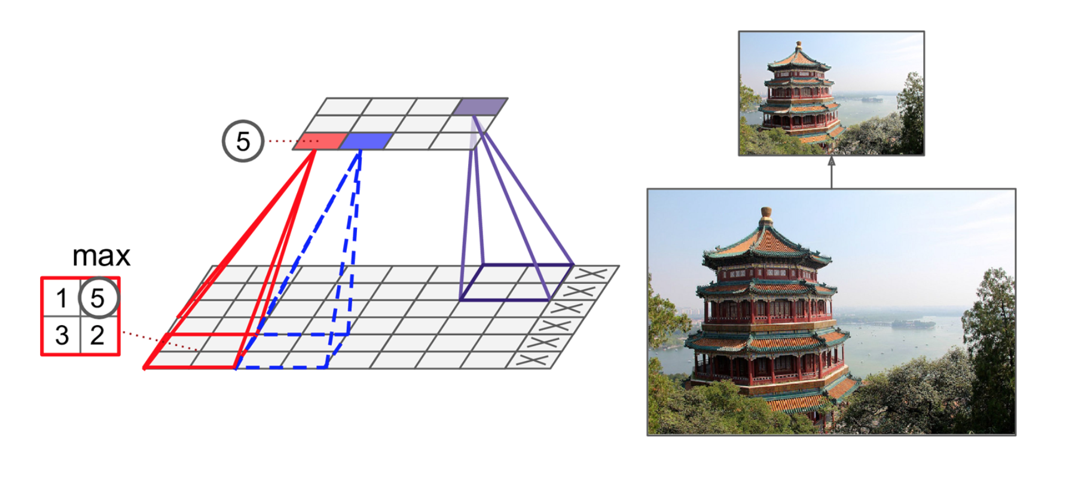
Max Pooling

Slide 14
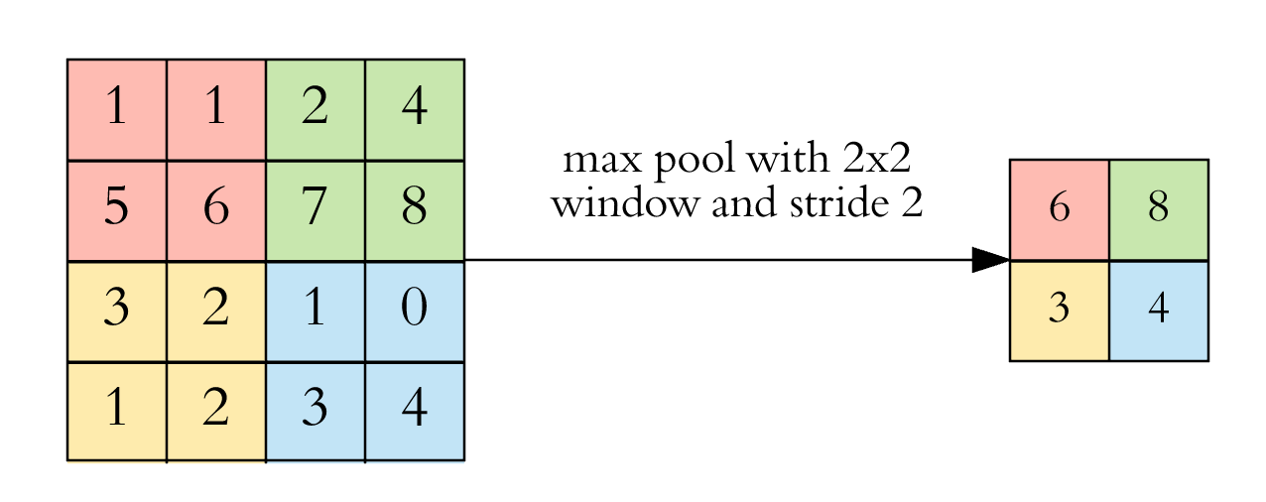
Max Pooling with a stride of 2

Slide 15
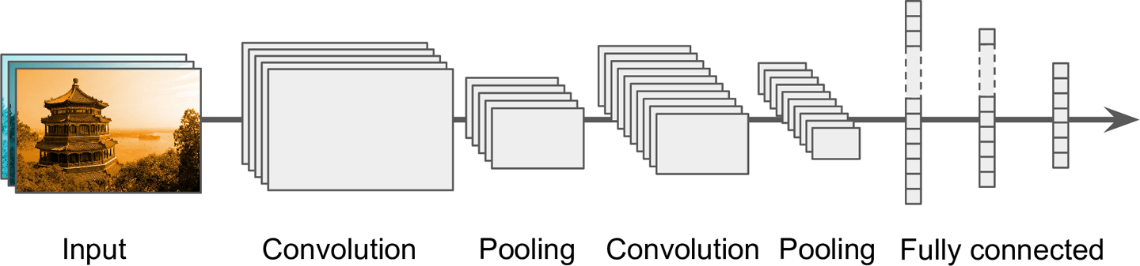
Full Architecture

Slide 16
Recent architectures that won by a significant margin in Imagenet Challenge
https://adeshpande3.github.io/adeshpande3.github.io/The-9-Deep-Learning-Papers-You-Need-To-Know-About.html
Notes:
Imagenet is a world cup of computer vision

Slide 17

Video

