Slide 1


Slide 2
Agenda
Small dose of basics
What is Tensor flow
Basic usage
Why to use it
Train, test, predict and save
Practice

Slide 3
Machine Learning
Small dose of machine learning basics

Slide 4
Frameworks and Libraries
Few frameworks
Scikit learn
TensorFlow
Caffee
MXNet
….

Slide 5
TensorFlow
Tensor is a python library used to design and develop, and train deep learning neural networks

Slide 6
Tensor
Tensors are the standard way of representing data in tensor flow
A tensor can be represented as an organized multidimensional array of numerical values

Slide 7
Tensor rank
Rank | Math Entity | Python Example
0 | Scalar (Magnitude only) | S = 483
1 | Vector (magnitude and direction) | V = [1.1, 2.2, 3.3]
2 | Matrix (table of numbers) | M = [[1,2,3],[4,5,6],[7,8,9]]
3 | 3-Tensor (cube of numbers) | T = [[[1],[2],[3]], [4],[5],[6]]]
n | N-Tensor | ----

Slide 8
Tensor datatypes
Data Type
DT_FLOAT | tf.float32
DT_DOUBLE | tf.float64
DT_INT8 | tf.int8
DT_INT16 | tf.int16
DT_INT32 | tf.int32
DT_INT64 | tf.int64
DT_UINT8 | tf.uint8
DT_STRING | tf.string
DT_BOOL | tf.bool
Notes:
Not need to assign type but use it when want to change defaults, or optimize memory

Slide 9
TensorFlow graph
In TensorFlow, computation is approached as a data graph
Add
Function
C
Matmul
Tensor
A
B
Graph
Notes:
1) Only tensors move across the gragh.

Slide 10
Tensor flow basic code
Program consist of two sections
Build a computational graph: series of tensorflow operations arranged into a graph of nodes
Run a computational graph
Notes:
Talk about session

Slide 11
Basic code demo

Slide 12
Environment setup and practice time

Slide 13
Why tensor flow
Support for providing deep level hyper parameters for machine learning algorithms
Designed for deep learning neural networks
Support GPU computing: https://youtu.be/-P28LKWTzrI
Support distributed computing

Slide 14
Linear regression code demo

Slide 15
Distributed TensorFlow
Training a large neural network on a single machine with a single CPU can take days or even weeks

Slide 16
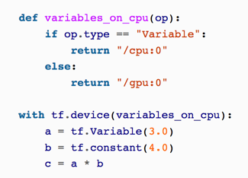
Multiple Devices on a Single Machine
major performance boost simply by adding GPU cards
train a neural network just as fast using 8 GPUs on a single machine rather than 16 GPUs across multiple machines
Placement

Slide 17
Multiple Devices on a Single Machine
TensorFlow then starts evaluating the nodes with zero dependencies
If these nodes are placed on separate devices, they obviously get evaluated in parallel. If they are placed on the same device, they get evaluated in different threads, so they may run in parallel too

Slide 18
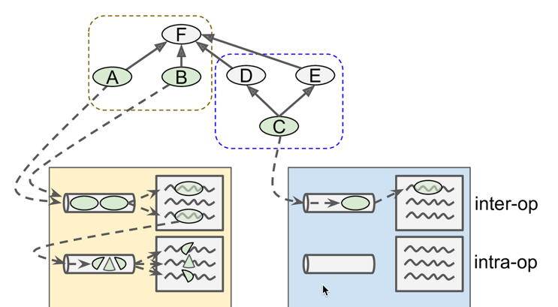
Notes:
Control dependency: We can control dependency to run sequentially. We need it in case we need to think about I/O or memory.

Slide 19
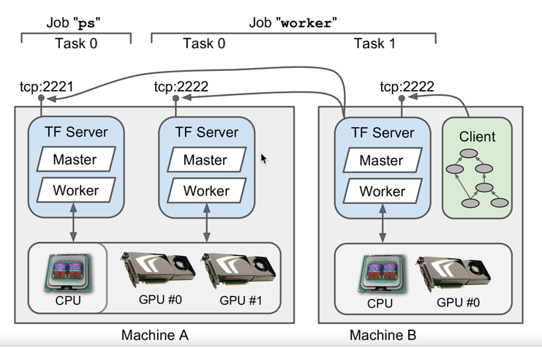
Multiple Devices Across Multiple Servers

Slide 20
Multiple Devices Across Multiple Servers
Every TensorFlow server provides two services:
the master service and
the worker service.
The master service allows clients to open sessions and use them to run graphs. It coordinates the computations across tasks, relying on the worker service to actually execute computations on other tasks and get their results.

Slide 21
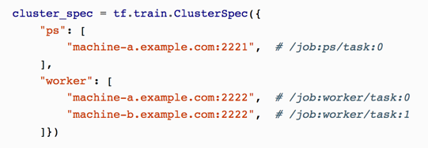
Multiple Devices Across Multiple Servers
Code snippet

Slide 22
Multiple Devices Across Multiple Servers
The client uses the gRPC protocol (Google Remote Procedure Call) to communicate with the server.
It is based on HTTP2, which opens a connection and leaves it open during the whole session, allowing efficient bidirectional communication once the connection is established.
Data is transmitted in the form of protocol buffers
Sharding Variables Across Multiple Parameter Servers

Slide 23
Asynchronous Communication Using Queues
Queues are another great way to exchange data
one common use case is to have a client create a graph that loads the training data and pushes it into a queue,
while another client creates a graph that pulls the data from the queue and trains a model
This can speed up training considerably because the training operations don’t have to wait for the next mini-batch at every step

Slide 24
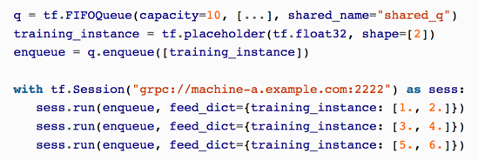
Asynchronous Communication Using Queues
simplest kind is the first-in first-out (FIFO) queue
Can enqueue one item or many items
Can dequeue one item or many items

Slide 25
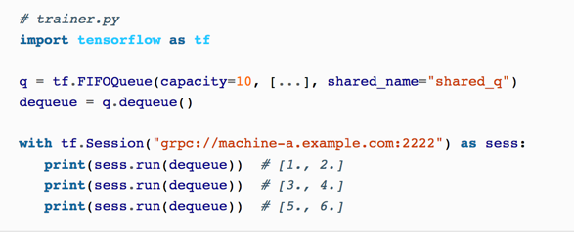
Asynchronous Communication Using Queues

Slide 26
Distributed system code demo

Slide 27
Practice time

