Slide 1
Russian Sage Perovskia atriplicifolia
John Brand
Perennial Plant Association Plant-of-the-year 1995

Slide 2
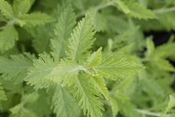
• Russian Sage is not a ‘sage’
• Member of mint family Lamiaceae
• Called ‘sage’ due to aromatic leaves
Leaves
Taxonomy

Slide 3
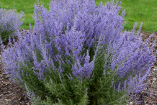
• Blooms from July to October
• Lavender-blue foliage
• Height – 3’ to 5’
• Spread – 2’ to 4’
Russian Sage Perovskia atriplicifolia
Plant description

Slide 4
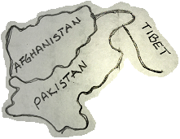
• Native to 8,000’ in central Asia
• Hardy in USDA zones 5-9
• Can grow in zone 4 with winter protection
• May persist for 10+ years
Native range
Plant description

Slide 5
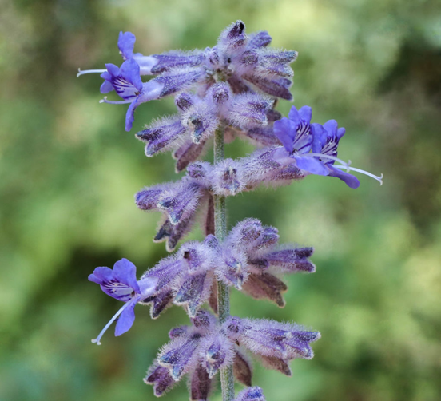
• Tolerates poor soils of varying pH
• Well drained soil essential
• Thrives in full sun
• Foliage ‘flops’ if grown in part shade
Lavender- blue foliage
Cultural needs

Slide 6
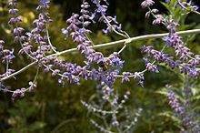
• Low maintenance perennial
• Good drought tolerance
• Dry-to-medium water requirement
Blue Spire – popular cultivar
Cultural needs

Slide 7
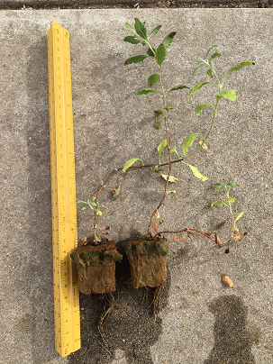
• Can be grown from seed year round
• Keep seeds moist at 60°-65° F
• Germination occurs within 1-4 months
• Can be grown from cuttings during summer
Seedlings after 4 months
Propagation

Slide 8
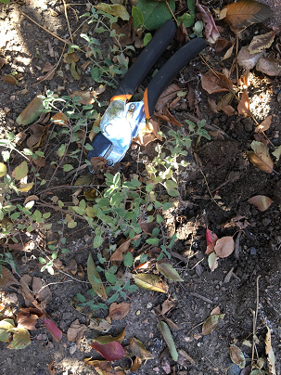
• Small plants hard to establish
• Usually grown as container plants
• Easy to grow once established
Natural germination
Propagation

Slide 9
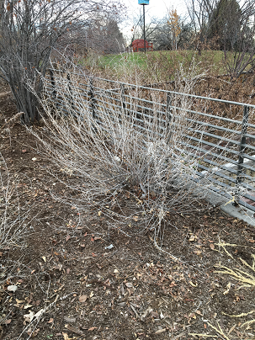
• Russian sage spreads by runners
• Divide plants every 4-6 years
• Prune 6”-8” in spring as lower buds appear
• In warm regions, deadheading gives 2nd bloom
Winter foliage
Routine care

Slide 10
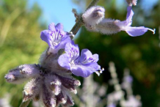
• No insect problems
• No disease problems
• Attracts bees, butterflies and other insects
Healthy foliage
Insect and disease

Slide 11
• Slow germination from seed
• Germination may be enhanced by cold treatment
• Takes a few years to flower
• Propagation through cuttings is slow
• May be easier to purchase plants from a nursery
BE PATIENT
Disadvantages, drawbacks, limitations

Slide 12
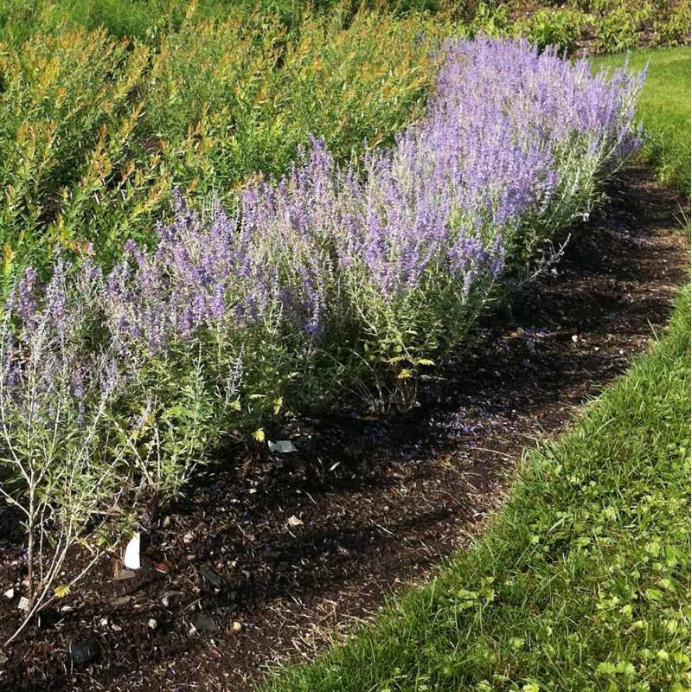
• Used as specimen plant in small spaces
• Excellent back border plant
• Complemented by ornamental grass
• Works well with whites, yellow and gray plantings
• May be deer resistant
Divider hedge
Garden uses

Slide 13
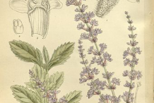
• Herbal tea can sooth stomach, control diarrhea
• Aromatic scent opens blocked airways
• Message oil stimulates circulation, warming body
• Not a culinary herb, toxic in large doses
Illustrated Russian Sage
Health benefits

Slide 14
• Marie Lannotti, How to Grow Russian Sage, 06/24/2018, thespruce.com/how-to-grow-russian-sage-1402795
• Missouri Botanical Garden, Perovskia atriplicifolia, missouribotanicalgarden.org/PlantFinderDetails.aspx?
kempercode=e540
• Susan Mahr, Russian Sage, Wisconsin Master Gardener, 08/213/2003,wimastergardener.org/files/2015/12/Perovskia_atriplicifolia.pdf
• Steven Hightower, Perovskia, University of California Master Gardener Program of Sonoma County, sonomamg.ucanr.edu/Plant_of_the_Month/Perovskia/#
References

Slide 15
• Wikipedia, The Free Encyclopedia, Perovskia atriplicifolia, perovskiaatriplicifolia,wikipedia,thefreeencyclopedia,en.
wikipedia.org/wiki/Perovskia_atriplicifolia
• Conrad Richter, Lifespan of Russian Sage, 05/31/2013,
richters.com/show.cgi?pages=QandA/Growing/20130531-
1.html, Richters Herbs, Goodwood, Ontario Canada
• Health Benefits of Russian Sage,
healthbenefitstimes.com/russian-sage/
References

Slide 16
• Melvin Payne, Melville Grosvenor, Gilbert Grosvenor, William Peele, David Cook, Jules Billard, 1975, National Geographic Atlas of the World, 4th Edition, National Geographic Society, Washington, D.C.
• herb garden, Colorado Academy, Denver, Colorado
• jfarmsboulder, Littleton, Colorado
References

