Slide 1
EXPath
A packaging system for XML libraries and a portable web application framework
XML Prague, March 13th, 2010
Florent Georges
H2O Consulting

Slide 2
EXPath
Introduction ←
Simple examples
The packaging system
Web applications
A comprehensive example
Conclusion

Slide 3
Introduction - History

Slide 4
Introduction - Scope

Slide 5
Introduction - Goals

Slide 6
Introduction - Processes

Slide 7
EXPath
Introduction
Simple examples ←
The packaging system
Web applications
A comprehensive example
Conclusion

Slide 8
Examples – HTTP Client

Slide 9
Examples – ZIP Facility

Slide 10
Examples – Google Contacts

Slide 11
EXPath
Introduction
Simple examples
The packaging system ←
Web applications
A comprehensive example
Conclusion

Slide 12
Packaging – … (see notebook)

Slide 13
EXPath
Introduction
Simple examples
The packaging system
Web applications ←
A comprehensive example
Conclusion

Slide 14
Webapps – …

Slide 15
EXPath
Introduction
Simple examples
The packaging system
Web applications
A comprehensive example ←
Conclusion

Slide 16
Freedom

Slide 17
EXPath
Introduction
Simple examples
The packaging system
Web applications
A comprehensive example
Conclusion ←

Slide 18
Conclusion

Slide 19
</ the END >

Slide 20
EXPath
A practical introduction
Introduction
The project ←
HTTP Client
ZIP facility
Packaging
Putting it all together
Sibling projects

Slide 21
Introduction
More and more demand for extensions for XSLT 2.0 and XQuery for one year
Extension functions are the easiest way
They are at the XPath level
Acting at the XPath level allows them to be used in another languages
XProc is a good example of such another language (EXProc defines also extensions for a few months)

Slide 22
The project
Collaborative
The base delivery unit is the module
The main deliverable is the specification
Each module has its own maintainer
Implementations as external extensions are encouraged during specification
Independent on any particular vendor
...though they are welcome, of course ;-)

Slide 23
The project
Extension functions libraries
But also:
  Testing framework (based on Jeni's XSpec?)
  Documentation system (based on Ken's XSLStyle?)
  General-purpose packaging system
  Help identifying best practices
  Servlet-like container
  ...

Slide 24
EXPath
A practical introduction
Introduction
The project
HTTP Client ←
ZIP facility
Packaging
Putting it all together
Sibling projects

Slide 25
HTTP Client
Send HTTP requests and handle responses
Based on the XProc step p:http-request
Enable one to:
  Retrieve plain resources on the web
  Query REST-based Web sevices
  Query SOAP-based Web services
  Query Google services

Slide 26
HTTP Client
http:send-request($request as element(http:request)) as item()+

Slide 27
HTTP Client
http:send-request($request as element(http:request)) as item()+
<http:request href="http://www.example.com/..." method="post">
<http:header name="X-Header" value="some value"/>
<http:body content-type="application/xml">
<hello>World!</hello>
</http:body>
</http:request>

Slide 28
HTTP Client
http:send-request($request as element(http:request)) as item()+
<http:request href="http://www.example.com/..." method="post">
<http:header name="X-Header" value="some value"/>
<http:body content-type="application/xml">
<hello>World!</hello>
</http:body>
</http:request>
<http:response status="200" message="Ok">
<http:header name="..." value="..."/>
...
<http:body content-type="application/xml"/>
</http:response>

Slide 29
HTTP Client
http:send-request(
<http:request href="http://www.balisage.net/" method="get"/>)
↘
(
?
)

Slide 30
HTTP Client
http:send-request(
<http:request href="http://www.balisage.net/" method="get"/>)
↘
(
<http:response status="200" message="OK">
<http:header name="Server" value="Apache/1.3.41 (Unix) ..."/>
...
<http:body content-type="text/html"/>
</http:response>
,
?
)

Slide 31
HTTP Client
http:send-request(
<http:request href="http://www.balisage.net/" method="get"/>)
↘
(
<http:response status="200" message="OK">
<http:header name="Server" value="Apache/1.3.41 (Unix) ..."/>
...
<http:body content-type="text/html"/>
</http:response>
,
<html xmlns="http://www.w3.org/1999/xhtml">
<head>
<title>Balisage: The Markup Conference</title>
...
)

Slide 32
HTTP Client
Live samples:
  XQuery with Saxon, MarkLogic and eXist
  Google's GData API
  WSDL Compiler
Notes:
TODO: Package the WSDL compiler and prepare a sample

Slide 33
EXPath
A practical introduction
Introduction
The project
HTTP Client
ZIP facility ←
Packaging
Putting it all together
Sibling projects

Slide 34
ZIP facility
Read and write ZIP files
  List all entries
  Extract specific entries
  Update existing entries
  Create brand-new ZIP files
Well suited for XML + ZIP documents (OpenDocument, Open XML, EPUB, etc.)

Slide 35
ZIP facility
List entries:
  zip:entries($href) as element(zip:file)
Extract entries:
  zip:xml-entry($href, $path) as document-node()
  zip:html-entry($href, $path) as document-node()
  zip:text-entry($href, $path) as xs:string
  zip:binary-entry($href, $path) as xs:base64Binary
Create new ZIP files:
  zip:zip-file($zip) as empty()
  zip:update-entries($zip, $output) as empty()

Slide 36
ZIP facility
<zip:file href="some.zip" xmlns:zip="http://www.expath.org/mod/zip">
<zip:entry name="file.xml" output="xml">
<hello>World!</hello>
</zip:entry>
<zip:entry name="index.html" output="html" href="/some/file.html"/>
<zip:dir name="dir">
<zip:entry name="file.txt" output="text">
Hello, world!
</zip:entry>
</zip:dir>
</zip:file>

Slide 37
ZIP facility
Live samples:
  List entries in a ZIP file
  Extract an XML entry
  Create a new file

Slide 38
ZIP facility
“Compound Document Template” pattern
Create a new ZIP file by copying an existing one, updating and adding some entries
For instance, you can edit a text document directly within OpenOffice, and use it as a template to format an input data document

Slide 39
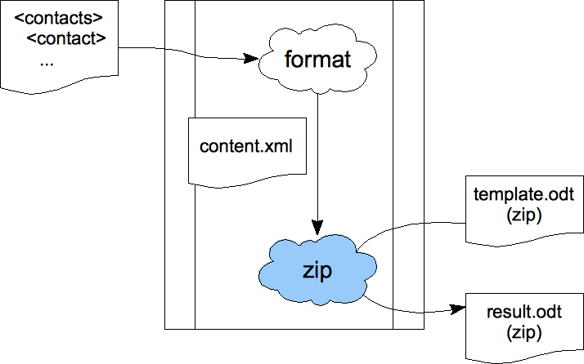
ZIP facility

Slide 40
EXPath
A practical introduction
Introduction
The project
HTTP Client
ZIP facility
Packaging ←
Putting it all together
Sibling projects

Slide 41
Packaging
Support XSLT, XQuery and XProc
Can be extended for other X* technologies
Independent on the processor for std X* files
Allow processor-dependent features (i.e. for Java extension functions)
Support only deploying libraries
Can be used as a building block for more complex frameworks, like XRX
Notes:
I have packaged:
- FXSL
- FunctX
- DocBook
- DITA Open Toolkot
- XSLStyle
- Google XSLT
- …
Should be extended for XML Schema
(for instance for XML databases, IDEs, XSLT 2.0)

Slide 42
Packaging
Deployment descriptor:
<package xmlns="http://expath.org/mod/expath-pkg">
<module version="0.1" name="google-xslt">
<title>Simple XQuery package for tests</title>
<xsl>
<import-uri>http://www.fgeorges.org/google/gdata.xsl</import-uri>
<file>xsl/gdata.xsl</file>
</xsl>
...
</module>
</package>

Slide 43
Packaging
Example of use:
<xsl:stylesheet xmlns:f="http://fxsl.sf.net/" version="2.0">
<xsl:import href="http://fxsl.sf.net/f/func-Fibonacci.xsl"/>
<xsl:template match="/" name="main">
<fibo>
<xsl:value-of select="f:fibo(10)"/>
</fibo>
</xsl:template>
</xsl:stylesheet>

Slide 44
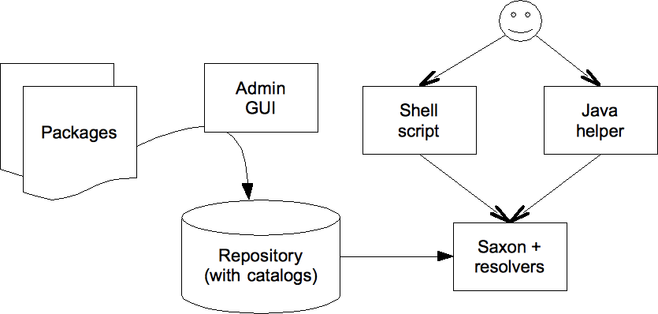
Packaging

Slide 45
Packaging
Examples:
  Deploy XSLT and XQuery for Saxon
  Deploy Java extensions for Saxon
  Deploy XQuery for eXist
  Deploy Java extensions for eXist

Slide 46
Packaging
For now, use an external application to deploy
Limited to the processor's mechanism to resolve URIs
For some processors, not possible to deploy without changing importing stylesheets/queries
Ideal situation: supported natively by a broad number of processors
Is a support for other frameworks, and CXAN

Slide 47
Packaging
In XSLT
<!-- the public and absolute import URI -->
<xsl:import href="http://www.expath.org/mod/http-client.xsl"/>
In XQuery? There is no convention.
import module namespace
http = "http://www.expath.org/mod/http-client"
at "http://www.expath.org/mod/http-client.xq";
- versus -
import module namespace
http = "http://www.expath.org/mod/http-client";

Slide 48
EXPath
A practical introduction
Introduction
The project
HTTP Client
ZIP facility
Packaging
Putting it all together ←
Sibling projects

Slide 49
Putting it all together
Use the HTTP Client to access various Google APIs (REST Web services): contacts, maps, ...
Use ZIP facility and the Compound Document Template pattern
All those libraries are accessed through the Packaging System

Slide 50
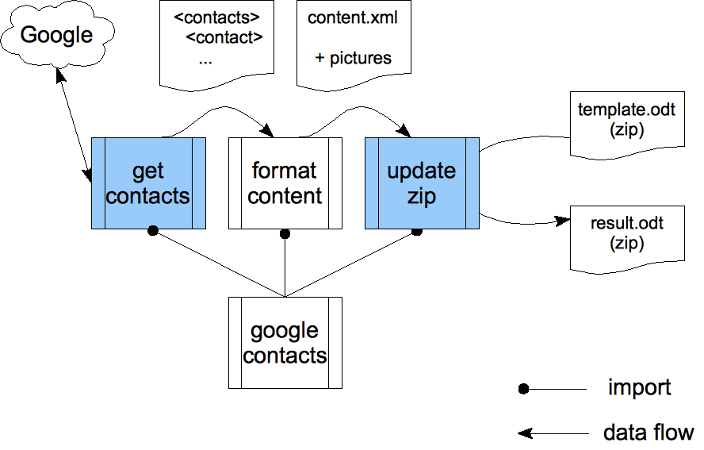
Putting it all together

Slide 51
EXPath
A practical introduction
Introduction
The project
HTTP Client
ZIP facility
Packaging
Putting it all together
Sibling projects ←

Slide 52
Sibling projects
EXQuery, EXSLT 2.0, and EXProc
Where's the border?
  EXPath Packaging system
  Servlet-like container definition
  Full XRX container definition

Slide 53
That's all Folks!
Plenty of other potential extensions
More low-level and general-purpose: nested sequences and first-class function items
Join the mailing list and browse the website:
http://www.expath.org/

Slide 54


