Slide 1
EXPath Packaging
A framework to package libraries and applications for core XML technologies
Balisage, August 4th, 2010
Montréal
Florent Georges
H2O Consulting

Slide 2
EXPath Packaging
Introduction ←
The problem
How to use it?
Write a package
A project structure
Going further
Conclusion

Slide 3
Introduction - History
EXSLT for XSLT 1.0
XSLT 2.0 and needs for new extensions
EXSLT 2.0, EXQuery & EXProc
XML Prague 2009 – EXPath
First modules – HTTP Client & ZIP Facility
Summer 2009 – the Packaging System
2010 – the Webapp module

Slide 4
Introduction - Goals
Collaboratively defining open standards for portable XPath extensions
The main means is extension functions
The main goal is defining portable specifications...
...and convincing vendors to endorse them
But also providing support to open-source implementations

Slide 5
Introduction - Processes
More or less formal, more or less informal (that is a feature, not a bug)
The definitive goal is writing specifications
The main tool is the mailing list
Each module has one main maintainer, responsible of editing & achieving consensus
More infos about processes on the wiki

Slide 6
EXPath Packaging
Introduction
The problem ←
How to use it?
Write a package
A project structure
Going further
Conclusion

Slide 7
The import problem
The way to import a module is dependent on the processor
XSLT import URI
XQuery evil: location hint
For now, there is no standard way to import a module in XSLT, XQuery nor XProc
No other modern programming language as this limitation

Slide 8
The import problem
(: in Saxon :)
import module namespace functx = "http://www.functx.com"
at "../../../../../../xlibs/functx/src/functx.xq";
declare function local:hello($who as xs:string) as xs:string
{
concat('Hello, ', functx:capitalize-first($who), '!')
};
...
(: in eXist :)
import module namespace functx = "http://www.functx.com"
at "xmldb:exist:///db/modules/functx.xq";
...

Slide 9
The import problem
The ideal solution would be to get rid of the location hint, and see the import URI as a name
(: portable :)
import module namespace functx = "http://www.functx.com";
declare function local:hello($who as xs:string) as xs:string
{
concat('Hello, ', functx:capitalize-first($who), '!')
};
...
Achievable somehow through XML Catalogs, but the install process is not uniform and thus even more painful for the user

Slide 10
XML Catalogs
XML Catalogs are in the correct direction, but need automatization
Both for the final user and for the author
The solution needs to be used consistently, XML Catalogs does not give enough info
Even when a catalog is shipped with a library, it needs advanced config in order to work
And there is no standard release structure
URI resolving is only part of the solution

Slide 11
EXPath Packaging
Introduction
The problem
How to use it? ←
Write a package
A project structure
Going further
Conclusion

Slide 12
How to use it?
A library user has two things to do:
  install the package, using an automatic installer
  import it and use it, of course, by simply using the pubic URI
Installers can be command line tools, or a web form, or whatever is provided by the processor
By using the public URIs (and only the public URIs), the written code is portable across different processors

Slide 13
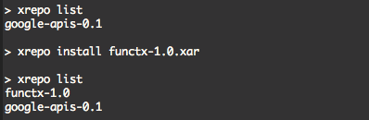
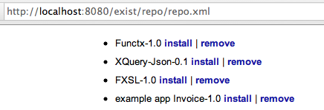
Installers
Command-line tool:
eXist's web-based install:

Slide 14
Import modules
Going back to our example:
(: portable :)
import module namespace functx = "http://www.functx.com";
declare function local:hello($who as xs:string) as xs:string
{
concat('Hello, ', functx:capitalize-first($who), '!')
};
...
It is now portable across processors, without imposing any configuration burden on the user

Slide 15
EXPath Packaging
Introduction
The problem
How to use it?
Write a package ←
A project structure
Going further
Conclusion

Slide 16
Requirements
Building upon and going behind XML Catalogs, a packaging format must:
  describe what is needed but is not in the X* specifications
  be understood by most processors
  package the components and additional informations in a single file
  be eXtensible (to allow other specs to build upon it, and allow processor specific infos)
Installation process can then be automated

Slide 17
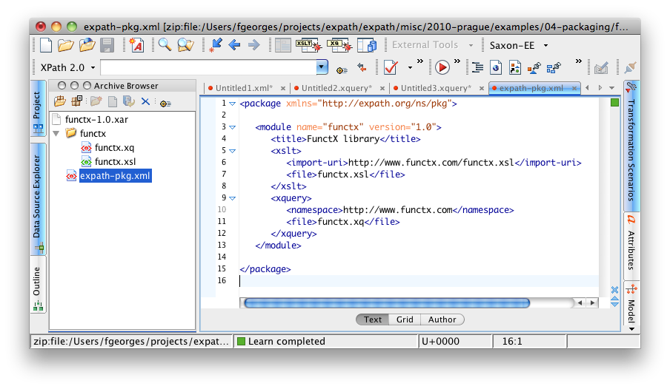
Overview

Slide 18
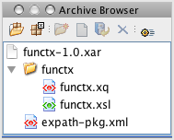
Structure
A package is a ZIP file
It contains exactly one subdirectory (content)
It contains a package descriptor: expath-pkg.xml
It can contain per-processor descriptors
It can contain descriptors for other specs

Slide 19
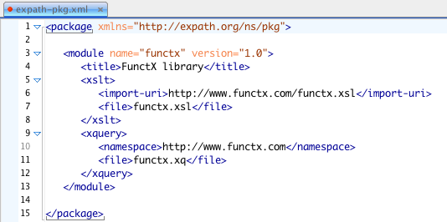
The descriptor
Record some meta infos about the package
Record the content component's public URIs

Slide 20
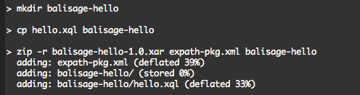
Putting it together
The components and the descriptor are just zipped together to make the XAR package
The XAR file must respect the structure described in the descriptor
Any ZIP tool can be used to achieve this goal

Slide 21
Standard repository layout
How packages are installed is implementation-dependent
The spec defines an optional repository layout
If the implementation adopts this layout, it can share repositories with others
Management tools in the command line have been built to manage such repositories (install, remove, list packages)
A Java library exists for the URI resolution

Slide 22
EXPath Packaging
Introduction
The problem
How to use it?
Write a package
A project structure ←
Going further
Conclusion

Slide 23
Too much for me!
That's fine, but as a library author, that seems a lot of work to do again and again
Besides, most of the steps are similar every time
Creating new libraries usually involve copying and pasting Makefiles or other build files, and adapting them, over and over again
By using some conventions, we can actually automate those repetitive tasks

Slide 24
Project?
Following a consistent structure, a project can be built automatically
This structure use naming conventions for directories
As well as a project descriptor for meta data (title, version, etc.)
The public URIs are maintained within the components themselves
An XSLT stylesheet packages the project

Slide 25

Project!
The basic project structure has a build/ directory with a project file, and a src/ directory with the project source files

Slide 26
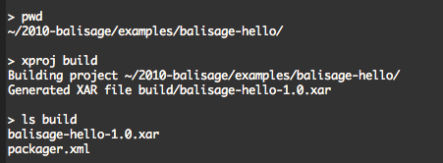
xproj
A simple script wraps the stylesheet invocation
You call it from the project directory to build the project package:

Slide 27
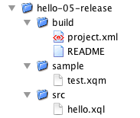
Releasing
Why did we put the test file outside the project? Let's include it.
And let's put a nice README file
Can we create automatically a proper release?

Slide 28
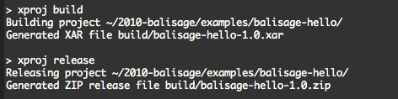
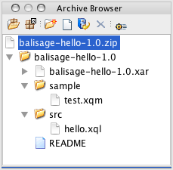
xproj, relaunched

Slide 29
(let's make it clear)
Before going further, let's make it clear this project structure stuff is already behind the packaging system itself
It is useful, or even crucial, for the user experience
But it is behind the packaging spec
The spec is the minimal common piece to conform to
Tools and specs can then be built upon it

Slide 30
EXPath Packaging
Introduction
The problem
How to use it?
Write a package
A project structure
Going further ←
Conclusion

Slide 31
Repository functions
A set of functions to manage a package repository directly from within XPath expression
Not part of the spec (but could be in a v.Next)
This is the approach followed by eXist:
  repo:list() as xs:string*
  repo:install($href as xs:string) as xs:boolean
  repo:remove($name as xs:string) as xs:boolean
Could be used to build convenient managers, not dependent on the processor

Slide 32
CXAN
http://cxan.org/
Comprehensive XML Archive Network
Follow the same principle as well-known CPAN for Perl and CTAN for (La)TeX
Work in progress
Collect existing packages
Make them accessible and searchable from a single one location

Slide 33
CXAN
CXAN is composed of:
  the package base set on the server
  the website to browse and search within this package set
  a command line tool to install packages by downloading them directly from the server

Slide 34

CXAN
Some challenges are still to solve:
  versioning
  dependencies between packages
  website interface

Slide 35
Webapps
Using X* technologies end-to-end for web applications
Most existing XML databases provide proprietary framework for that (eXist, MarkLogic, Sausalito, etc.)
Then again, we are stuck with processor-locked applications
A standard would allow to write portable web applications, libraries and frameworks

Slide 36
Request / response
<web:request servlet="name" path="/path" method="get">
<web:uri>http://example.org/my-app/path/one?p=v</web:uri>
<web:authority>http://example.org</web:authority>
<web:context-root>/my-app</web:context-root>
<web:path>
<web:part>path/</web:part>
<web:match name="which">one</web:match>
</web:path>
<web:param name="p" value="v"/>
<web:header name="connection" value="keep-alive"/>
...
</web:request>
<web:response status="200" message="Ok">
<web:header name="..." value="..."/>
...
<web:body content-type="text/html" method="xhtml"/>
</http:response>

Slide 37
Entry point
Either a:
  XQuery function
  main XQuery module
  XSLT function
  XSLT named template
  XSLT stylesheet
  XProc pipeline
Must accept two parameters
  the request element
  the sequence of bodies (possibly empty)

Slide 38
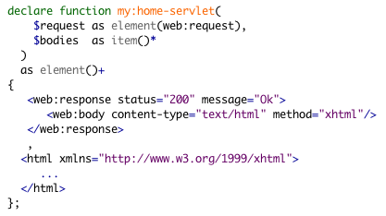
Entry point

Slide 39
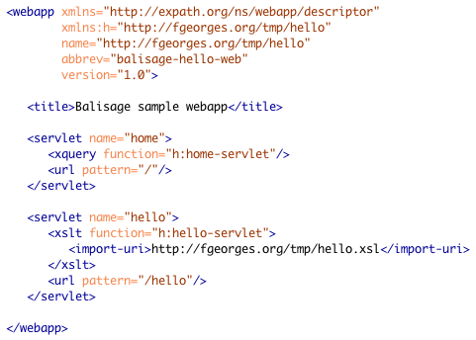
Web descriptor
Map requests to entry points
Based on URI matching

Slide 40
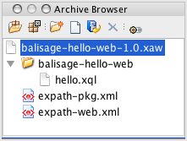
Packaging
A webapp is packaged as any standard project
The web descriptor is inserted next to the package descriptor
All the resolution mechanism is already there

Slide 41
Building block
Once again, the webapp spec follow the same principle than packaging: defining only the strict minimum low-level mapping between an HTTP request and an X* component (and its response back to HTTP)

Slide 42
EXPath Packaging
Introduction
The problem
How to use it?
Write a package
A project structure
Going further
Conclusion ←

Slide 43

Join the mailing list and browse the website:
http://expath.org/

Slide 44


