Slide 1
EXPath
A practical introduction
Balisage, August 13th, 2009
Florent Georges
fgeorges.org

Slide 2
EXPath
A practical introduction
Introduction ←
The project
HTTP Client
ZIP facility
Packaging
Putting it all together
Sibling projects

Slide 3
Introduction
XPath is a textual language to navigate XDM trees
It is used standalone or embedded in XSLT, XQuery, XProc, XForms, and other languages
A recommendation defines a standard library of functions
An implementation or host language can provide additional functions: the extension functions

Slide 4
Introduction
More and more demand for extensions for XSLT 2.0 and XQuery for one year
Extension functions are the easiest way
They are at the XPath level
Acting at the XPath level allows them to be used in another languages
XProc is a good example of such another language (EXProc defines also extensions for a few months)

Slide 5
Introduction
S
S

Slide 6
EXPath
A practical introduction
Introduction
The project ←
HTTP Client
ZIP facility
Packaging
Putting it all together
Sibling projects

Slide 7
The project

Slide 8
The project

Slide 9
EXPath
A practical introduction
Introduction
The project
HTTP Client ←
ZIP facility
Packaging
Putting it all together
Sibling projects

Slide 10
HTTP Client
Send HTTP requests and handle responses
Based on the XProc step p:http-request
Enable one to:
  Retrieve plain resources on the web
  Query REST-based Web sevices
  Query SOAP-based Web services
  Query Google services

Slide 11
HTTP Client
http:send-request($request as element(http:request)) as item()+
<http:request href="http://www.example.com/..." method="post">
<http:header name="X-Header" value="some value"/>
<http:body content-type="application/xml">
<hello>World!</hello>
</http:body>
</http:request>
<http:response status="200" message="Ok">
<http:header name="..." value="..."/>
...
<http:body content-type="application/xml"/>
</http:response>

Slide 12
HTTP Client
http:send-request(
<http:request href="http://www.balisage.net/" method="get"/>)
↘
(
<http:response status="200" message="OK">
<http:header name="Server" value="Apache/1.3.41 (Unix) ..."/>
...
<http:body content-type="text/html"/>
</http:response>
,
<html xmlns="http://www.w3.org/1999/xhtml">
<head>
<title>Balisage: The Markup Conference</title>
...
)

Slide 13
HTTP Client
Live samples:
  XQuery with Saxon, MarkLogic and eXist
  Google's GData API
  WSDL Compiler
Notes:
TODO: Package the WSDL compiler and prepare a sample

Slide 14
EXPath
A practical introduction
Introduction
The project
HTTP Client
ZIP facility ←
Packaging
Putting it all together
Sibling projects

Slide 15
ZIP facility
Read and write ZIP files
  List all entries
  Extract specific entries
  Update existing entries
  Create brand-new ZIP files
Well suited for XML + ZIP documents (OpenDocument, Open XML, EPUB, etc.)

Slide 16
ZIP facility
List entries:
  zip:entries($href) as element(zip:file)
Extract entries:
  zip:xml-entry($href, $path) as document-node()
  zip:html-entry($href, $path) as document-node()
  zip:text-entry($href, $path) as xs:string
  zip:binary-entry($href, $path) as xs:base64Binary
Create new ZIP files:
  zip:zip-file($zip) as empty()
  zip:update-entries($zip, $output) as empty()

Slide 17
ZIP facility
<zip:file href="some.zip" xmlns:zip="http://www.expath.org/mod/zip">
<zip:entry name="file.xml" output="xml">
<hello>World!</hello>
</zip:entry>
<zip:entry name="index.html" output="html" href="/some/file.html"/>
<zip:entry name="dir">
<zip:entry name="file.txt" output="text">
Hello, world!
</zip:entry>
</zip:entry>
</zip:file>

Slide 18
ZIP facility
Live samples:
  List entries in a ZIP file
  Extract an XML entry
  Create a new file

Slide 19
ZIP facility
“Compound Document Template” pattern
Create a new ZIP file by copying an existing one, updating and adding some entries
For instance, you can edit a text document directly within OpenOffice, and use it as a template to format an input data document

Slide 20
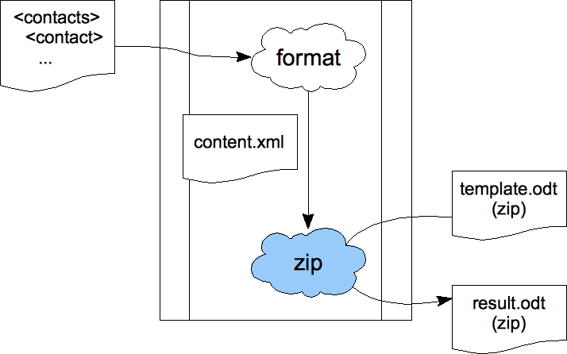
ZIP facility

Slide 21
EXPath
A practical introduction
Introduction
The project
HTTP Client
ZIP facility
Packaging ←
Putting it all together
Sibling projects

Slide 22
Packaging
Support XSLT, XQuery and XProc
Can be extended for other X* technologies
Independent on the processor for std X* files
Allow processor-dependent features (i.e. for Java extension functions)
Support only deploying libraries
Can be used as a building block for more complex frameworks, like XRX
Notes:
I have packaged:
- FXSL
- FunctX
- DocBook
- DITA Open Toolkot
- XSLStyle
- Google XSLT
- …
Should be extended for XML Schema
(for instance for XML databases, IDEs, XSLT 2.0)

Slide 23
Packaging
Deployment descriptor:
<package xmlns="http://expath.org/mod/expath-pkg">
<module version="0.1" name="google-xslt">
<title>Simple XQuery package for tests</title>
<xsl>
<import-uri>http://www.fgeorges.org/google/gdata.xsl</import-uri>
<file>xsl/gdata.xsl</file>
</xsl>
...
</module>
</package>

Slide 24
Packaging
Example of use:
<xsl:stylesheet xmlns:f="http://fxsl.sf.net/" version="2.0">
<xsl:import href="http://fxsl.sf.net/f/func-Fibonacci.xsl"/>
<xsl:template match="/" name="main">
<fibo>
<xsl:value-of select="f:fibo(10)"/>
</fibo>
</xsl:template>
</xsl:stylesheet>

Slide 25
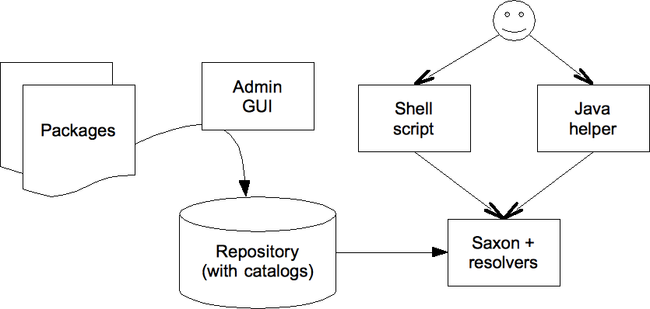
Packaging

Slide 26
Packaging
Examples:
  Deploy XSLT and XQuery for Saxon
  Deploy Java extensions for Saxon
  Deploy XQuery for eXist
  Deploy Java extensions for eXist

Slide 27
Packaging
For now, use an external application to deploy
Limited to the processor's mechanism to resolve URIs
For some processors, not possible to deploy without changing importing stylesheets/queries
Ideal situation: supported natively by a broad number of processors
Is a support for other frameworks, and CXAN

Slide 28
EXPath
A practical introduction
Introduction
The project
HTTP Client
ZIP facility
Packaging
Putting it all together ←
Sibling projects

Slide 29
Putting it all together
Use the HTTP Client to access various Google APIs (REST Web services): contacts, maps, ...
Use ZIP facility and the Compound Document Template pattern
All those libraries are accessed through the Packaging System

Slide 30
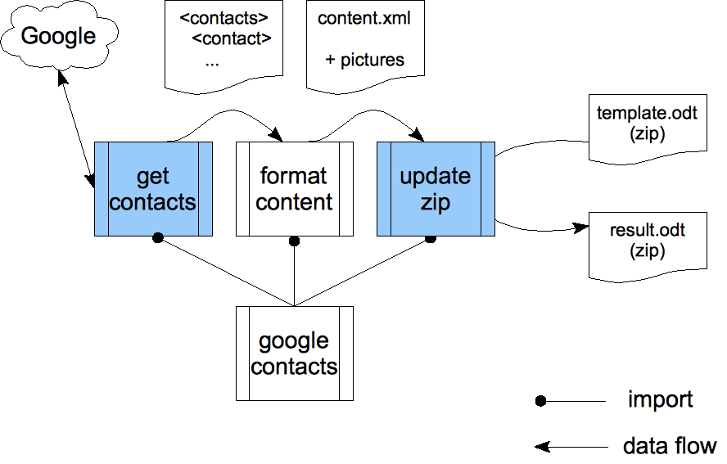
Putting it all together

Slide 31
EXPath
A practical introduction
Introduction
The project
HTTP Client
ZIP facility
Packaging
Putting it all together
Sibling projects ←

Slide 32
Sibling projects
EXQuery, EXSLT 2.0, and EXProc
Where's the border?
  EXPath Packaging system
  Servlet-like container definition
  Full XRX container definition

Slide 33
That's all Folks!
Plenty of other potential extensions
More low-level and general-purpose: nested sequences and first-class function items
Join the mailing list and browse the website:
http://www.expath.org/

