Slide 1
EXPath Webapp
CXAN: a case-study for Servlex, an XML web framework
XML Prague, March 26th, 2011
Florent Georges
H2O Consulting

Slide 2
EXPath Webapp
Introduction ←
Webapp, the module
Data-driven
Servlex
The CXAN website
From scratch
Conclusion

Slide 3
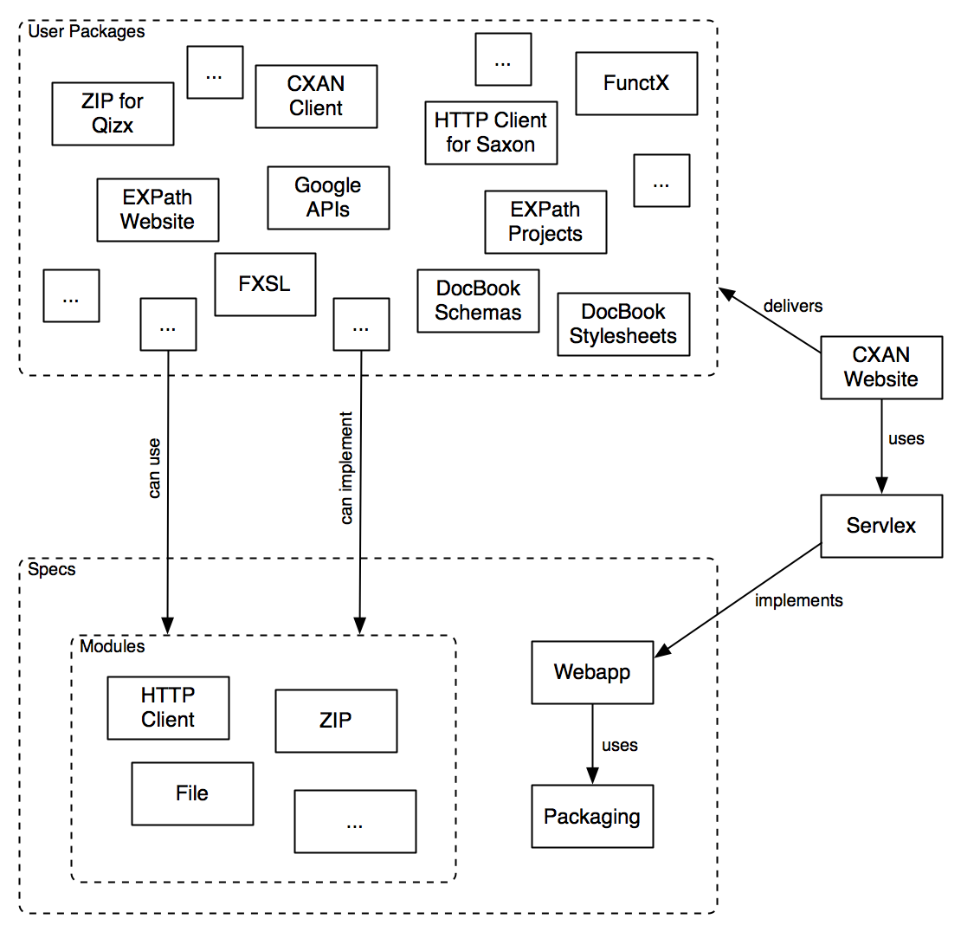
The EXPath Universe

Slide 4
Introduction - Packaging
A specification to package libraries
Supported by several processors
  eXist
  Qizx
  Saxon (as 3d party impl)
  Calabash (as 3d party impl)
A package is a standalone file...
... a ZIP file with components and a descriptor

Slide 5
Introduction - CXAN
Same idea as CTAN for TeX/LaTeX, or CPAN for Perl, or APT for Debian
A central, comprehensive, organized collection of packages:
  Libraries (XSLT, XQuery, XProc, schemas, …)
  Applications (command line, webapps, …)
Maintained on a central website
Accessible through a browser
Accessible through the CXAN client

Slide 6
Introduction - Webapp
Define a web container to deploy webapps
A webapp is a set of components (in XSLT, XQuery or XProc)
It has a descriptor to map incoming URIs to specific components
It is packaged using the Packaging System
A webapp is able to do whatever is possible to do with HTTP on server-side
That is, it is able to build your website

Slide 7
Introduction - Samples
An existing implementation of EXPath Webapp is Servlex
Some existing websites deployed on Servlex:
  http://expath.org/
  http://h2oconsulting.be/
  and... http://cxan.org/
Of interest:
  http://h2oconsulting.be/xqts/
  http://h2oconsulting.be/tools/dump

Slide 8
EXPath Webapp
Introduction
Webapp, the module ←
Data-driven
Servlex
The CXAN website
From scratch
Conclusion

Slide 9
Webapp - Goal
The final, user-level goal is to be able to respond to any HTTP request on the server (so implementing websites, web services, etc.)
Webapp is aimed at defining a processor-agnostic web container for XML technologies
The web container allows one to deploy web applications written directly in XSLT, XQuery and/or XProc
A webapp is interoperable as long as it respects the rules in the Webapp spec

Slide 10
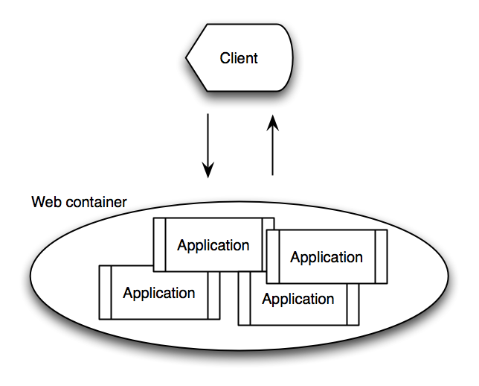
Webapp - At 10,000 feet
The Webapp Module defines a web container responding to HTTP requests
The processing is defined by user applications

Slide 11
Webapp - Overall processing
Under the hood, the URI of each HTTP request is inspected
It is used to choose an application to serve it
It is then used to pick a component within the application, using its own map
The component is evaluated with an XML representation of the HTTP request
The component result is an XML rep of the HTTP response to send back

Slide 12
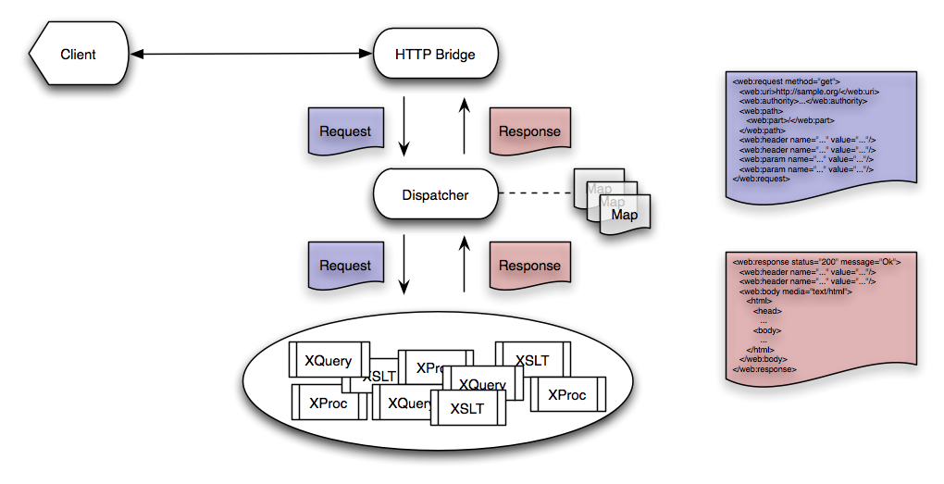
Webapp - 1:1 scale

Slide 13
Webapp – The dispatcher
Based on the web descriptor
It maps URI to components, using regexs
<webapp name="http://cxan.org/website" version="0.3.0">
<title>CXAN website</title>
<servlet name="home">
<xproc uri="http://cxan.org/website/pages/home.xproc"/>
<url pattern="/"/>
</servlet>
</webapp>

Slide 14
Webapp - Filters & Co.
The dispatcher can perform more complex processing
According to the map, it can setup filters, error handlers, chain them, and order them
Error handlers help setting a consistent error reporting mechanism
Filters can apply a consistent layout, inject data, handle authentication, or build a dedicated data model for the application

Slide 15
EXPath Webapp
Introduction
Webapp, the module
Data-driven ←
Servlex
The CXAN website
From scratch
Conclusion

Slide 16
Data – What's different?
Nothing, theoretically
...

Slide 17
Data - Testability
Bullet list...
...

Slide 18
EXPath Webapp
Introduction
Webapp, the module
Data-driven
Servlex ←
The CXAN website
From scratch
Conclusion

Slide 19
Title
Bullet list...
...

Slide 20
EXPath Webapp
Introduction
Webapp, the module
Data-driven
Servlex
The CXAN website ←
From scratch
Conclusion

Slide 21
Title
Bullet list...
...

Slide 22
EXPath Webapp
Introduction
Webapp, the module
Data-driven
Servlex
The CXAN website
From scratch ←
Conclusion

Slide 23
Title
Bullet list...
...

Slide 24
EXPath Webapp
Introduction
Webapp, the module
Data-driven
Servlex
The CXAN website
From scratch
Conclusion ←

Slide 25

Join the mailing list and browse the website:
http://expath.org/

Slide 26


