Slide 1
实验汇报(8.19)
报告人：孙昊哲

Slide 2
汇报内容
Kalman filter
Hidden Markov model
论文学习
Question

Slide 3
Kalman filter
01

Slide 4
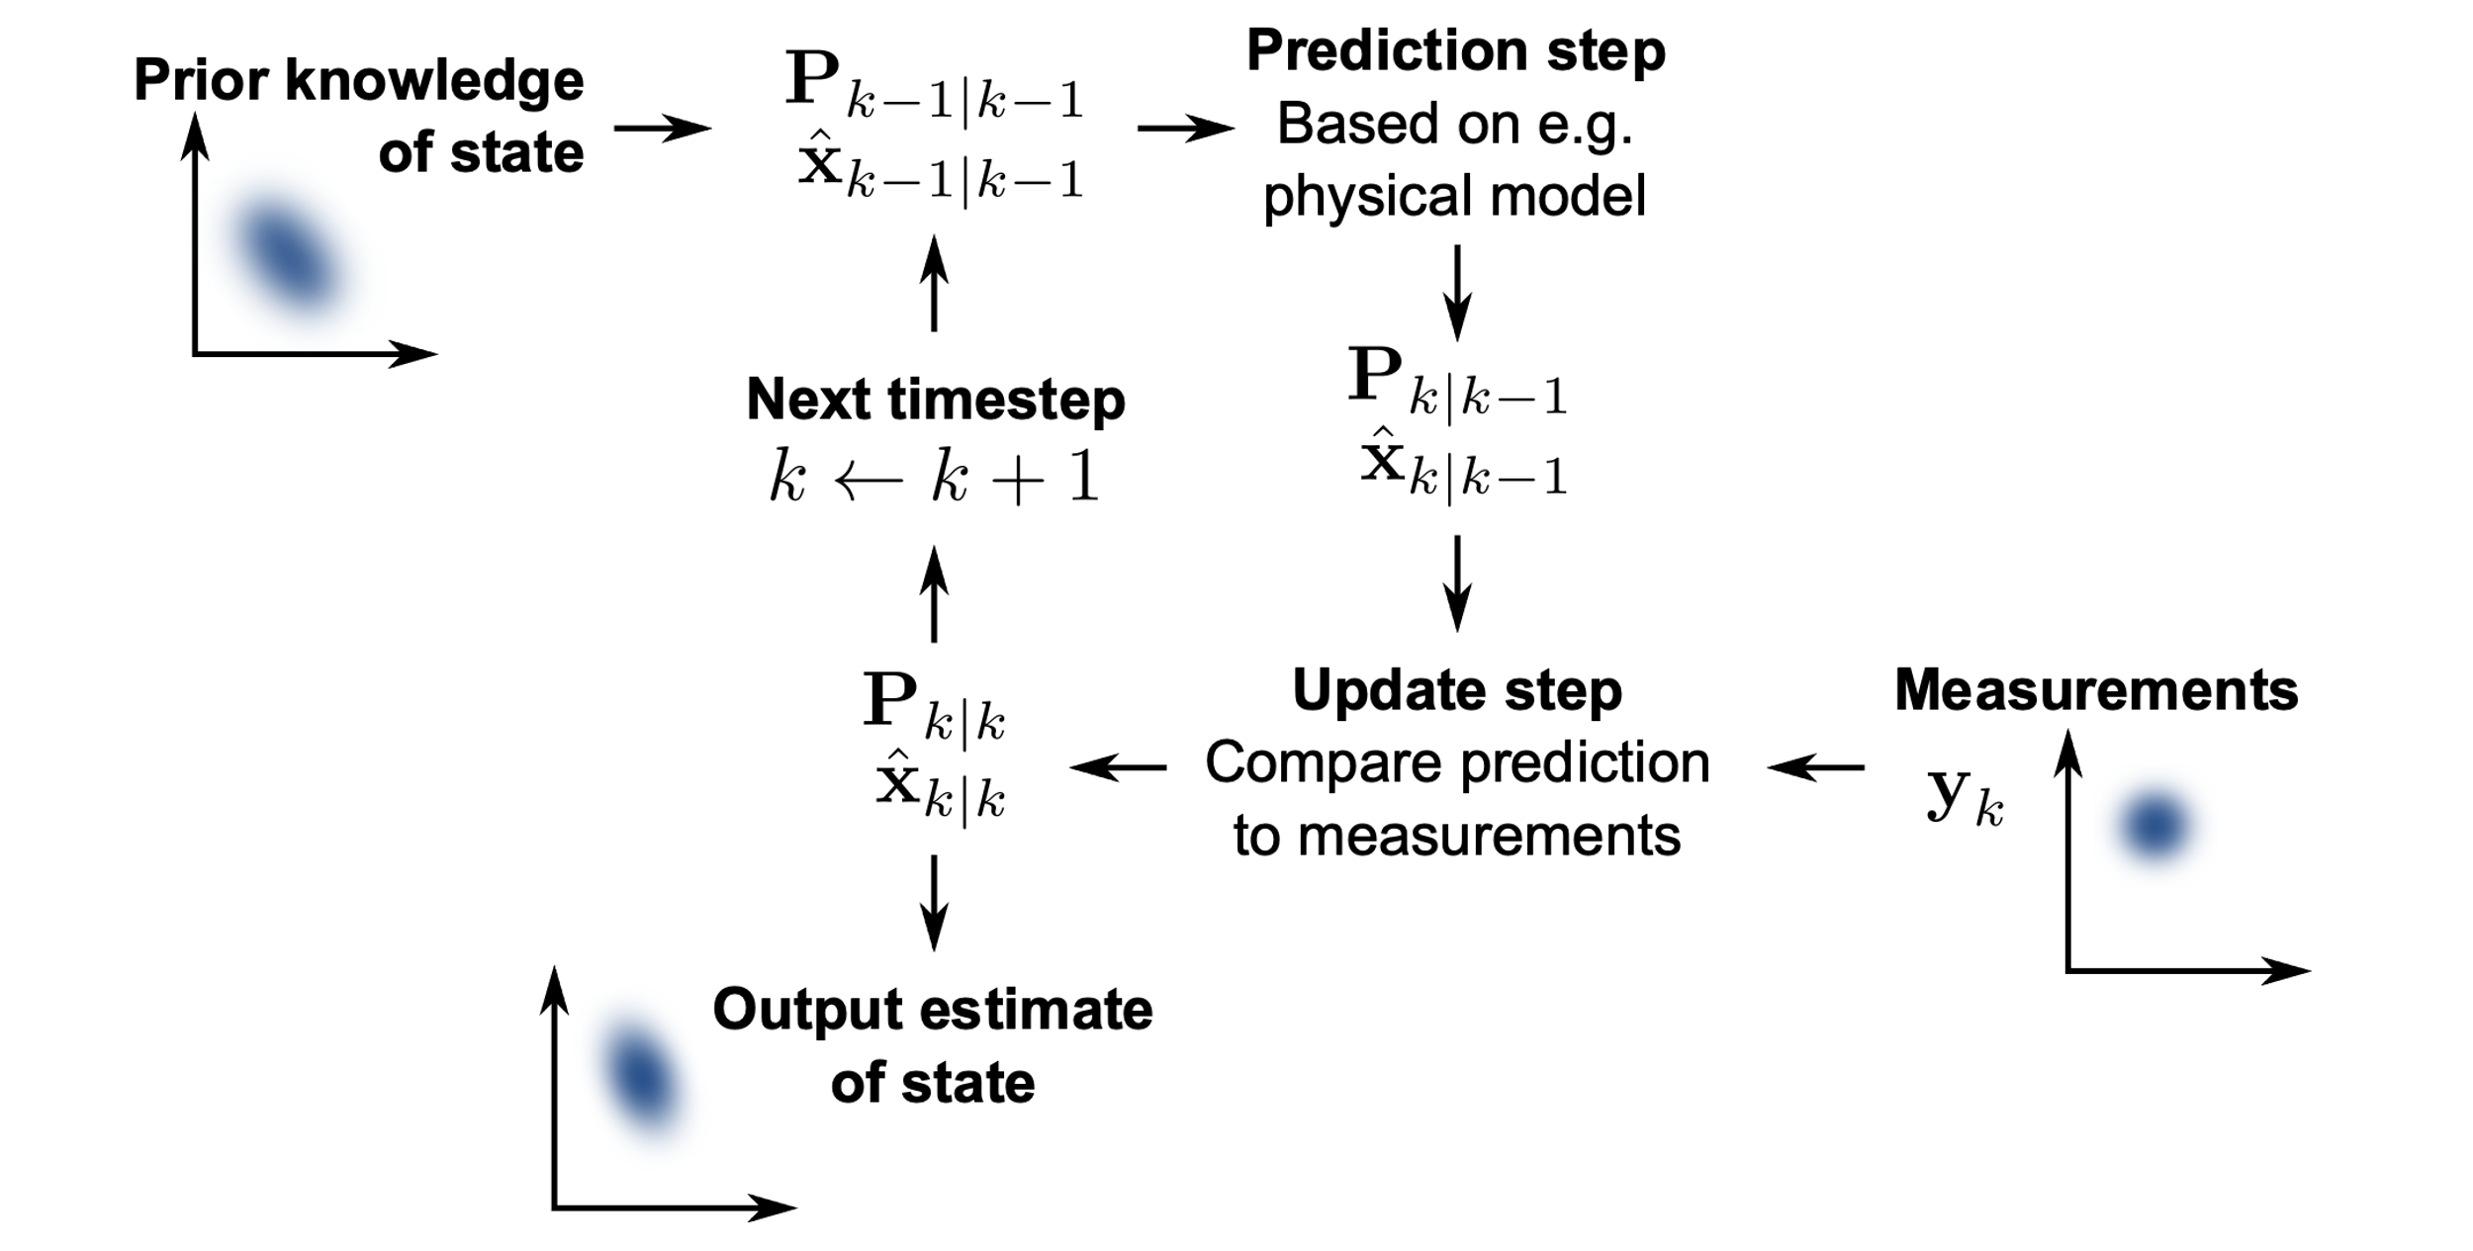
Kalman filter
卡尔曼滤波（Kalman filter）是一种高效率的递归滤波器（自回归滤波器），它能够从一系列的不完全及包含噪声的测量中，估计动态系统的状态。

Slide 5

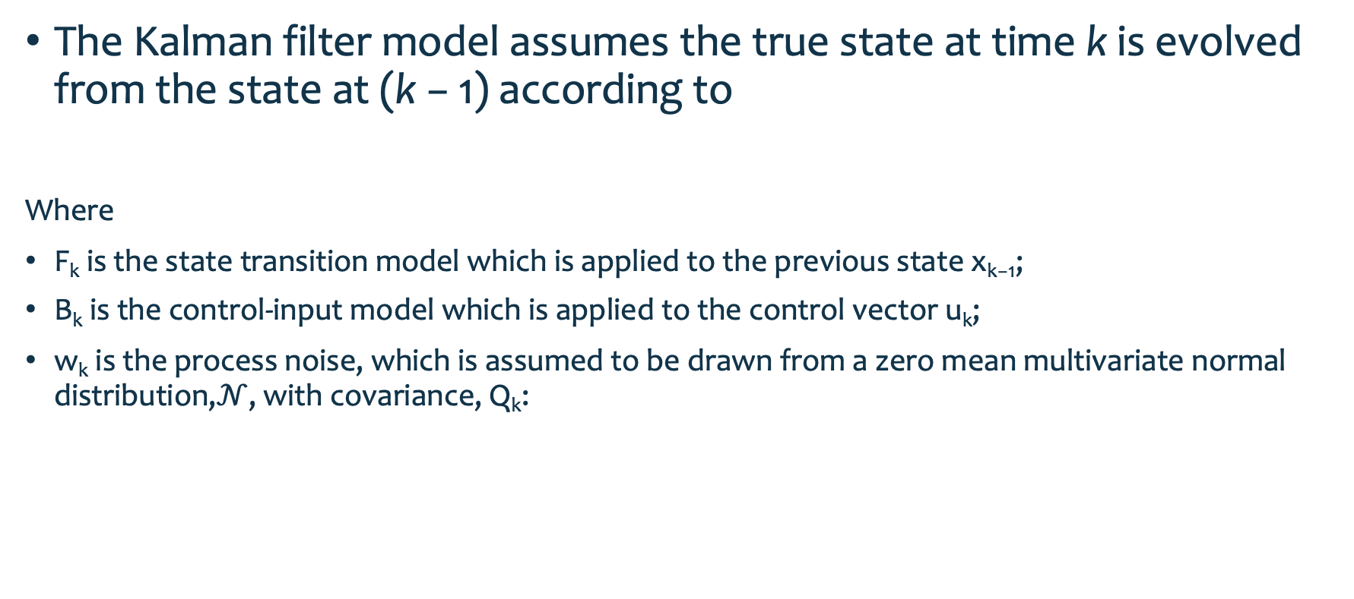
Underlying dynamic system model
The Kalman filter model assumes the true state at time k is evolved from the state at (k − 1) according to
Where
F_{k} is the state transition model which is applied to the previous state x_{k−1};
B_{k} is the control-input model which is applied to the control vector u_{k};
w_{k} is the process noise, which is assumed to be drawn from a zero mean multivariate normal distribution,$𝒩$, with covariance, Q_{k}:
Notes:
基本动态系统模型
卡尔曼滤波模型假设k时刻的真实状态是从（k − 1）时刻的状态演化而来，符合下式：
xk=Fkxk−1+Bkuk+wk
其中
Fk是作用在xk−1上的状态变换模型（/矩阵/向量）。
Bk是作用在控制器向量uk上的输入－控制模型。
wk是过程噪声，并假定其符合均值为零，协方差矩阵为Qk的多元正态分布。
wk∼N(0,Qk)

Slide 6
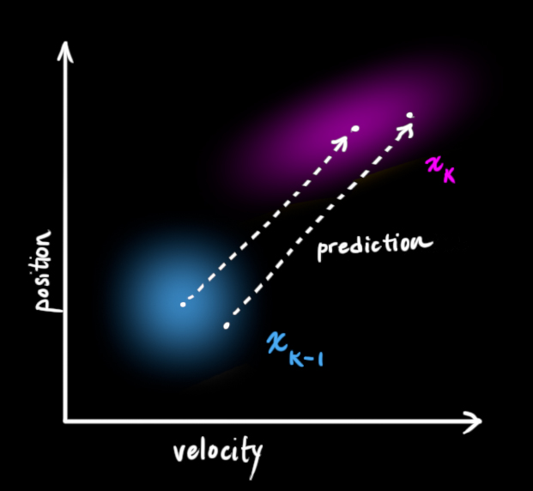
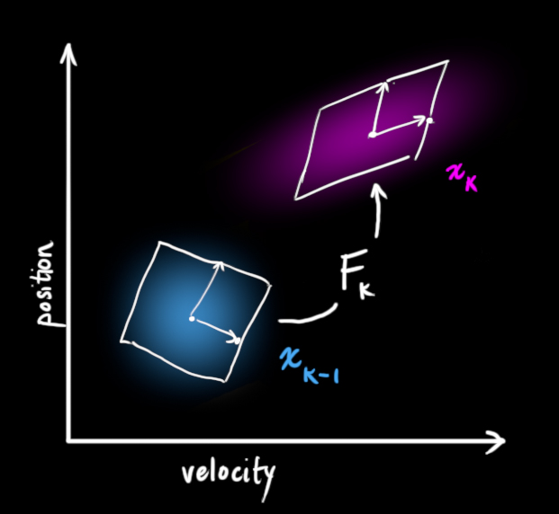
Underlying dynamic system model

Slide 7


Underlying dynamic system model
At time k an observation (or measurement) z_{k} of the true state x_{k} is made according to
Where
H_{k} is the observation model, which maps the true state space into the observed space；
v_{k} is the observation noise, which is assumed to be zero mean Gaussian white noise with covariance Rk:
Notes:
基本动态系统模型
时刻k，对真实状态xk的一个测量zk满足下式：
zk=Hkxk+vk
其中Hk是观测模型，它把真实状态空间映射成观测空间，vk是观测噪声，其均值为零，协方差矩阵为Rk,且服从正态分布。
vk∼N(0,Rk)

Slide 8
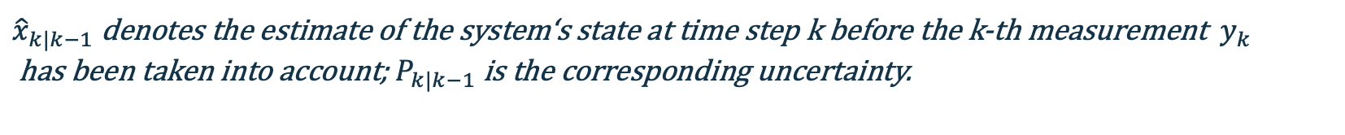
Kalman filter
${\hat{x}}_{k|k−1}$ denotes the estimate of the system‘s state at time step k before the k-th measurement $y_{k}$ has been taken into account; $P_{k|k−1}$ is the corresponding uncertainty.

Slide 9
Kalman filter
卡尔曼滤波器的操作包括两个阶段：预测与更新(predict and update):
在预测(predict)阶段，滤波器使用上一状态的估计，做出对当前状态的估计。
在更新(update)阶段，滤波器利用对当前状态的观测值优化在预测阶段获得的预测值，以获得一个更精确的新估计值。

Slide 10

Underlying dynamic system model
The Kalman filter model assumes the true state at time k is evolved from the state at (k − 1) according to
Where
F_{k} is the state transition model which is applied to the previous state x_{k−1};
B_{k} is the control-input model which is applied to the control vector u_{k};
w_{k} is the process noise, which is assumed to be drawn from a zero mean multivariate normal distribution,$𝒩$, with covariance, Q_{k}:
Notes:
基本动态系统模型
卡尔曼滤波模型假设k时刻的真实状态是从（k − 1）时刻的状态演化而来，符合下式：
xk=Fkxk−1+Bkuk+wk
其中
Fk是作用在xk−1上的状态变换模型（/矩阵/向量）。
Bk是作用在控制器向量uk上的输入－控制模型。
wk是过程噪声，并假定其符合均值为零，协方差矩阵为Qk的多元正态分布。
wk∼N(0,Qk)

Slide 11
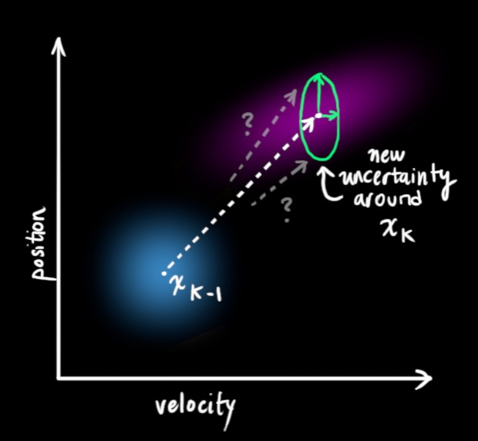
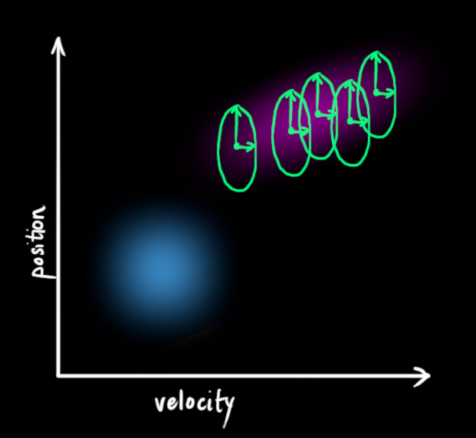
Underlying dynamic system model

Slide 12
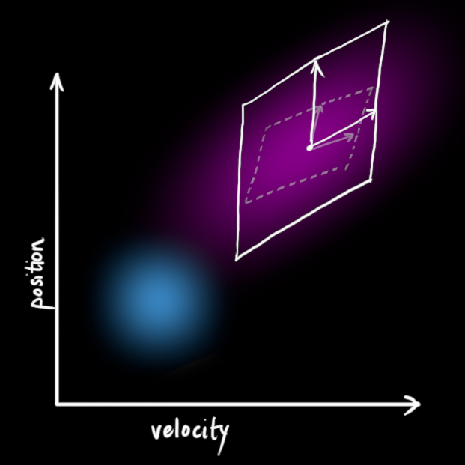
Underlying dynamic system model

Slide 13


Predict
Predicted (a priori) state estimate
Predicted (a priori) estimate covariance

Slide 14
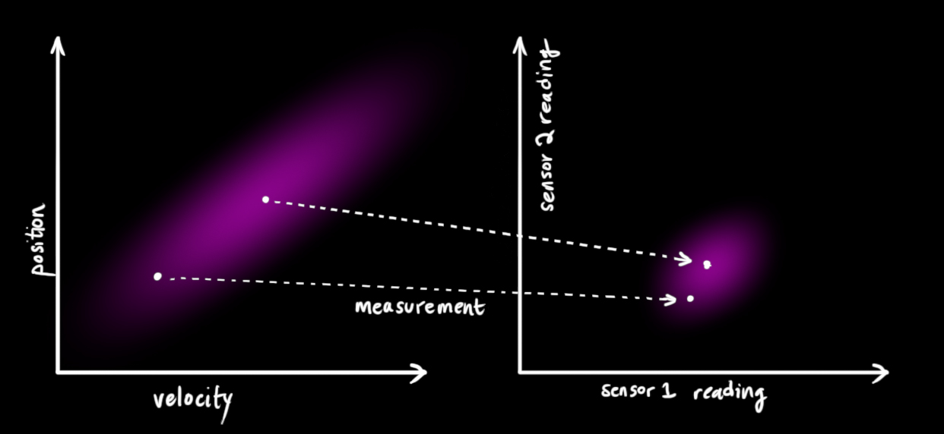
Update
Refining the estimate with measurements
Notes:
我们可能还有一些传感器来测量系统的状态。目前我们不用太关心所测量的状态变量是什么。也许一个测量位置一个测量速度。每个传感器可以提供一些关于系统状态的数据信息，每个传感器检测一个系统变量并且产生一些读数。

Slide 15
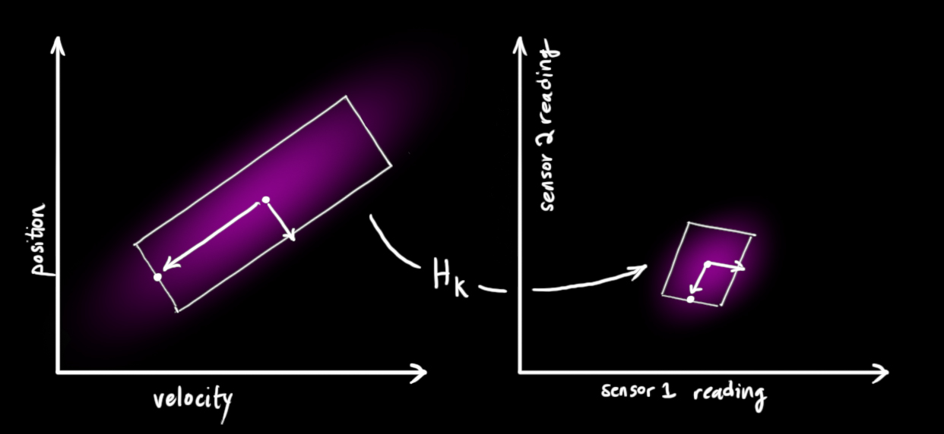
Update
Refining the estimate with measurements
Notes:
注意传感器测量的范围和单位可能与我们跟踪系统变量所使用的范围和单位不一致。我们需要对传感器做下建模：通过矩阵 H_k

Slide 16
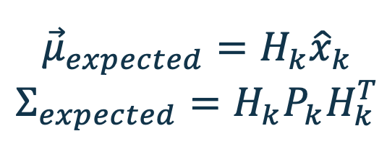
Update
$${\vec{μ}}_{expected}=H_{k}{\hat{x}}_{k}$$
$$Σ_{expected}=H_{k}P_{k}H_{k}^{T}$$

Slide 17
Underlying dynamic system model
At time k an observation (or measurement) z_{k} of the true state x_{k} is made according to
Where
H_{k} is the observation model, which maps the true state space into the observed space；
v_{k} is the observation noise, which is assumed to be zero mean Gaussian white noise with covariance R_{k}:
Notes:
基本动态系统模型
时刻k，对真实状态xk的一个测量zk满足下式：
zk=Hkxk+vk
其中Hk是观测模型，它把真实状态空间映射成观测空间，vk是观测噪声，其均值为零，协方差矩阵为Rk,且服从正态分布。
vk∼N(0,Rk)

Slide 18
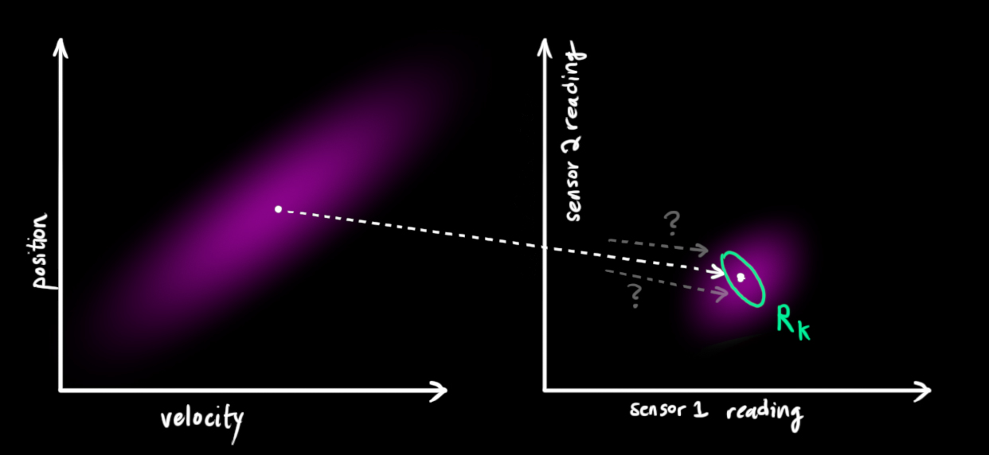

Update
observation noise
Covariance: $R_{k}$
Mean:${\vec{z}}_{k}$
Notes:
卡尔曼滤波也可以处理传感器噪声。换句话说，我们的传感器有自己的精度范围，对于一个真实的位置和速度，传感器的读数受到高斯噪声影响会使读数在某个范围内波动。
我们观测到的每个数据，可以认为其对应某个真实的状态。但是因为存在不确定性，某些状态的可能性比另外一些可能性更高。
我们将这种不确定性的方差为描述为 Rk 。读数的平均值为 z¯k 。所以现在我们有了两个高斯斑，一个来自于我们预测值，另一个来自于我们测量值。

Slide 19
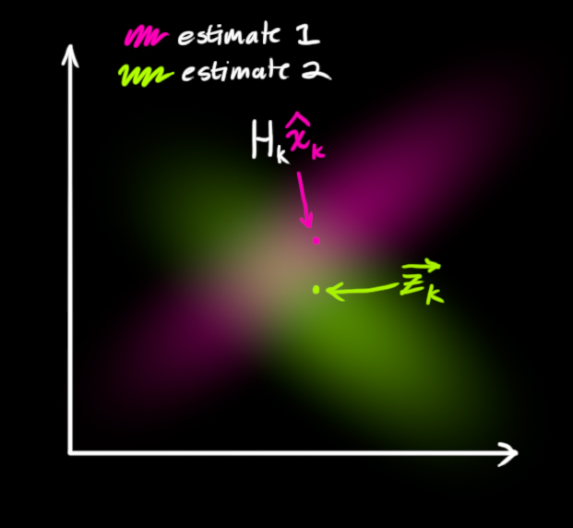
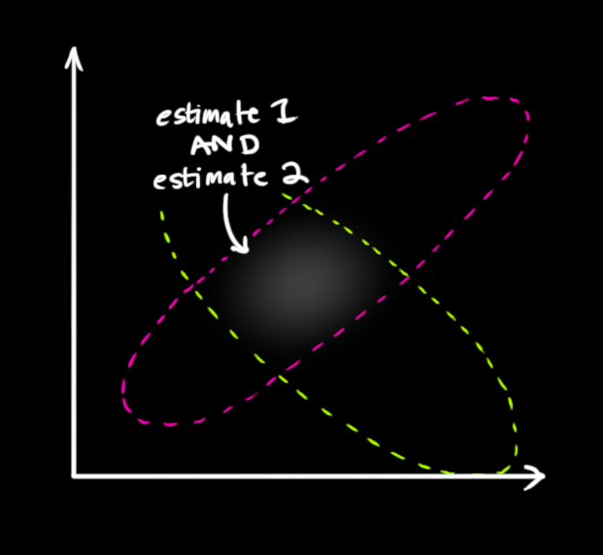
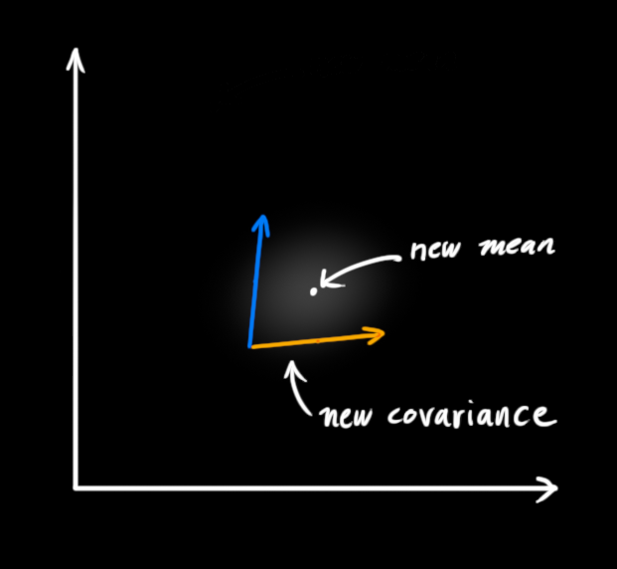
Update
Notes:
我们根据之前的predict和根据现在测量数据更新的Z_k，得到一个新的高斯斑，具体做法就是将他们相乘，相乘以后将是是一个新的高斯斑

Slide 20

Update
In general:
$$X\sim 𝒩\left(μ_{1},σ_{1}^{2}\right),Y\sim 𝒩(μ_{2},σ_{2}^{2})$$
For the new distribution $Z=X×Y$
$$k=\frac{σ_{1}^{2}}{σ_{1}^{2}+σ_{2}^{2}}$$
$$μ^{′}=μ_{1}+k\left(μ_{2}−μ_{1}\right)$$
$$σ^{′2}=σ_{1}^{2}+kσ_{1}^{2}$$

Slide 21

Update
Matrix form:
$$K=Σ_{0}{\left(Σ_{0}+Σ_{1}\right)}^{−1}$$
$$\vec{μ′}=\vec{μ_{0}}+K(\vec{μ_{1}}−\vec{μ_{0}})$$
$$Σ^{′}=Σ_{0}−KΣ_{0}$$
Reference:http://www.lucamartino.altervista.org/2003-003.pdf

Slide 22
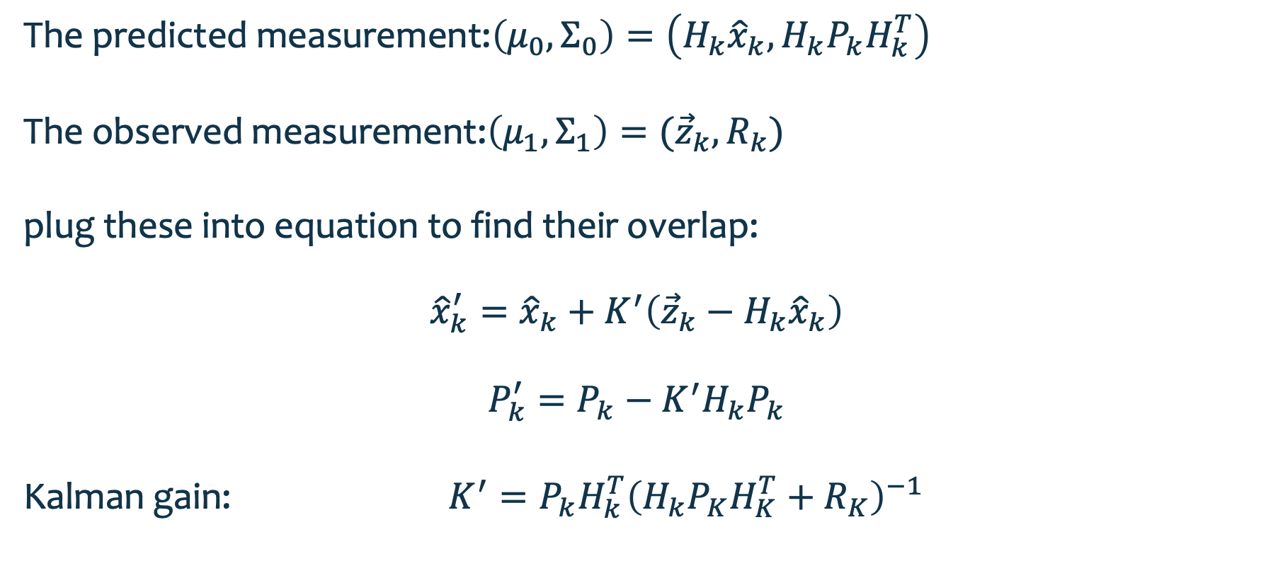
Update
The predicted measurement:$\left(μ_{0},Σ_{0}\right)=\left(H_{k}{\hat{x}}_{k},H_{k}P_{k}H_{k}^{T}\right)$
The observed measurement:$\left(μ_{1},Σ_{1}\right)=({\vec{z}}_{k},R_{k})$
plug these into equation to find their overlap:
$${\hat{x}}_{k}^{′}={\hat{x}}_{k}+K^{′}\left({\vec{z}}_{k}−H_{k}{\hat{x}}_{k}\right)$$
$$P_{k}^{′}=P_{k}−K^{′}H_{k}P_{k}$$
Kalman gain: $K^{′}=P_{k}H_{k}^{T}{\left(H_{k}P_{K}H_{K}^{T}+R_{K}\right)}^{−1}$

Slide 23
Hidden Markov model
02

Slide 24
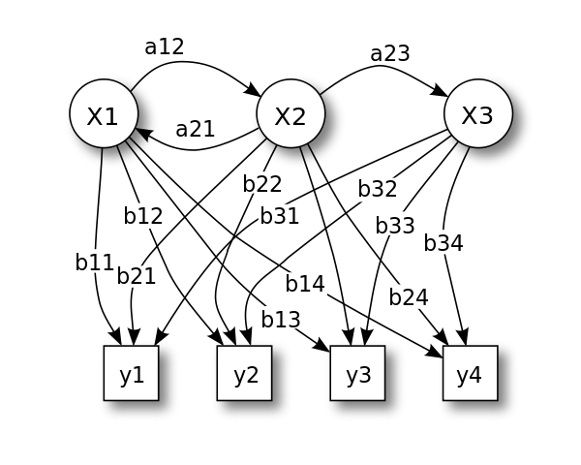
Hidden Markov model
A hidden Markov model is a statistical Markov model in which the system being modeled is assumed to be a Markov process — call it X — with unobservable states.

Slide 25
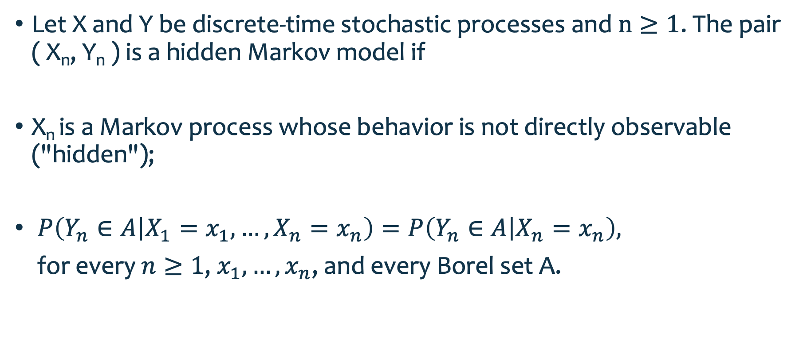
Hidden Markov model
Let X and Y be discrete-time stochastic processes and $n≥1$. The pair ( X_{n}, Y_{n} ) is a hidden Markov model if
X_{n} is a Markov process whose behavior is not directly observable ("hidden");
$P\left(Y_{n}∈A | X_{1}=x_{1},…,X_{n}=x_{n}\right)=P\left(Y_{n}∈A | X_{n}=x_{n}\right),$
for every $n≥1$, $x_{1},…,x_{n}$, and every Borel set A.

Slide 26
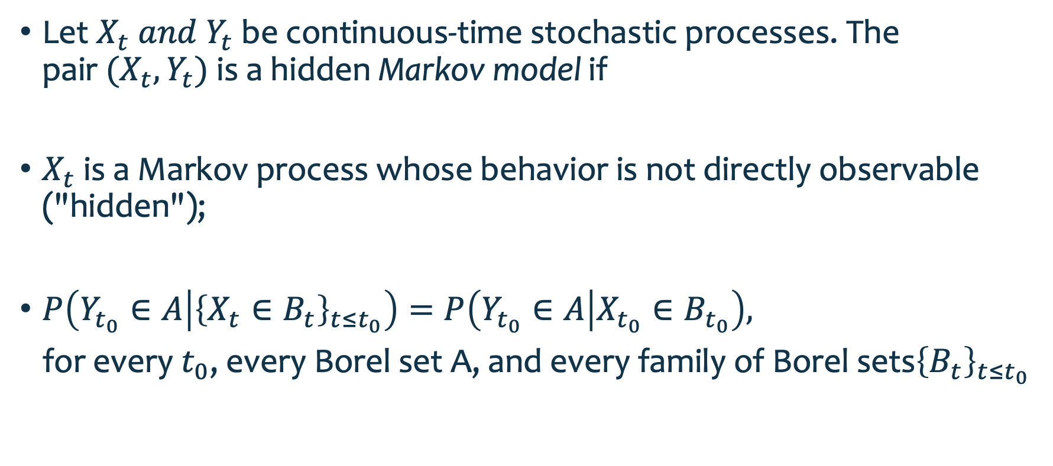
Hidden Markov model
Let $X_{t} and Y_{t}$ be continuous-time stochastic processes. The pair $(X_{t},Y_{t})$ is a hidden Markov model if
$X_{t}$ is a Markov process whose behavior is not directly observable ("hidden");
$P\left(Y_{t_{0}}∈A | {\left\{X_{t}∈B_{t}\right\}}_{t≤t_{0}}\right)=P\left(Y_{t_{0}}∈A | X_{t_{0}}∈B_{t_{0}}\right),$
for every $t_{0}$, every Borel set A, and every family of Borel sets${\left\{B_{t}\right\}}_{t≤t_{0}}$

Slide 27
论文学习
03

Slide 28
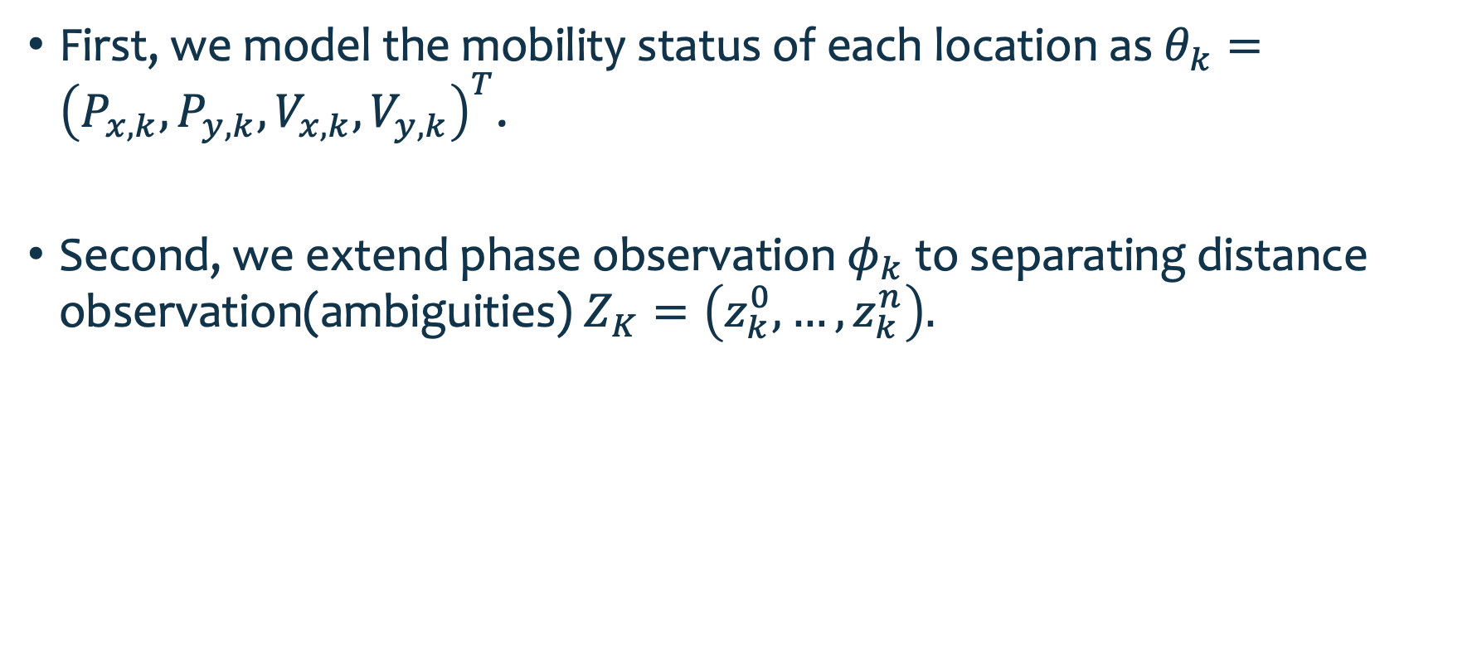
HMM Tracking Framework
First, we model the mobility status of each location as $θ_{k}={\left(P_{x,k},P_{y,k},V_{x,k},V_{y,k}\right)}^{T}$.
Second, we extend phase observation $φ_{k}$ to separating distance observation(ambiguities) $Z_{K}=\left(z_{k}^{0},…,z_{k}^{n}\right).$

Slide 29
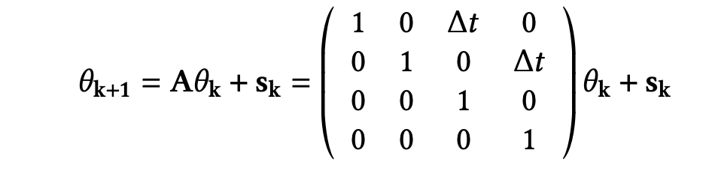

HMM Tracking Framework
Transition equation
Where $θ_{k}\sim 𝒩(m_{K},Σ_{k})$,$s_{k}\sim 𝒩(0,Q_{k})$

Slide 30

HMM Tracking Framework
Observation equation
$z_{k}=\sqrt{{\left(P_{x,k}−A_{k,i}\right)}^{2}+{\left(P_{y,k}−A_{y,i}\right)}^{2}}+u_{k}$
Where $u_{k}\sim 𝒩(0,R_{k})$

Slide 31


HMM Tracking Framework
State estimation
$z_{k}=Cθ_{k}+u_{k}$
Where

Slide 32
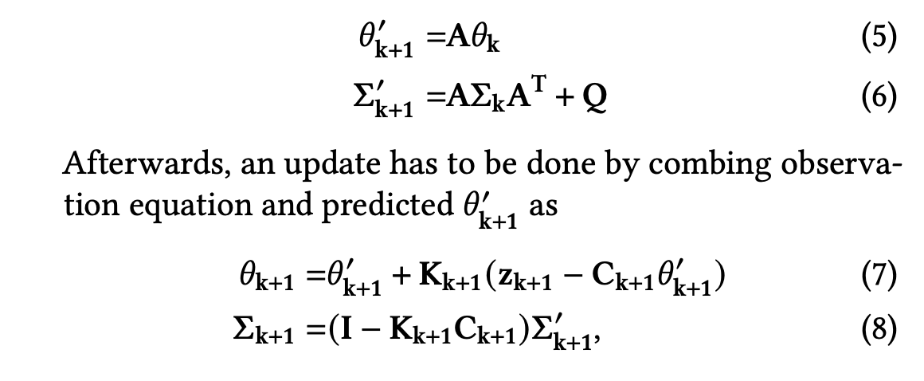
HMM Tracking Framework

Slide 33
Question
04

Slide 34

Question
Second, we extend phase observation $φ_{k}$ to separating distance observation(ambiguities) $Z_{K}=\left(z_{k}^{0},…,z_{k}^{n}\right).$

Slide 35
Thank you!

