Slide 1
实验汇报（9.2）
报告人 孙昊哲

Slide 2
主要议程
The Step Of GLAC
Program
Question
Plan

Slide 3
The Step Of GLAC

Slide 4
The Step Of GLAC
First, we interpolate phases and use initial state pruning to obtain a handful of quality initial positions and velocities.

Slide 5
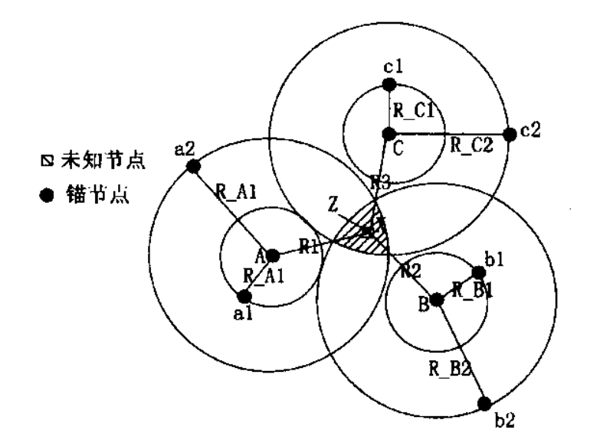
The Step Of GLAC
Initial position estimation
Question : Why don’t we measure phases at the same time?

Slide 6
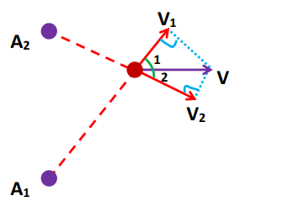

The Step Of GLAC
Initial velocity estimation
$$V_{ob}=\vec{v}∗\vec{e}=\left(v_{x} , v_{y}\right)∗\left(e_{x},e_{y}\right)=v_{x}e_{x}+v_{y}e_{y}$$
$$\frac{V_{ob}}{e_{y}}=v_{x}\frac{e_{x}}{e_{y}}+v_{y}$$

Slide 7

The Step Of GLAC
Initial velocity estimation
$$\frac{V_{ob}}{e_{y}}=v_{x}\frac{e_{x}}{e_{y}}+v_{y}$$
$$y=ax+b$$
We can get several interpolated phases to apply linear least squre.

Slide 8
The Step Of GLAC
Second, For each candidate trajectory during an update, we use nearest neighbor pruning to select the next distance observation and employ an EKF to estimate hidden mobility states and the likelihood of the trajectory.

Slide 9
The Step Of GLAC
At last, We normalize likelihoods among trajectories at every time snapshot and the trajectory of the highest likelihood is chosen as the optimal one.

Slide 10
Program
02

Slide 11
Program
Learning Java
Able to understand the GLAC program
Add tracking trajectories
Add a new simulation shape
Redesign the GUI

Slide 12
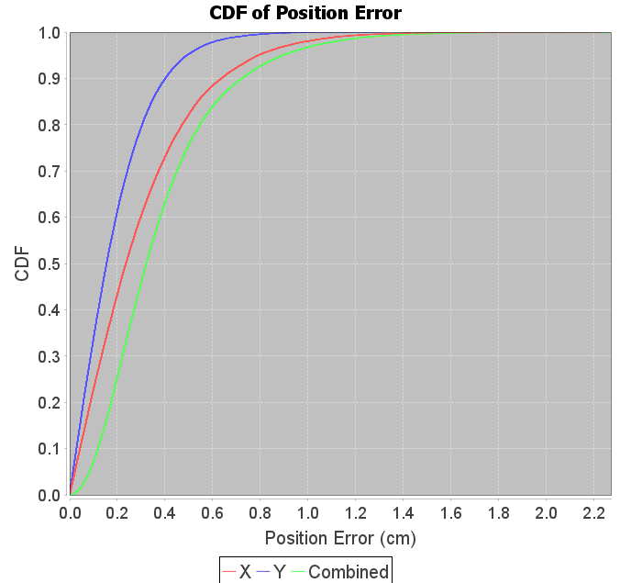
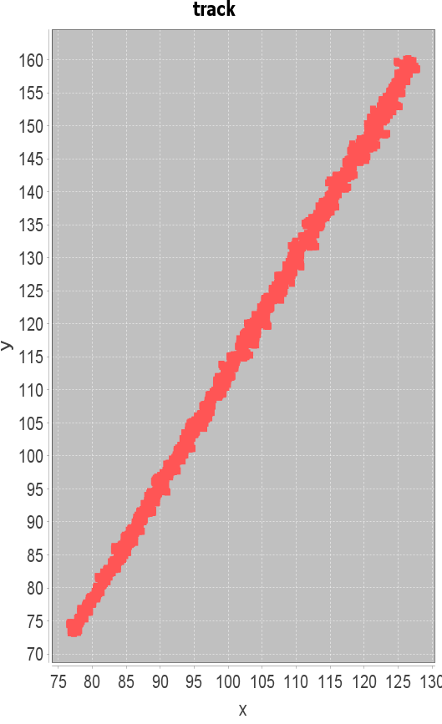
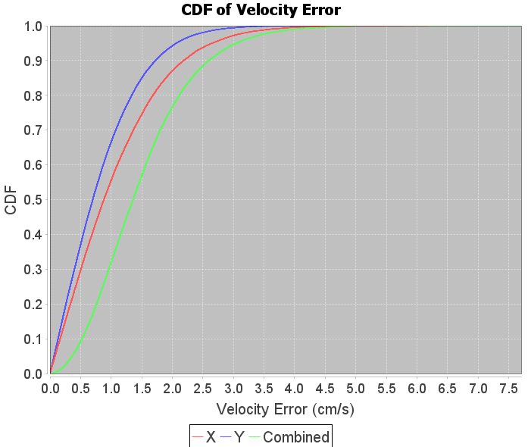
Program
Line

Slide 13
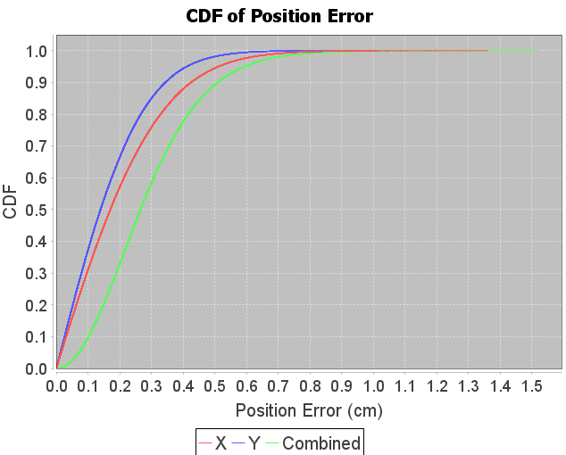
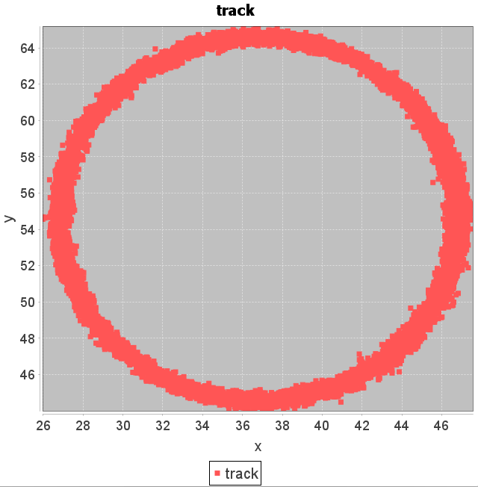
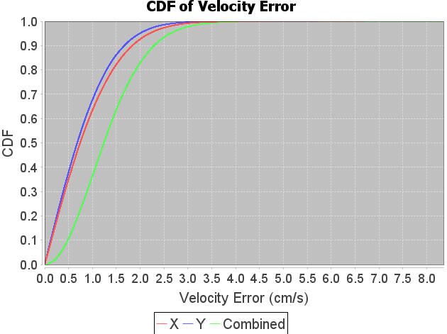
Program
Circle

Slide 14
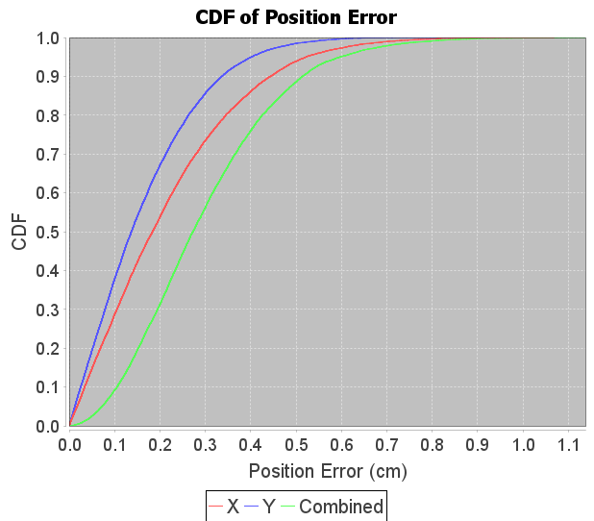
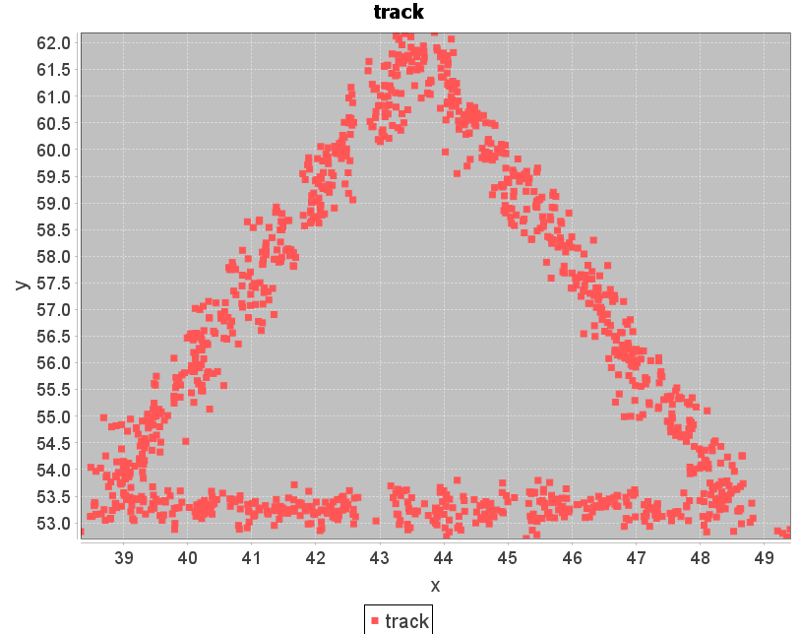
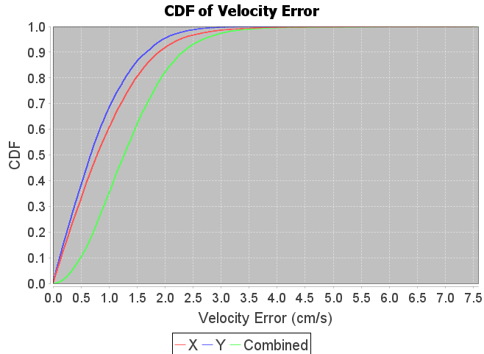
Program
Triangle

Slide 15
Program
Redesign the GUI
The GUI of the origin program is designed with the NetBeans Tools
I can hardly alter the GUI code with the IDE(IntelliJ IDEA), which I’m used to using
So I want to design a simplified GUI with Swing

Slide 16
Program
Unskilled in using Java, especially GUI of Java

Slide 17
Question
03

Slide 18
Question
Why don’t we measure phases at the same time?
What to do next?

Slide 19
Plan
04

Slide 20
Plan
扩展到三维
设计一套GUI
测试对不同条件这个方案是否都能够有良好的表现(Evaluate)
学习一下用LaTeX做PPT

Slide 21
Thank you!

