Slide 1
Behaviour Tree AI

Slide 2
Introdution
Behaviour Tree (BT) is one model of implementation of Artificial Intelligence.
BTs originate from the computer game industry as a powerful tool to model the behavior of non-player characters (NPCs).
Usually drawn to form a branching diagram.

Slide 3
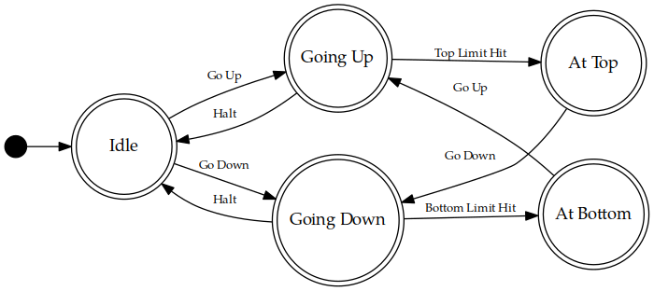
Other implementation of Game AI
Finite State Machine

Slide 4
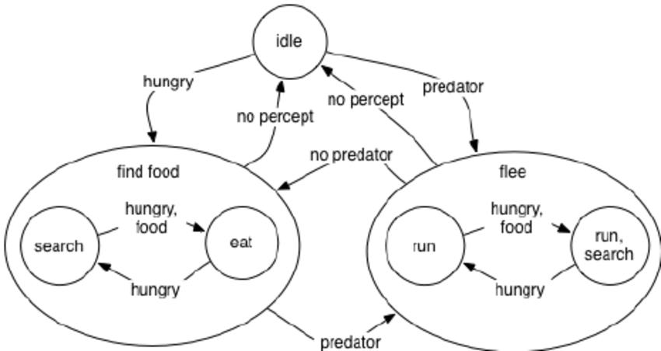
Other implementation of Game AI
Hierarchical Finite State Machine

Slide 5
Structure of Behaviour Tree
Root
Sequence
Repeater
Selector
Leaf
Leaf
Leaf
Leaf
Leaf
Leaf
Leaf

Slide 6
Advantages
Reusability
Easier to create complex behaviour
Easily drawn with graph

Slide 7
Disadvantages
Always start from root
Cannot directly go to relevant node, it needs to iterate higher priority nodes first

Slide 8
Types of Node
Composite Nodes
Decorator Nodes
Leaf Nodes

Slide 9
Composite Nodes
Selector Nodes
Sequence Nodes

Slide 10
Selector Node
Acts to select its children
Will stop at first Success and return success immediately
Fail only if every child had returned fail
Selector
Leaf
Leaf
Leaf

Slide 11
Selector Node
Acts to select its children
Will stop at first Success and return success immediately
Fail only if every child had returned fail
Selector
Leaf
Leaf
Leaf

Slide 12
Selector Node
Acts to select its children
Will stop at first Success and return success immediately
Fail only if every child had returned fail
Selector
Leaf
Leaf
Leaf

Slide 13
Selector Node
Acts to select its children
Will stop at first Success and return success immediately
Fail only if every child had returned fail
Selector
Leaf
Leaf
Leaf

Slide 14
Selector Node
Acts to select its children
Will stop at first Success and return success immediately
Fail only if every child had returned fail
Selector
Leaf
Leaf
Leaf

Slide 15
Selector Node
Acts to select its children
Will stop at first Success and return success immediately
Fail only if every child had returned fail
Selector
Leaf
Leaf
Leaf

Slide 16
Selector Node
Acts to select its children
Will stop at first Success and return success immediately
Fail only if every child had returned fail
Selector
Leaf
Leaf
Leaf

Slide 17
Sequence Node
Its children will run in sequence one after the other
Will stop at first failure and return failure immediately
Returns success once every child had succeeded
Sequence
Leaf
Leaf
Leaf

Slide 18
Sequence Node
Its children will run in sequence one after the other
Will stop at first failure and return failure immediately
Returns success once every child had succeeded
Sequence
Leaf
Leaf
Leaf

Slide 19
Sequence Node
Its children will run in sequence one after the other
Will stop at first failure and return failure immediately
Returns success once every child had succeeded
Sequence
Leaf
Leaf
Leaf

Slide 20
Sequence Node
Its children will run in sequence one after the other
Will stop at first failure and return failure immediately
Returns success once every child had succeeded
Sequence
Leaf
Leaf
Leaf

Slide 21
Sequence Node
Its children will run in sequence one after the other
Will stop at first failure and return failure immediately
Returns success once every child had succeeded
Sequence
Leaf
Leaf
Leaf

Slide 22
Sequence Node
Its children will run in sequence one after the other
Will stop at first failure and return failure immediately
Returns success once every child had succeeded
Sequence
Leaf
Leaf
Leaf

Slide 23
Sequence Node
Its children will run in sequence one after the other
Will stop at first failure and return failure immediately
Returns success once every child had succeeded
Sequence
Leaf
Leaf
Leaf

Slide 24
Root Node
Actually a selector node
Acts as the entry point of the BT
Root
Sequence
Leaf
Leaf
Leaf
Leaf
Leaf

Slide 25
Leaf Node
This is the node where the actual action will take place
Can be realized in code using pointer to function or other means that provide similar functionality (depends on the language used)
The actual action is responsible to return its node state (Success, Failure, or Running)

Slide 26
Leaf Node
public class LeafNode : Node
{
public delegate NodeState NodeAction ();
private NodeAction action;
public LeafNode(NodeAction delegatedAction)
{
action = delegatedAction;
state = NodeState.FAILED;
}
public override NodeState Evaluate()
{
state = action();
return state;
}
}

Slide 27
Decorator Nodes
Repeater Node
Inverter Node
Test Node
Succeeder Node
etc

Slide 28
Repeater Node
Used to repeat its child action (limited / unlimited)
Can be set to care / not with its children return value
Repeater
Leaf

Slide 29
Repeater Node
Used to repeat its child action (limited / unlimited)
Can be set to care / not with its children return value
Repeater
Leaf

Slide 30
Repeater Node
Used to repeat its child action (limited / unlimited)
Can be set to care / not with its children return value
Repeater
Leaf

Slide 31
Repeater Node
Used to repeat its child action (limited / unlimited)
Can be set to care / not with its children return value
Repeater
Leaf

Slide 32
Repeater Node
Used to repeat its child action (limited / unlimited)
Can be set to care / not with its children return value
Repeater
Leaf

Slide 33
Repeater Node
Used to repeat its child action (limited / unlimited)
Can be set to care / not with its children return value
Repeater
Leaf

Slide 34
Repeater Node
Used to repeat its child action (limited / unlimited)
Can be set to care / not with its children return value
Repeater
Leaf

Slide 35
Inverter Node
Used to invert its child return value
Inverter
Leaf

Slide 36
Inverter Node
Used to invert its child return value
Inverter
Leaf

Slide 37
Inverter Node
Used to invert its child return value
Inverter
Leaf

Slide 38
Inverter Node
Used to invert its child return value
Inverter
Leaf

Slide 39
Inverter Node
Used to invert its child return value
Inverter
Leaf

Slide 40
Test Node
Used to perform a certain test before executing its child
If the test succeed then the child will be executed and it will return whatever its child returns
Returns fail immediately if the test fail
Test
Test
Leaf
Leaf

Slide 41
Test Node
Used to perform a certain test before executing its child
If the test succeed then the child will be executed and it will return whatever its child returns
Returns fail immediately if the test fail
Test
Test
Leaf
Leaf

Slide 42
Test Node
Used to perform a certain test before executing its child
If the test succeed then the child will be executed and it will return whatever its child returns
Returns fail immediately if the test fail
Test
Test
Leaf
Leaf

Slide 43
Test Node
Used to perform a certain test before executing its child
If the test succeed then the child will be executed and it will return whatever its child returns
Returns fail immediately if the test fail
Test
Test
Leaf
Leaf

Slide 44
Test Node
Used to perform a certain test before executing its child
If the test succeed then the child will be executed and it will return whatever its child returns
Returns fail immediately if the test fail
Test
Test
Leaf
Leaf

Slide 45
Succeeder Node
Will return success no matter what its child returns
Succeeder
Leaf

Slide 46
Succeeder Node
Will return success no matter what its child returns
Succeeder
Leaf

Slide 47
Succeeder Node
Will return success no matter what its child returns
Succeeder
Leaf

Slide 48
Succeeder Node
Will return success no matter what its child returns
Succeeder
Leaf

Slide 49
Succeeder Node
Will return success no matter what its child returns
Succeeder
Leaf

Slide 50
Implementation Example

Slide 51
Example In Action

