Slide 1
Shared memory

Slide 2
Shared memory
Physical Memory
Process A
Process B
Instruction memory
Instruction memory
Share
Data
Share
Share
Virtual address space B
Data
Virtual address space A

Slide 3
Create a shared memory region
Create a shared memory region
Attach a process with the shared memory
Use
Detach a process from the shared memory

Slide 4
Create a shared memory region
Create a shared memory instance
int shmget(key_t key, int size, int msgflg)
Flag (IPC_CREAT, IPC_EXCL, read, write permission)
Shared memory identifier
Name of the shared memory
#of bytes

Slide 5
int main()
{
int shmid;
key_t key;
key=131;
shmid=shmget(key,20, IPC_CREAT|0666);
printf("\nq=%d",shmid);
}
ipcs –m displays the shared memory information in the system
Keys ShmID owner permission bytes nattach

Slide 6
Shared Memory Limits
Shared Memory Segment Defaults Value
Maximum segment size 1,048,576 bytes
Minimum segment size 1 byte
System wide maximum number of segments 100
Maximum number of segments per process 6?
that can be attached

Slide 7
Physical Memory
Process A
Process B
Share
Share
Shared memory
Virtual address space B

Slide 8
Create a shared memory region
Attach a process with the shared memory
Use
Detach a process from the shared memory

Slide 9
Physical Memory
Process A
Process B
Attach
Share
Attach
Share
Share
Virtual address space B

Slide 10
void *shmat(int shmid, const void *shmaddr, int shmflg);
SHM_RDONLY,
SHM_RND
attach occurs at the address shmaddr
Virtual address of the shared memory segment
shmaddr - (shmaddr % SHMLBA))
shmat() attaches the shared memory segment identified by shmid to the address space of the calling process.

Slide 11
#include <sys/types.h>
#include <sys/ipc.h>
#include <sys/shm.h>
char *ptr
key = 10
size = 20
shmflg =
shmid = shmget (key, size, shmflg));
ptr=(char*)shmat(shmid, NULL, 0);

Slide 12
int main()
{
int shmid,f,key=2,i,pid;
char *ptr;
shmid=shmget((key_t)key,100,IPC_CREAT|0666);
ptr=(char*)shmat(shmid,NULL,0);
printf("shmid=%d ptr=%u\n",shmid, ptr);
pid=fork();
if(pid==0)
{
strcpy(ptr,“hello\n");
}
else
{
wait(0);
printf("%s\n",ptr);
}
}
Child writes “Hello” to the shared memory
Parent reads “Hello” from the shared memory

Slide 13
example
writer.c
reader .c
int main()
{
int shmid,f,key=3,i,pid;
char *ptr;
shmid=shmget((key_t)key,100,IPC_CREAT|0666);
ptr=shmat(shmid,NULL,0);
printf("shmid=%d ptr=%u\n",shmid, ptr);
strcpy(ptr,"hello");
i=shmdt((char*)ptr);
}
int main()
{
int shmid,f,key=3,i,pid;
char *ptr;
shmid=shmget((key_t)key,100,IPC_CREAT|0666);
ptr=shmat(shmid,NULL,0);
printf("shmid=%d ptr=%u\n",shmid, ptr);
printf("\nstr %s\n",ptr);
}
ptr
Shared memory

Slide 14
int main()
{
struct databuf *ptr;
int shmid,f,key=2,i,pid;
char *ptr;
shmid=shmget((key_t)key,100,IPC_CREAT|0666);
ptr=(struct databuf*)shmat(shmid,NULL,0);
printf("shmid=%d ptr=%u\n",shmid, ptr);
pid=fork();
if(pid==0)
{
ptr->nread=read(0,ptr->buf,10000);
}
else
{
wait(0);
printf("parent\n");
write(1,ptr->buf,10000);
}
struct databuf
{
int nread;
char buf[1000];
};

Slide 15
File descriptor table
File descriptor (integer) | File name
0 | stdin
1 | stdout
2 | stderr
Use open(), read(), write() system calls to access files
Open() creates a file and returns fd (minimum value)
fd=open(path, O_WRONLY|O_CREAT|O_TRUNC, mode)

Slide 16
Disassociate process from memory
Physical Memory
Process A
Process B
Share
Share
Share
Virtual address space B

Slide 17
Disassociate process from memory
int shmdt(const void *shmaddr);
int main()
{
shmid=shmget((key_t)key,100,IPC_CREAT|0666);
ptr=shmat(shmid,NULL,0);
printf("shmid=%d ptr=%u\n",shmid, ptr);
strcpy(ptr,"hello");
printf("\nstr is %s",ptr);
i=shmdt((char*)ptr);
}

Slide 18
example
writer.c
reader .c
int main()
{
int shmid,f,key=3,i,pid;
char *ptr;
shmid=shmget((key_t)key,100,IPC_CREAT|0666);
ptr=shmat(shmid,NULL,0);
printf("shmid=%d ptr=%u\n",shmid, ptr);
strcpy(ptr,"hello");
i=shmdt((char*)ptr);
}
int main()
{
int shmid,f,key=3,i,pid;
char *ptr;
shmid=shmget((key_t)key,100,IPC_CREAT|0666);
ptr=shmat(shmid,NULL,0);
printf("shmid=%d ptr=%u\n",shmid, ptr);
printf("\nstr %s\n",ptr);
}
ptr
Shared memory

Slide 19
Kernal data structure
/* One shmid data structure for each shared memory segment in the system. */
struct shmid_ds {
struct ipc_perm shm_perm; /* operation perms */
int shm_segsz; /* size of segment (bytes) */
time_t shm_atime; /* last attach time */
time_t shm_dtime; /* last detach time */
time_t shm_ctime; /* last change time */
unsigned short shm_cpid; /* pid of creator */
unsigned short shm_lpid; /* pid of last operator */
short shm_nattch; /* no. of current attaches */
/* the following are private */
unsigned short shm_npages; /* size of segment (pages) */
unsigned long *shm_pages; /* array of ptrs to frames -> SHMMAX */
struct vm_area_struct *attaches; /* descriptors for attaches */
};

Slide 20
struct ipc_perm {
key_t key;
ushort uid; /* user euid and egid */
ushort gid;
ushort cuid; /* creator euid and egid */
ushort cgid;
ushort mode; /* access modes see mode flags below */
};

Slide 21
int shmctl(int shmid, int cmd, struct shmid_ds *buf);
IPC_STAT
IPC_SET
IPC_RMID
Remove shared memory
struct shmid_ds set;
shmctl(shmid, IPC_STAT, &set);
shmctl(shmid, IPC_SET, &set);
shmctl(shmid, IPC_RMID, 0);

Slide 22
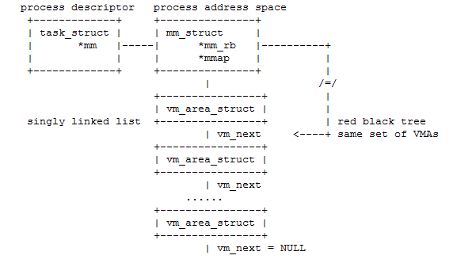
$pmap –x pid

Slide 23
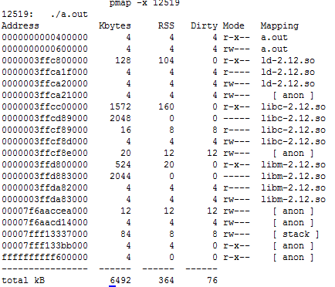

Slide 24
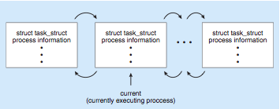
Process Representation in Linux
Represented by the C structure task_struct pid t pid; /* process identifier */ long state; /* state of the process */ unsigned int time slice /* scheduling information */ struct task struct *parent; /* this process’s parent */ struct list head children; /* this process’s children */ struct files struct *files; /* list of open files */ struct mm_struct *mm; /* address space of this pro */
Doubly linked list

Slide 25
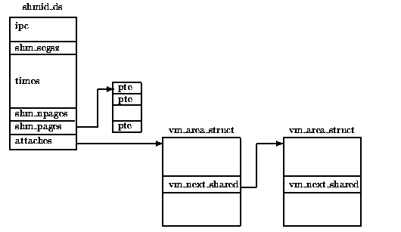

Slide 26
struct vm_area_struct {
struct mm_struct *vm_mm; /* associated mm_struct */
unsigned long vm_start; /* VMA start, inclusive */
unsigned long vm_end; /* VMA end, exclusive */
unsigned long vm_flags;
struct vm_area_struct *vm_next; /* points to next VMA */
struct vm_operations_struct *vm_ops; /* associated ops */
...
}

