Slide 1
pGlycoQuant Manual

Slide 2
### Version: pGlycoQuant_V1.1
### Release Date: 2021.08.31
## Computer configuration
RAM: 16G or higher is recommended
ROM: for one raw data (1G) 5G or higher is recommended
OS: Windows10 or higher
Other: MSFileReader 3.0 Sp1 or higher is needed
## Description
At present, pFind, pGlyco, Byonic and MSFragger software glycosylation identification results can be used for quantification by pGlycoQuant.

Slide 3
### Notes for running Byonic result
1. It is found that the name of mass spectrum data recorded by Byonic software is inconsistent with the original data, when running pGlycoQuant in Byonic mode, it should be guaranteed that the name of the mass spectrum data recorded in the Byonic result file is the same as that of the entered mass spectrum data.
2. Byonic glycosylation modification reliable results screening commonly used scores are Score and LogProb, rather than FDR. FDR cannot be modified on the pGlycoQuant interface. To modify B4_THRESHOLD_SCORE_BYONIC and B5_THRESHOLD_PROB_BYONIC in the config file (default: 200 and 2, indicating score≥200 and absolute value of LogProb ≥2).
3. Byonic ini files are required for quantification, in the ./ini/ini_Byonic directory.
### Notes for running MSFragger result
MSFragger ini files are required for quantification, in the ./ini/ini_MSFragger directory.
## Cite us
Weiqian Cao, et. al. pGlycoQuant with a deep residual network for precise and minuscule-missing-value quantitative glycoproteomics enabling the functional exploration of site-specific glycosylation. bioRxiv 2021.11.15.468561.
doi: https://doi.org/10.1101/2021.11.15.468561

Slide 4
An Example for pGlyco Quantitation

Slide 5
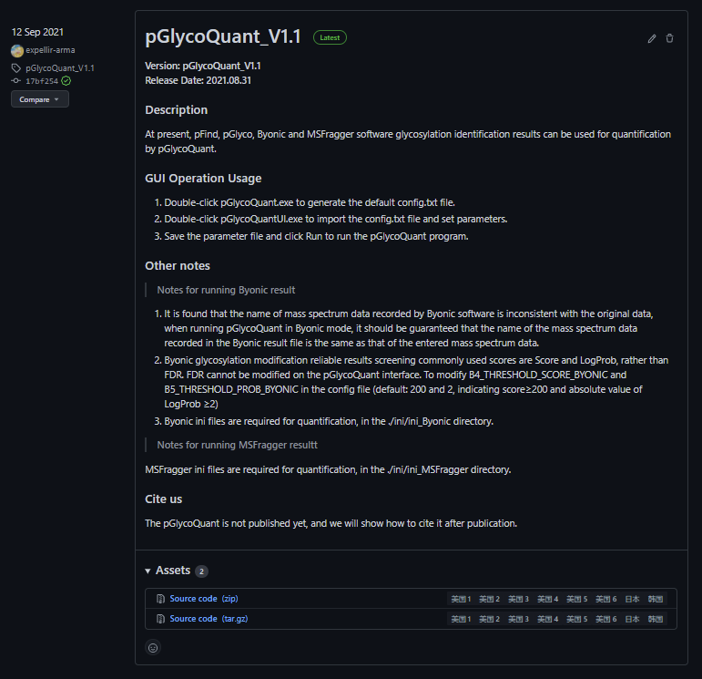
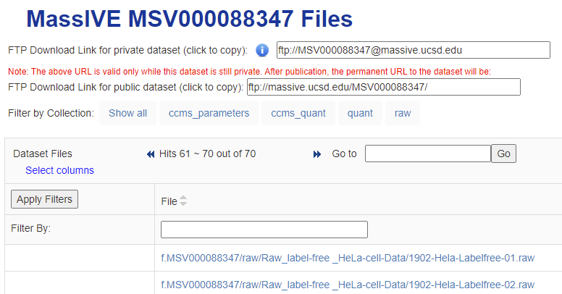
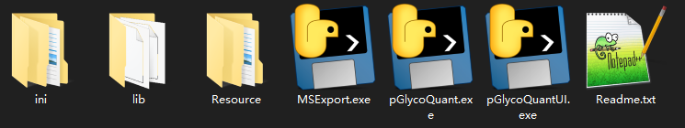
1 pGlycoQuant download
① Login https://github.com/expellir-arma/pGlycoQuant/releases and download Source code (zip) at the bottom of this page.
② The unzipped pGlycoQuant files.
③ The dataset to demo the software could be downloaded from MassIVE (https://massive.ucsd.edu/) with identifier MSV000088347. The login name of the dataset's web page (including title, description, and metadata) is MSV000088347_reviewer and password is a.
The dataset ftp://massive.ucsd.edu/raw/Raw_label-free%20_HeLa-cell-Data/1902-Hela-Labelfree-01.raw and 1902-Hela-Labelfree-02.raw could be used for testing.
①
③
②

Slide 6
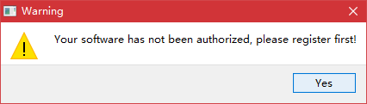
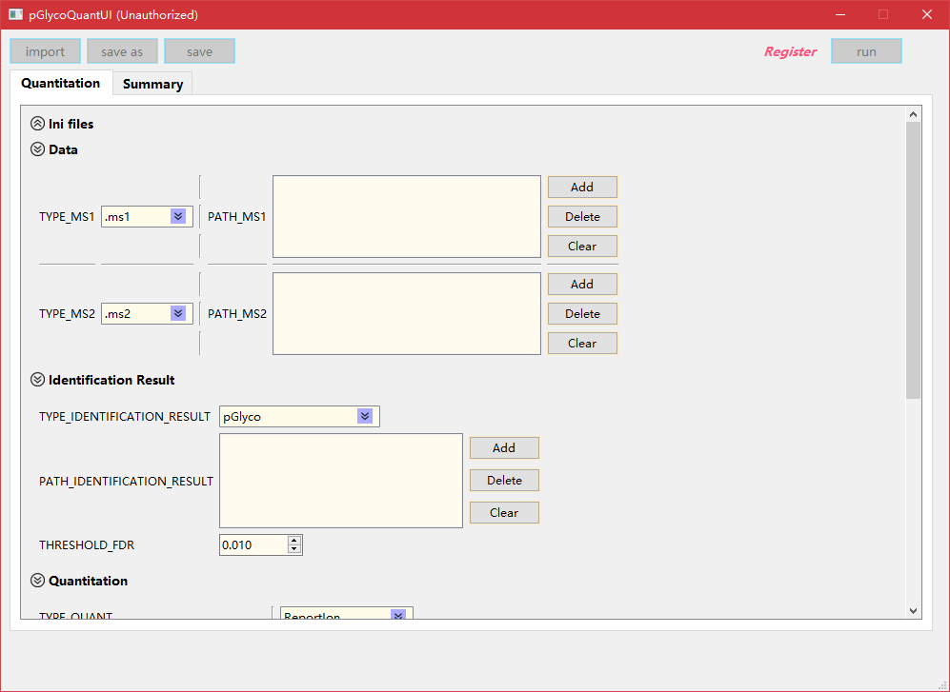
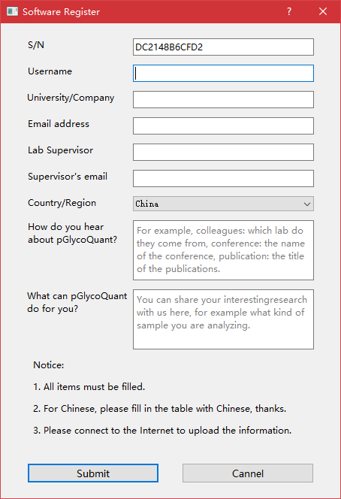
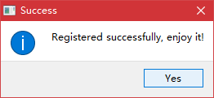
2 pGlycoQuant register
① Double click pGlycoQuantUI.exe, if software has not been authorized, click Register button, before that, make sure that your PC is linked to the Internet.
② Fill the register information and click Submit, then pGlycoQuant will be authorized.
①
②

Slide 7
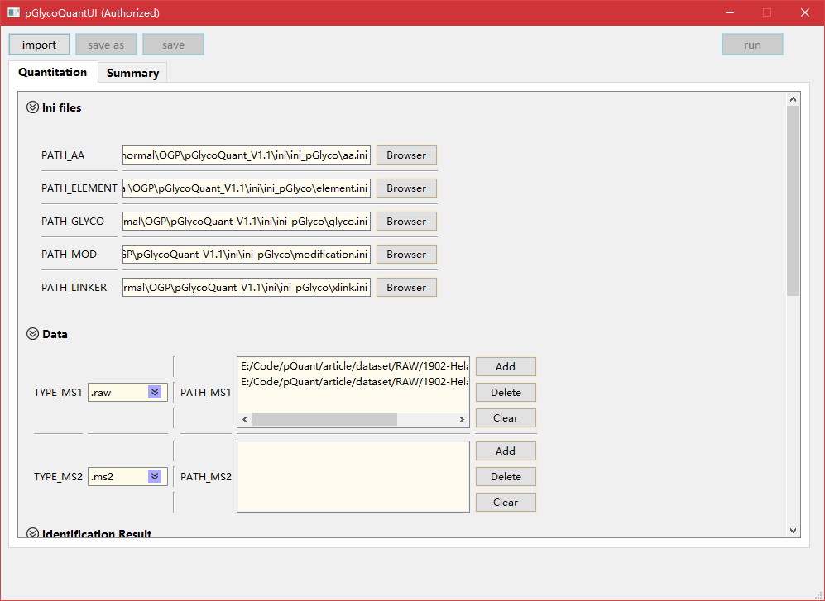
3 pGlycoQuant quantitation
① Ensure that the ini file paths are valid.
② Set the TYPE_MS1 as .raw and fill the raw files into the PATH_MS1 blank.
①
②

Slide 8
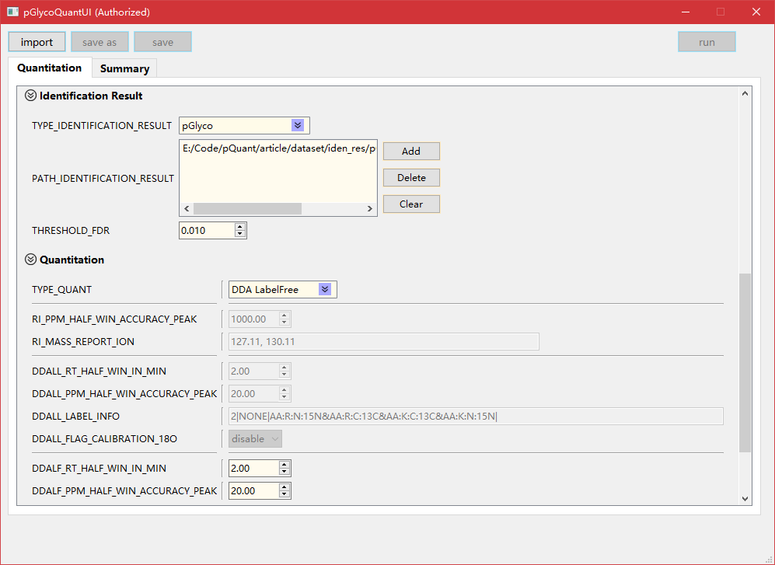
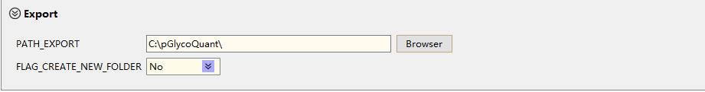
3 pGlycoQuant quantitation
① Set TYPE_IDENTIFICATION_RESULT as pGlyco (For other identification software results like Byonic and MSFragger, Byonic and MSFragger glyco-N options also can be chosen).
② Put the identification result file pGlycoDB-GP-FDR-Pro.txt (the identification result of 1902-Hela-Labelfree-01.raw and 1902-Hela-Labelfree-02.raw by using pGlyco) here and set FDR as 0.01.
③ Set TYPE_QUANT as DDA LabelFree.
④ Set the Output Folder for saving the quantitation results.
①
②
③
④

Slide 9
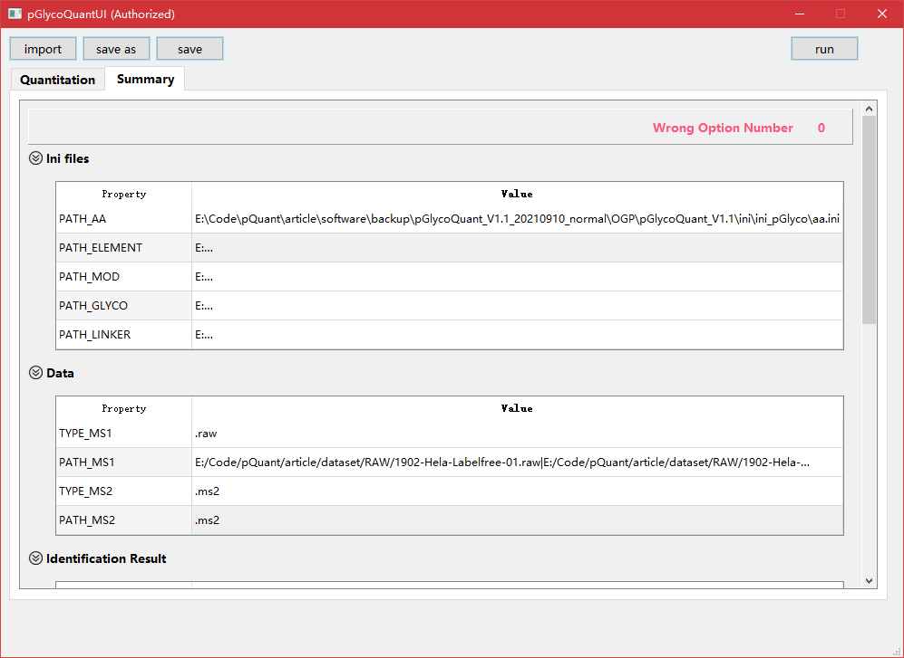
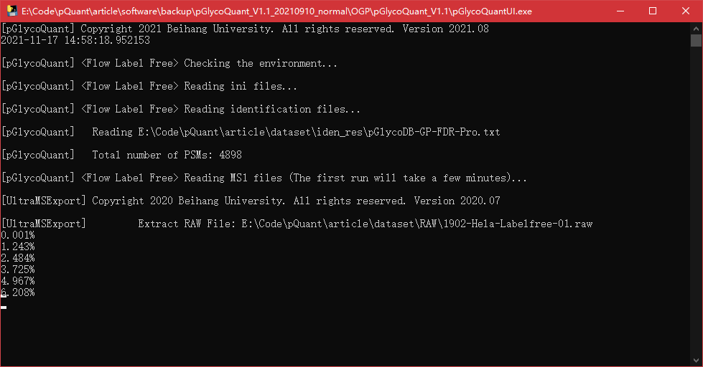
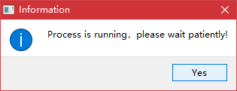
3 pGlycoQuant quantitation
③
① Click Summary button and make sure that the Wrong Option Number is 0.
② Then click save as button to save the config file.
③ Click run button to start the quantitation, the progress information will be shown in the command-line interface.
②
①
③

Slide 10
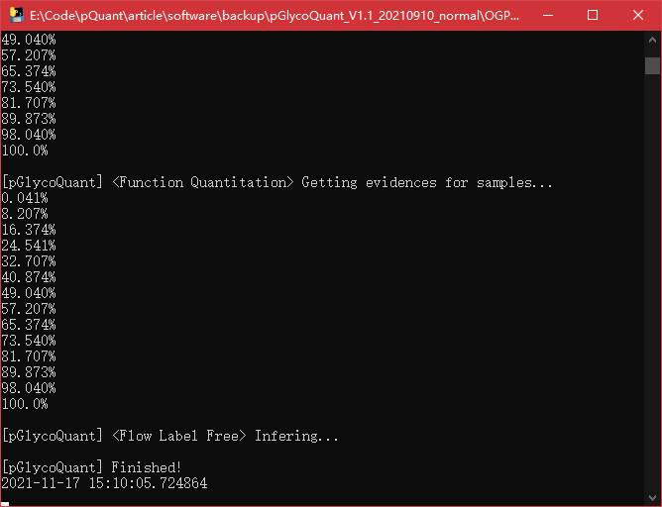
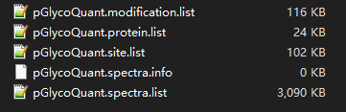
4 quantitation results
①
① The completed information.
② The quantitation results.
②

Slide 11
Thanks!

