Slide 1
Engagement Attribution
A pattern I've implemented before — sharing for team evaluation
Captures every marketing engagement as an event-level record in Salesforce.
Attributes engagement to Accounts and Opportunities through topic + account match — OCR membership not required.
Surfaces engagement intelligence on Account and Opportunity pages for sales.
Preserves raw event data for later attribution and AI work.
Sharing the design with the team; will validate fit against our actual situation once discovery is done.
May 2026
Engagement Attribution — Zelis
1 / 6

Slide 2
OCR ≠ Buying Committee
Opportunity Contact Role
People Actually Engaging
Sales-entered
Observed via HubSpot
Reflects the deal team
Reflects everyone interested
Updated when reps remember
Recorded automatically
Used by Campaign Influence
Not used by anything currently
Overlap exists but they aren't the same set. The gap includes the buying committee and ecosystem influencers (consultants, partners via AccountContactRelation).
May 2026
Engagement Attribution — Zelis
2 / 6

Slide 3
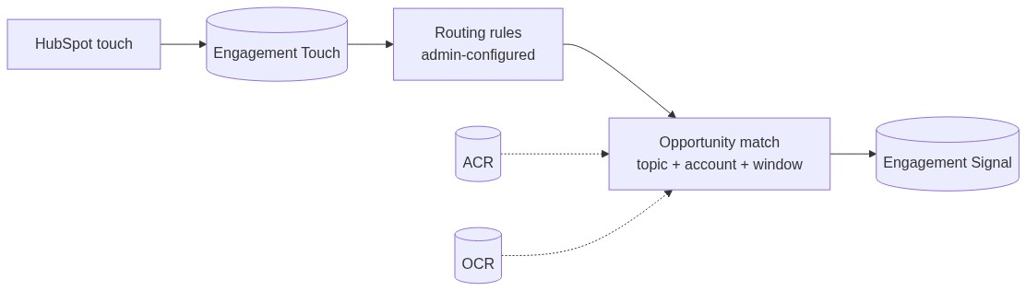
Per-Touch Records, Per-Opportunity Signals
One Engagement Touch record per HubSpot event (downloads, form fills, webinars, etc.).
Admin-managed routing rules classify each touch by topic and intent.
Opportunity matching uses topic + account + time window. OCR membership not required.
Campaign Influence keeps running unchanged; this augments it.
May 2026
Engagement Attribution — Zelis
3 / 6

Slide 4
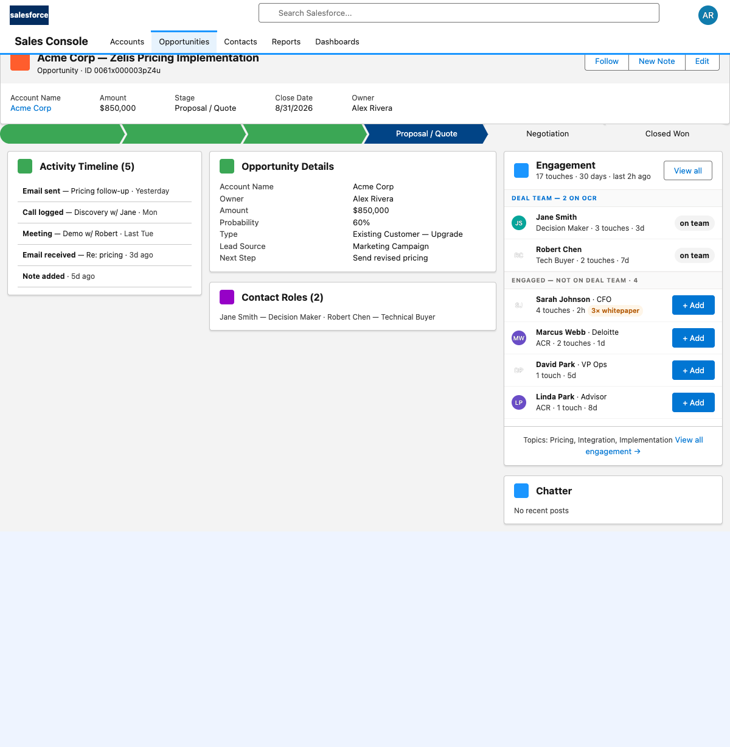
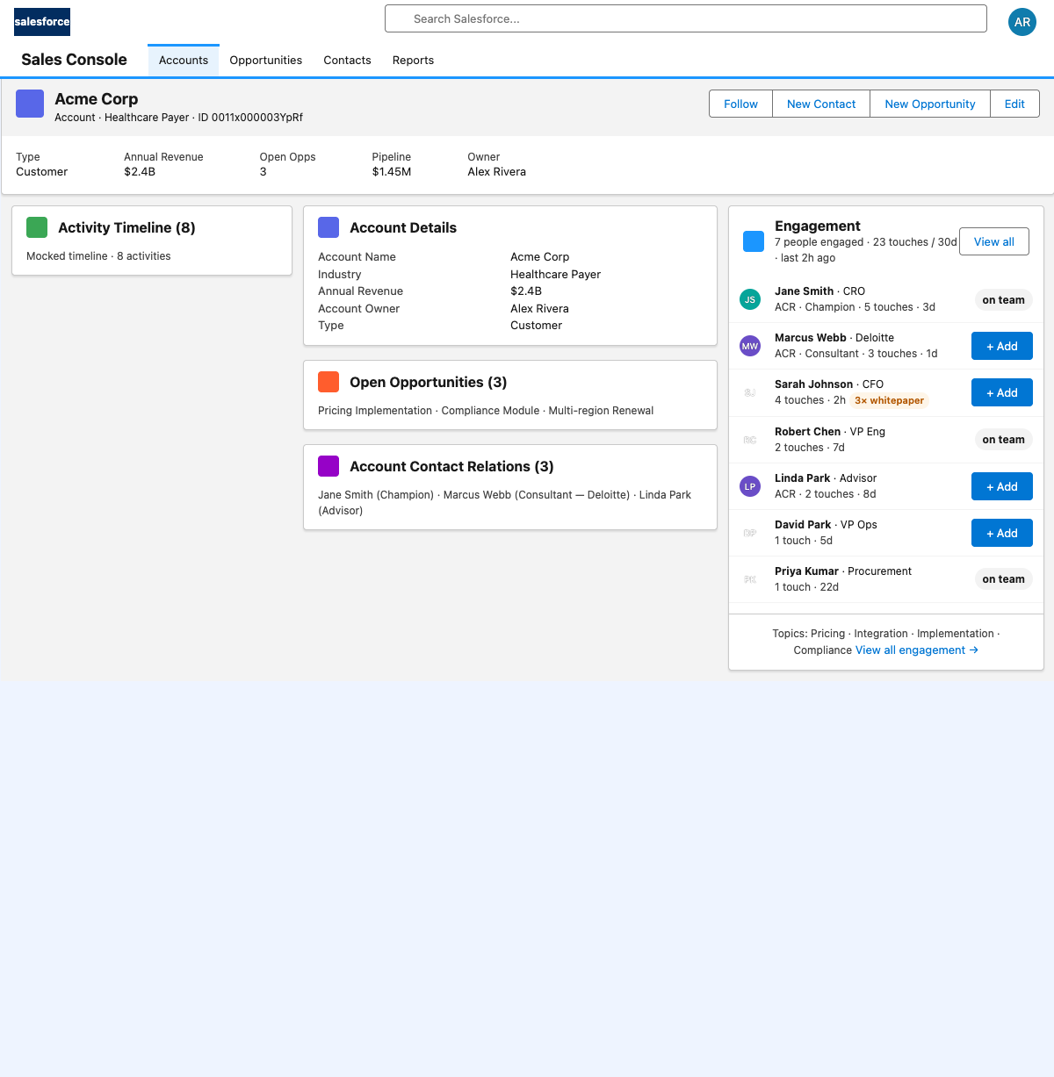
What Sales Sees — Compact Panel + Drill-Down
Opportunity view
Account view
Engagement panel sits on the right rail — small footprint, alongside Chatter and Files.
One click "+ Add" → role-picker modal → real OpportunityContactRole record created.
"View all" → grouped detail modal with per-asset history (multiple downloads of the same asset visible).
May 2026
Engagement Attribution — Zelis
4 / 6

Slide 5
Outcomes (From Prior Deployments) + AI Foundation
Available Today
Foundation for Tomorrow — AI / Next-Best-Action
Attribution covers everyone who engaged, not just OCR members.
Sales sees engagement signals tied to active opportunities.
Event-level data preserved.
Admin can add new touch types without engineering.
Campaign Influence keeps working for baseline reporting.
Per-rep next-best-action: "CFO at United Healthcare just downloaded pricing — third time. Reach out."
Buying-motion detection: sequence-aware models (executive engagement → procurement → user).
Cross-account influence: "this consultant is active across three of our deals."
Predictive deal scoring tied to engagement velocity, not just stage.
“We’re not building the AI today. We’re making sure the data is in a shape that lets us build it.”
May 2026
Engagement Attribution — Zelis
5 / 6

Slide 6
Appendix: Layer Fabric (For Reference)
fflib-aligned layers: Service / Selector / Domain / UnitOfWork / Application factory.
Custom Metadata Types for admin-configurable routing rules.
Platform Events for async decoupling (ingest → routing; lead conversion → reparenting).
Identity resolution treats unresolved touches as a first-class state (Pending Resolution).
May 2026
Engagement Attribution — Zelis
6 / 6

Slide 7
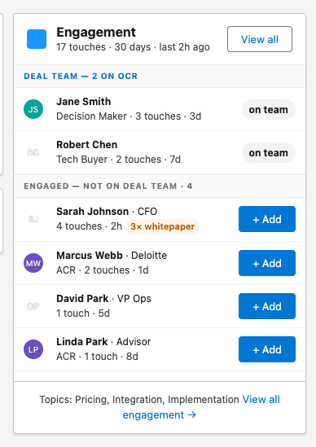
Backup — Opportunity page, compact engagement panel
Right rail · ~300px tall · Deal Team (2 on OCR) + Engaged not on Deal Team (4) · inline ‘+ Add’.
May 2026
Engagement Attribution — Zelis
7 / 10

Slide 8
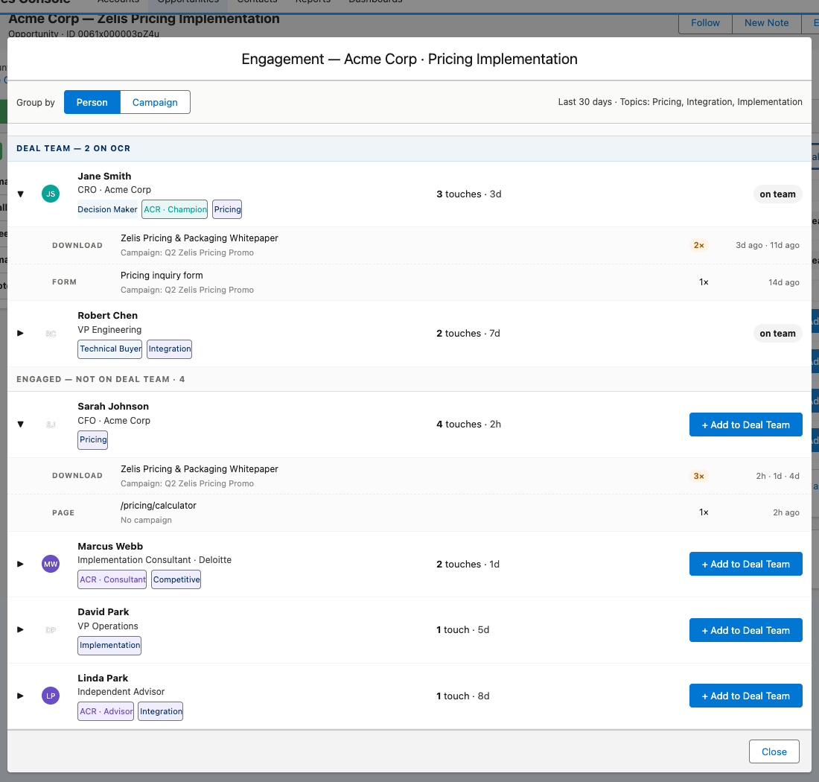
Backup — Opportunity detail modal (View all)
Full grouped detail · per-asset rows · expand caret reveals individual touches with repeat-count badges.
May 2026
Engagement Attribution — Zelis
8 / 10

Slide 9
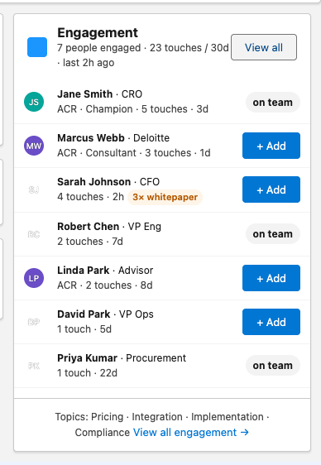
Backup — Account page, compact engagement panel
Account scope · single flat list (ACR + Contact) · same component, different scope context.
May 2026
Engagement Attribution — Zelis
9 / 10

Slide 10
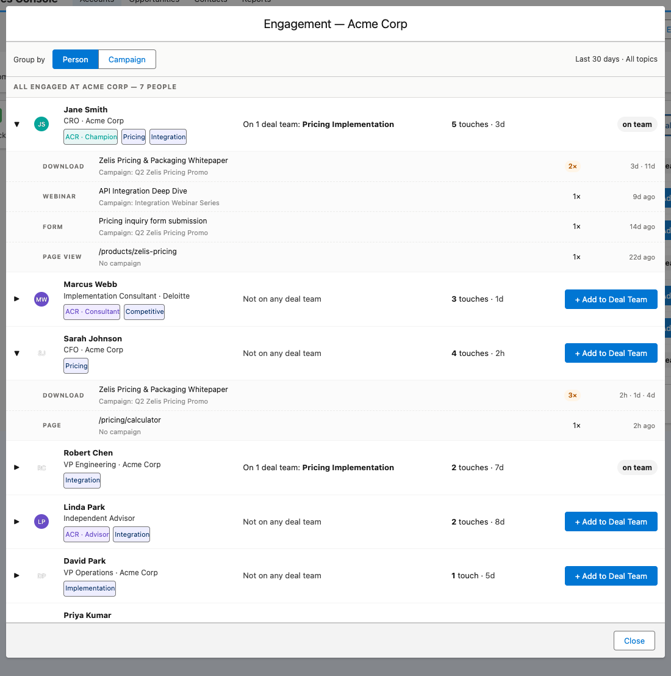
Backup — Account detail modal (View all)
All people engaged at the account · group by Person ↔ Campaign · expand for per-asset history.
May 2026
Engagement Attribution — Zelis
10 / 10

