Slide 1
Marketing Influence
Closing the attribution gap on the buying committee
Every marketing touch -> a record
Attribute via topic + account, not OCR
Right-rail panel on Account + Opportunity
Event-level data preserved for AI
Augments Campaign Influence; doesn't replace it
May 2026
Marketing Influence — Zelis
1 / 6

Slide 2
OCR is not the buying committee
Opportunity Contact Role
Everyone Engaging
Sales-entered
Observed automatically
The deal team
Everyone interested
Updated when remembered
Always current
Campaign Influence uses it
Today: nothing uses it
The gap = CFOs, evaluators, consultants, partners
May 2026
Marketing Influence — Zelis
2 / 6

Slide 3
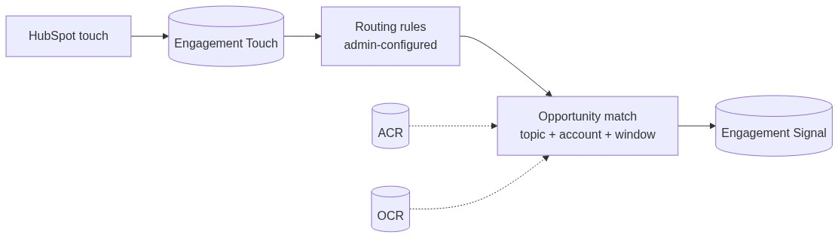
One touch in, one signal out
Each HubSpot event -> one Touch record
Admin-managed rules classify by topic, intent
Topic + account match -> signal on the Opp
Campaign Influence keeps running
May 2026
Marketing Influence — Zelis
3 / 6

Slide 4
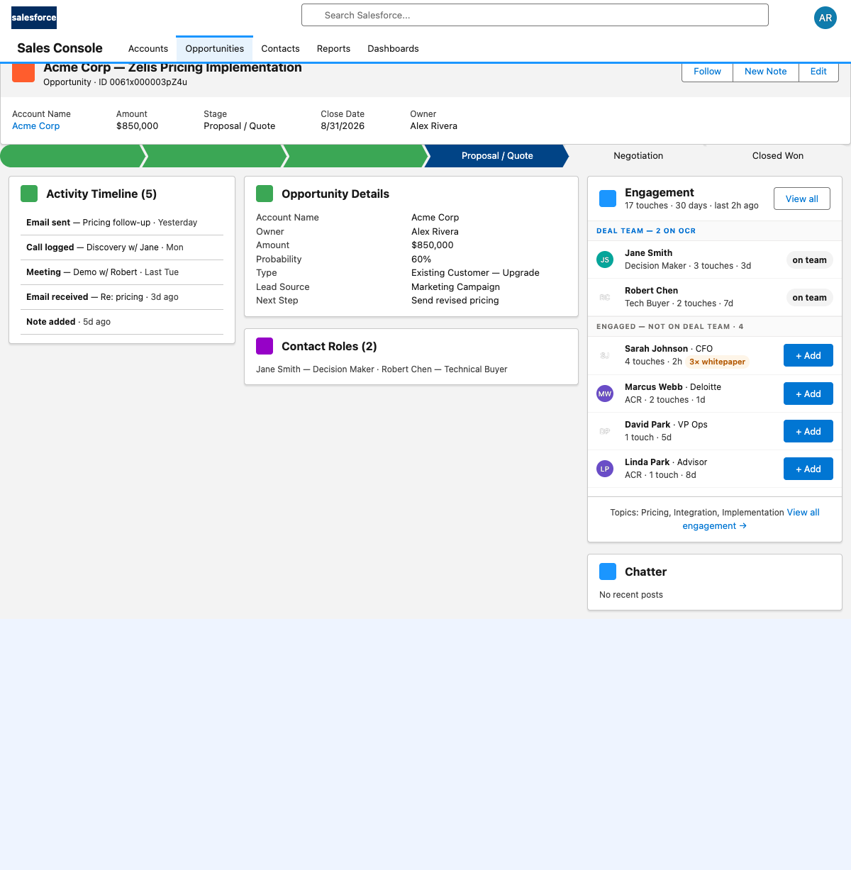
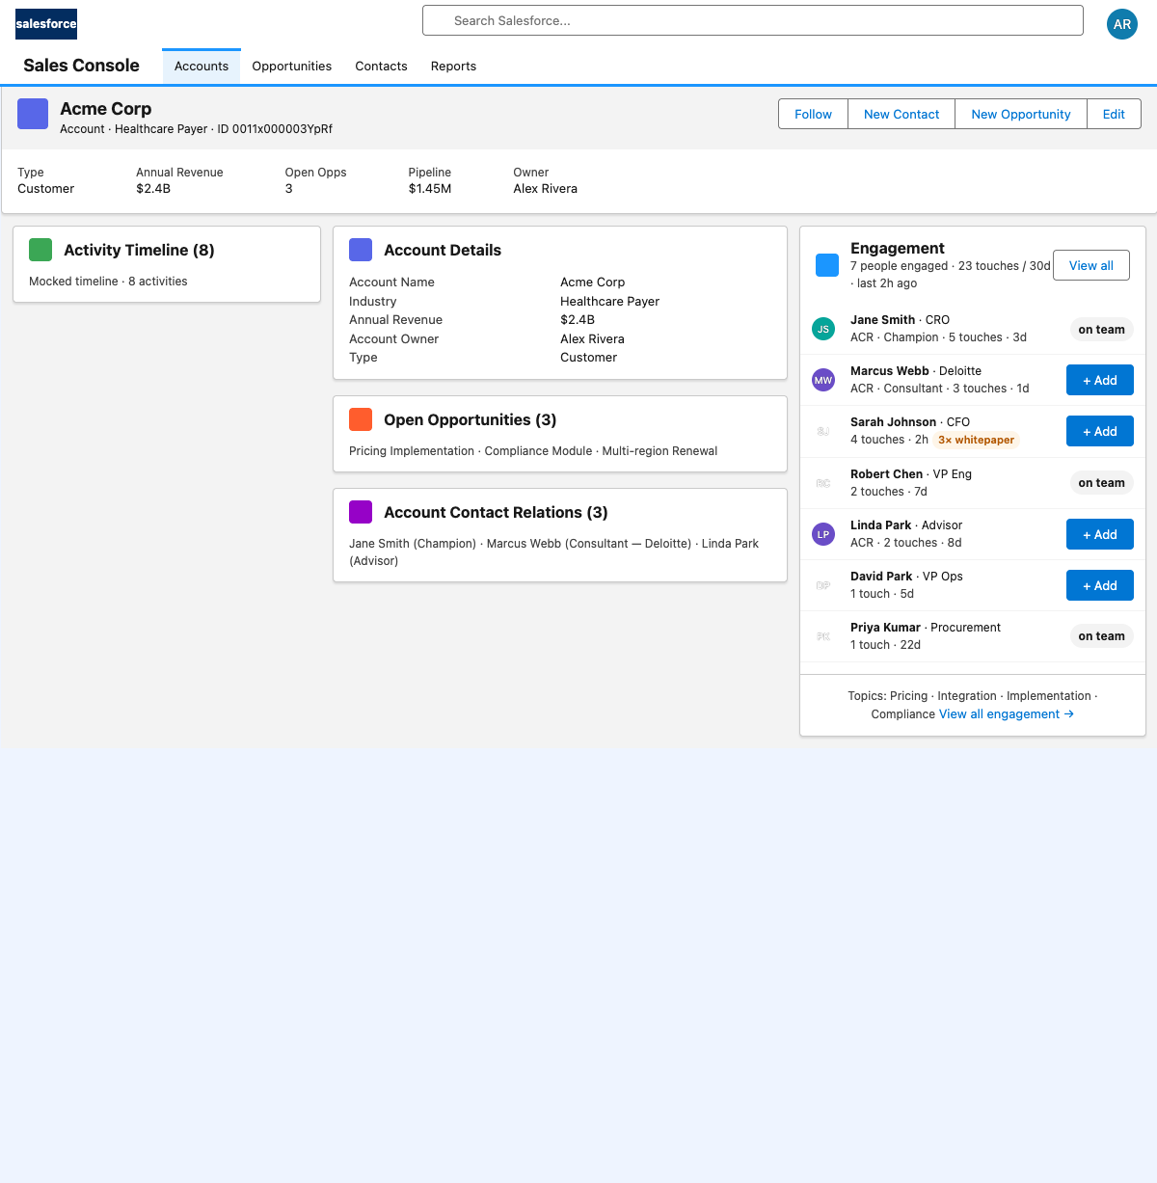
What sales sees
On the Opportunity
On the Account
Right-rail panel — small footprint
+ Add -> role-picker -> real OCR record
View all -> grouped per-asset detail
May 2026
Marketing Influence — Zelis
4 / 6

Slide 5
Today's value, tomorrow's foundation
Today
Tomorrow — AI / Next-Best-Action
Attribution covers everyone who engaged
Sales sees signals on active deals
Event-level data preserved
Admins add touch types — no engineering
Campaign Influence keeps running
Per-rep next-best-action prompts
Buying-motion sequence detection
Cross-account influence patterns
Engagement-velocity deal scoring
"Not building AI today. Shaping the data so we can."
May 2026
Marketing Influence — Zelis
5 / 6

Slide 6
Appendix — how it's built
Selector / Service / Domain layers
CMDT-driven routing rules
Trigger-based signal routing
Pending touches as a first-class state
May 2026
Marketing Influence — Zelis
6 / 6

Slide 7
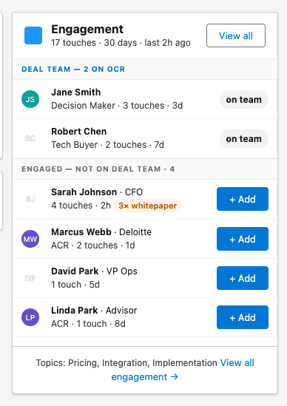
Backup — Opportunity panel
Deal Team + Not on Deal Team. Inline + Add.
May 2026
Marketing Influence — Zelis
7 / 10

Slide 8
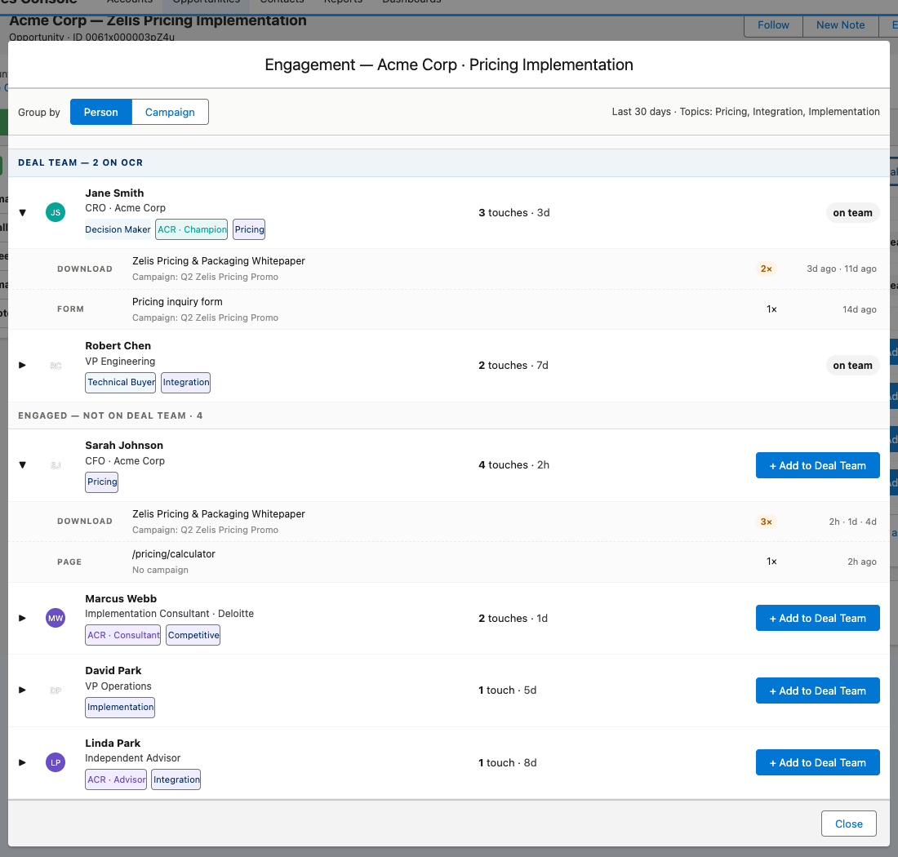
Backup — Opportunity detail modal
Per-asset rows. Expand for individual touches.
May 2026
Marketing Influence — Zelis
8 / 10

Slide 9
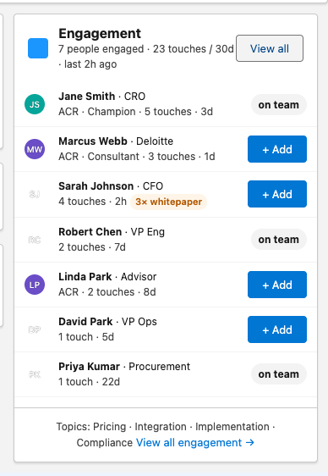
Backup — Account panel
Flat list. ACR + Contact. Same component, account scope.
May 2026
Marketing Influence — Zelis
9 / 10

Slide 10
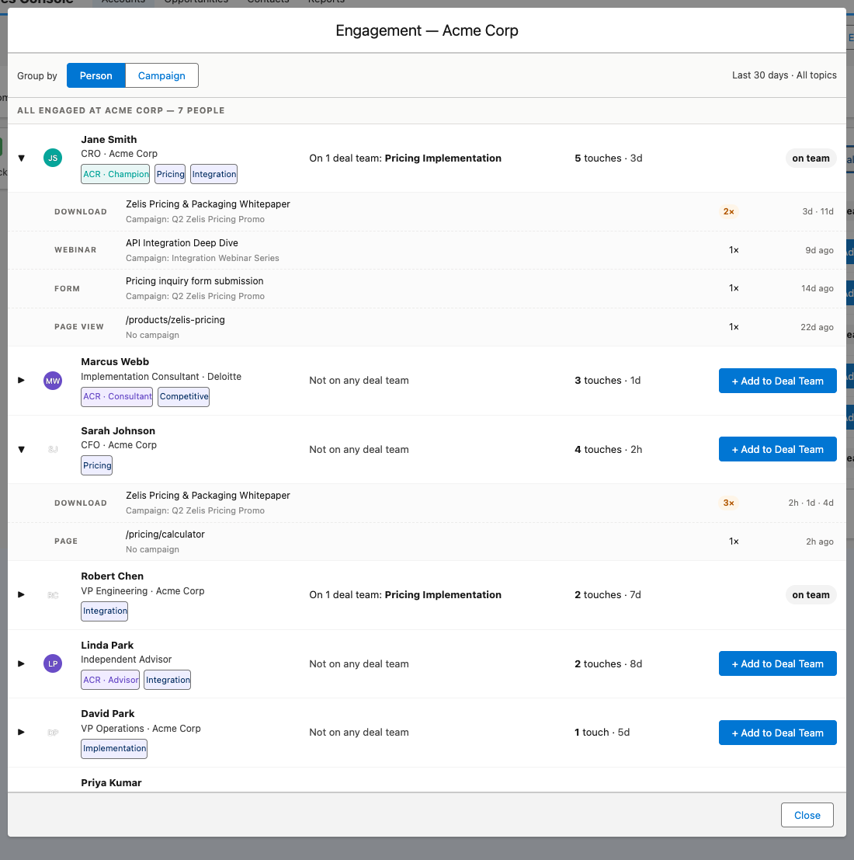
Backup — Account detail modal
All engaged people. Group by Person ↔ Campaign.
May 2026
Marketing Influence — Zelis
10 / 10

