Slide 1
Understand Customer Portfolio Using Machine Learning
lIYAN Wang | Solutions Engineering

Slide 2
Agenda
Project Introduction
Dataset Overview
Data Pre-processing
Model Building
Model Interpretation
Model Usage
Future Work

Slide 3
Project Introduction
This project aims to use Showpad customers' profile(historical data) to build statistical models that will help understand:
What patterns indicate customer will churn
How likely the customer will churn
What score the customer should be labeled in terms of risk to churn
Suggested Methods:
Logistic regression, Random forest, K-nearest Neighbor, Linear Discriminant Analysis, Naïve Bayes, Neural Network

Slide 4
Glance at Dataset
In the original csv file, there are 1,091 rows of records and 40 columns, where 4 rows are just created for test. So only 1,087 rows contain real data.
51 out of 1,087 rows have irrelevant values
40 columns/variables are mixed with categorical(governing law) and numeric(# of licenses used) variables.

Slide 5
Data Cleaning
After meeting with Joy and Shannon on Jun 27th, we decided to remove the following 14 highlighted variables from dataset:
Customer Name
SFDC Account ID
Okay for Speech API Rollout?
Current Location (primary)
Current Location (secondary)
Filename (primary)
Filename (secondary)
Initial Term Start Date
Initial Term Length
Auto-renewal
Termination Rights
Marketing
Non-Solicit Obligations
Legal Terms and Conditions
SLA
DPA
Privacy Policy Change Notice Requirement
Data or Security Breach Notice Requirement
Change of Control provision
Governing Law
Notable Non-Standard Terms
Outrageous Terms
Expected Renewal ARR * (converted) Currency
Expected Renewal ARR * (converted)
Account Status
Account Contract End Date
Account Owner
Customer Success Coach
Expected Renewal ARR * Currency
Expected Renewal ARR *
Package
N° of Licenses
Used Licenses
Assigned users
Segment
Employees
Fortune Rank
Billing State/Province
Billing Country
Hoovers Industry

Slide 6
Data Transformation(1)
Transformation on the remaining variables:
Convert 'Initial term start date’ to 'Duration’, i.e. calculated from initial term start date to “today’s” date(Jul 23rd).
Group/Bucket variables into standard/uniformed format
Convert 'Notable Non-standard Terms' and 'Outrageous Terms' into binary type and combine , i.e. any filled-in contents is considered 'Yes'
Convert currency into uniformed format, i.e. use 'Expected Renewal ARR *' of its own currency to generate renewal ARR in EUR
Impute ‘Employees’ missing values with most frequent values

Slide 7
Data Reduction
Run random forest model to screen out variables making no contributions to model building. Kept variables are shown below:
Okay for Speech API Rollout?
Duration
Initial Term Length
Auto-renewal
Termination Rights
Marketing
Non-Solicit Obligations
Legal Terms and Conditions
SLA
DPA
Privacy Policy Change Notice Requirement
Data or Security Breach Notice Requirement
Change of Control provision
Governing Law
Notable Non-Standard Terms
Outrageous Terms
Expected Renewal ARR
Package
N° of Licenses
Used Licenses
Assigned users
Segment
Employees

Slide 8
Data Transformation(2)
Create dummy variables* for remaining categorical variables after feature selection: Auto-renewal, Termination rights, Package and etc.
Use min-max normalization* for numeric variable standardization: Duration , Expected Renewal ARR, N° of Licenses, Used Licenses, Assigned users and Employees
* Dummy variables: representation takes the value 0 or 1 to indicate the absence or presence of some categorical effect. For example: Gender has 2 levels, female and male, and can be represented as gender_F and gender_M. Female is coded as (1,0) and male (0,1).
* Mix-max normalization: x_scaled = (x-min(x)) / (max(x)–min(x)) with default x-scaled range (0,1)

Slide 9
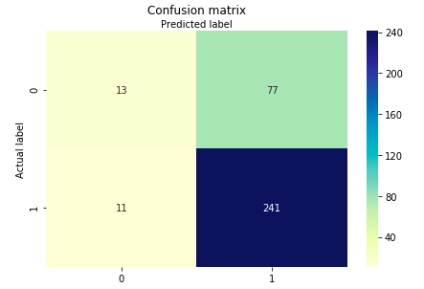
Model Building
1,036 rows and 36variables used
67/33 split of training and test
12 models were built using different classification algorithms.
The best model was using logistic regression with L1 penalty, which had an accuracy of 74.27% on test data.
10 fold cross validation: Overall Accuracy: 0.71 (+/- 0.03)

Slide 10
Model Interpretation
Predictor | Representation | Estimate
(intercept) |  | -0.22679842
termination_rights_2 | Yes - less than 90-day notice | 0.39039065
legal_terms_3 | Standard (MSA 1Apr18) | -0.32973426
legal_terms_4 | Standard (3Apr17) | -0.05593888
legal_terms_5 | Standard (15Nov16) | 1.40385712
sla_1 | SLA - No | 0.63694925
sec_breach_note_1 | No | -0.4317903
sec_breach_note_2 | Yes - within 24 hours of discovery | -1.73722291
sec_breach_note_3 | Yes - between 24-48 hours after discovery | 0.60964524
sec_breach_note_4 | Yes - greater than 48 hours after discovery | 1.33329409
package_1 | Enterprise | 0.34575481
package_4 | Professional | 0.47580221
package_5 | Ultimate | -1.25153624
segment_0 | MM | -0.12035668
segment_1 | ENT | 0.10391241
renewal_ARR |  | -5.63414579

Slide 11
Predictor | Representation | Estimate
(intercept) |  | -0.22679842
termination_rights_2 | Yes - less than 90-day notice | 0.39039065
legal_terms_3 | Standard (MSA 1Apr18) | -0.32973426
legal_terms_4 | Standard (3Apr17) | -0.05593888
legal_terms_5 | Standard (15Nov16) | 1.40385712
sla_1 | SLA - No | 0.63694925
sec_breach_note_1 | No | -0.4317903
sec_breach_note_2 | Yes - within 24 hours of discovery | -1.73722291
sec_breach_note_3 | Yes - between 24-48 hours after discovery | 0.60964524
sec_breach_note_4 | Yes - greater than 48 hours after discovery | 1.33329409
package_1 | Enterprise | 0.34575481
package_4 | Professional | 0.47580221
package_5 | Ultimate | -1.25153624
segment_0 | MM | -0.12035668
segment_1 | ENT | 0.10391241
renewal_ARR |  | -5.63414579
Although the table contains 15 rows, the estimates are from a model that contains 7 predictor variables. There are two different reasons why the number of predictors differs from the number of estimates. The estimate of the (Intercept) is unrelated to the number of predictors; The second reason is that sometimes categorical predictors are represented by multiple coefficients.
Now look at the estimate for termination_rights_2. It is 0.76. As this is a positive number, we say that its sign is positive. The interpretation is that all else being equal, customers choose 30 day notice auto-renewal are more likely to have churned.

Slide 12
Predictor | Representation | Estimate
(intercept) |  | -0.22679842
termination_rights_2 | Yes - less than 90-day notice | 0.39039065
legal_terms_3 | Standard (MSA 1Apr18) | -0.32973426
legal_terms_4 | Standard (3Apr17) | -0.05593888
legal_terms_5 | Standard (15Nov16) | 1.40385712
sla_1 | SLA - No | 0.63694925
sec_breach_note_1 | No | -0.4317903
sec_breach_note_2 | Yes - within 24 hours of discovery | -1.73722291
sec_breach_note_3 | Yes - between 24-48 hours after discovery | 0.60964524
sec_breach_note_4 | Yes - greater than 48 hours after discovery | 1.33329409
package_1 | Enterprise | 0.34575481
package_4 | Professional | 0.47580221
package_5 | Ultimate | -1.25153624
segment_0 | MM | -0.12035668
segment_1 | ENT | 0.10391241
renewal_ARR |  | -5.63414579
The renewal_ARR coefficients tell us that customers have higher renewal ARR are less likely to have churned.
Customers who subscribe to Enterprise and Professional package are more likely to churn whereas those who subscribe to Ultimate are less likely to have churned.
The effect of having a customer subscribing to Ultimate versus Enterprise (1.25 – 0.34 = 0.91) is about twice as big in terms of leading to churn as is the effect of subscribing to Professional(0.47).

Slide 13
Model Interpretation
Indicators that customer are more likely to churn:
Termination rights: Yes - less than 90-day notice
Legal terms: Standard (15Nov16)
SLA: No
Data or Security Breach Notice Requirement: Yes - between 24-48 hours after discovery, Yes - greater than 48 hours after discovery
Package: Enterprise, Professional
Segment: ENT

Slide 14
Model Interpretation
Indicators that customer are less likely to churn:
Legal terms: Standard (MSA 1Apr18), Standard (3Apr17)
Data or Security Breach Notice Requirement: No, Yes - within 24 hours of discovery
Package: Ultimate
Segment: MM
Renewal_ARR

Slide 15
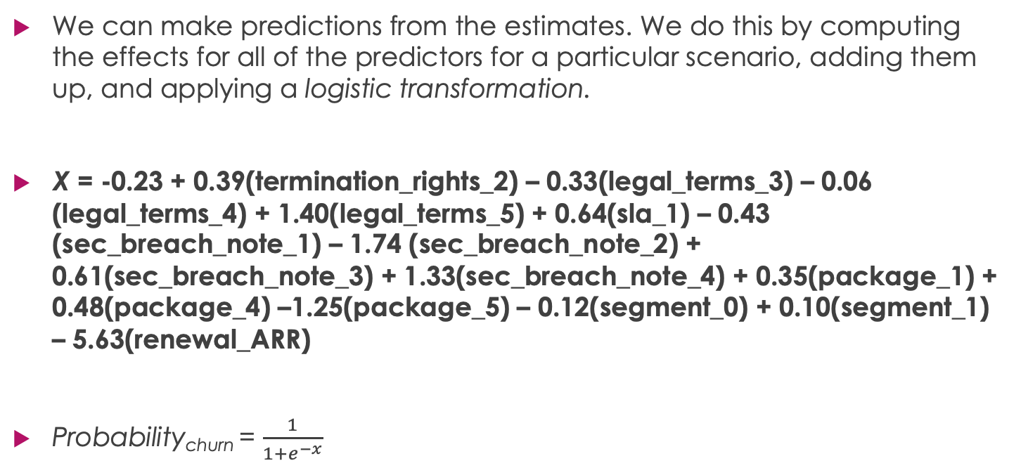
Model Usage
We can make predictions from the estimates. We do this by computing the effects for all of the predictors for a particular scenario, adding them up, and applying a logistic transformation.
X = -0.23 + 0.39(termination_rights_2) – 0.33(legal_terms_3) – 0.06 (legal_terms_4) + 1.40(legal_terms_5) + 0.64(sla_1) – 0.43 (sec_breach_note_1) – 1.74 (sec_breach_note_2) + 0.61(sec_breach_note_3) + 1.33(sec_breach_note_4) + 0.35(package_1) + 0.48(package_4) –1.25(package_5) – 0.12(segment_0) + 0.10(segment_1) – 5.63(renewal_ARR)
Probability_{churn} = $\frac{1}{1+e^{−x}}$

Slide 16
Model Usage
Now we have computed probability of churn for each customer, we could look at probability distribution and use it to score a customer.
5-scale score generated from whole dataset:
1: Unlikely to churn
2: Slightly likely to churn
3: Moderately likely to churn
4: Very likely to churn
5: Extremely likely to churn

Slide 17
Future Work
We have historical data(customers active at Feb2018) built for the model. If an updated dataset is provided for test or validation, the model should be more generalized and robust.
No record contains governing law in Ireland nor Texas, which was suggested as a separate grouping level. Germany was grouped with ’the rest countries in the EU’ because only 2 rows were found.
33 % of employees were missing in the original dataset. If real data was provided, it is possible that employee is a predicting variable.

Slide 18
Questions?

