Slide 1
BUSINESS REQUIREMENTS DOCUMENT
Traveler Guide
A personalized travel companion that turns any trip into a journey — suggesting places to explore along your route, always with the traveler in control.
React Native
Next.js
NestJS Microservices
MySQL Spatial
Mapbox
AI Voice
v1.0 · Draft for review · 08 Aug 2026

Slide 2
SECTION 1 & 2
Purpose & Objectives
Purpose
Objectives
Traveler Guide is a mobile app that turns an ordinary drive from A to B into a personalized journey. It suggests places to explore along the way — matched to the traveler's interests — and never changes the route or adds a stop without the traveler's confirmation.
1
Personalize every trip using profile interests plus trip-specific interests.
2
Suggest relevant stops — history, food, nature, fuel, prayer, rest — along the route.
3
Keep the traveler in control: no route change or stop without confirmation.
4
Offer a hands-free AI voice assistant for safe use while driving.
5
Run reliably and scale on a microservices backend.

Slide 3
SECTION 3
Scope
In Scope
Out of Scope (initial phase)
iOS & Android app (React Native CLI), plus public website & admin portal (Next.js).
Map providers beyond Mapbox (Google / OSM added later).
Onboarding & profile interests; trip-specific interests & preferences.
Elasticsearch / OpenSearch (architecture ready, MySQL search first).
Personalized routes with recommended stops along the way.
Payment methods beyond Apple Pay, Google Pay & the Saudi gateway.
AI voice assistant, social posts, friends, chat, reviews and trips.
Offline maps and fully offline trip mode.
Businesses, subscriptions & payments; admin & moderation.

Slide 4
SECTION 4
Stakeholders & User Roles
Role | Platform | Access
Traveler | Mobile app | Plans and takes trips, sets interests, gets recommendations, posts and reviews.
Business Owner | Web / mobile | Manages a business listing and promotions; views business analytics.
Moderator | Admin portal | Reviews and moderates places, posts, reviews and reported content.
Admin | Admin portal | Manages users, businesses, content, interests and platform settings.
Super Admin | Admin portal | Full control — all data, roles, recommendation weights and reports.

Slide 5
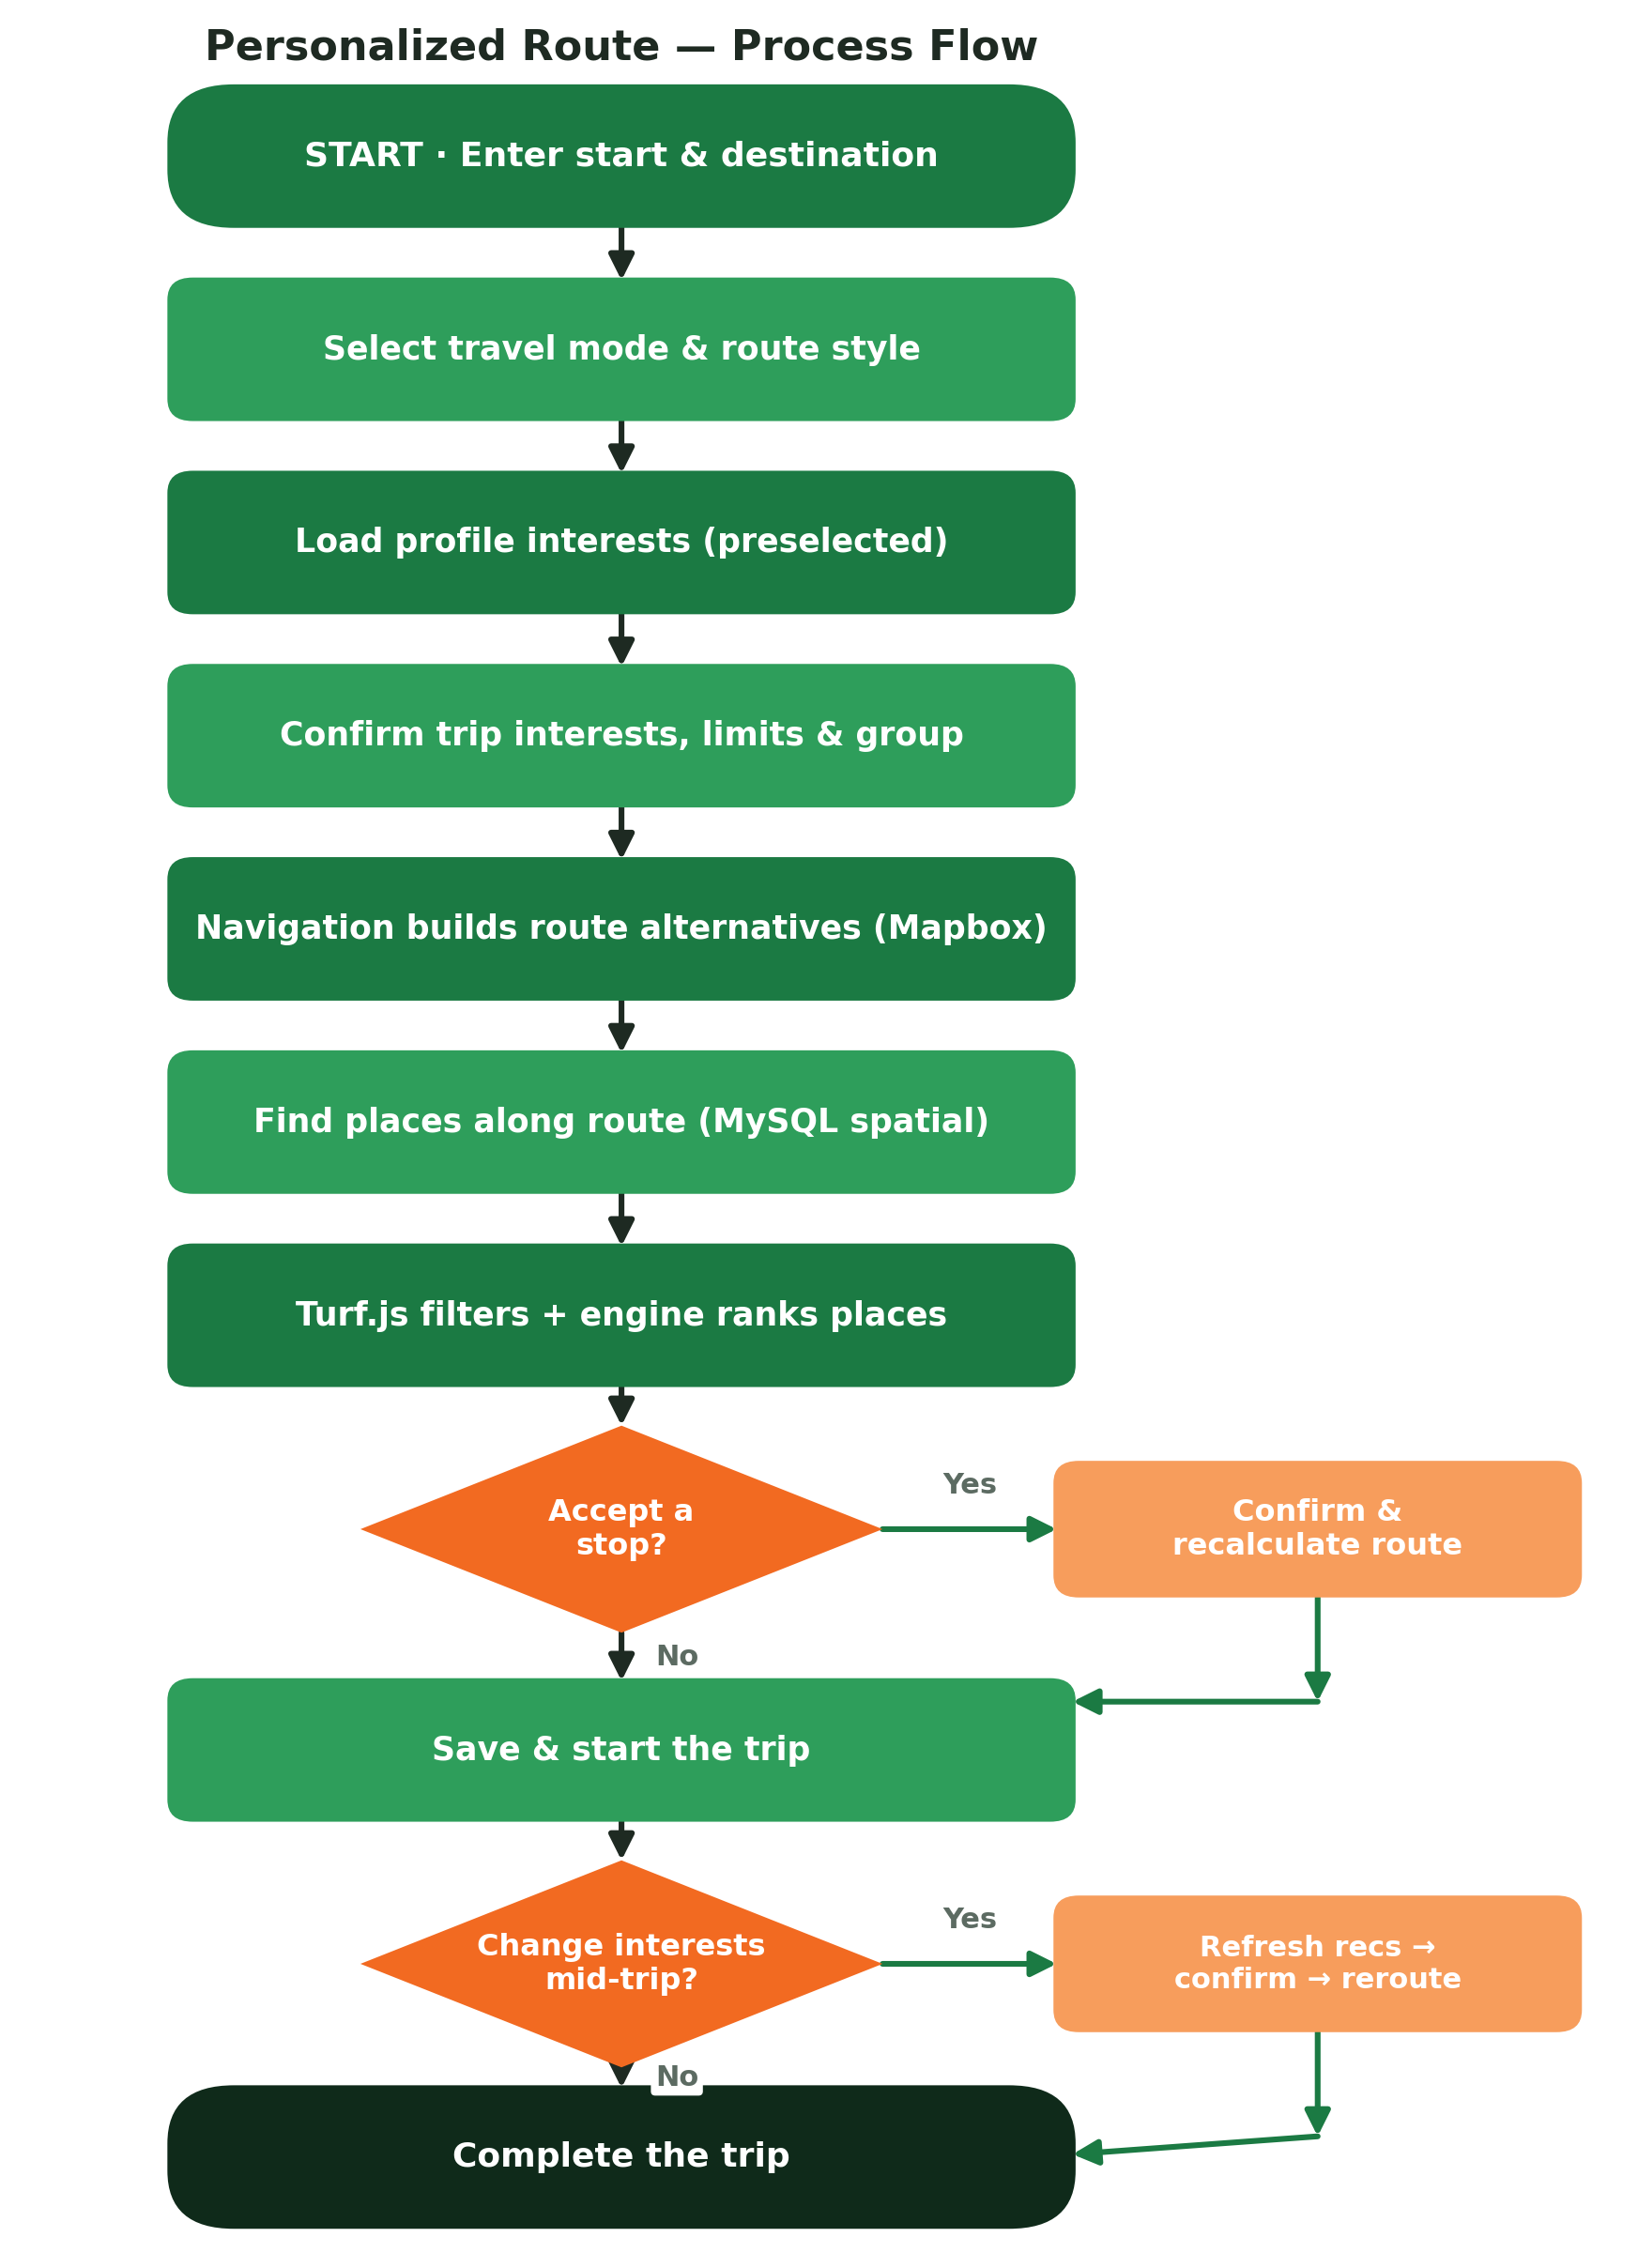
SECTION 5
Personalized Route — Process Flow
How a trip goes from a start and destination to a personalized route. The route only changes after the traveler confirms — and the same applies when interests change mid-trip.
Key rule No route change and no added stop happens without the traveler's confirmation — including AI voice actions.

Slide 6
SECTION 6
Functional Requirements
ID | Requirement
FR-01 | Register & log in with JWT access and refresh tokens; role and permission based access.
FR-02 | Onboarding: select profile travel interests — skippable and editable later.
FR-03 | Manage profile interests: add, remove, enable/disable, set priority, reset.
FR-04 | Set default travel preferences: route style, extra time, deviation, group, auto-stops.
FR-05 | Create a trip by entering a start, destination and travel mode.
FR-06 | Trip interests preselected from profile and editable per trip (override profile).
FR-07 | Calculate route alternatives via Mapbox with traffic-aware duration.
FR-08 | Find candidate places along the route using MySQL spatial queries.
FR-09 | Rank places with the recommendation engine (interests, rating, deviation, more).
FR-10 | Review recommendations and accept or reject stops.
FR-11 | Recalculate the route only after the traveler confirms a stop or route change.
FR-12 | Change interests during an active trip and refresh recommendations.
FR-13 | AI voice assistant prepares changes but always asks for confirmation.
FR-14 | Social, chat, reviews, businesses, subscriptions & payments; admin & moderation.

Slide 7
SECTION 7
Personalized Interests & Recommendations
1 · Profile Interests
2 · Trip Interests
Chosen at onboarding (History, Food, Nature, Adventure…). Saved as defaults. Can be skipped, edited, prioritized or reset any time.
Asked before every route: “What would you like to explore on this trip?” Preselected from the profile, but editable — and they OVERRIDE profile interests.
Recommendation score — what ranks a place
Adds points: trip & profile interest match · priority · route style · rating · popularity · open now · weather · group & budget fit · saved places.
Subtracts points: route deviation · extra travel time · previously rejected · already visited.
Sponsored places may get a small, limited boost, must still match interests, and are clearly marked.

Slide 8
SECTION 8
Non-Functional Requirements
Area | Requirement
Security & Privacy | JWT auth, role & permission access, per-service MySQL accounts, location retention limits.
Architecture | NestJS microservices; each service owns its own MySQL database; no cross-database access.
Communication | REST via the API Gateway; RabbitMQ RPC (sync) and events (async).
Real-time | WebSockets for chat, notifications, live trips, location and AI streaming.
Performance | Redis caching, MySQL spatial indexes, provider & recommendation caching, pagination.
Data | MySQL 8.4 spatial types & indexes; Prisma ORM; Turf.js for route geometry.
Quality | TypeScript strict mode; unit, integration & end-to-end tests; builds must pass.
Deployment | Docker & Docker Compose; pnpm workspaces & Turborepo.

Slide 9
SECTION 9
Microservices Architecture
17 independent services, each owning its own MySQL database and communicating through the API Gateway and RabbitMQ.
API Gateway
Auth
User
Trip
Place
Navigation
Social
Chat
Notification
Media
AI
Payment
Business
Moderation
Analytics
Search
Scheduler

Slide 10
SECTION 10
Technology Stack
Layer | Technology | Purpose
Mobile app | React Native CLI | Android & iOS app (no Expo).
Web & Admin | Next.js | Public website and admin portal.
Backend | NestJS microservices | 17 services, clean architecture.
Database | MySQL 8.4 (spatial) | Per-service DB; spatial types & indexes.
ORM | Prisma (MySQL) | Data access and migrations.
Cache / Sessions | Redis | Caching, sessions, queues, presence.
Messaging | RabbitMQ | RPC (sync) and events (async).
Real-time | WebSockets | Chat, notifications, live trips, AI streaming.
Geometry | Turf.js | Route corridors & deviation filtering.
Maps | Mapbox | Routes, traffic, alternatives.
Storage | AWS S3 / MinIO | Media storage (MinIO for local dev).
Payments | Apple / Google Pay + Saudi gateway | Subscriptions & purchases.
DevOps | Docker · pnpm · Turborepo | Containers and monorepo tooling.

Slide 11
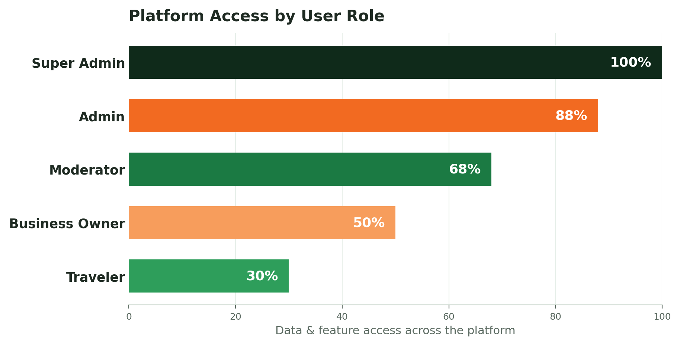
SECTION 11
Platform Access by Role
Access is tiered — travelers get what they need for their own trips, while admins and super admins oversee the whole platform.

Slide 12
SECTION 12
Key Rules & Success Metrics
Key Rules
Success Metrics
Trip interests override profile interests.
Recommendation acceptance rate.
No route change or added stop without confirmation — AI included.
Trips completed and interests personalized per trip.
Each service owns its own MySQL database; no cross-DB access.
AI voice assistant adoption.
Location data has retention limits; access is role-based.
Business promotion & subscription conversion.

