Slide 1
Poker Chip Counter
Emory Hackathon 2014
Sheng Jiang, Andrew Lei, Mark Qi, Jesse Zhao

Slide 2
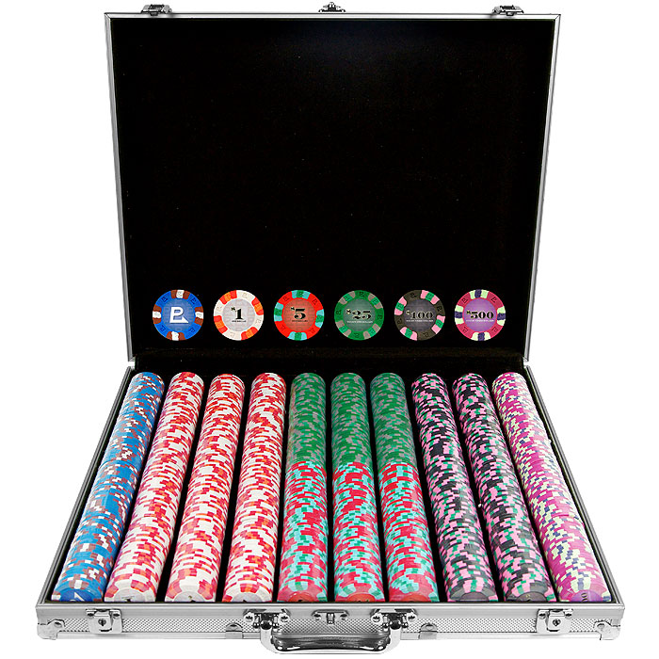
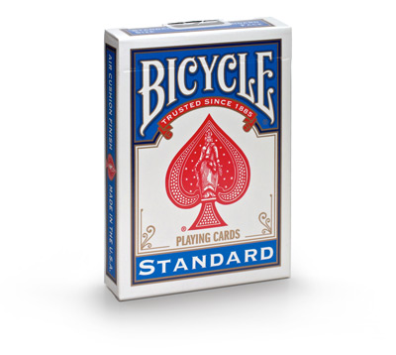
Inspiration
Vs.
Platform: Node.js, Heroku as cloud hosting server

Slide 3


Thank You!
Emory Hackathon
Microsoft Corporation
All the sponsors

