Slide 1

Predicting and Optimizing a Marketing Campaign
Alice Fan

Slide 2
Predictive Modeling for Marketing
Understanding impact and effectiveness of campaigns is crucial for businesses
Allows for efficient allocation of resources, and ability to target the right audience
Overall, predictive modeling can improve ROI for marketing campaigns

Slide 3
Marketing Dataset & Features
This Kaggle dataset is synthetic and has customer information as well as previous campaign outcome result. The ‘target’ column indicates whether or not a campaign was successful.
It has over 31K unique records.
Features include:
Age
Gender
Occupation
Marital Status
Account Balance
Campaign Outcome
Last Campaign Result
Campaign Duration
And more
https://www.kaggle.com/datasets/khanimar/marketing-campaign-analysis-data

Slide 4
Data Cleaning Problems & Solutions
The dataset was already fairly clean. There were only two issues that needed to be addressed.
Problem No 1: There are newer customers that was not a part of the campaign prior to this one, so there were a lot of null values that needed to be filled in the “day since last campaign” column. Those null values were replaced with -1.
Problem No 2: There were a few outliers within the dataset that had extremely high account balances compared to the rest. Those were taken out of the dataset.
Data Cleaning Notebook: https://github.com/expl0ding/Capstone3/blob/main/Capstone_3_Data_Clean.ipynb :

Slide 5
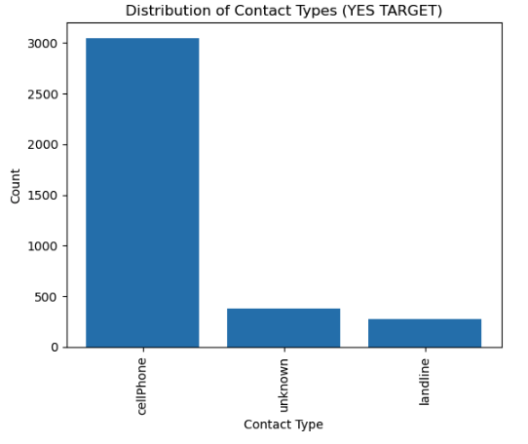
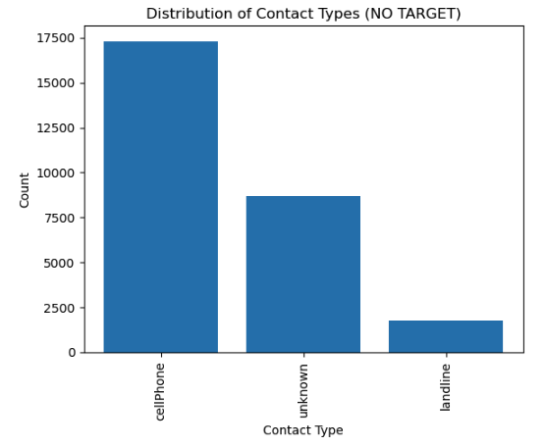
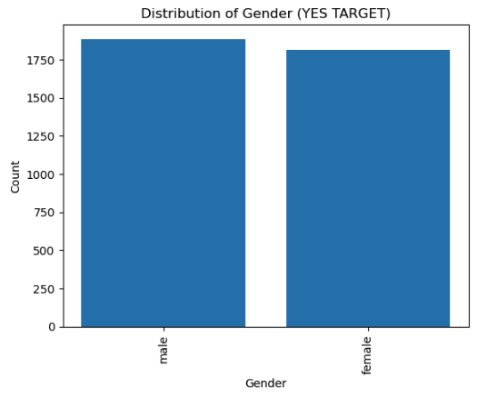
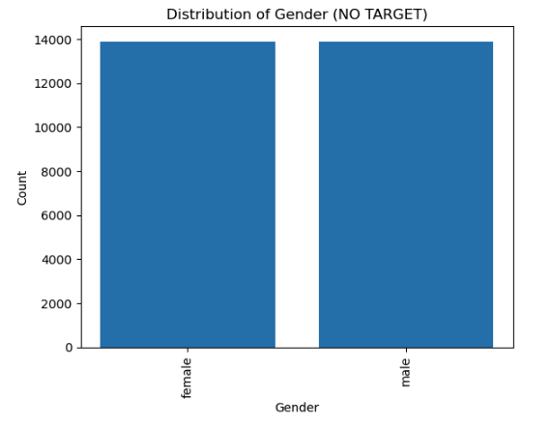
Data Exploration
Contact Type Converted vs Not Converted
I separated the dataset into those that converted and those that did not, to look at the difference in features. A majority of the features did not make an impact in the outcome of the campaign. Those include, distribution of contact types, gender, among some others.
As you can see in the charts to the left, they are pretty evenly distributed across converted and not converted campaigns.
Gender Converted vs Not Converted
EDA Notebook: https://github.com/expl0ding/Capstone3/blob/main/Capstone3_EDA.ipynb

Slide 6
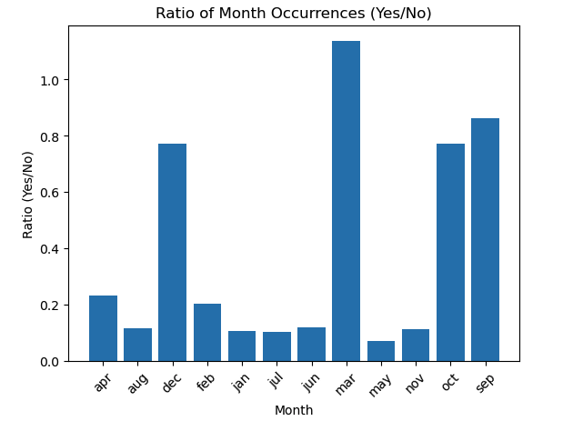
Data Exploration
Looking at the successful and failed campaigns by month, March, December, September, and October have the highest likelihood for the campaign to be successful.
EDA Notebook: https://github.com/expl0ding/Capstone3/blob/main/Capstone3_EDA.ipynb

Slide 7
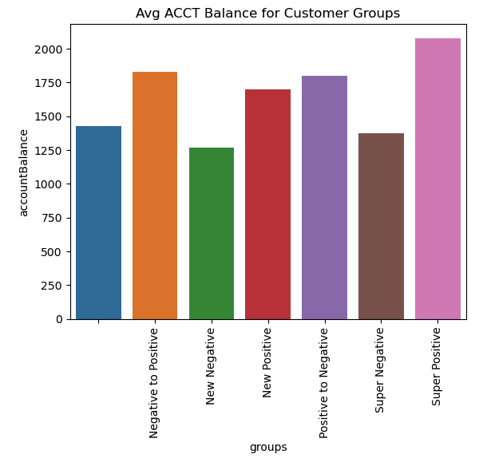
Data Exploration
I then drilled down deeper and separated the customers into groups based on the outcome of the last campaign as well as the latest campaign.
Super Positive Customers: customers that have converted both previous and current
New Positive Customers: customers that were unknown in the previous and converted in the current
Negative to Positive: customers that did not convert in the previous campaign and converted in the current
Super Negative Customers: customers that did not convert in the previous and did not convert in the current
New Negative Customers: customers that were unknown in the previous and did not convert in the current
Positive to Negative: customers that converted in the previous and did not convert in the current
From these groups, it seems that those that have converted at least once have a higher account balance.
EDA Notebook: https://github.com/expl0ding/Capstone3/blob/main/Capstone3_EDA.ipynb

Slide 8
Machine Learning
Tool: Python’s scikit-learn
Cross Validation: training and testing set: 20% + 80% split (sorted by ‘daysSinceLastCampaign’ and the most recent ones reserved for the testing set
Models Used: Decision Tree, Logistic Regression, Random Forest, Gradient Boosting
Evaluation Metrics: F1 score, Accuracy Score, Confusion Matrix, ROC Curve
Best Model: Random Forest Model
Performance Metrics:
Accuracy: 91%
Highest ROC Curve for True Positive Rate
Modeling Notebook: https://github.com/expl0ding/Capstone3/blob/main/Capstone3_Modeling.ipynb
Model Metrics File: https://github.com/expl0ding/Capstone3/blob/main/Model_Metrics_Capstone3.txt

Slide 9
Machine Learning
Based on the winning Random Forest Model, the most important features for predicting the campaign outcome were uncovered. The top three features are duration of the campaign, the customer account balance, and the customer age.
Modeling Notebook: https://github.com/expl0ding/Capstone3/blob/main/Capstone3_Modeling.ipynb
Model Metrics File: https://github.com/expl0ding/Capstone3/blob/main/Model_Metrics_Capstone3.txt

Slide 10
Summary
The final Random Forest Model is highly effective in predicting marketing campaign outcomes based on customer and campaign attributes incorporating important features to make accurate predictions.
Using this model offers several advantages. It allows for efficient resource allocation by identifying customers most likely to respond positively to a campaign. Marketers can prioritize their efforts and allocate resources where they are most likely to yield favorable results, leading to a higher return on investment. Armed with this knowledge, the marketing team can focus on these influential factors during campaign planning and execution, aligning their efforts with the characteristics of the target audience.
The marketing team will be able to move away from a one-size-fits-all approach and adopt a personalized and customer-centric strategy. This approach improves engagement, customer satisfaction, and ultimately leads to higher conversion rates. This model allows for data-driven decisions, refines targeting strategies, and creates impactful campaigns that resonate with individual customers.

