Slide 1
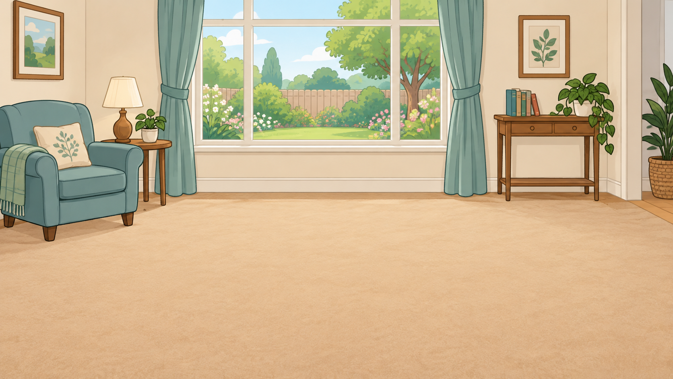
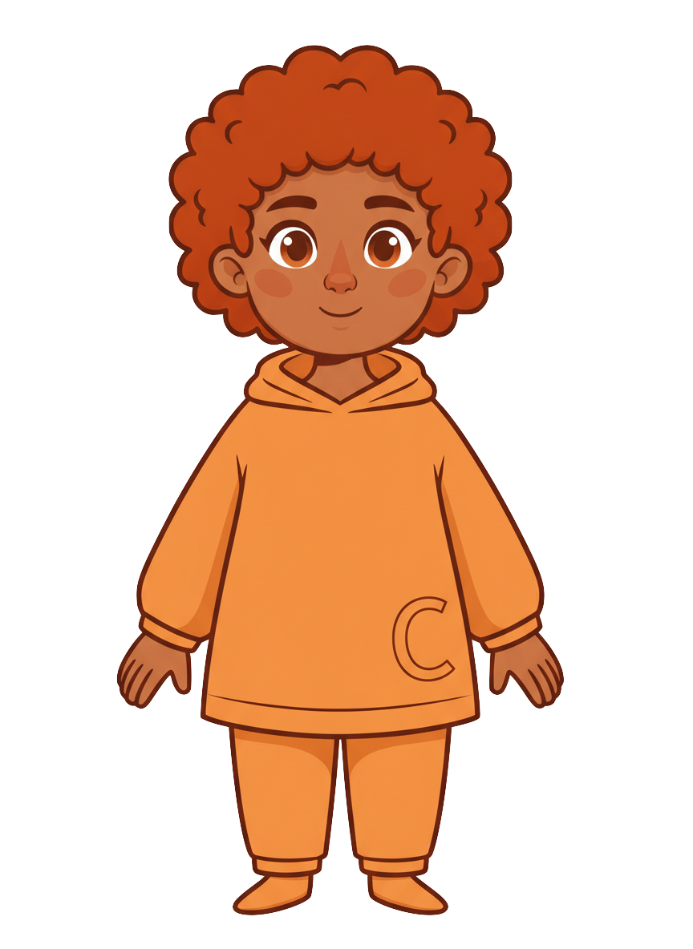
This is Finn.

Slide 2


Finn has 8 cookies.

Slide 3
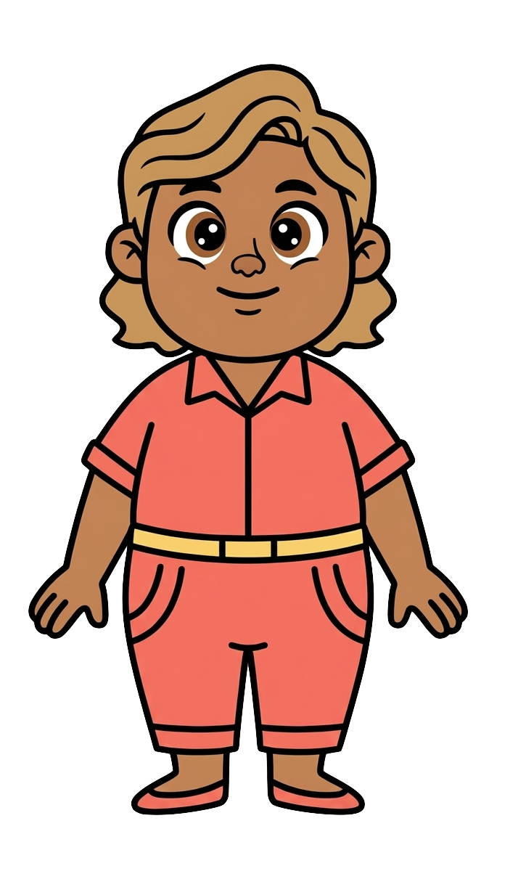
This is Cleo.

Slide 4
Cleo has 2 cookies.

Slide 5
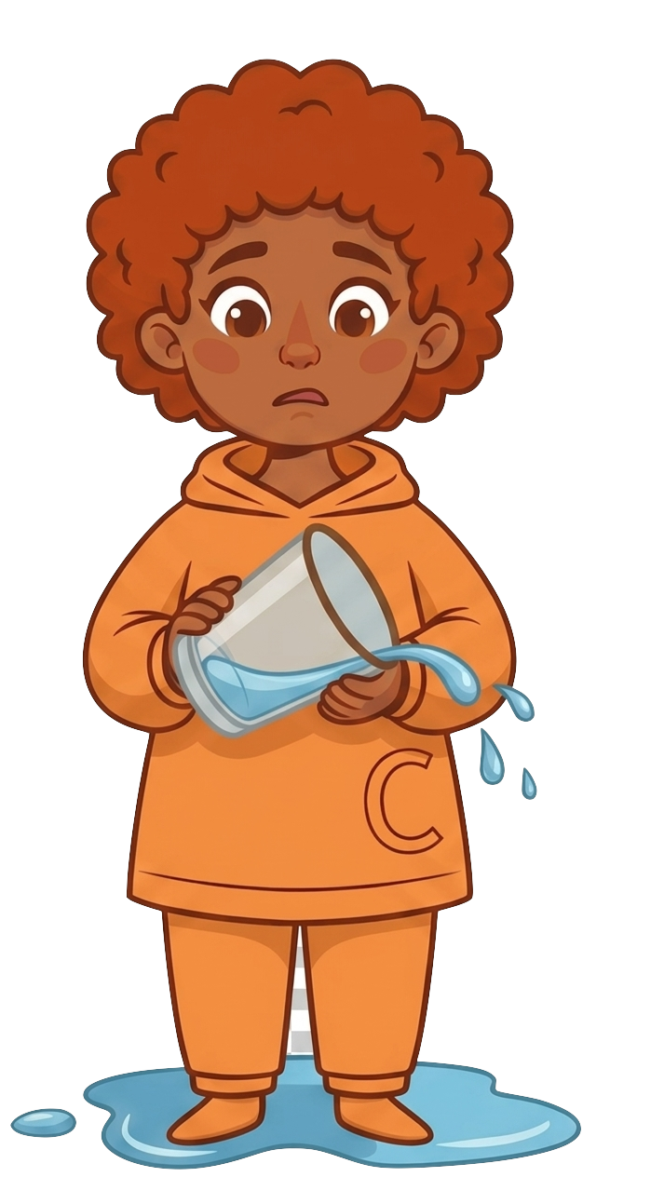
Finn spills water.

Slide 6
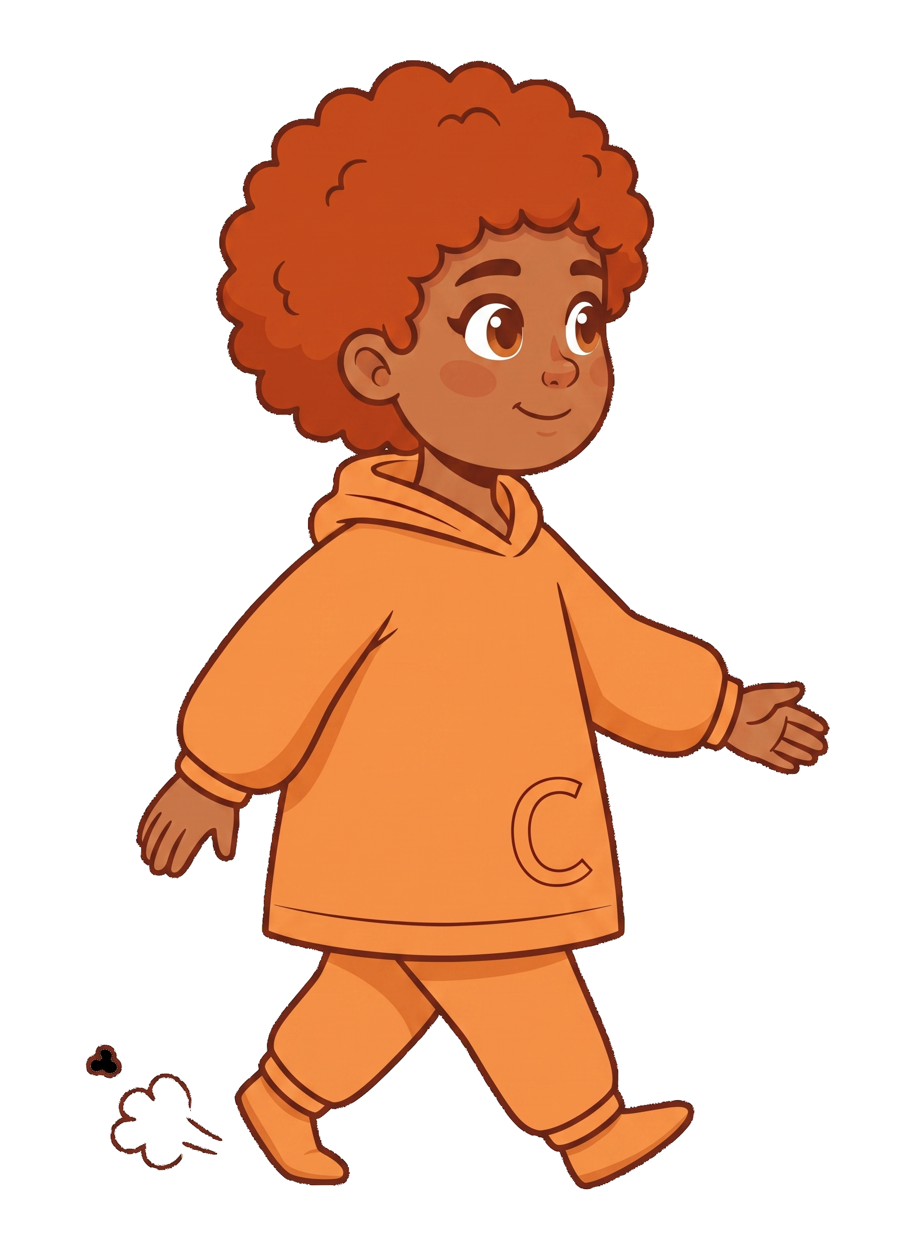
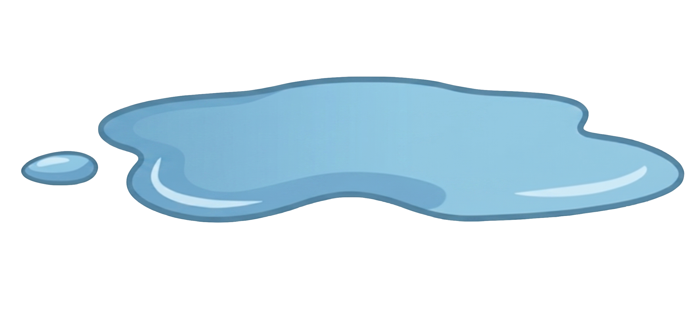
Finn doesn’t clean it up and walks away.

Slide 7
Finn doesn’t clean it up and walks away.

Slide 8
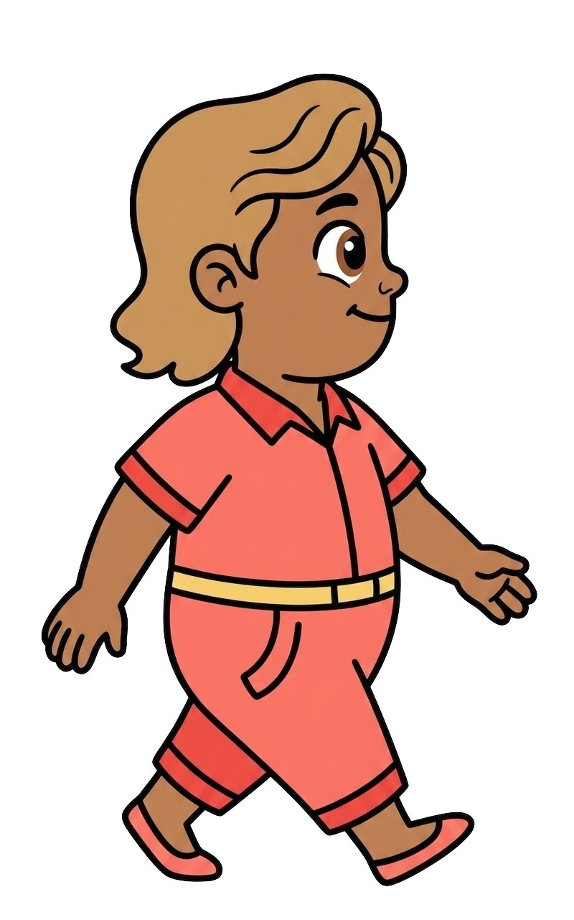
Cleo walks in.

Slide 9
Cleo tells Finn, “I know I could slip on the water you left on the floor and drop my cookies.”

Slide 10
Cleo tells Finn, “I’m not okay with that.”

Slide 11
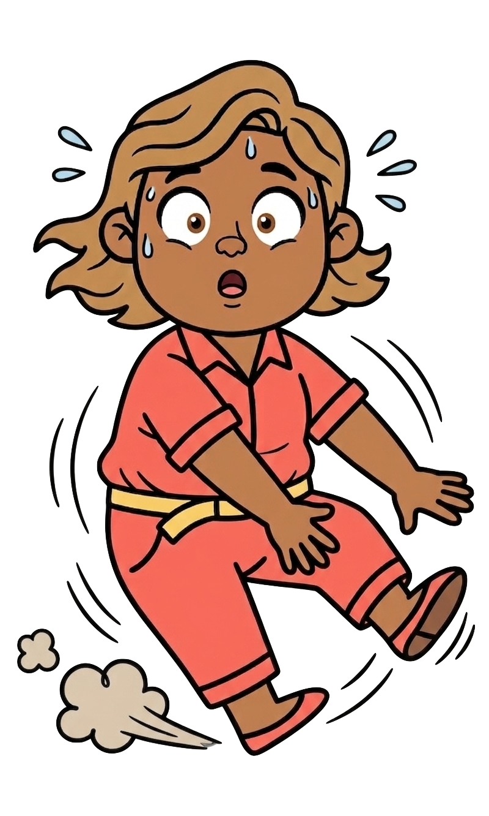
Oh no! Cleo slips on the water!

Slide 12
2 of Cleo’s cookies fall!

Slide 13
Finn still has 8 cookies. Cleo now has 0 cookies.

