Slide 1
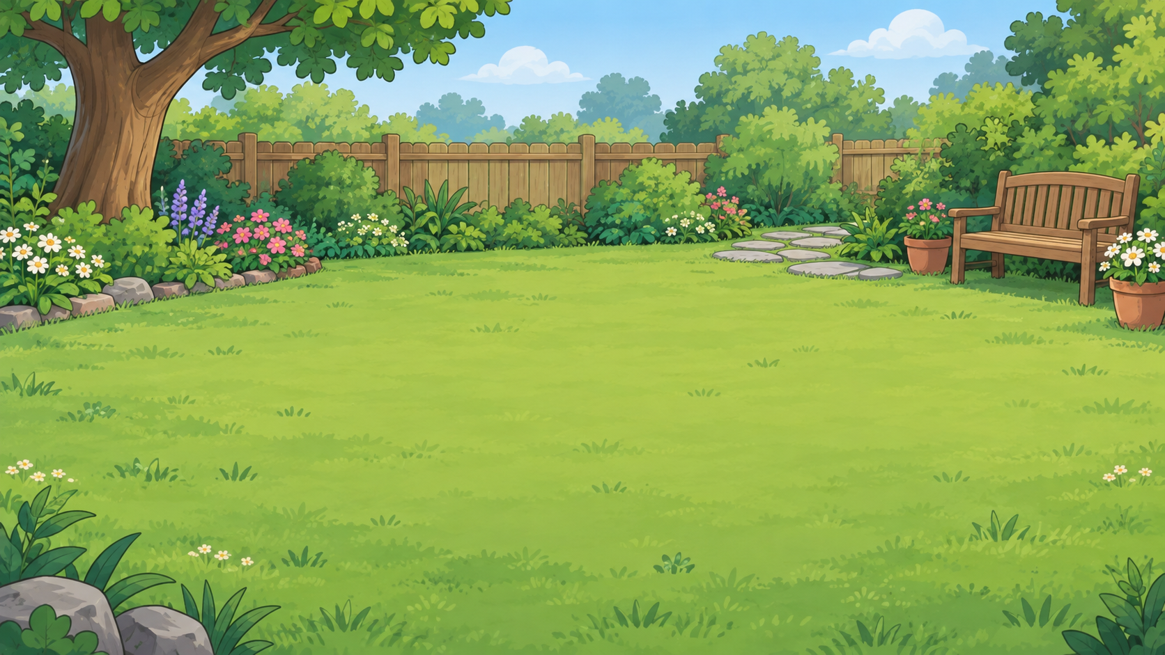
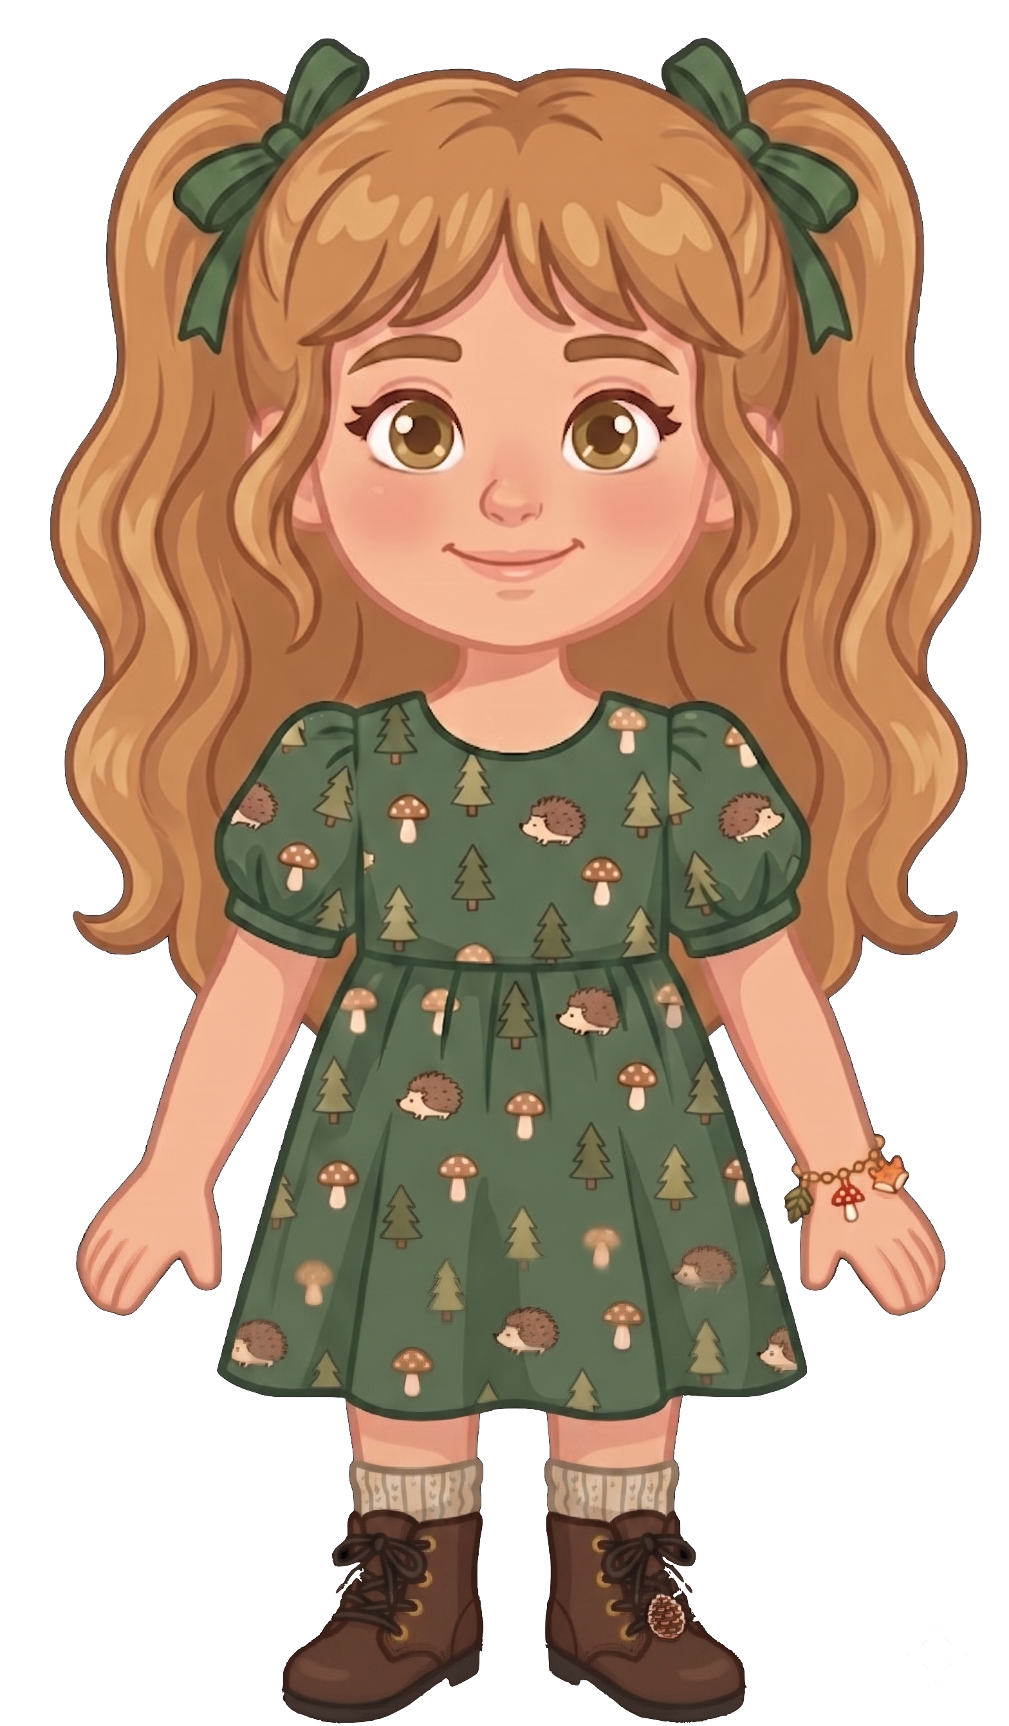
This is Nora.

Slide 2


Nora has 8 cookies.

Slide 3
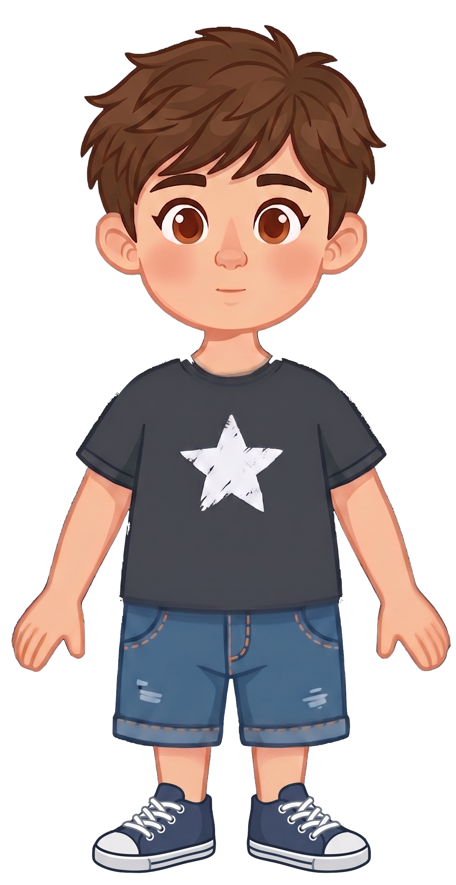
This is Eric.

Slide 4
Eric has 2 cookies.

Slide 5
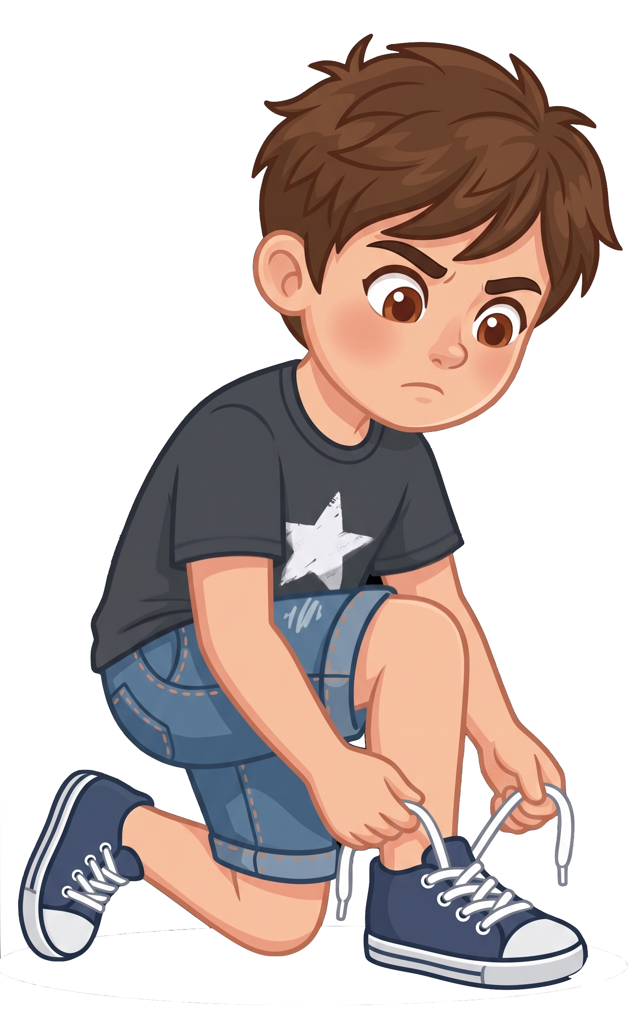
Eric tells Nora, “I know a squirrel could eat my cookies.”
Notes:
Source scene: code/experiments/experiment1/adults/slides/pilot-v3/control_squirrel.pptx, slide 5.
Wording: code/experiments/experiment2/consent/materials.json.
Eric tells Nora: I know a squirrel could eat my cookies.

Slide 6
Eric tells Nora, “I’m okay with that.”
Notes:
Source scene: code/experiments/experiment1/adults/slides/pilot-v3/control_squirrel.pptx, slide 5.
Wording: code/experiments/experiment2/consent/materials.json.
Eric tells Nora: I’m okay with that.

Slide 7
Eric is tying his shoelaces.

Slide 8
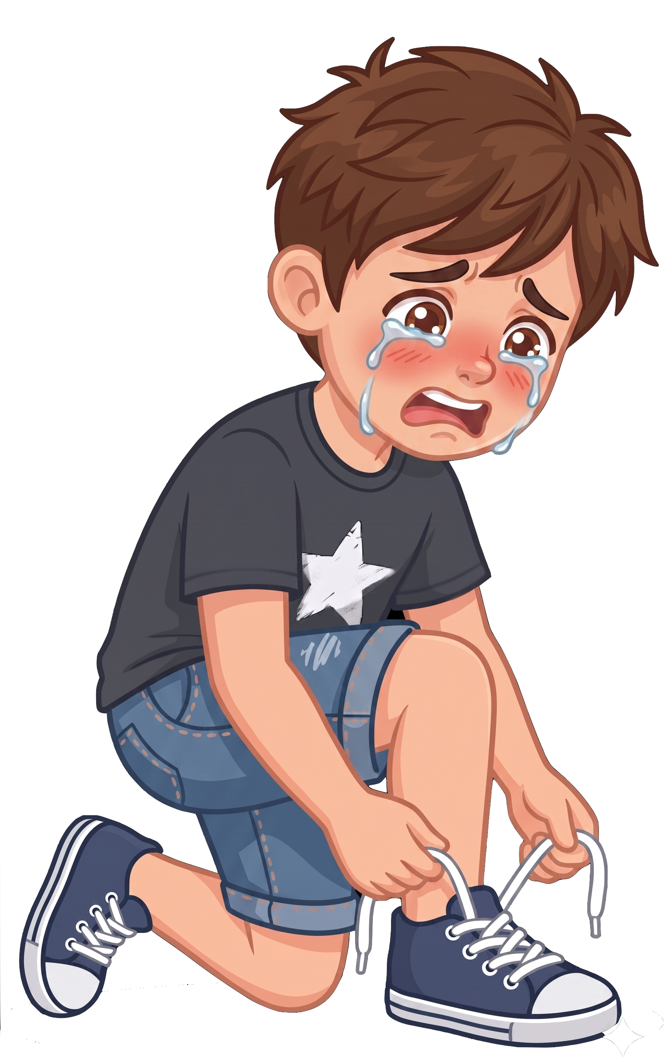
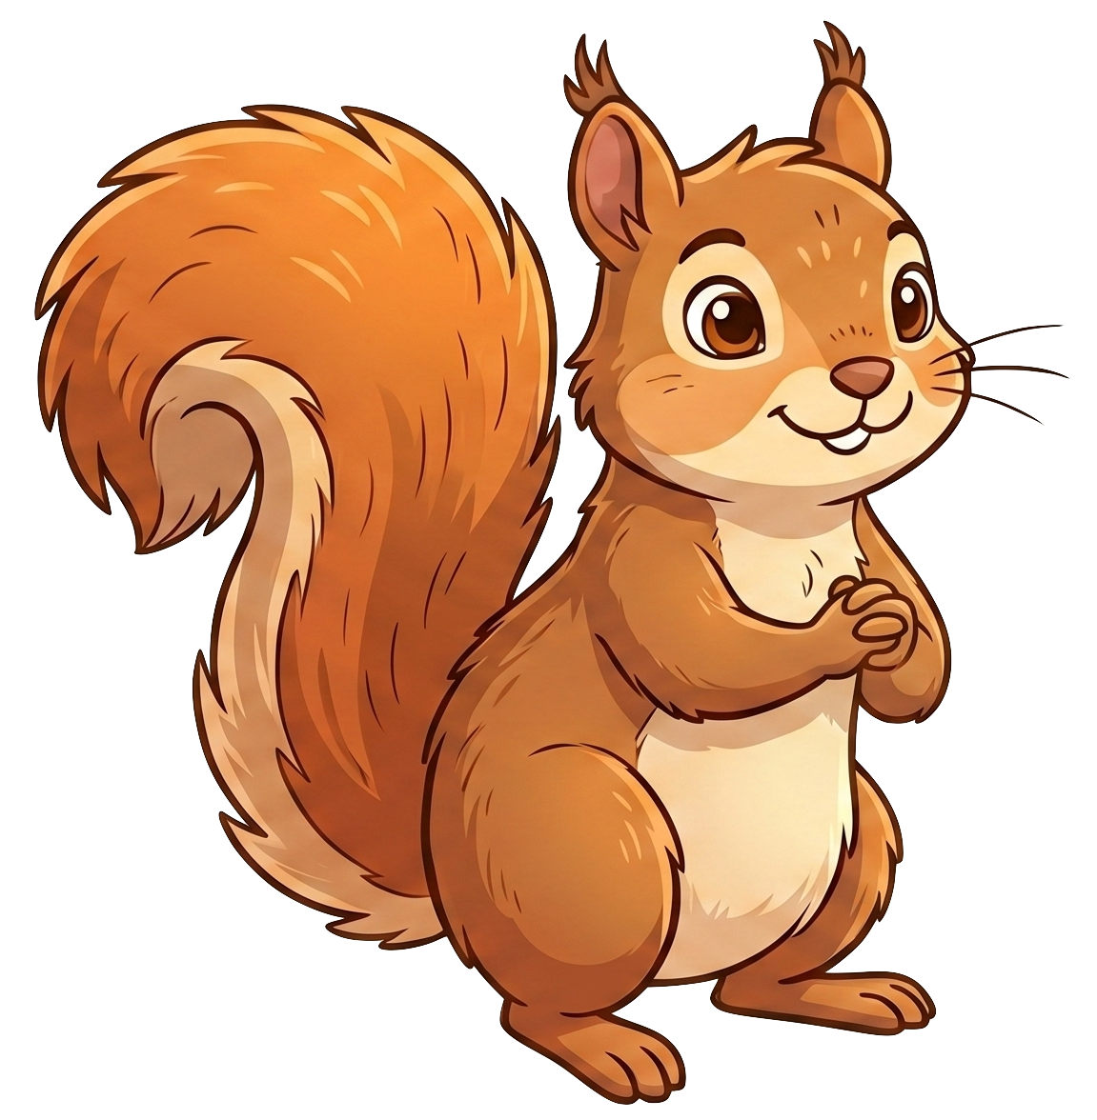
Oh no! A squirrel eats 2 of Eric’s cookies!

Slide 9
Nora still has 8 cookies. Eric now has 0 cookies.

