Slide 1

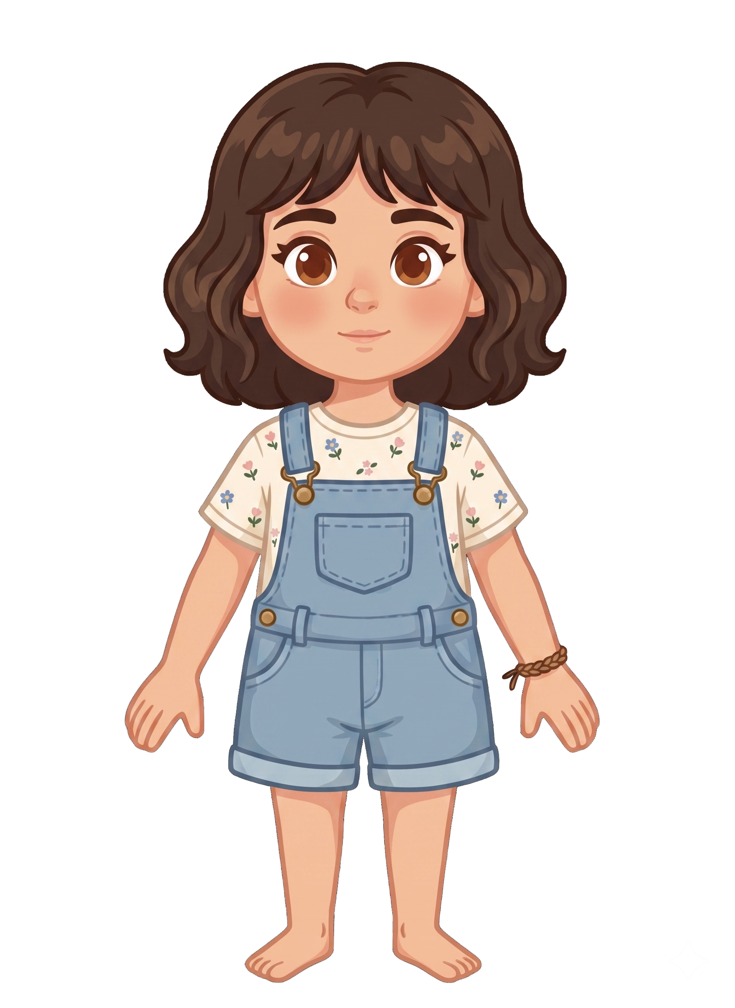
This is Katie.

Slide 2


Katie has 2 cookies.

Slide 3
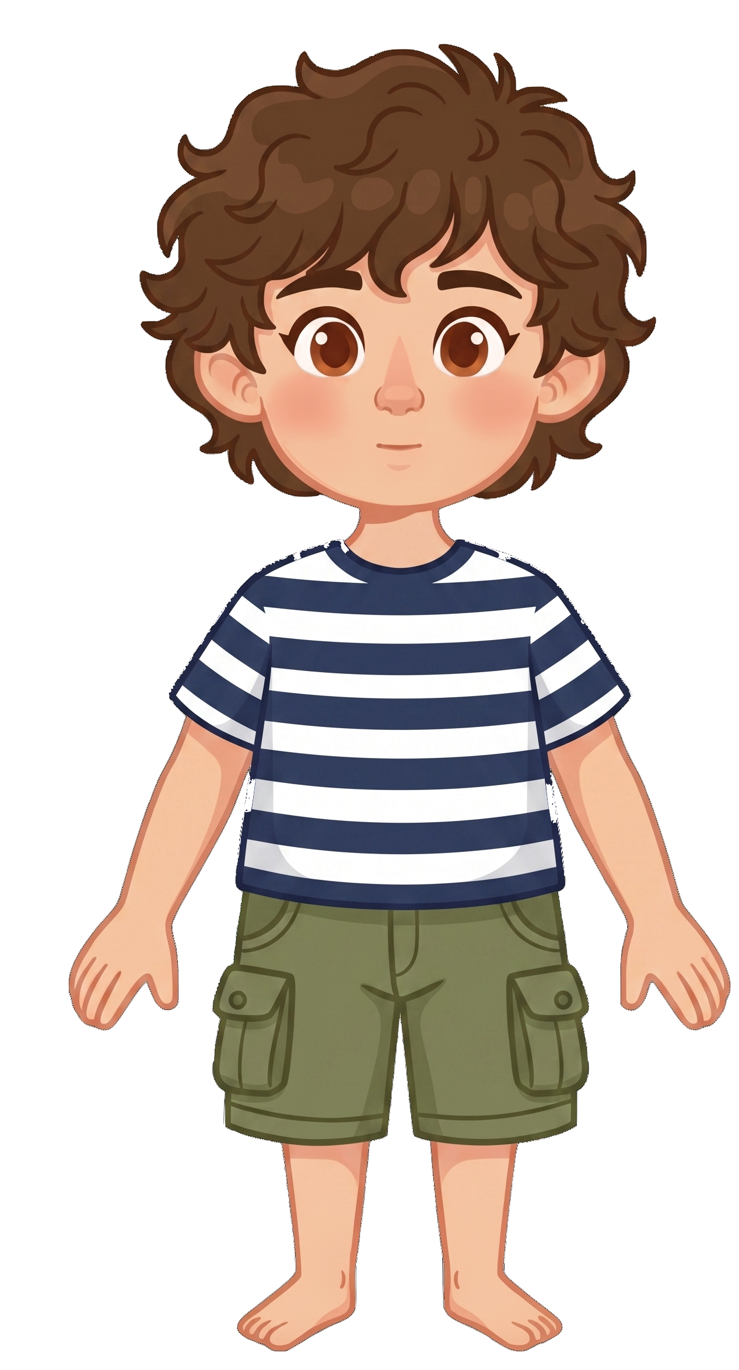
This is Tony.

Slide 4
Tony has 8 cookies.

Slide 5

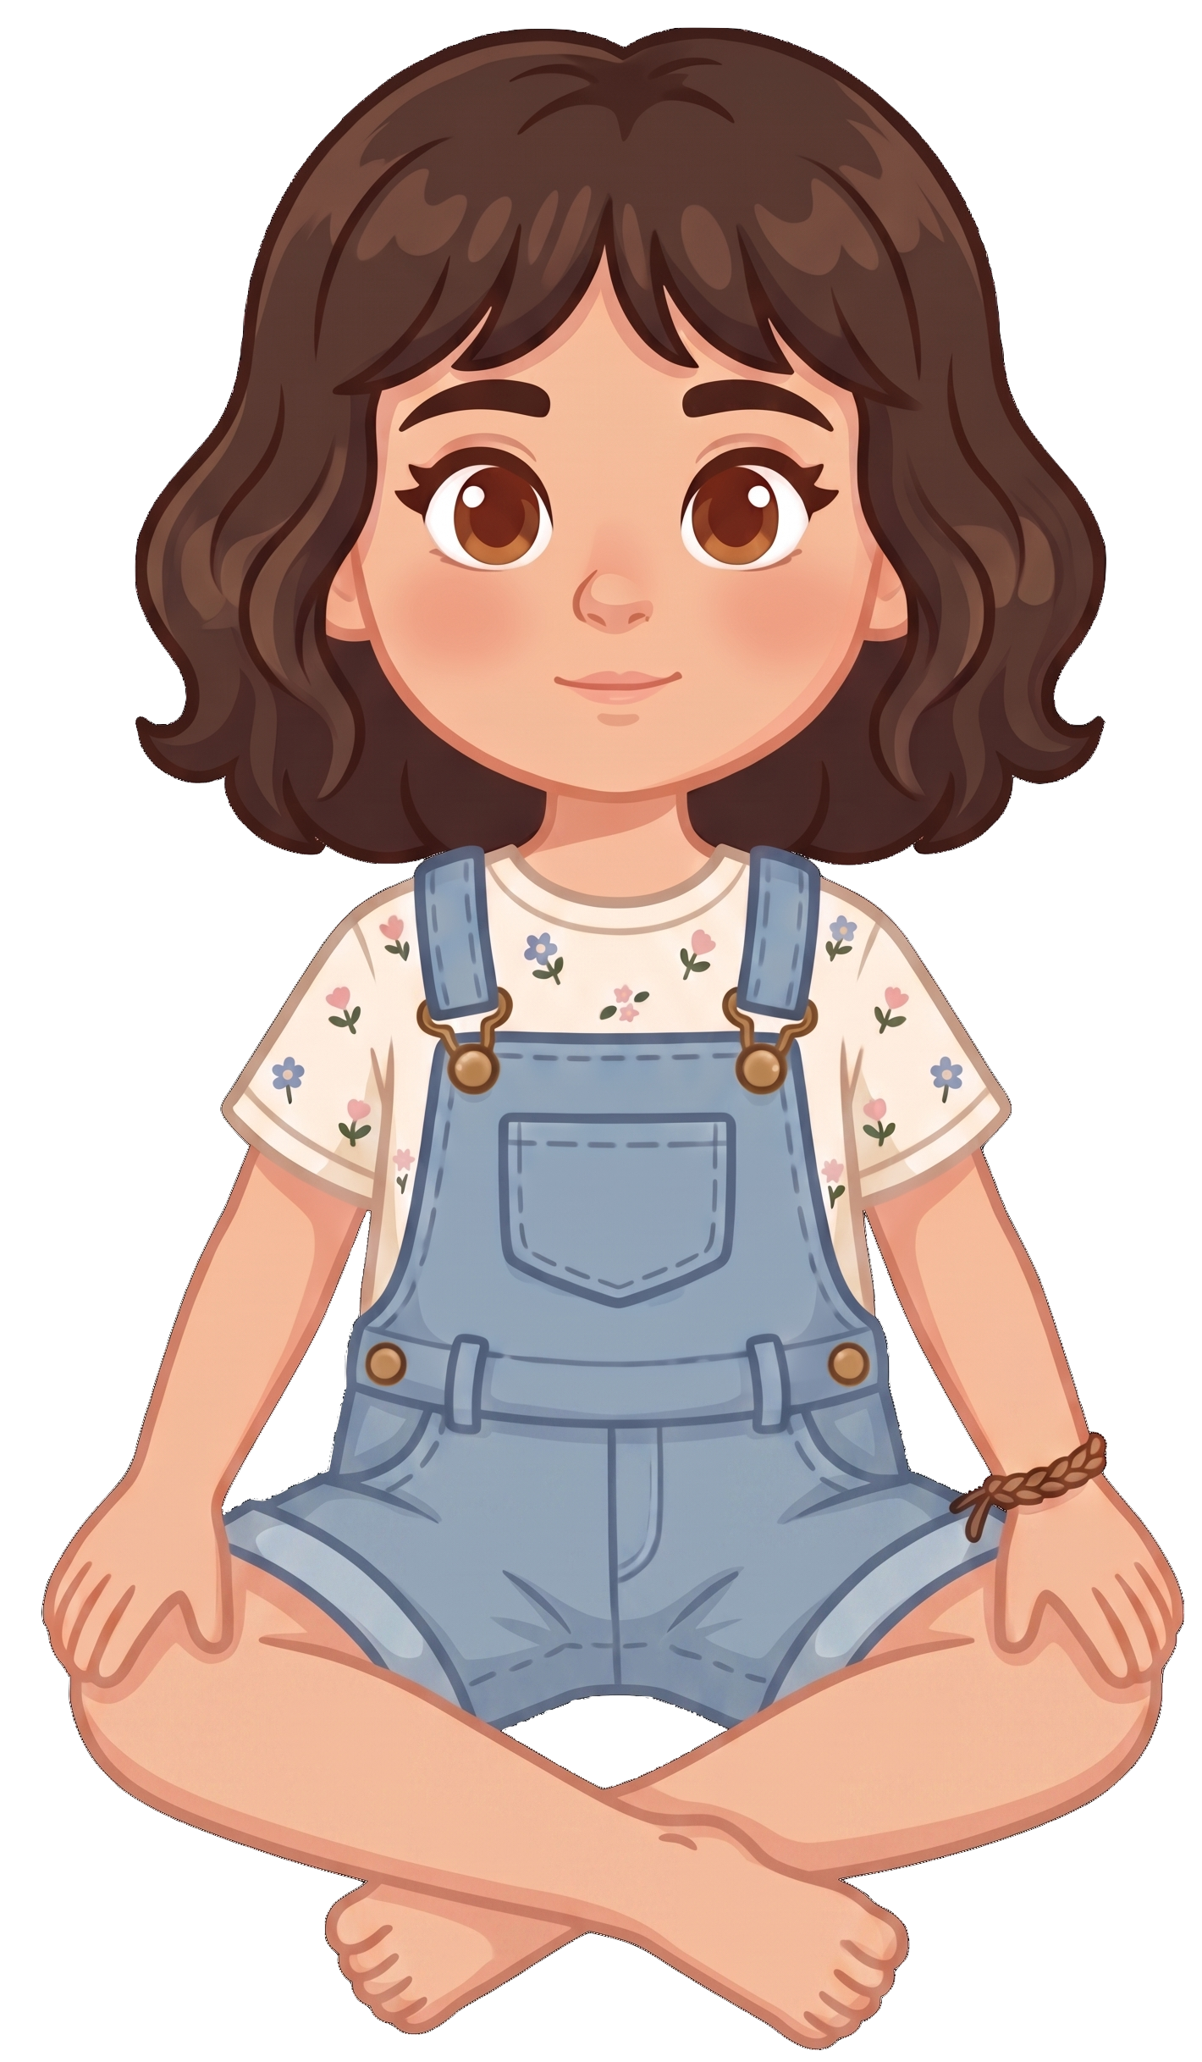
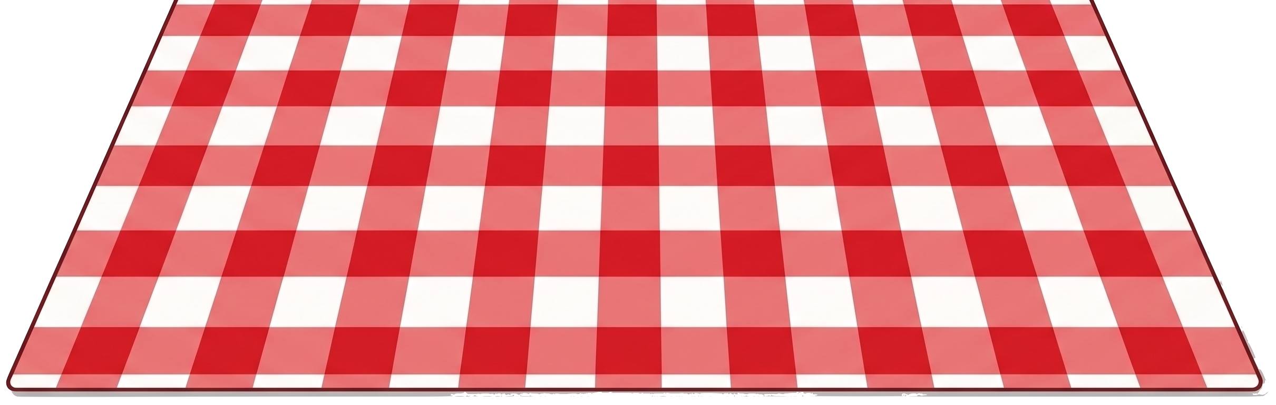
Katie and Tony are having a picnic.

Slide 6
Katie tells Tony, “I know the wind could blow my cookies away.”
Notes:
Source scene: code/experiments/experiment1/adults/slides/pilot-v3/control_wind.pptx, slide 5.
Wording: code/experiments/experiment2/consent/materials.json.
Katie tells Tony: I know the wind could blow my cookies away.

Slide 7
Katie tells Tony, “I’m okay with that.”
Notes:
Source scene: code/experiments/experiment1/adults/slides/pilot-v3/control_wind.pptx, slide 5.
Wording: code/experiments/experiment2/consent/materials.json.
Katie tells Tony: I’m okay with that.

Slide 8

Oh no! A gust of wind blows.

Slide 9
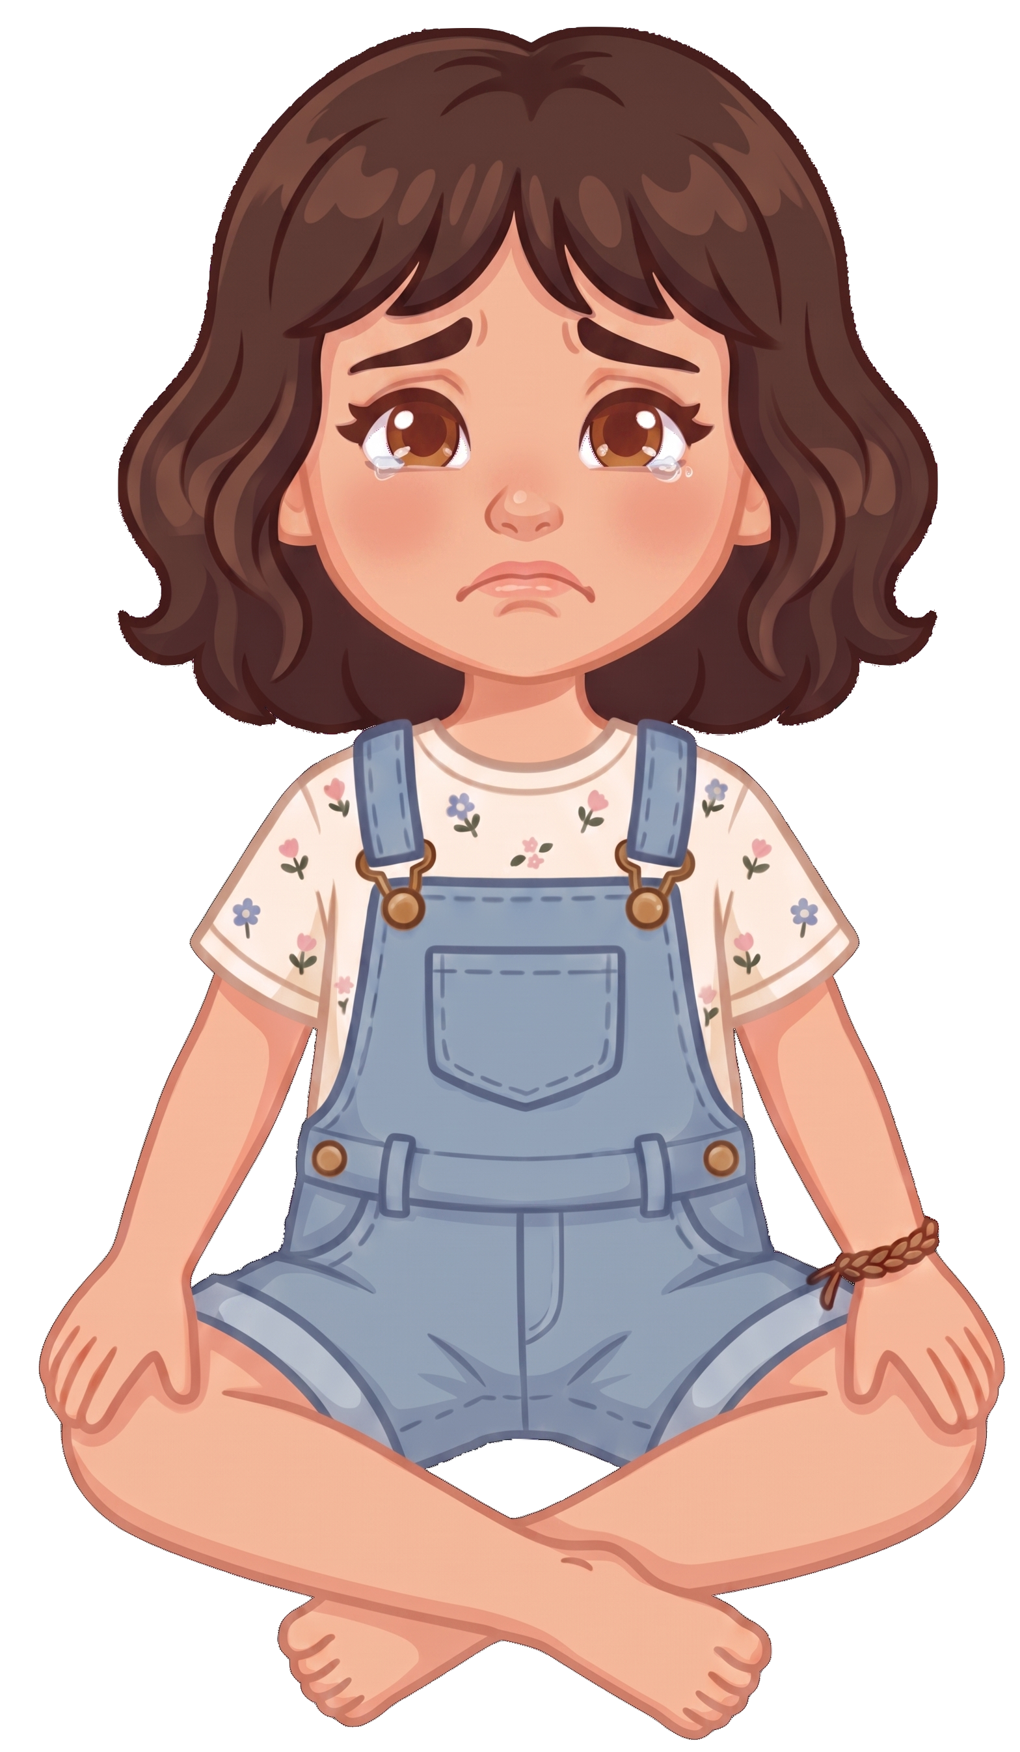
2 of Katie’s cookies blow away!

Slide 10

Tony still has 8 cookies. Katie now has 0 cookies.

