Slide 1
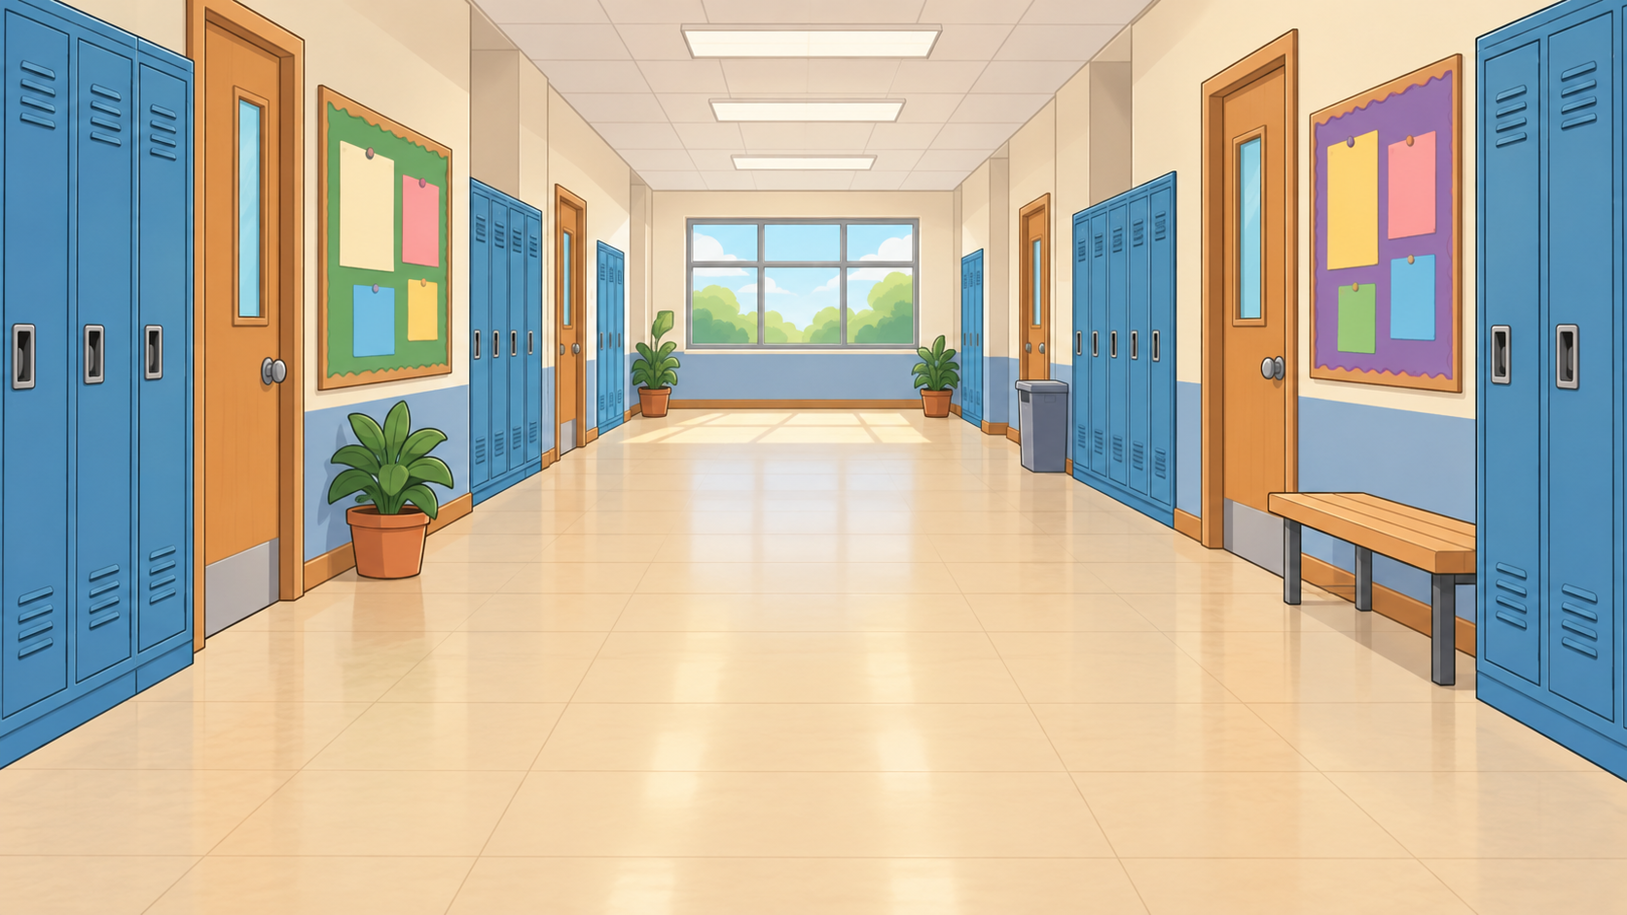
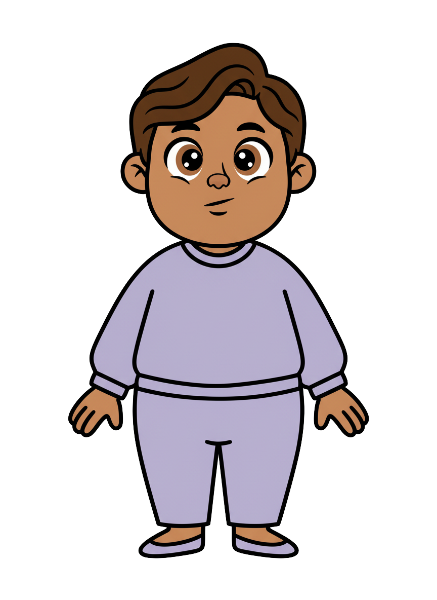
This is Milo.

Slide 2


Milo has 8 cookies.

Slide 3
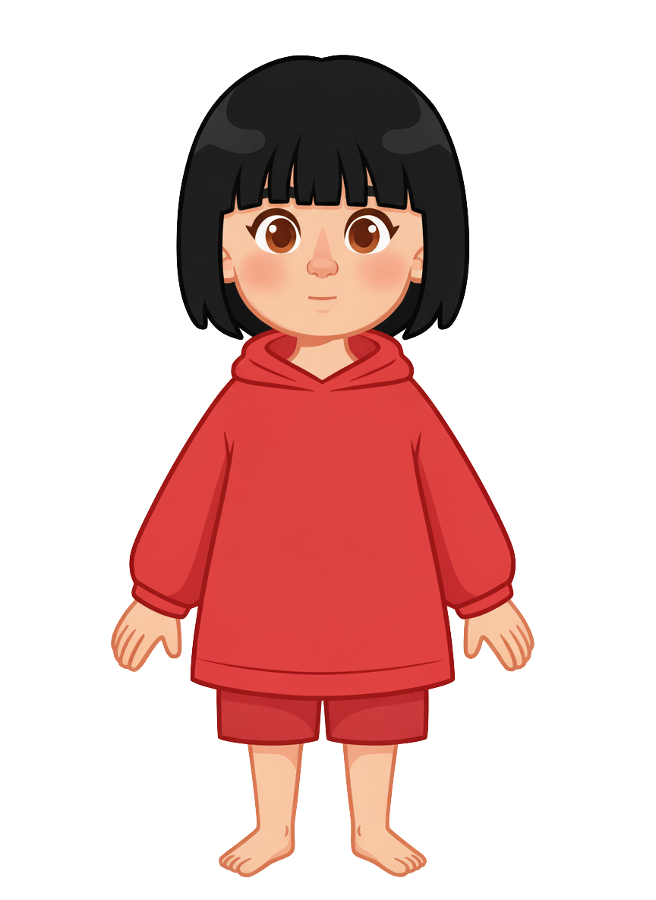
This is Sasha.

Slide 4
Sasha has 2 cookies.

Slide 5
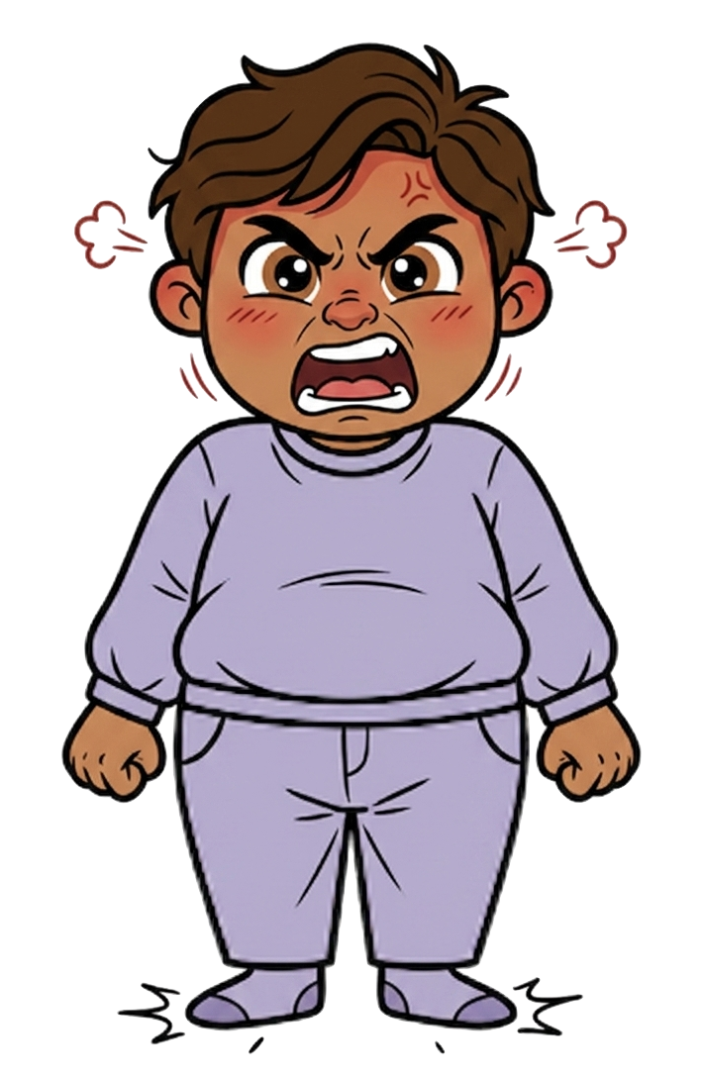
Milo is angry.

Slide 6
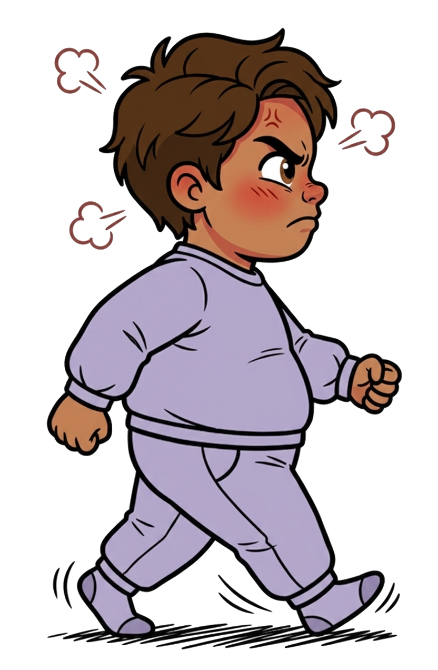
He walks over.

Slide 7
Sasha tells Milo, “I know you’re going to knock my cookies onto the ground.”
Notes:
Source scene: code/experiments/experiment1/adults/slides/pilot-v3/intentional_hit.pptx, slide 6.
Wording: code/experiments/experiment2/consent/materials.json.
Sasha tells Milo: I know you’re going to knock my cookies onto the ground.

Slide 8
Sasha tells Milo, “I’m okay with that.”
Notes:
Source scene: code/experiments/experiment1/adults/slides/pilot-v3/intentional_hit.pptx, slide 6.
Wording: code/experiments/experiment2/consent/materials.json.
Sasha tells Milo: I’m okay with that.

Slide 9
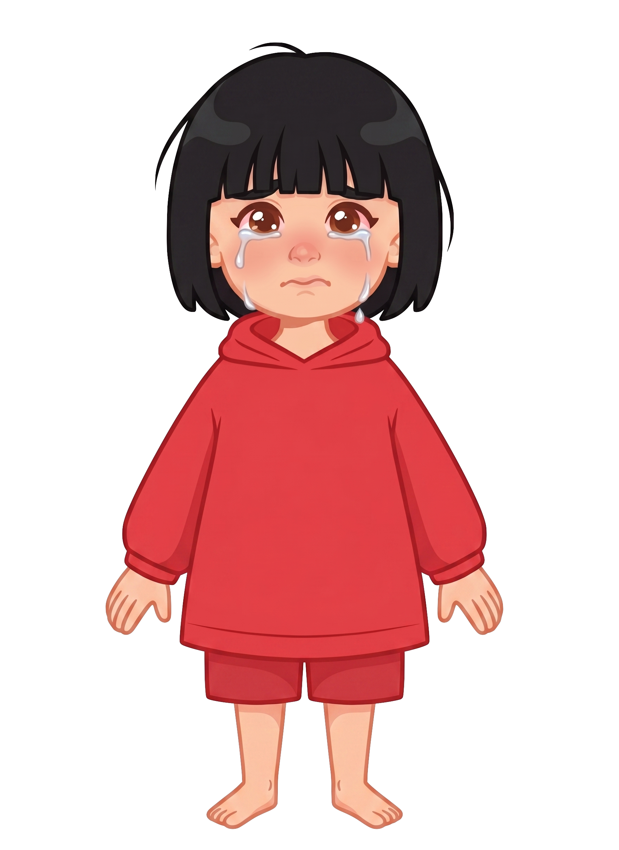
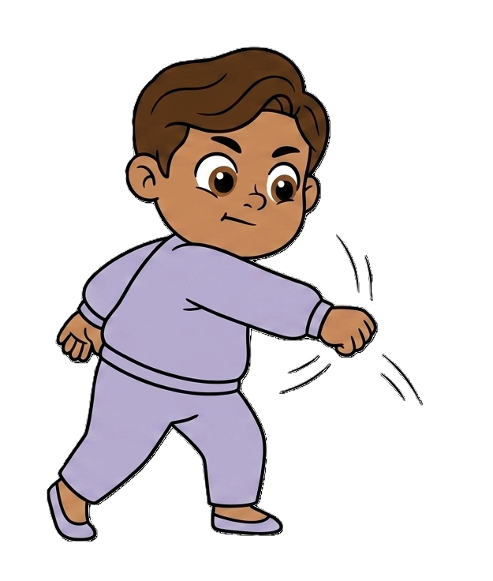
And hits 2 of Sasha’s cookies!

Slide 10

Milo still has 8 cookies. Sasha now has 0 cookies.

