Slide 1
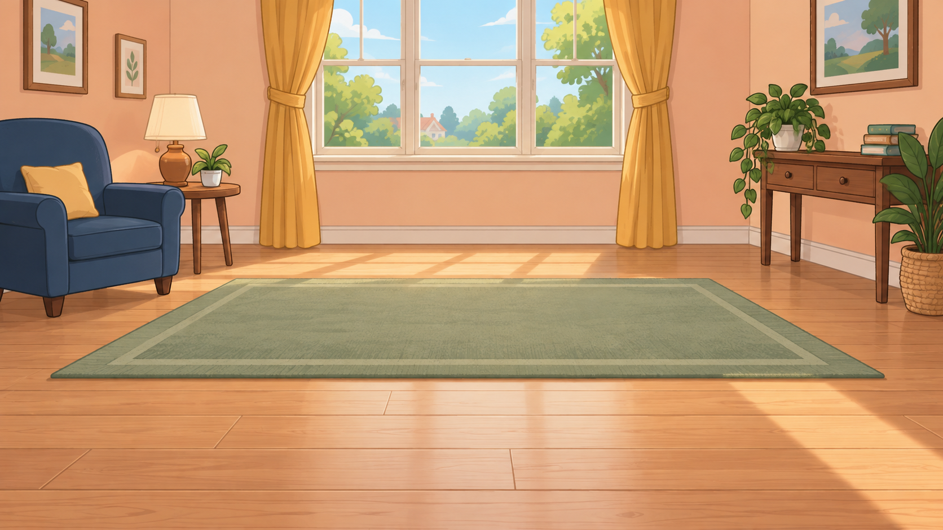
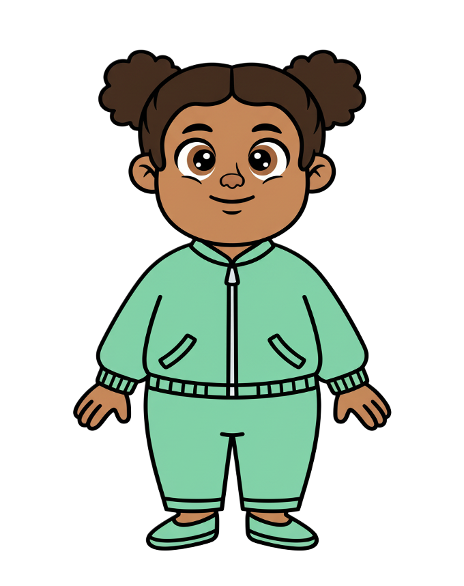
This is Zoe.

Slide 2


Zoe has 8 cookies.

Slide 3
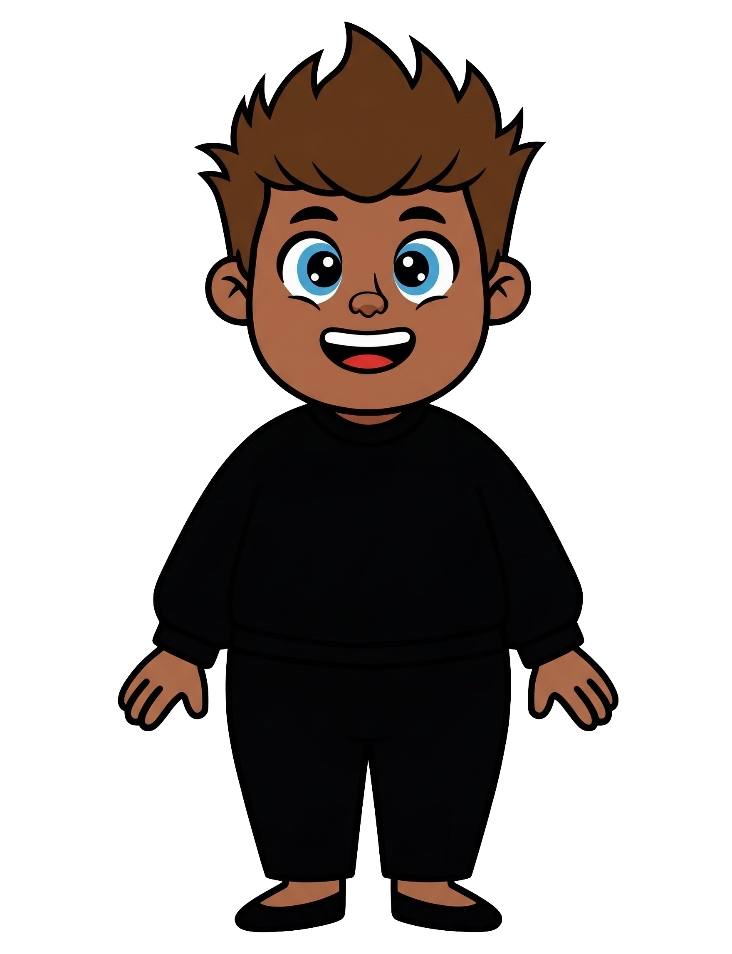
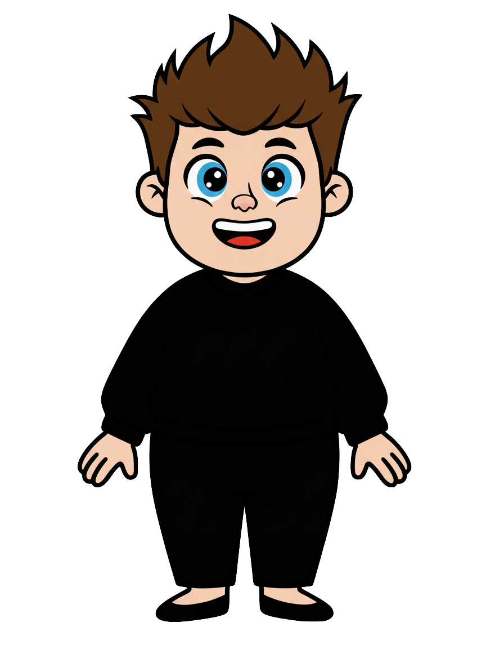
This is Rex.

Slide 4
Rex has 2 cookies.

Slide 5
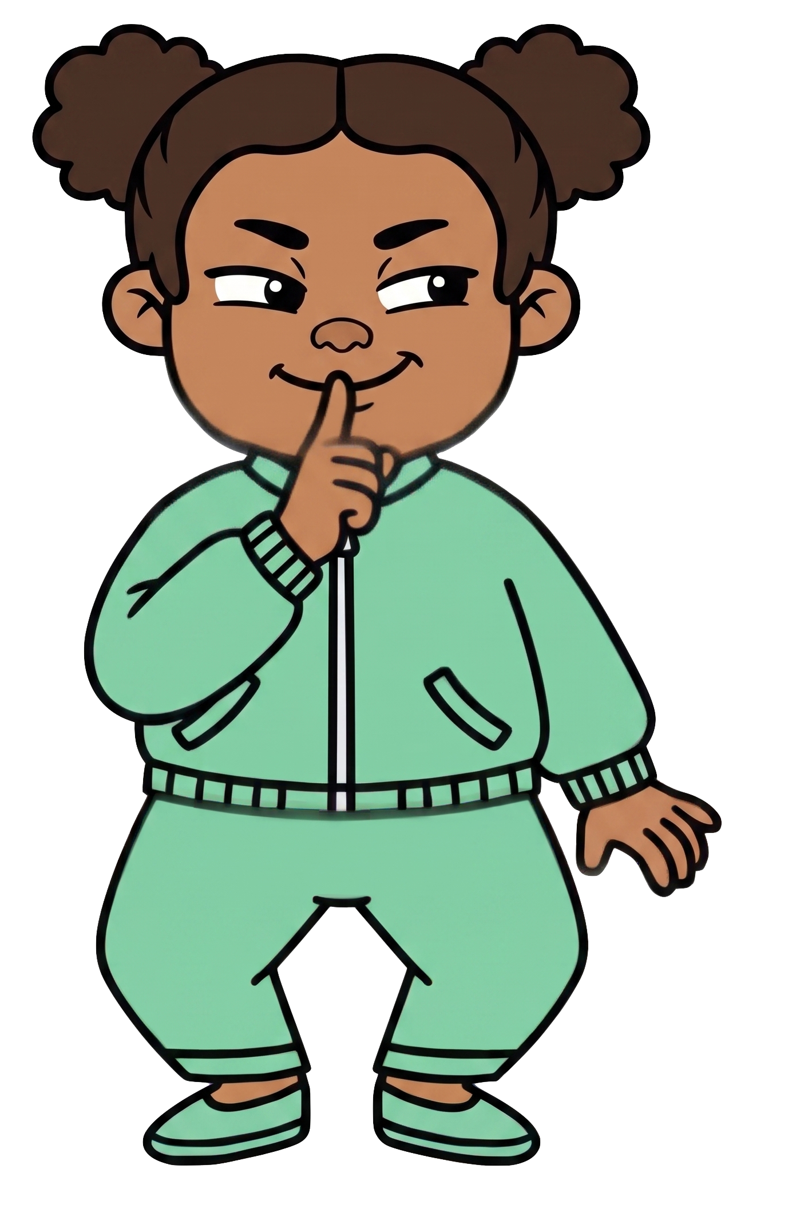
Zoe wants Rex to have fewer cookies.

Slide 6
Rex tells Zoe, “I know you’re going to throw my cookies away.”
Notes:
Source scene: code/experiments/experiment1/adults/slides/pilot-v3/intentional_throw.pptx, slide 5.
Wording: code/experiments/experiment2/consent/materials.json.
Rex tells Zoe: I know you’re going to throw my cookies away.

Slide 7
Rex tells Zoe, “I’m okay with that.”
Notes:
Source scene: code/experiments/experiment1/adults/slides/pilot-v3/intentional_throw.pptx, slide 5.
Wording: code/experiments/experiment2/consent/materials.json.
Rex tells Zoe: I’m okay with that.

Slide 8
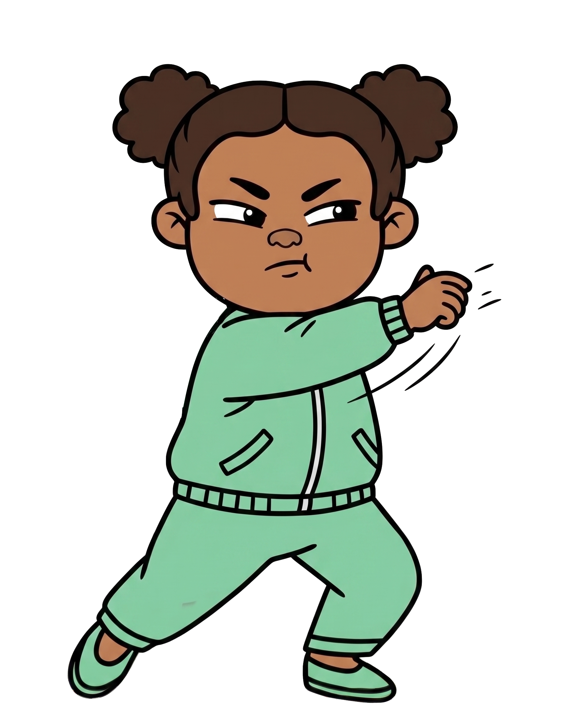

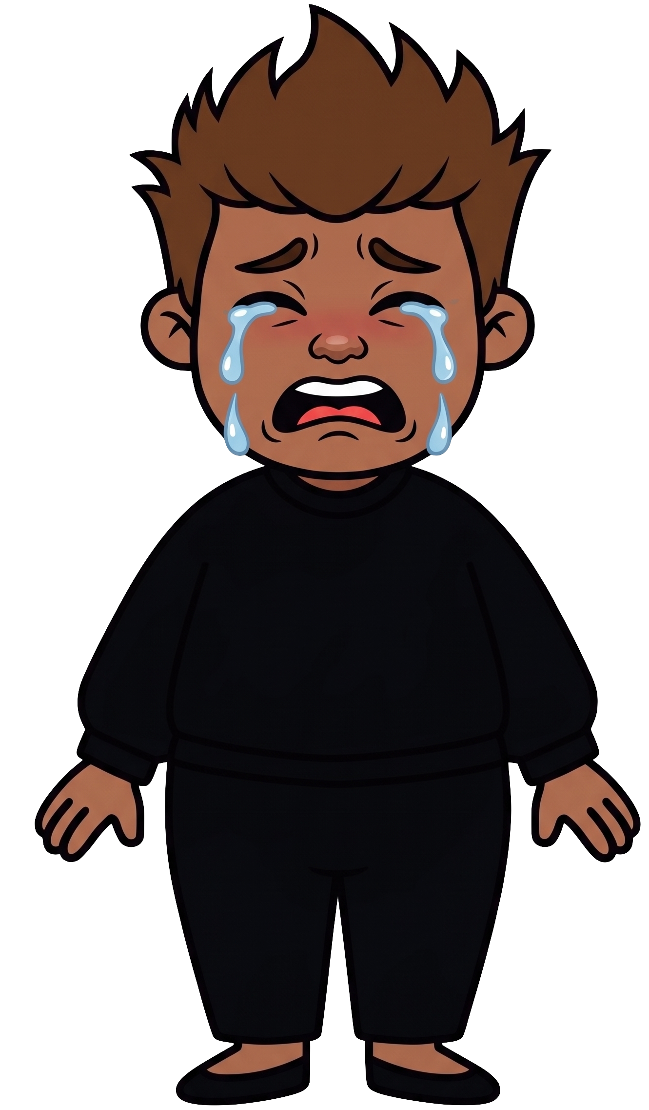
Oh no! Zoe throws 2 of Rex’s cookies!

Slide 9

Zoe still has 8 cookies. Rex now has 0 cookies.

