Slide 1

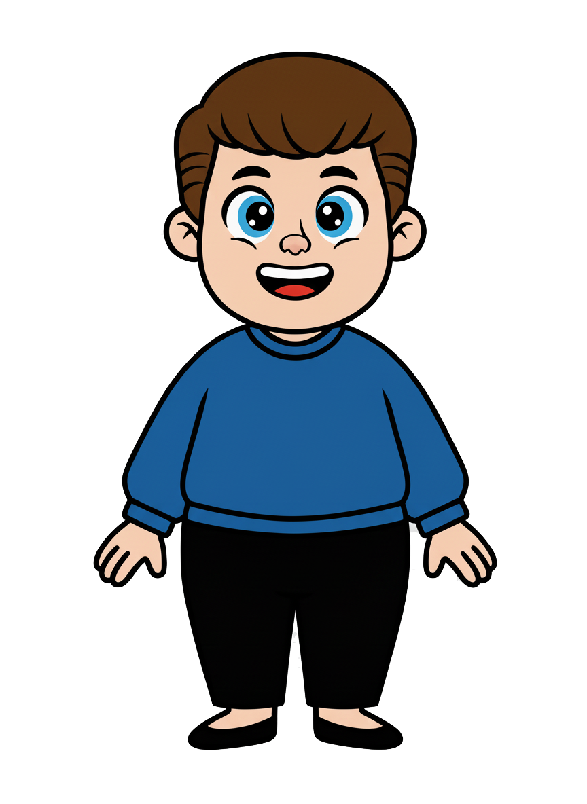
This is Kai.

Slide 2


Kai has 8 cookies.

Slide 3
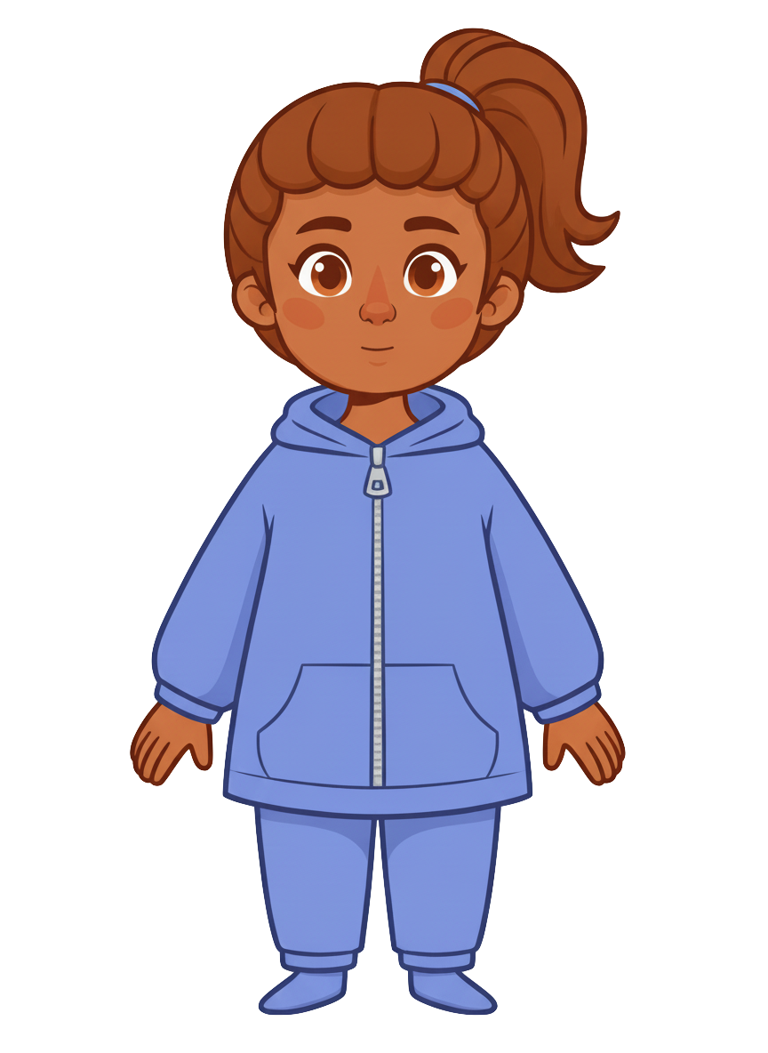
This is Ruby.

Slide 4
Ruby has 2 cookies.

Slide 5
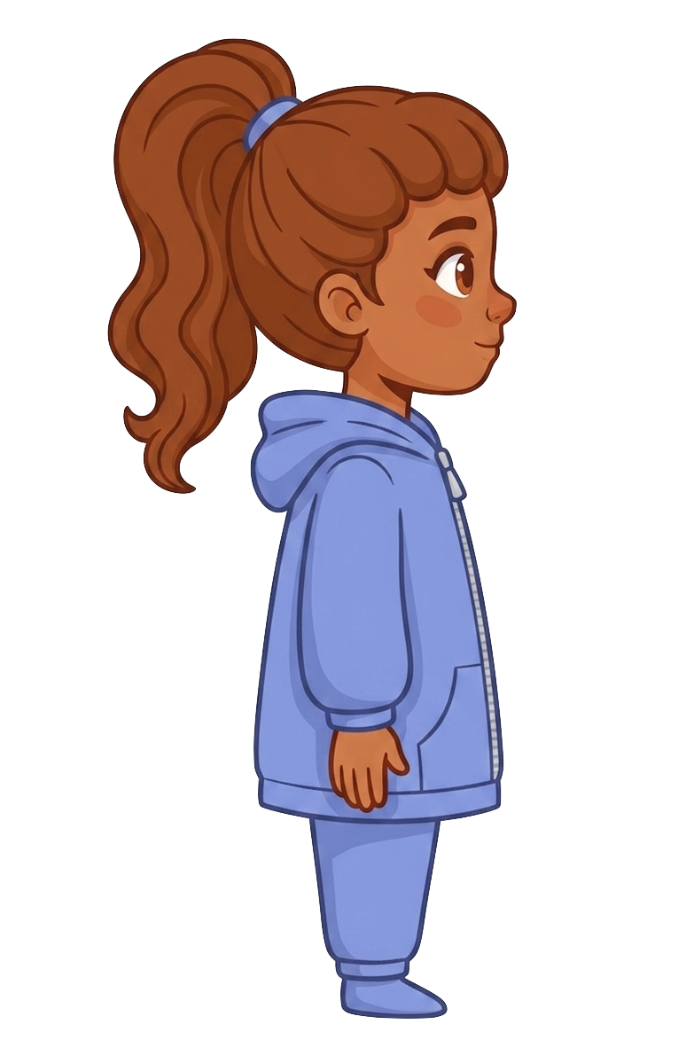
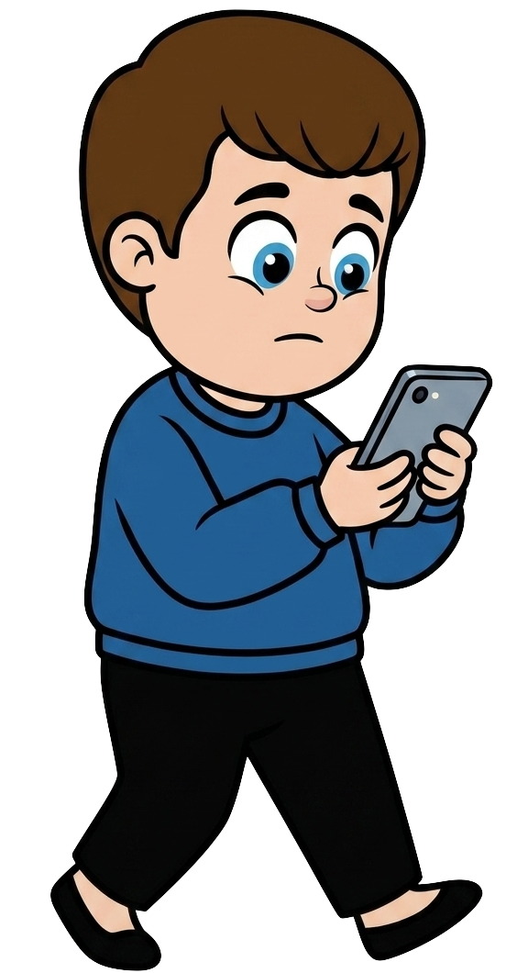
Kai is walking and staring at his phone.

Slide 6
Ruby tells Kai, “I know you could bump into me while looking at your phone and knock my cookies onto the ground.”
Notes:
Source scene: code/experiments/experiment1/adults/slides/pilot-v3/negligence_phone.pptx, slide 5.
Wording: code/experiments/experiment2/consent/materials.json.
Ruby tells Kai: I know you could bump into me while looking at your phone and knock my cookies onto the ground.

Slide 7
Ruby tells Kai, “I’m not okay with that.”
Notes:
Source scene: code/experiments/experiment1/adults/slides/pilot-v3/negligence_phone.pptx, slide 5.
Wording: code/experiments/experiment2/consent/materials.json.
Ruby tells Kai: I’m not okay with that.

Slide 8
Kai is walking and staring at his phone.

Slide 9
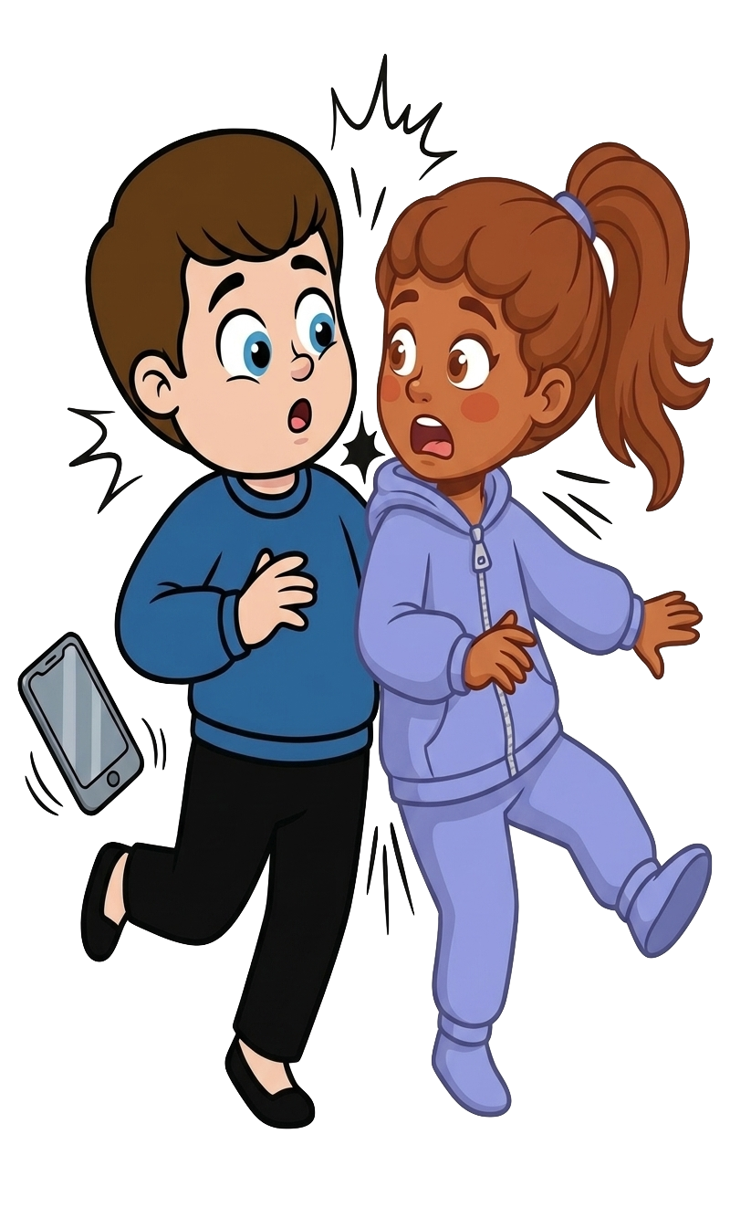
Oh no! Kai bumps into Ruby!

Slide 10
2 of Ruby’s cookies fall!

Slide 11

Kai still has 8 cookies. Ruby now has 0 cookies.

