Slide 1
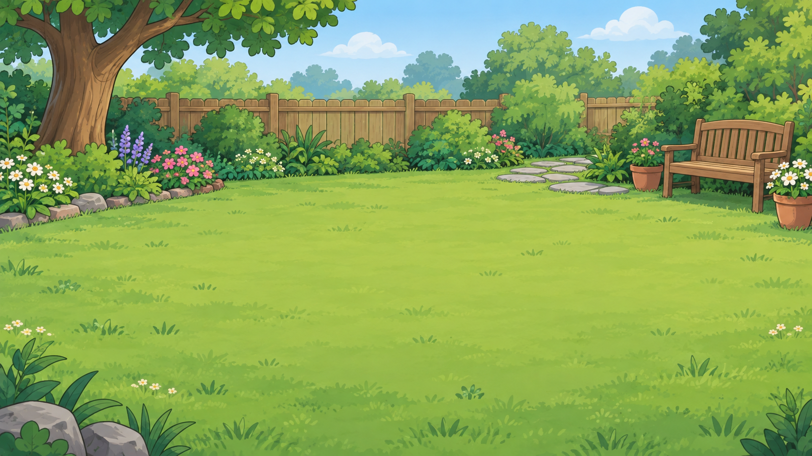
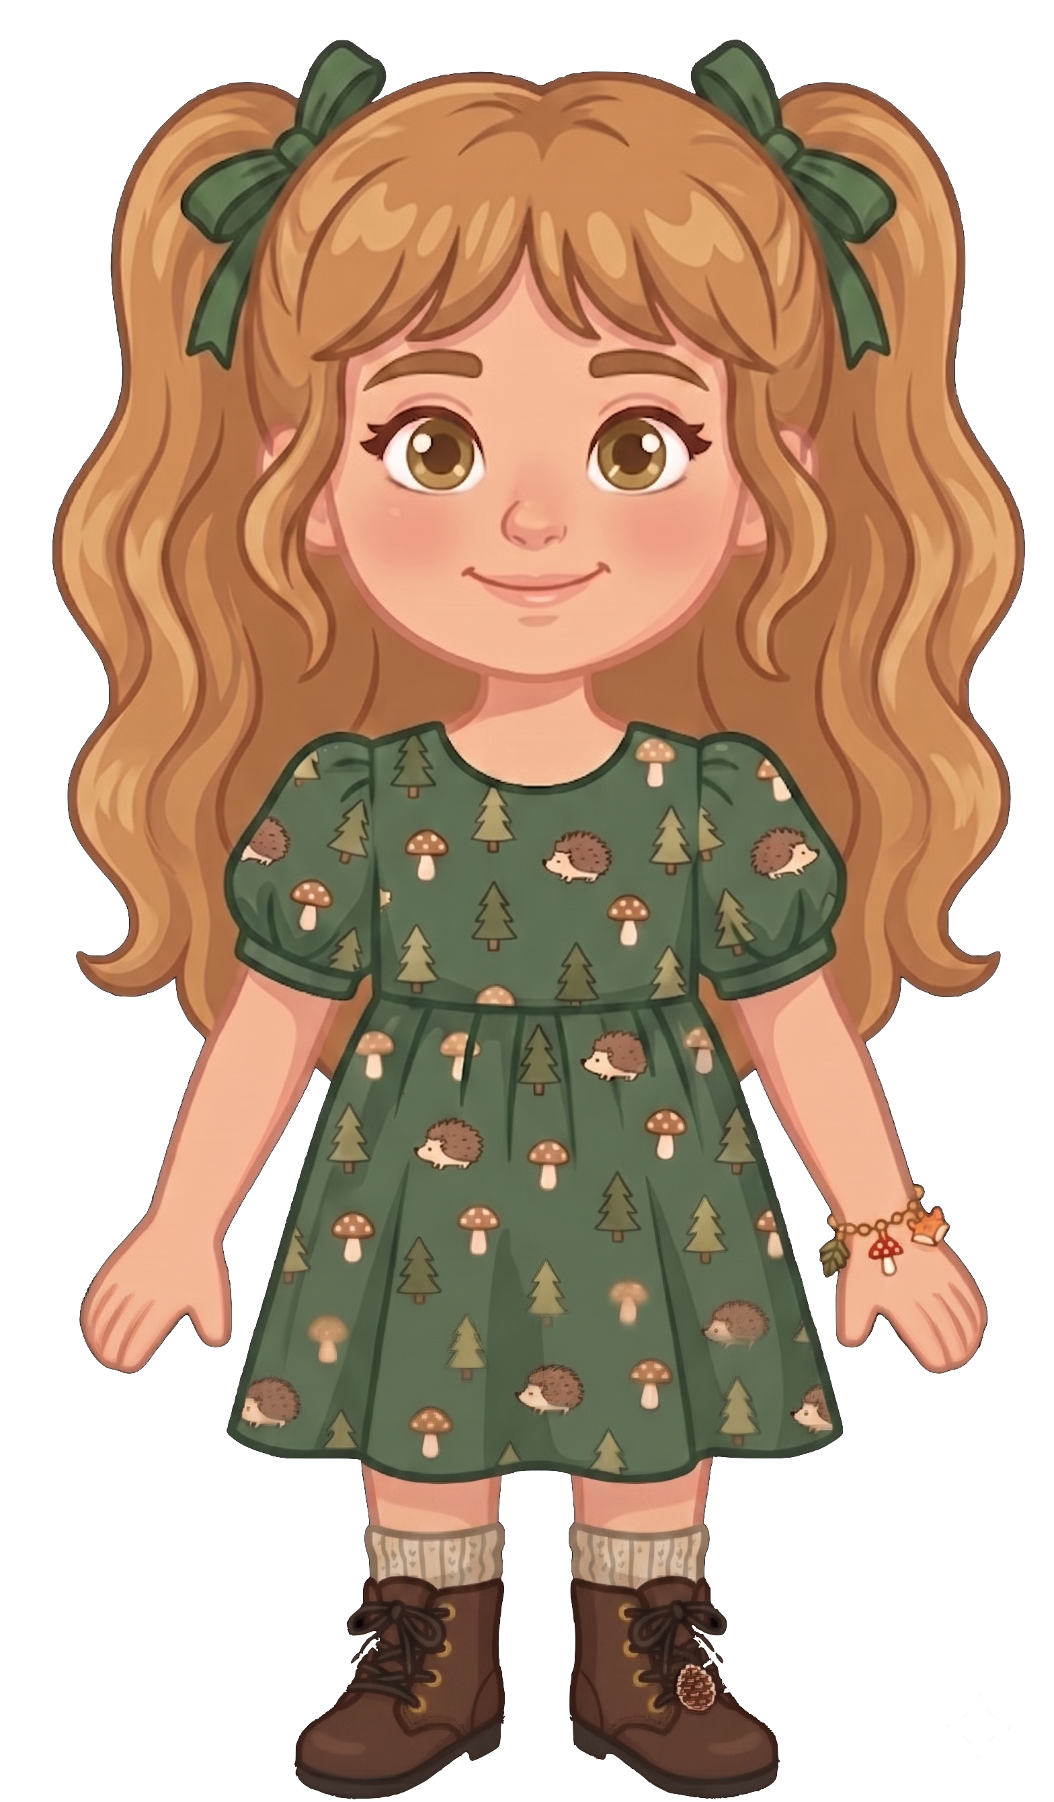
This is Nora.

Slide 2


Nora has 8 cookies.

Slide 3
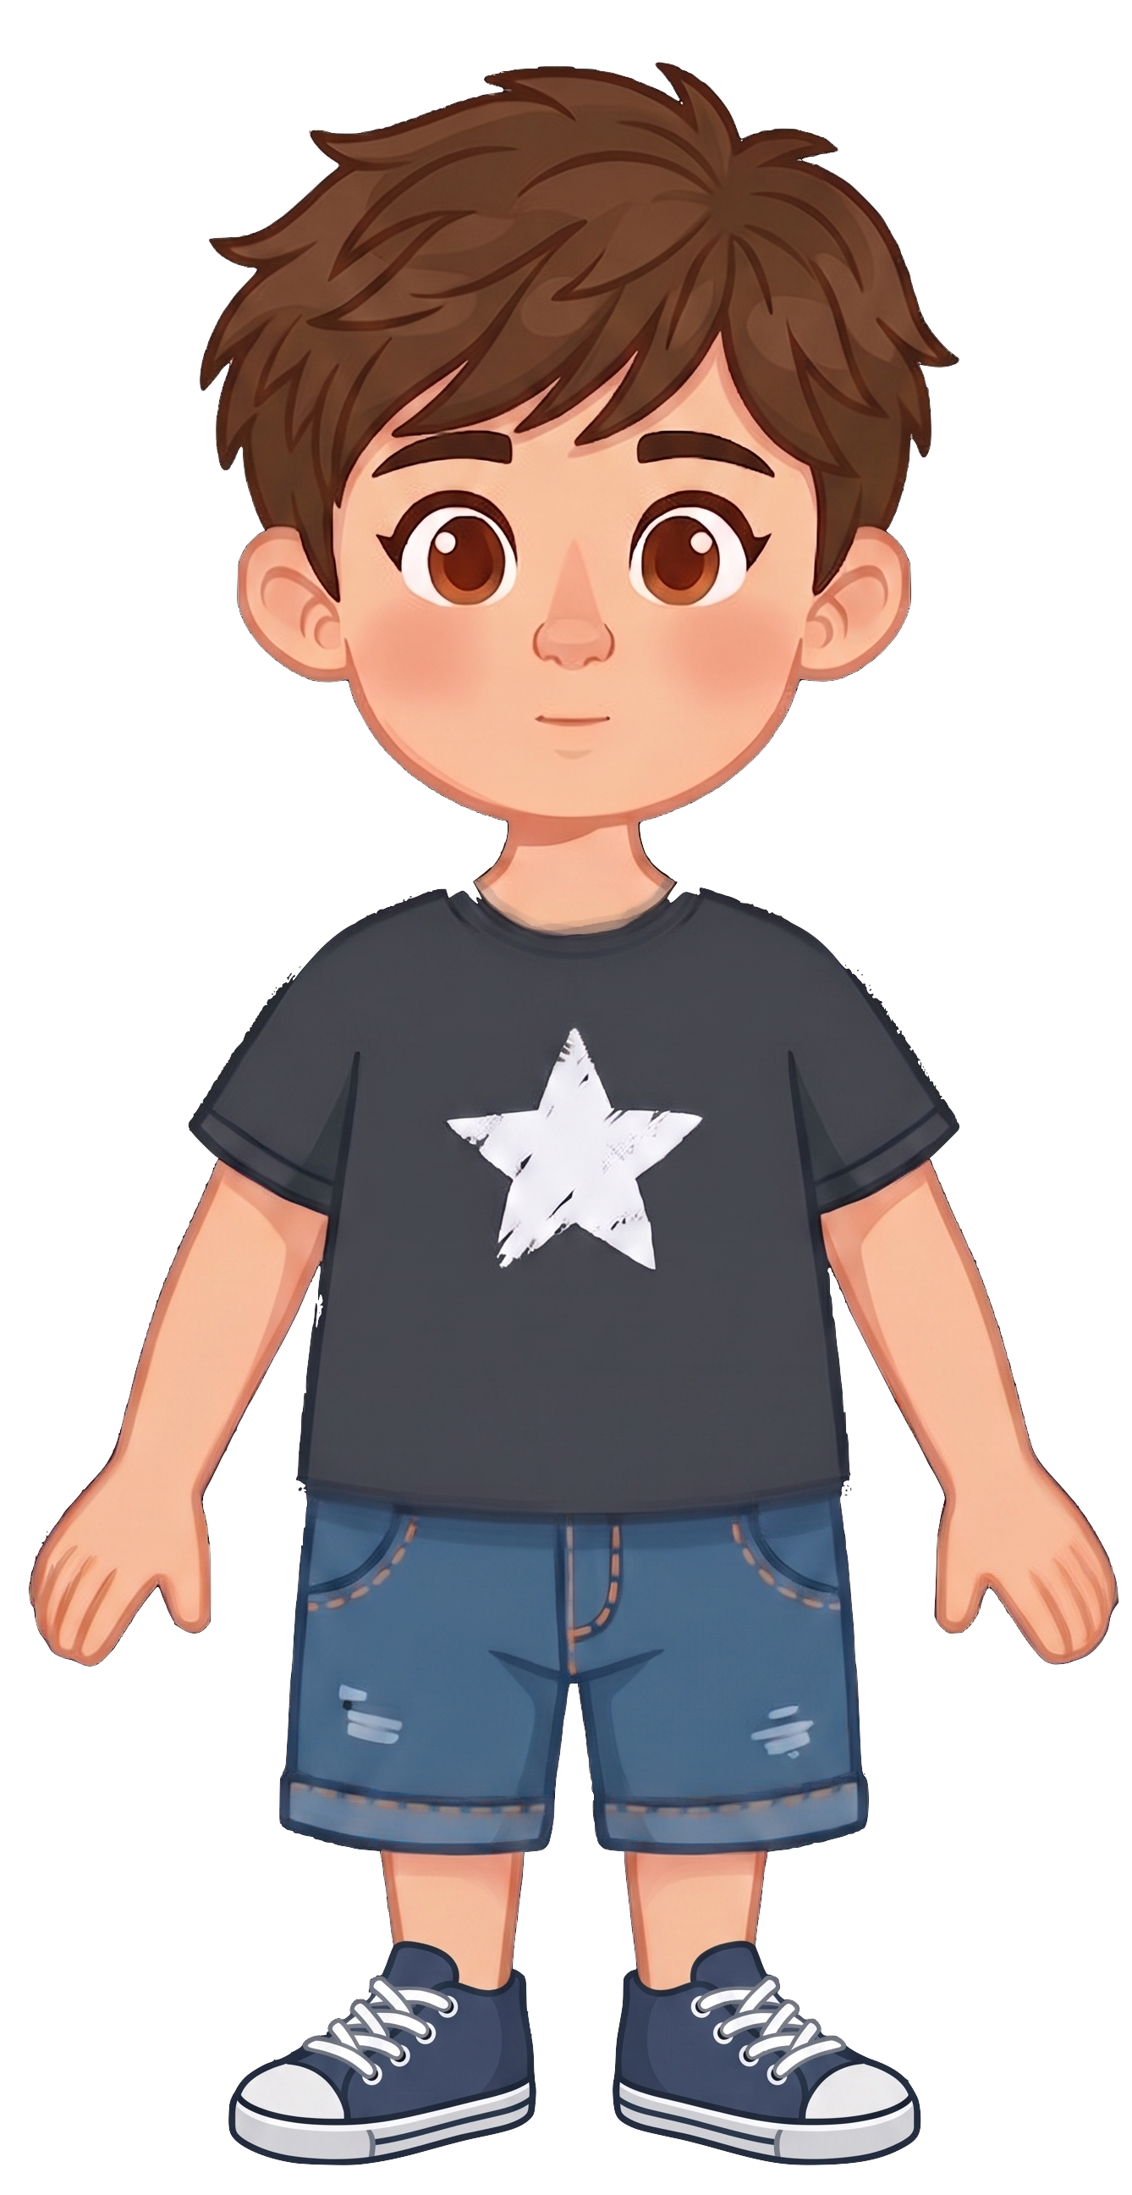
This is Eric.

Slide 4
Eric has 2 cookies.

Slide 5
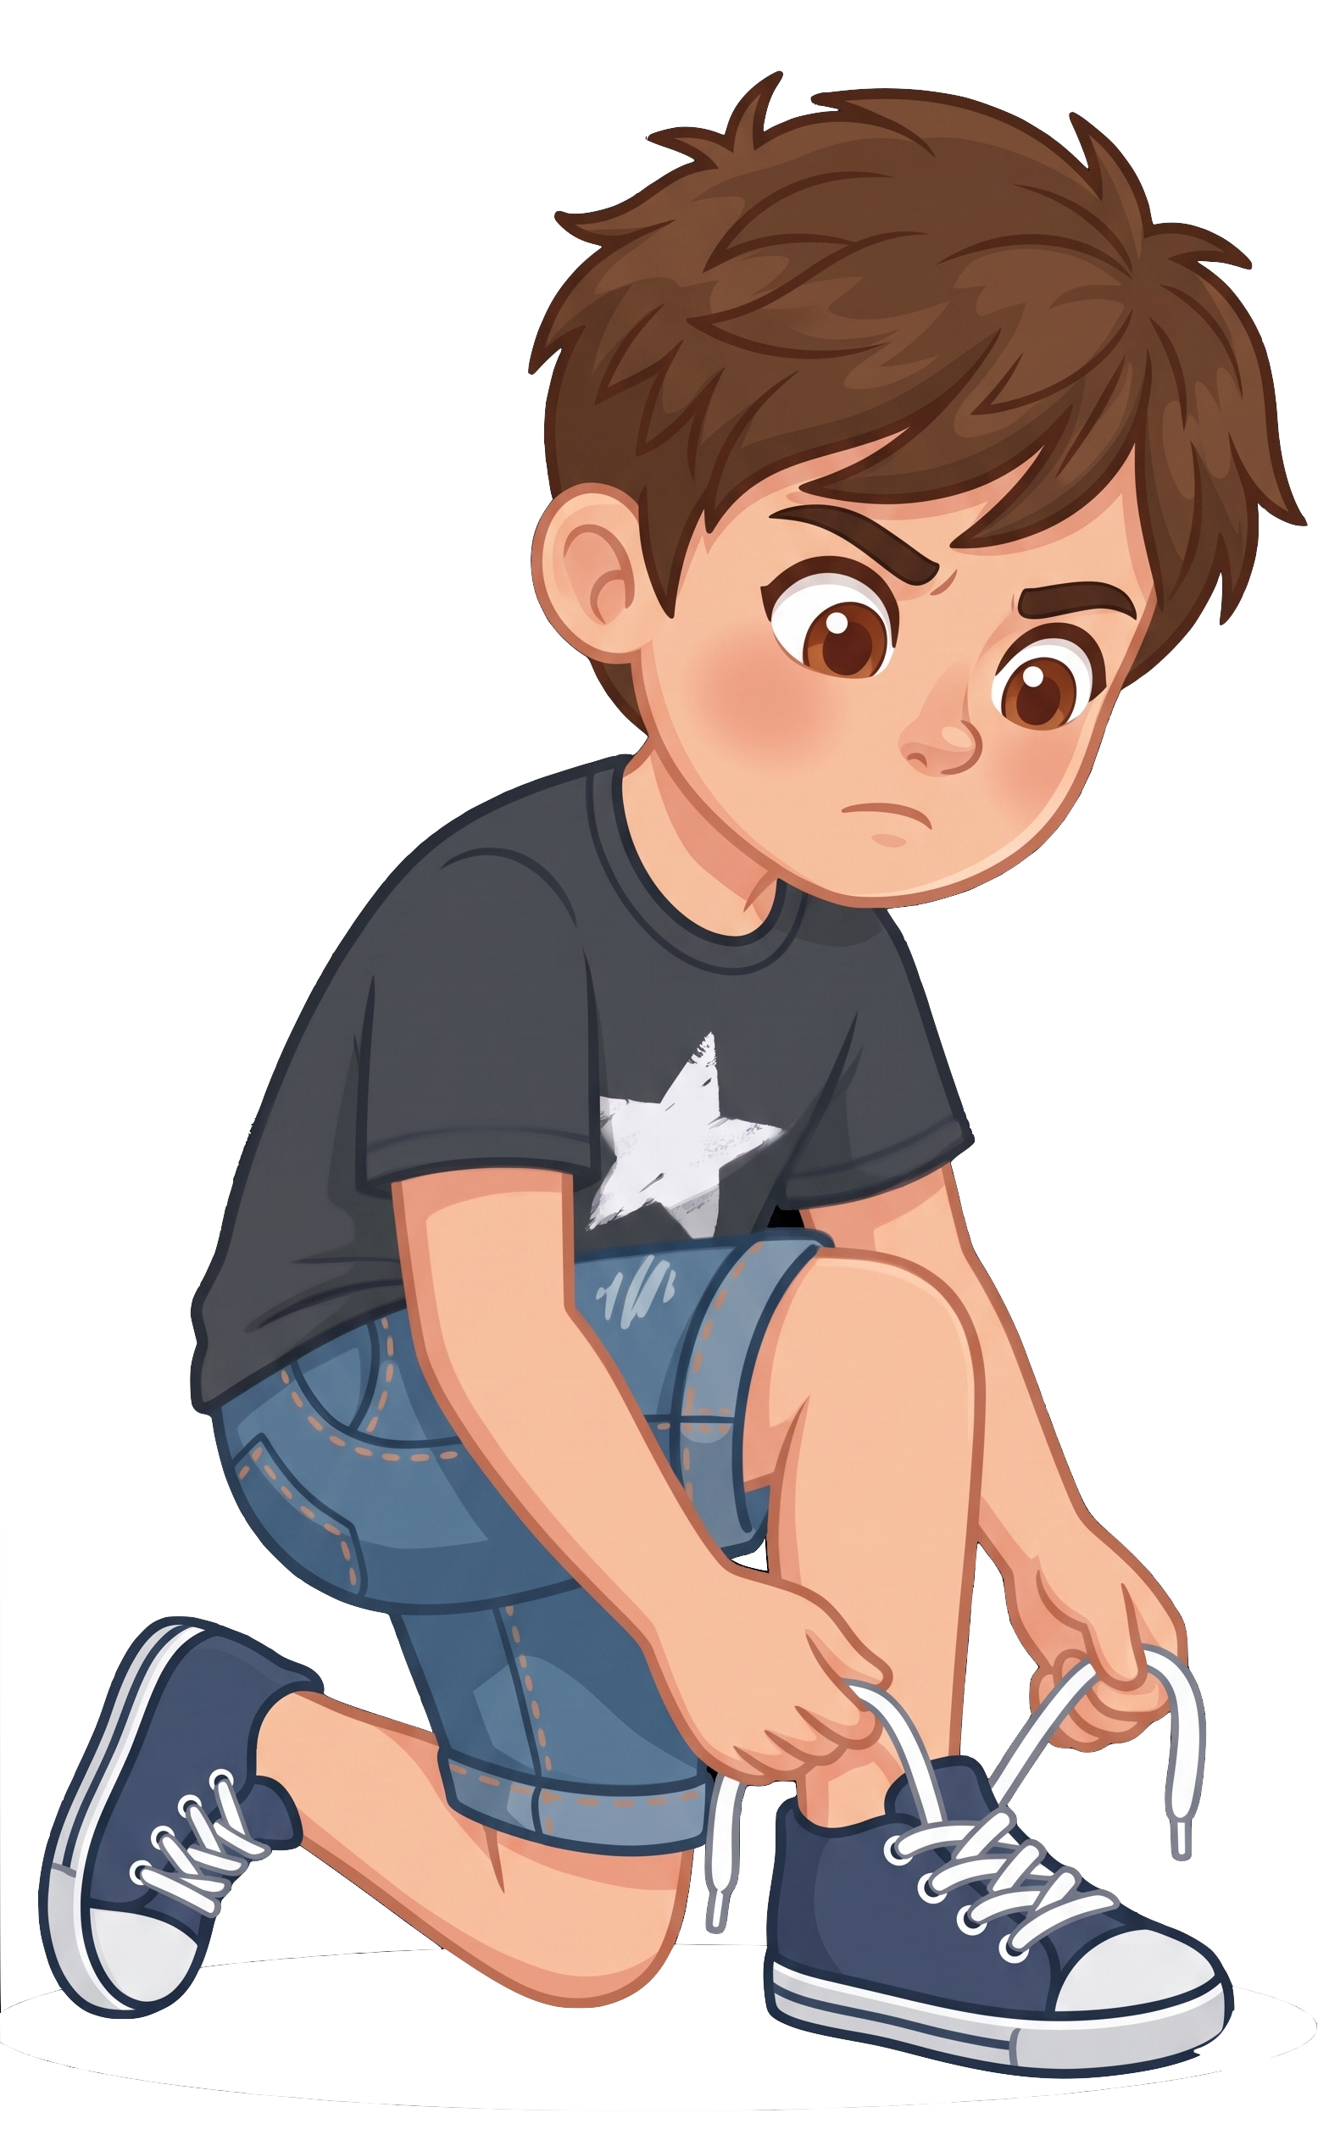
Eric is tying his shoelaces.

Slide 6
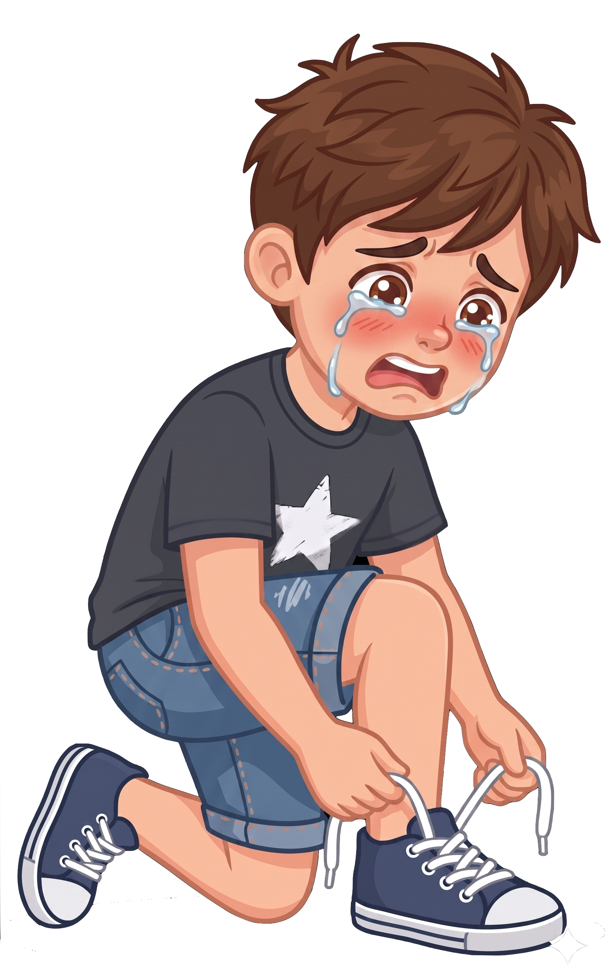
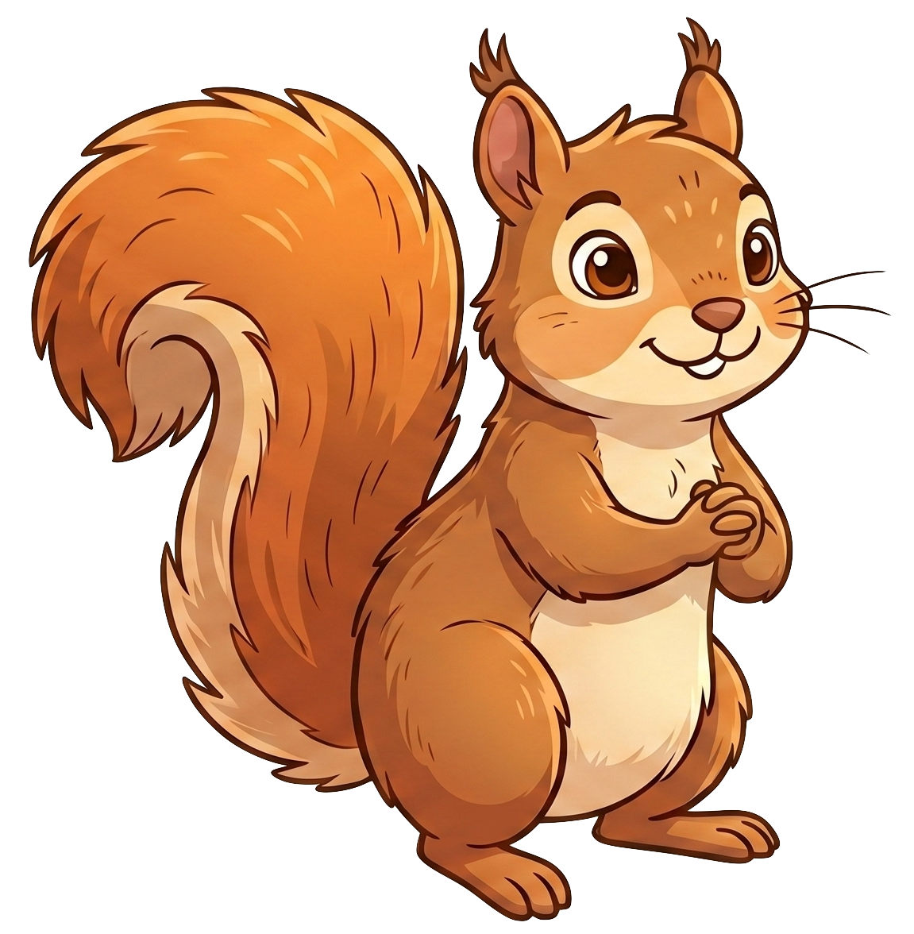
Oh no! A squirrel eats 2 of Eric’s cookies!

Slide 7
Nora still has 8 cookies. Eric now has 0 cookies.

