Slide 1
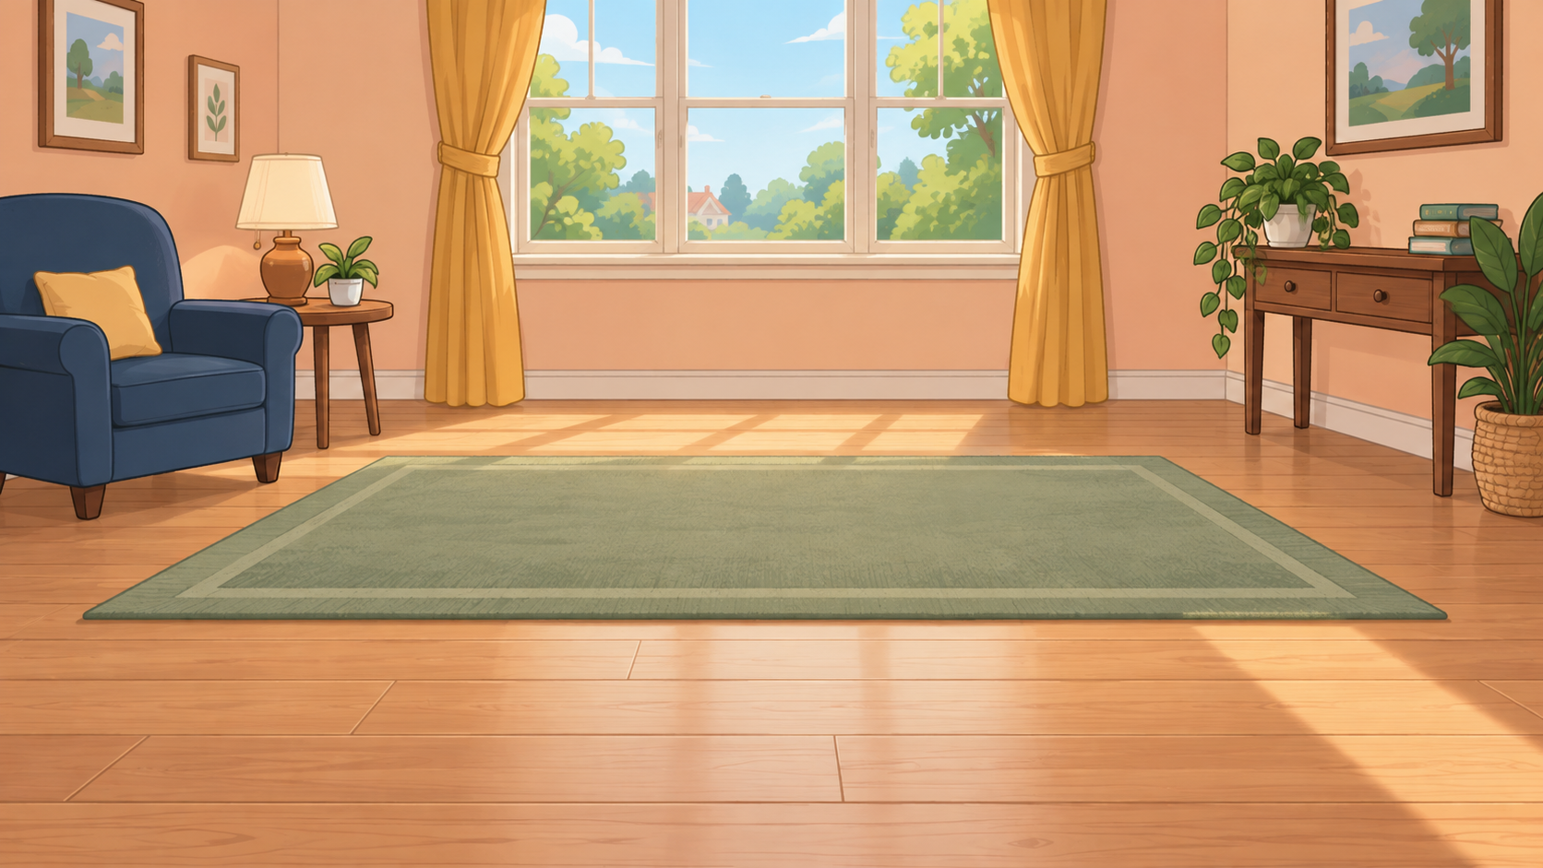
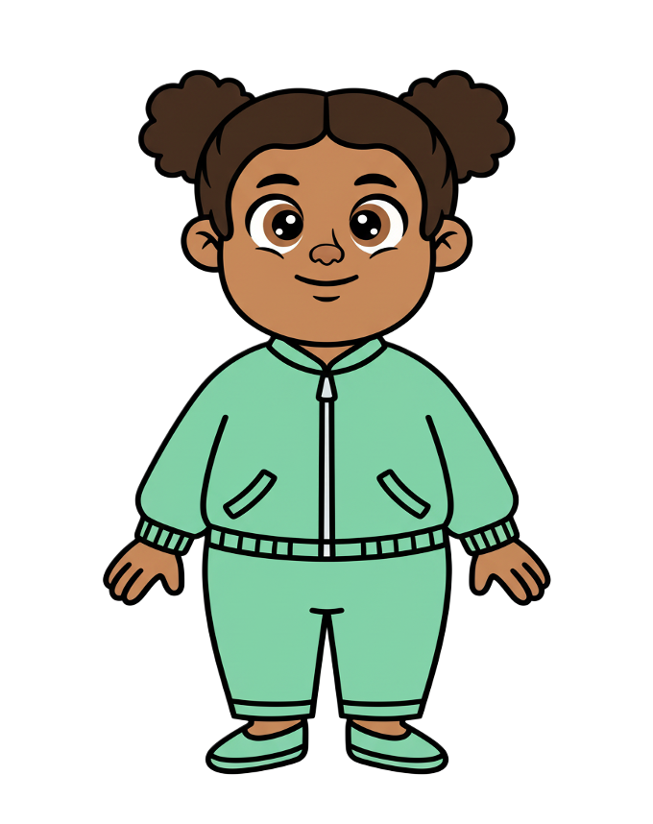
This is Zoe.

Slide 2


Zoe has 8 cookies.

Slide 3
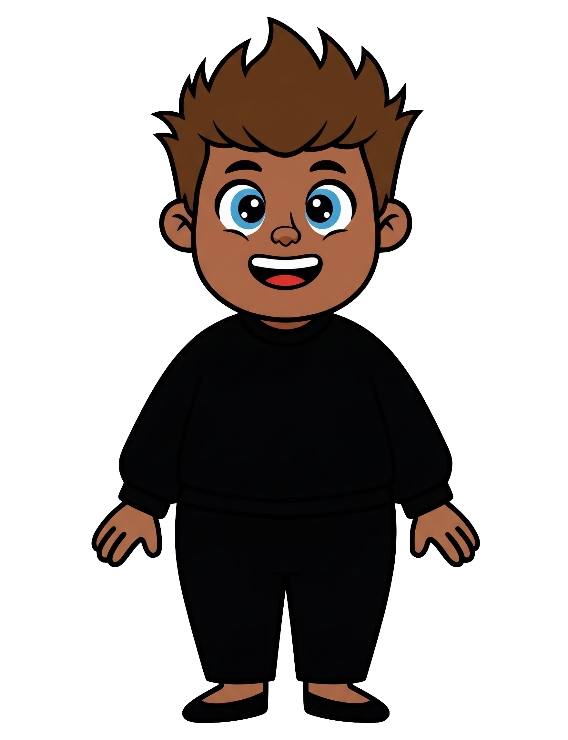
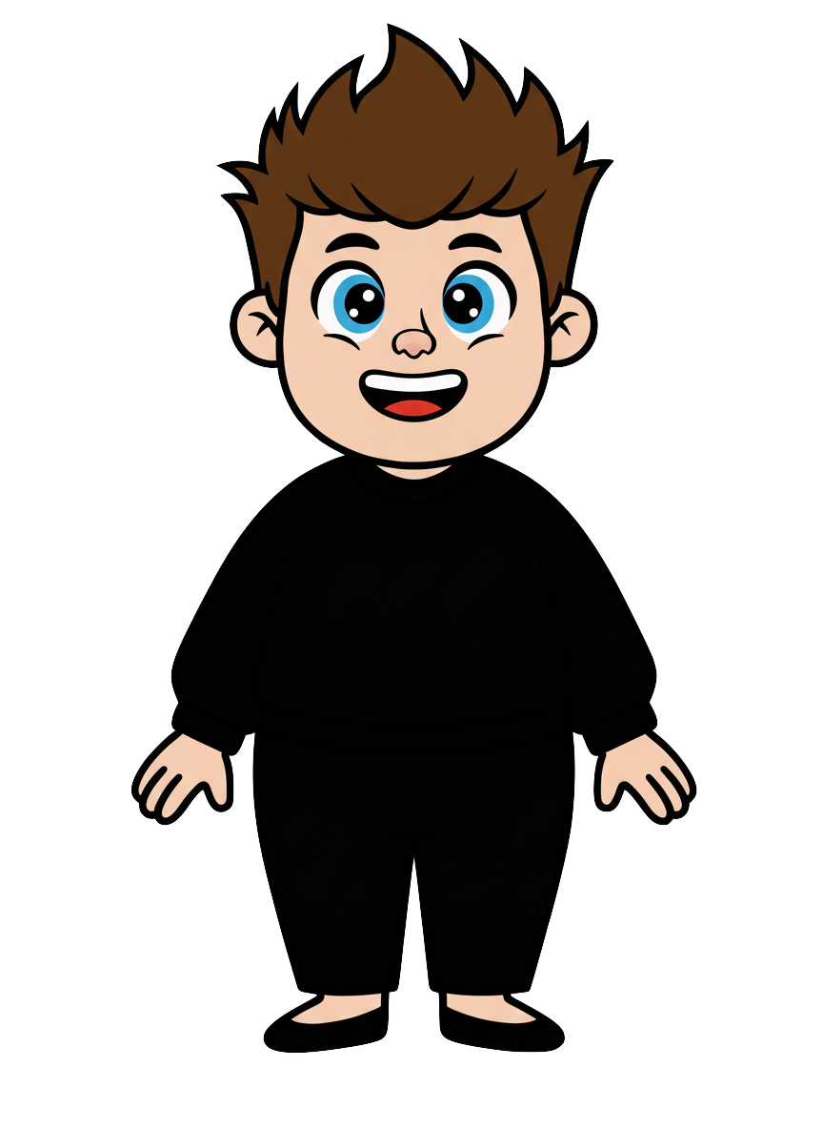
This is Rex.

Slide 4
Rex has 2 cookies.

Slide 5
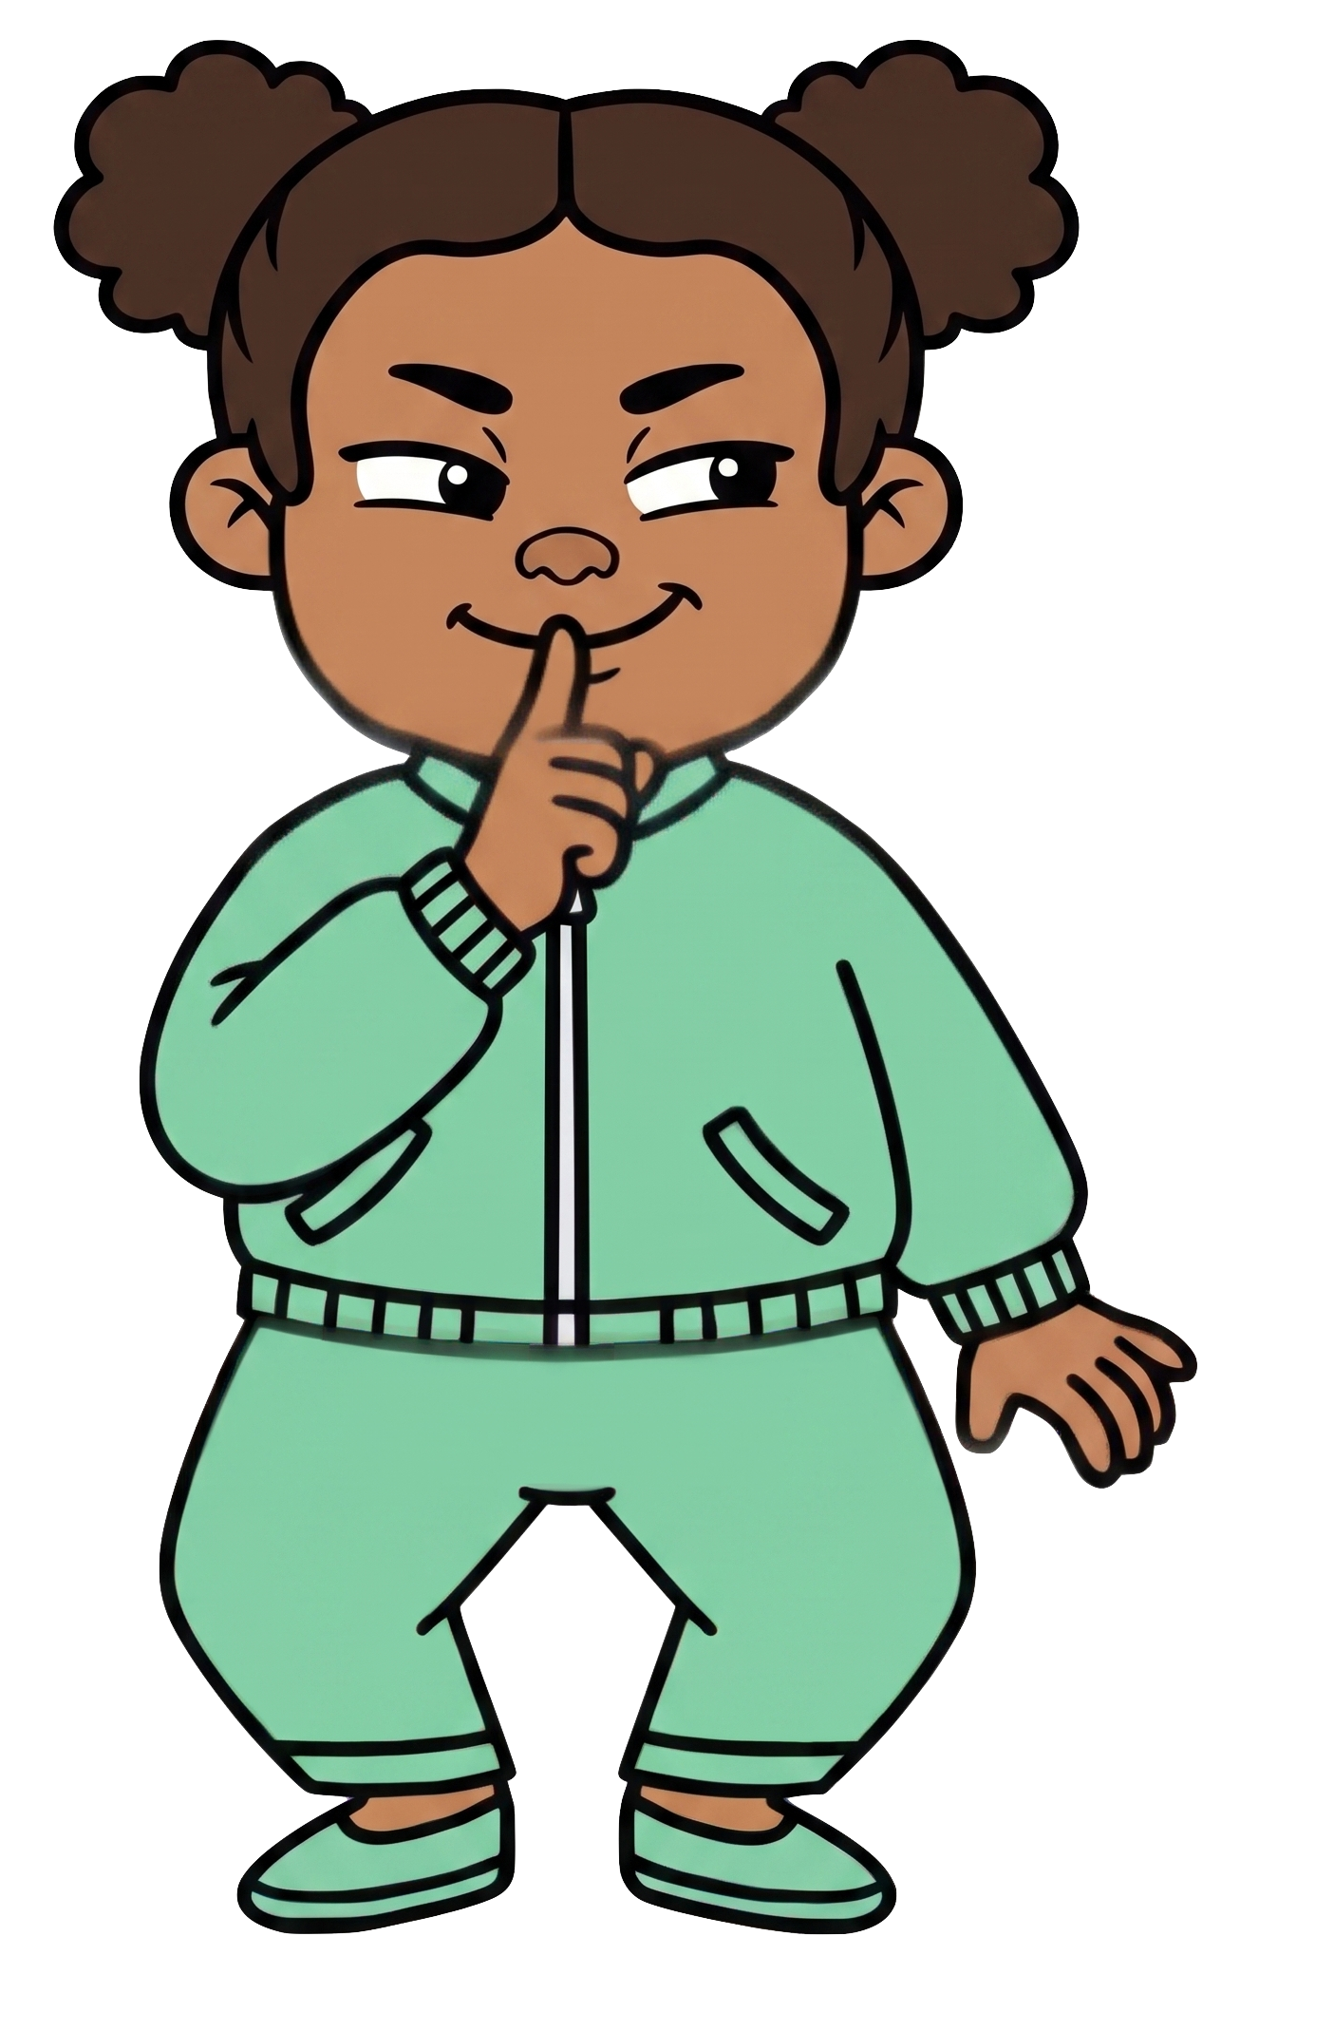
Zoe wants Rex to have fewer cookies.

Slide 6
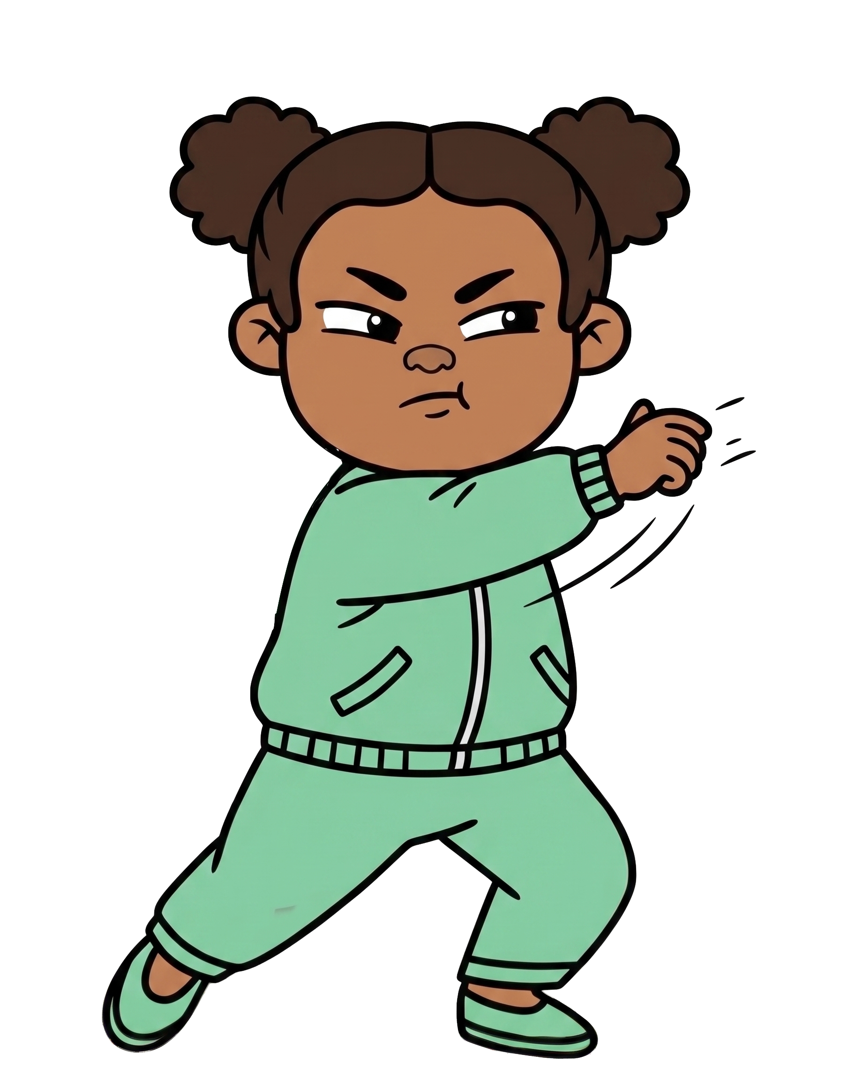

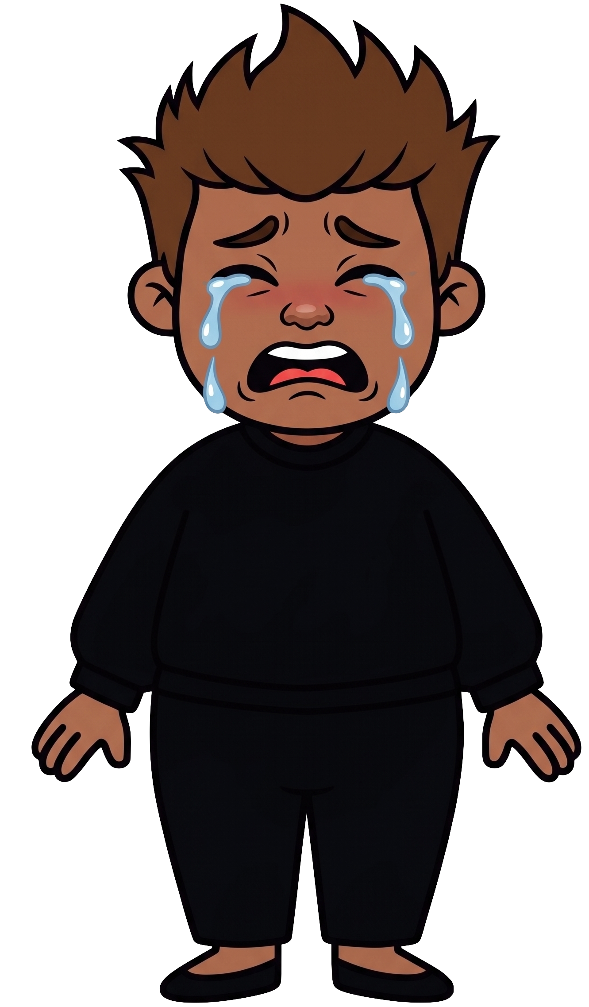
Oh no! Zoe throws 2 of Rex’s cookies!

Slide 7

Zoe still has 8 cookies. Rex now has 0 cookies.

