Slide 1
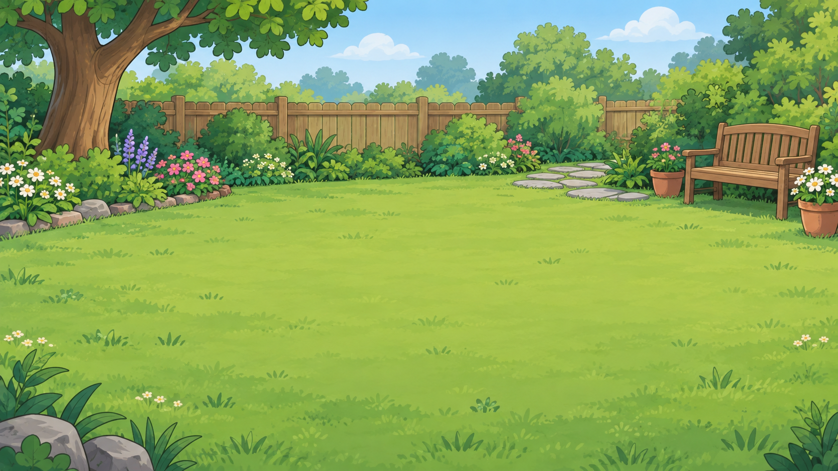
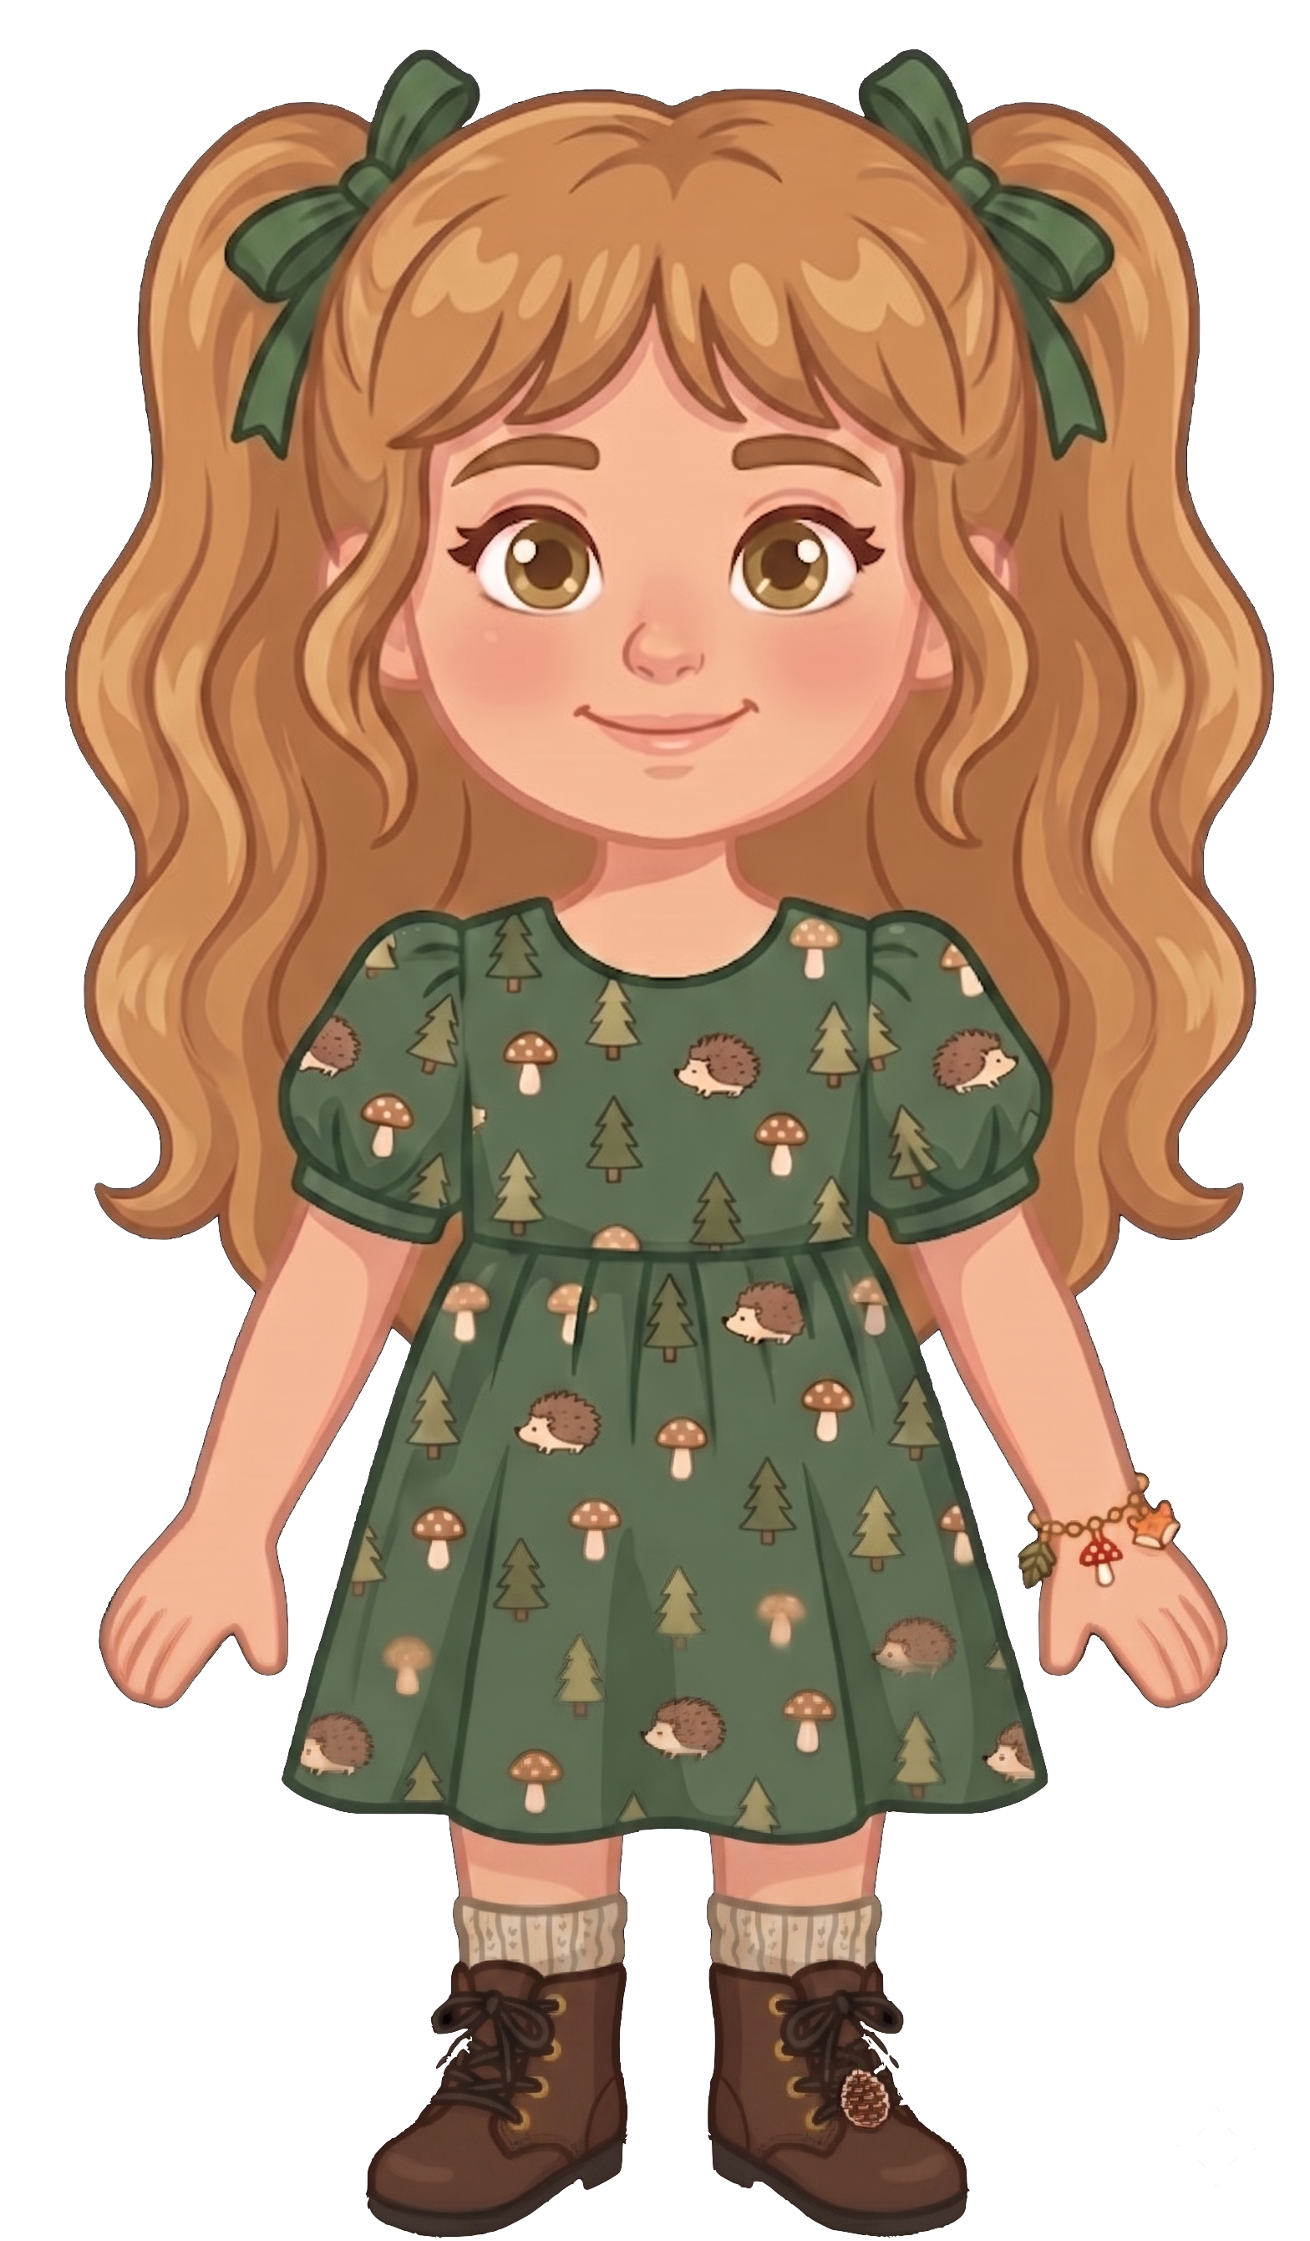
This is Nora.

Slide 2


Nora has 8 cookies.

Slide 3
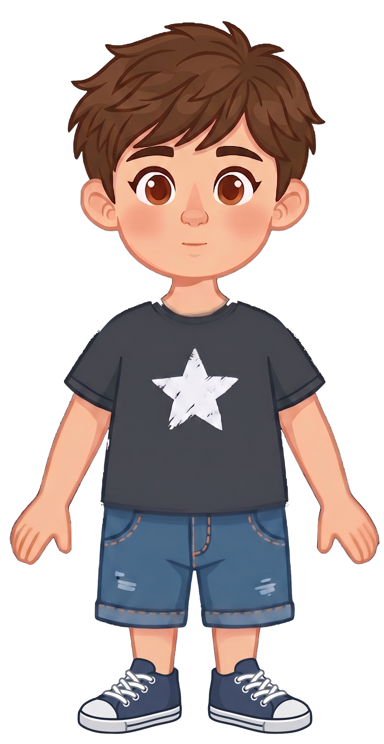
This is Eric.

Slide 4
Eric has 2 cookies.

Slide 5
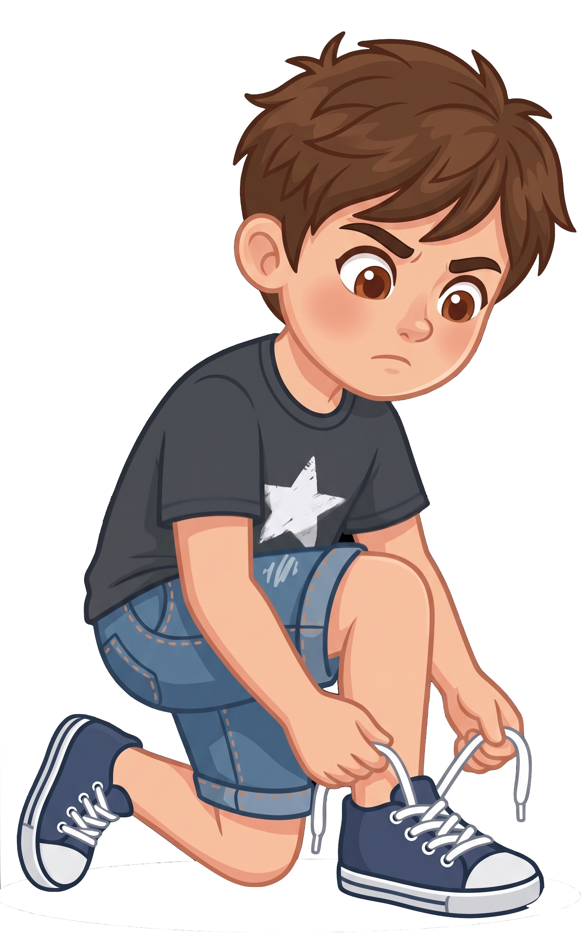
Eric is tying his shoelaces.

Slide 6
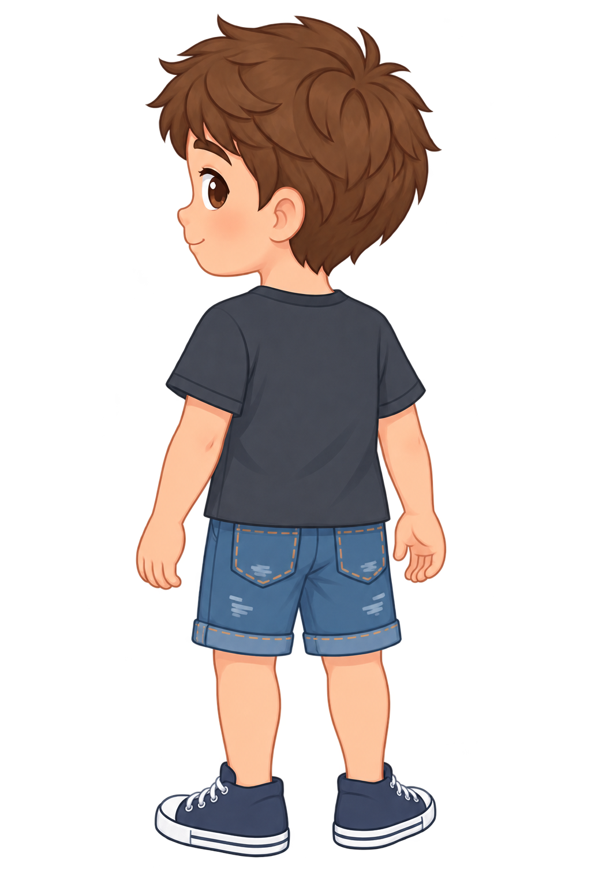
Eric walks away from his cookies.

Slide 7
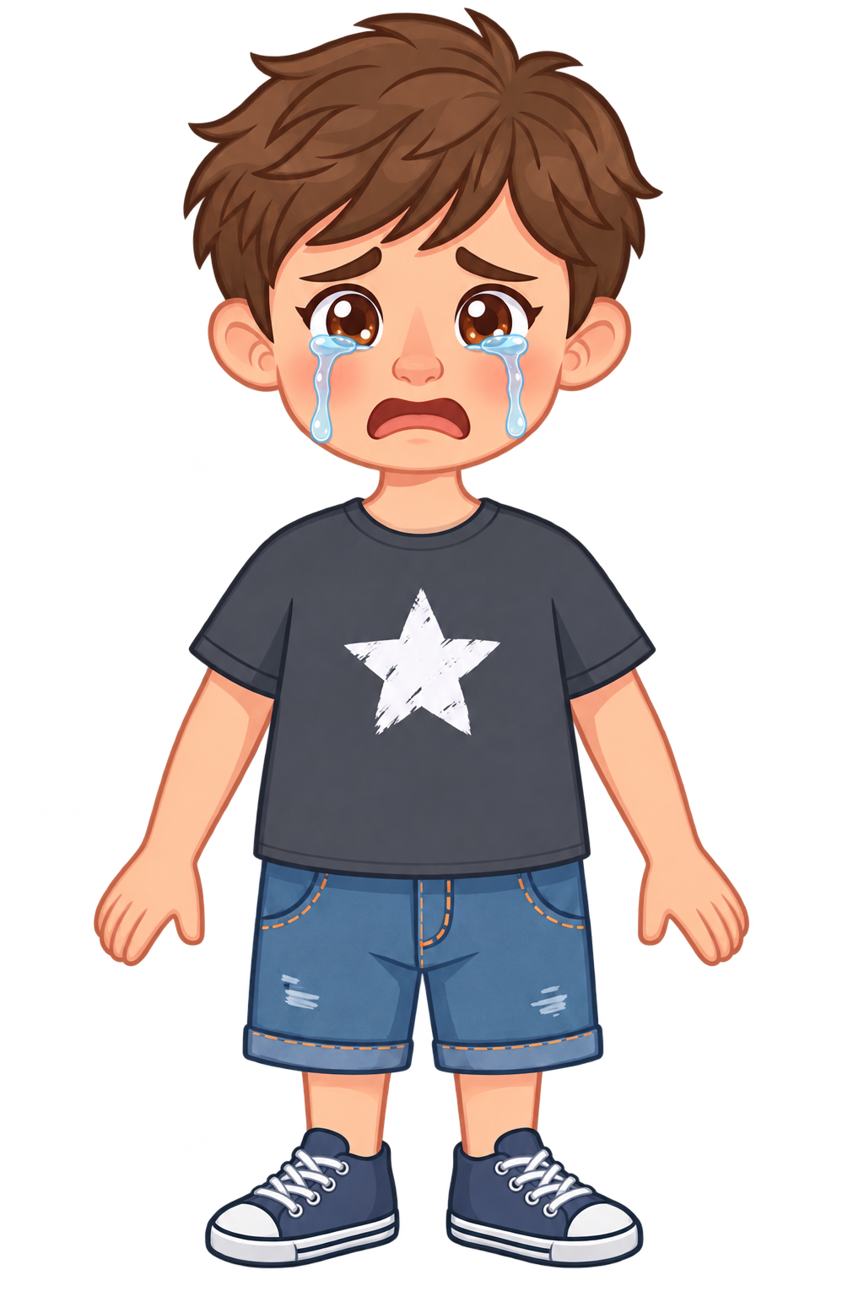
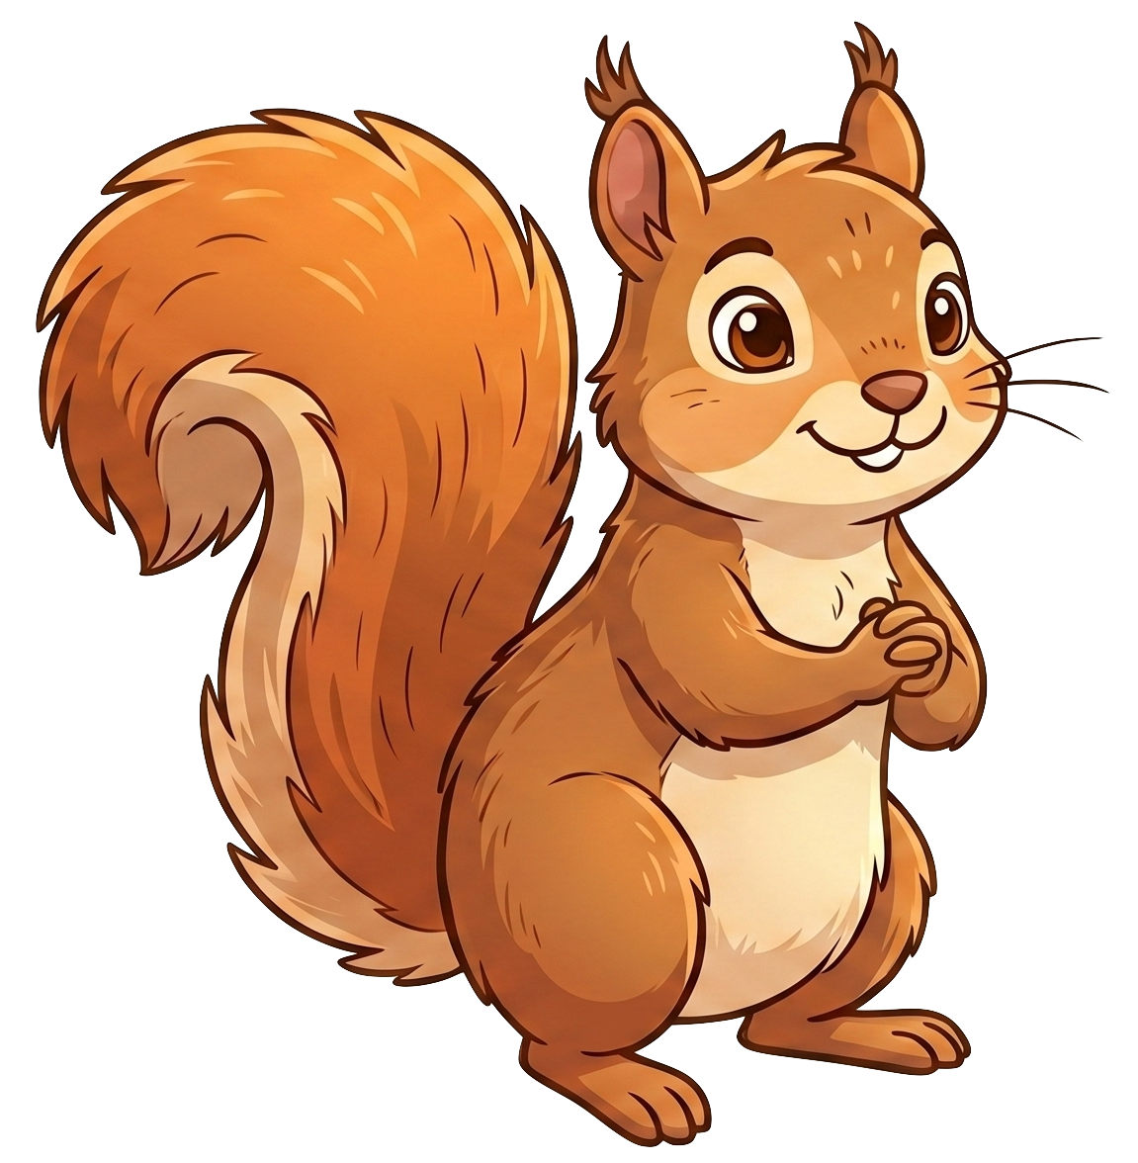
Oh no! A squirrel eats 2 of Eric’s cookies!

Slide 8
Nora still has 8 cookies. Eric now has 0 cookies.

