Slide 1
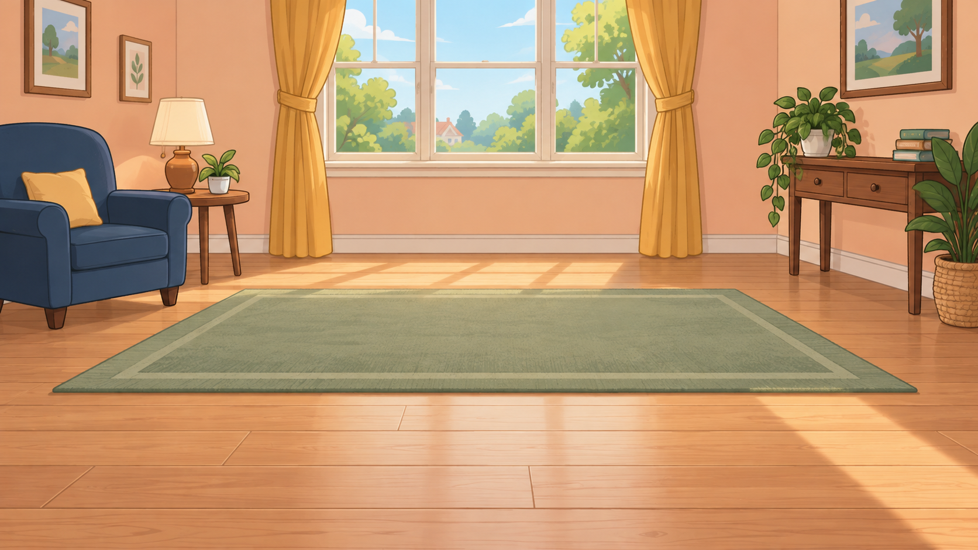
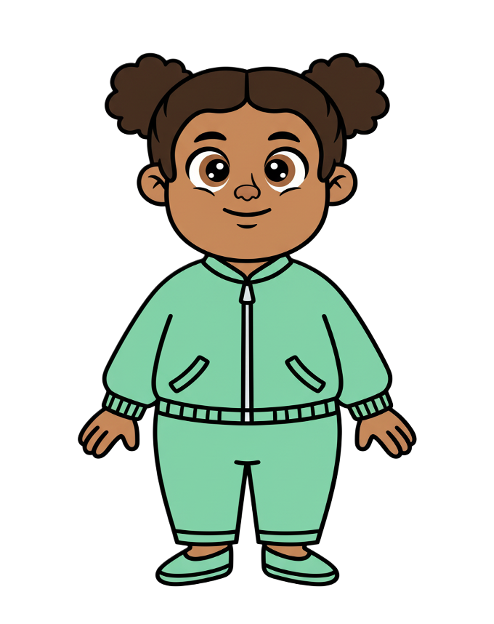
This is Zoe.

Slide 2


Zoe has 8 cookies.

Slide 3
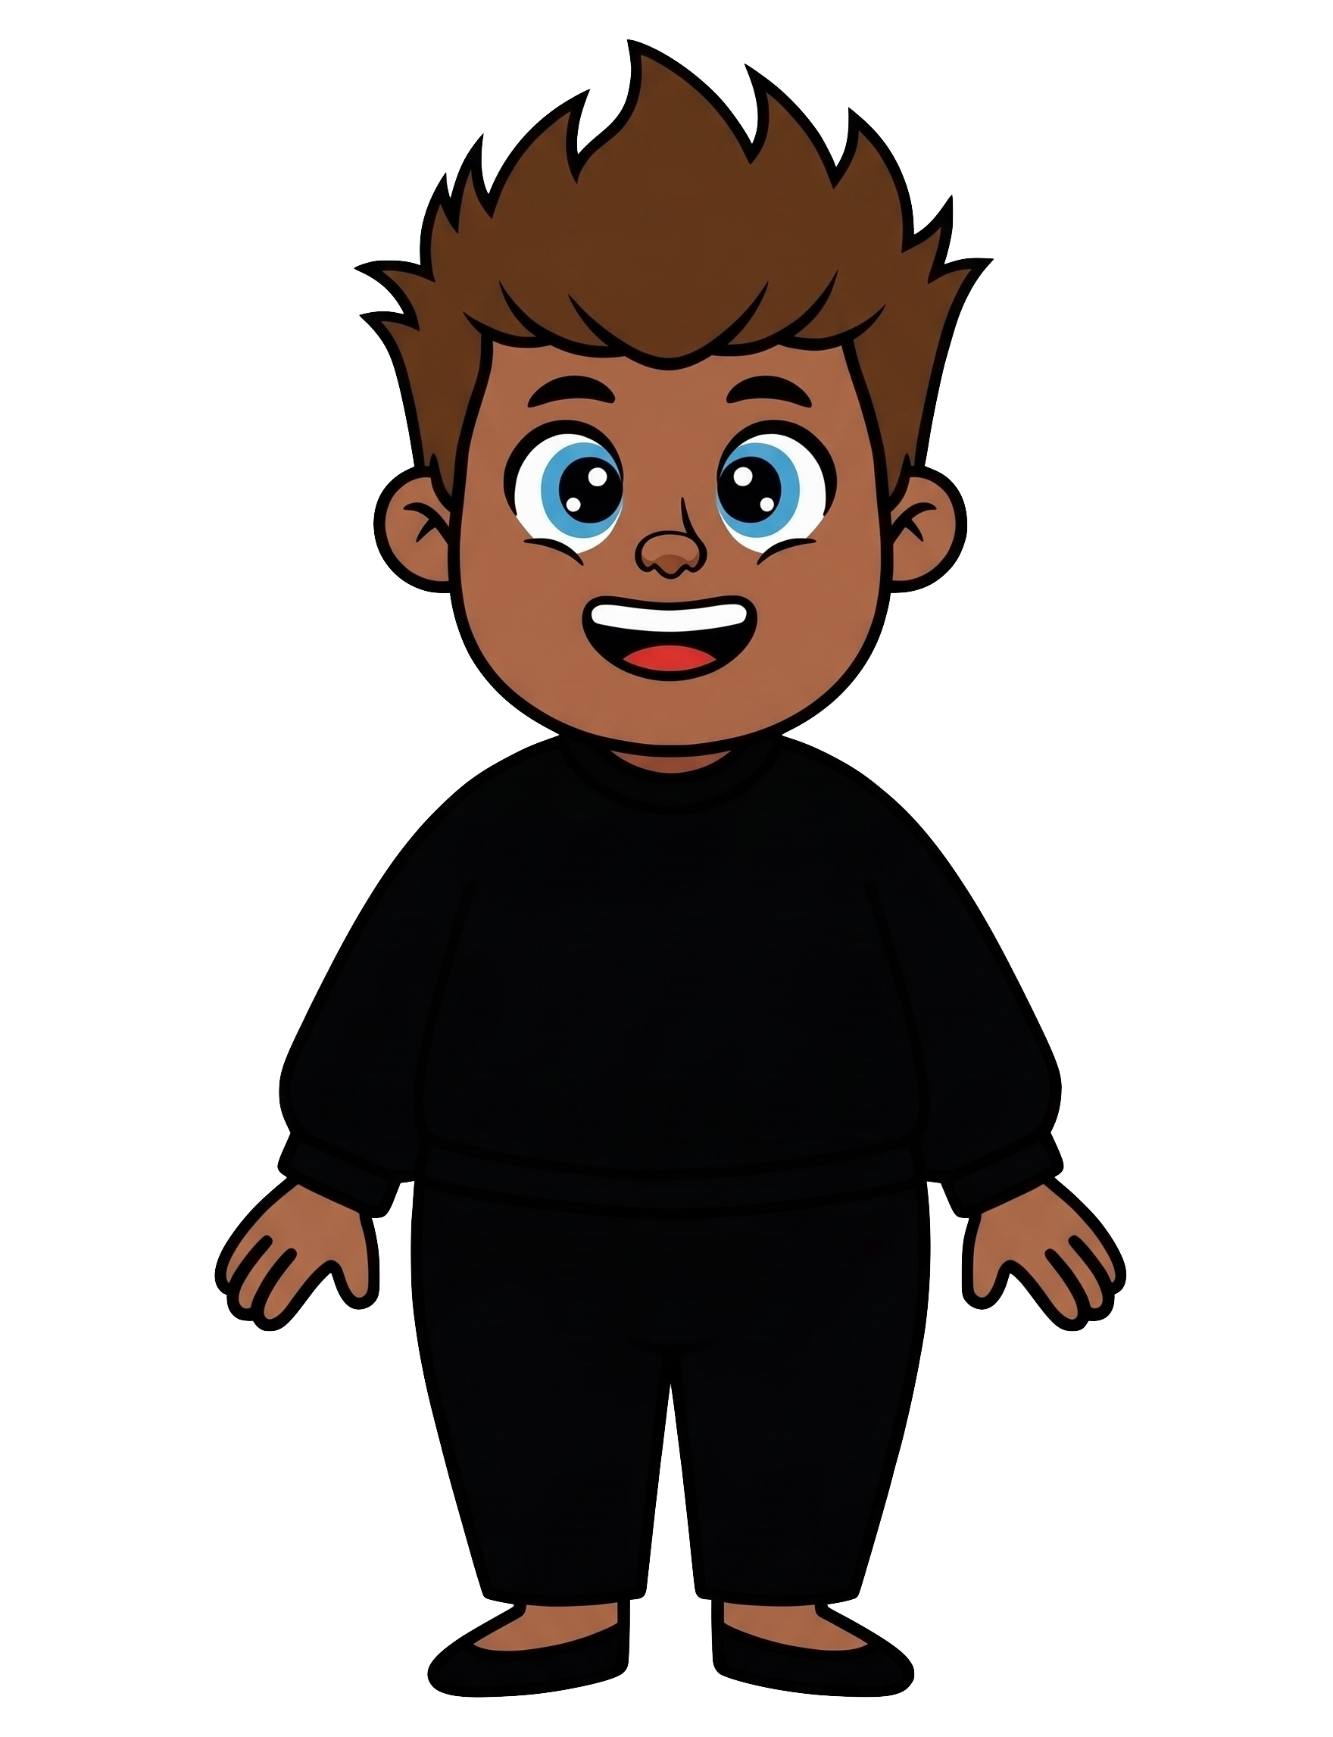
This is Rex.

Slide 4
Rex has 2 cookies.

Slide 5
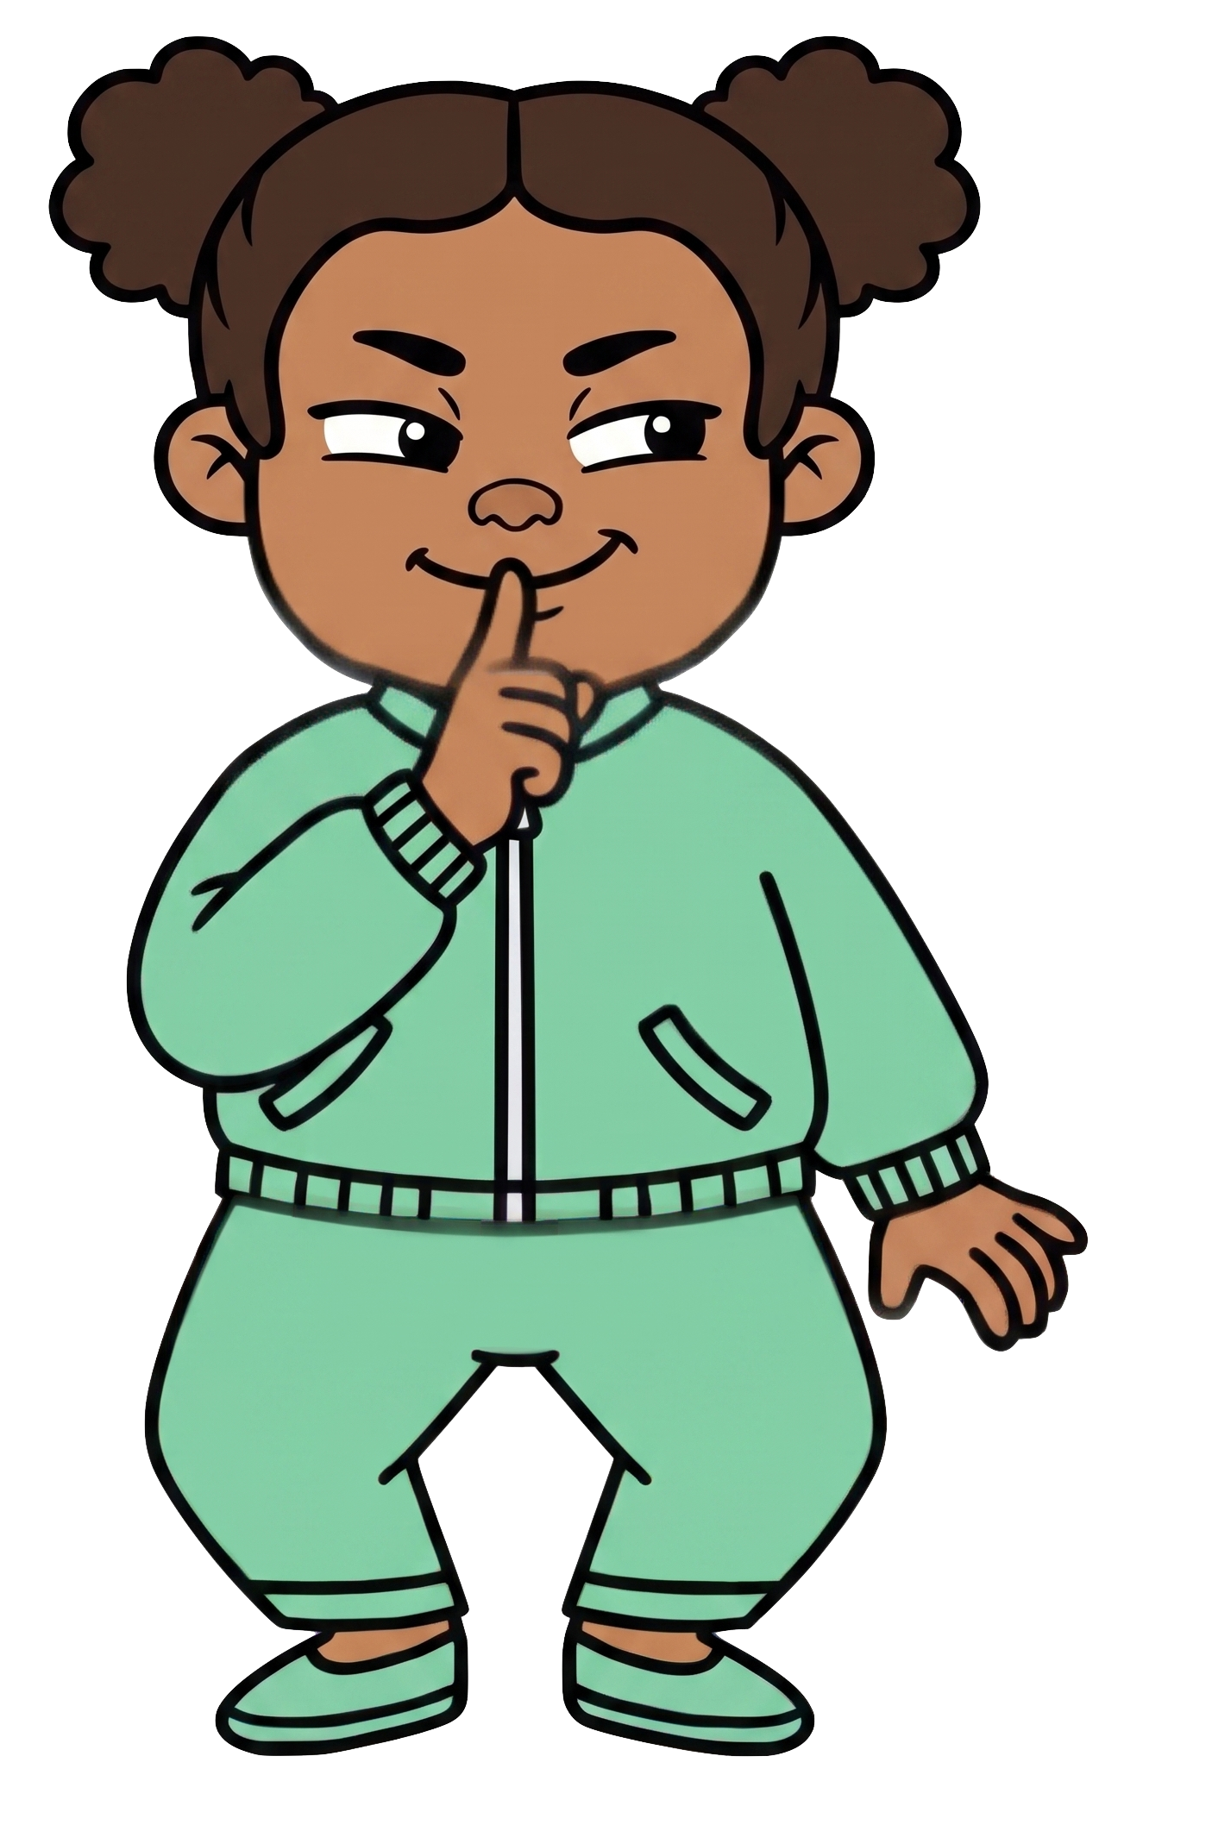
Zoe wants Rex to have fewer cookies.

Slide 6
Rex puts his cookies on the ground.

Slide 7
Rex walks away.

Slide 8
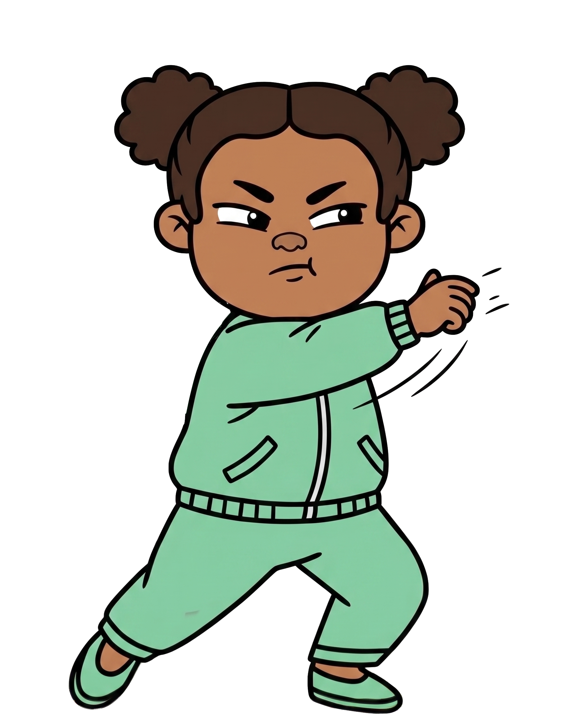
Oh no! Zoe throws 2 of Rex’s cookies!

Slide 9

Zoe still has 8 cookies. Rex now has 0 cookies.

