Slide 1
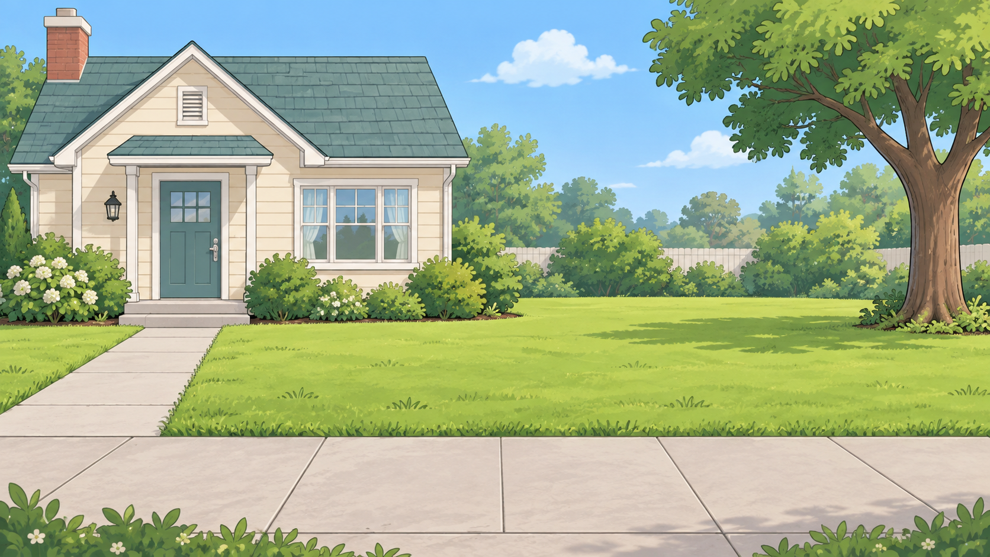
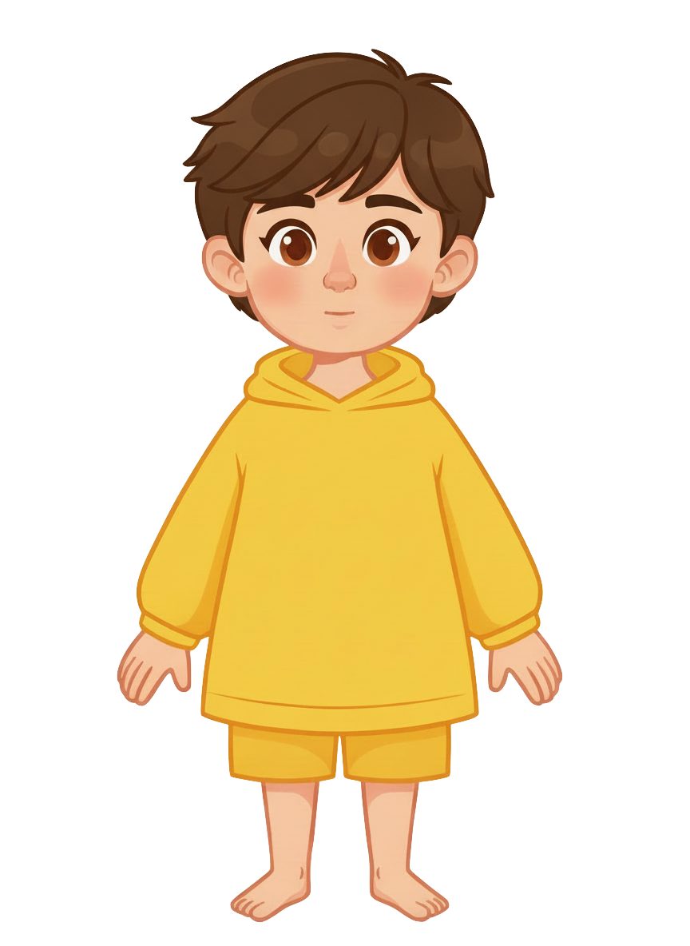
This is Sam.

Slide 2


Sam has 8 cookies.

Slide 3

Sam has an alligator.

Slide 4
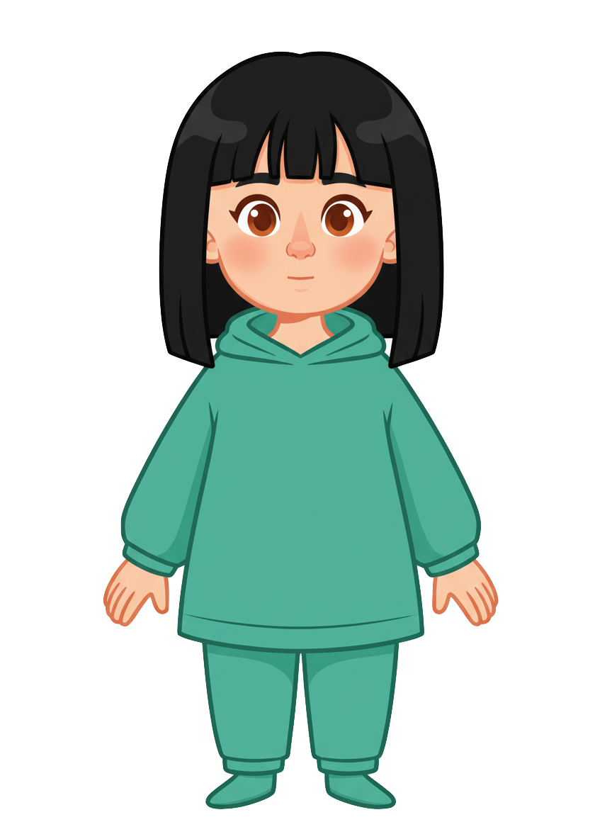
This is Ella.

Slide 5
Ella has 2 cookies.

Slide 6
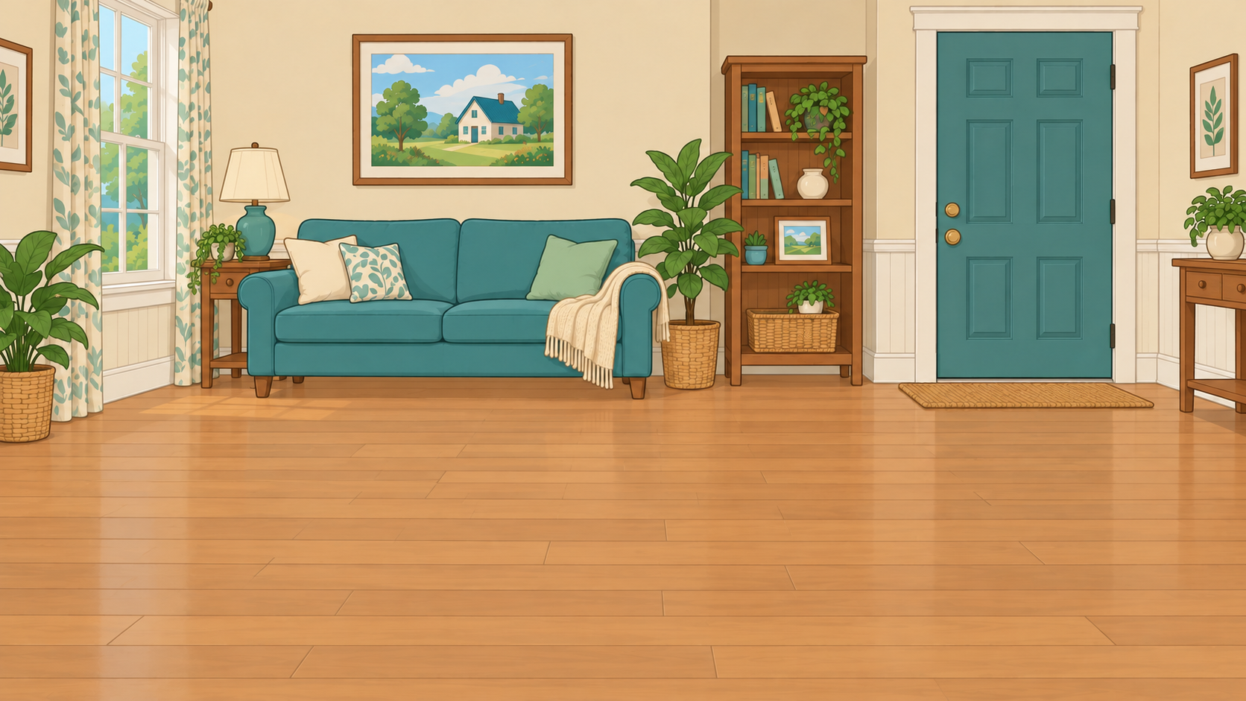
Sam puts his alligator inside the house.

Slide 7
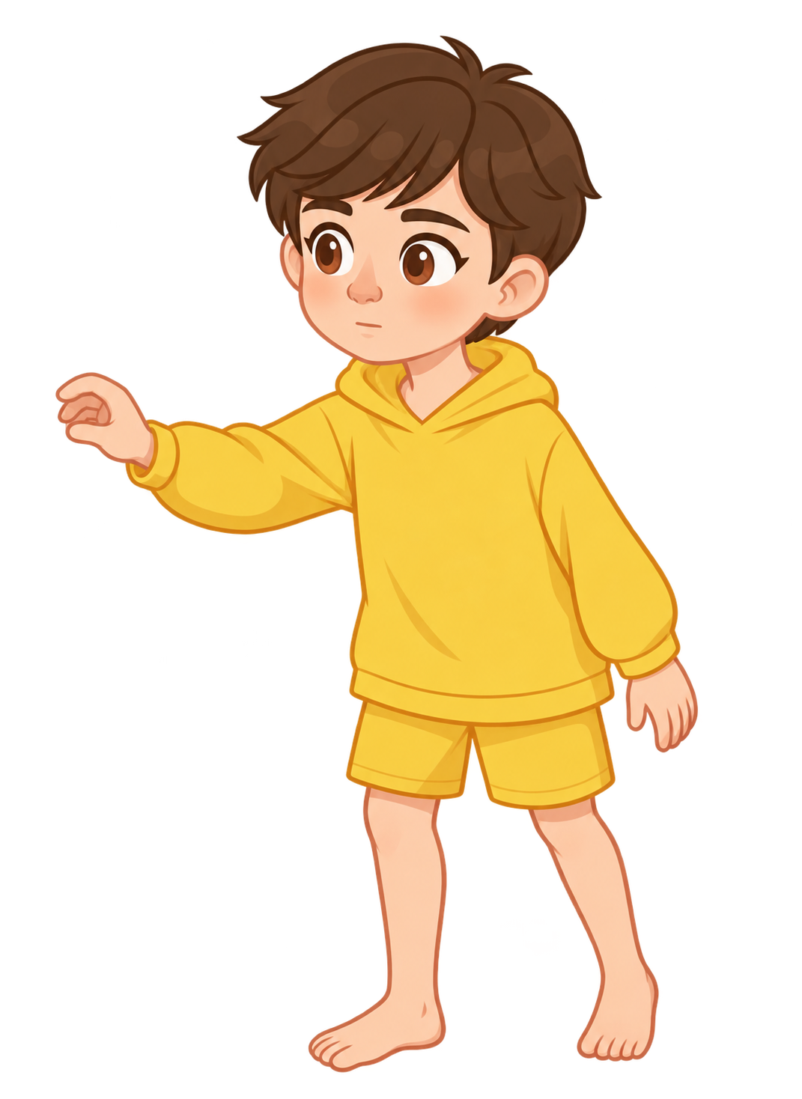
Sam locks the door and checks the lock.

Slide 8
Ella puts her cookies on the ground and walks away.

Slide 9
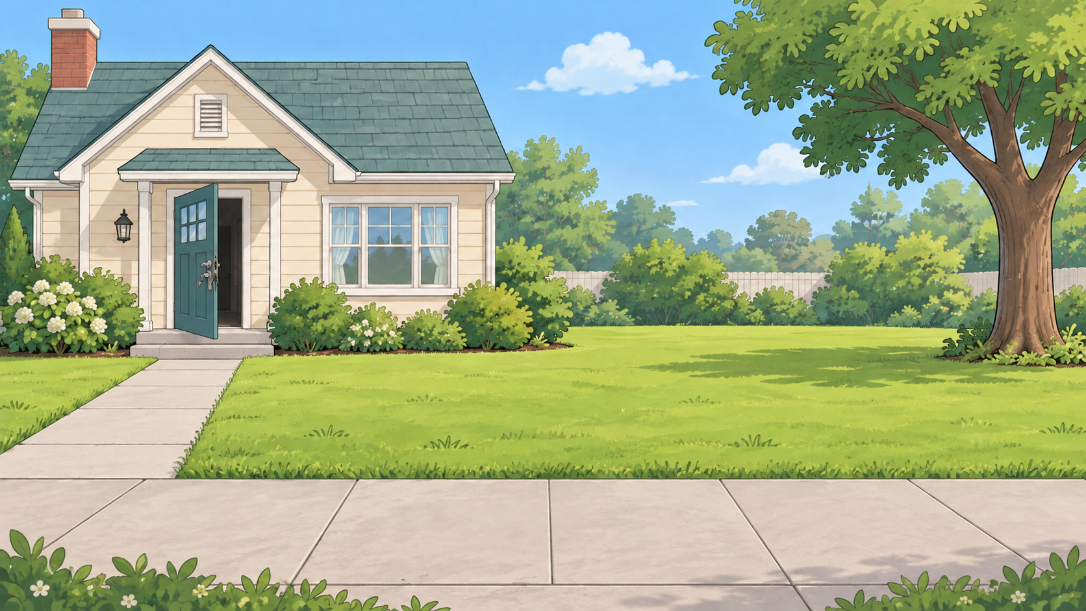
Oh no! The alligator breaks out of the house!

Slide 10
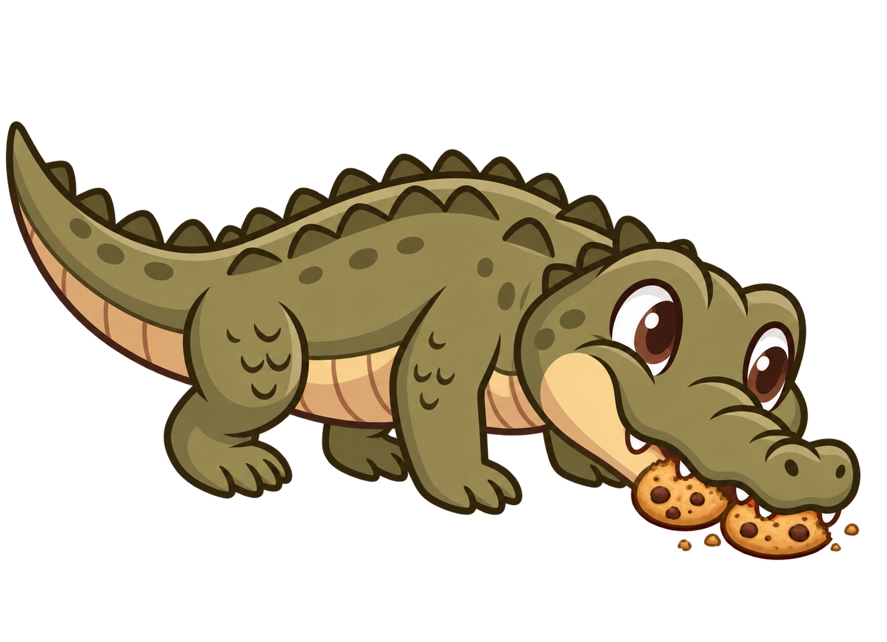
The alligator eats 2 of Ella’s cookies!

Slide 11
Sam still has 8 cookies. Ella now has 0 cookies.

