Slide 1
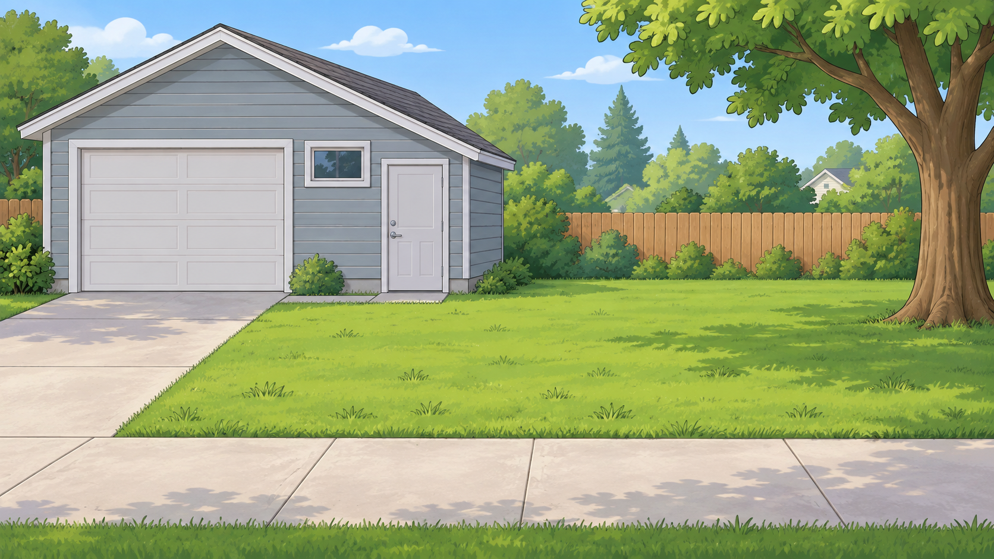
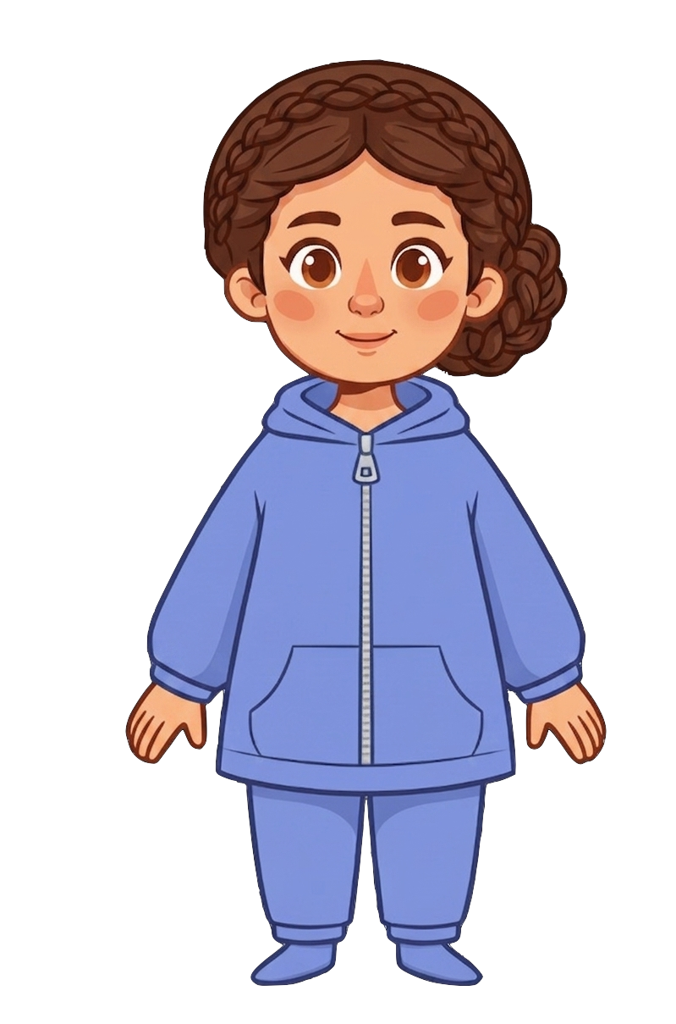
This is Catherine.

Slide 2


Catherine has 8 cookies.

Slide 3
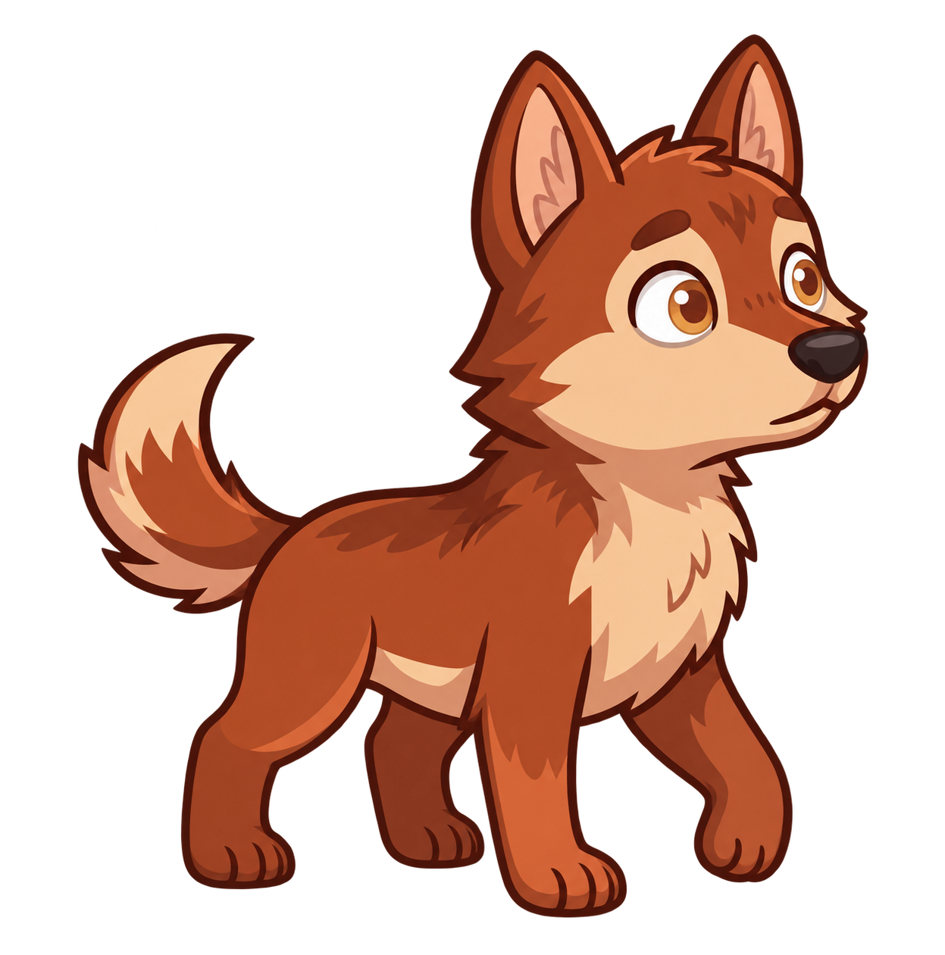
Catherine has a pet wolf.

Slide 4
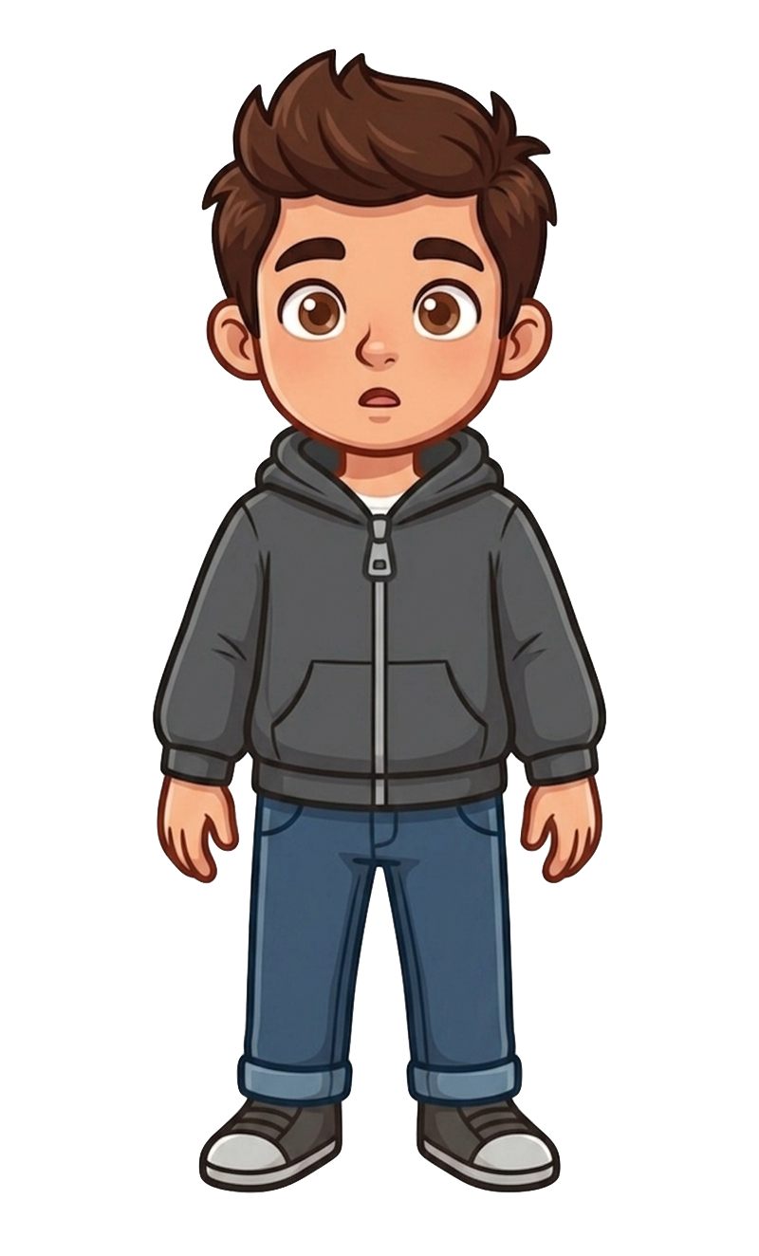
This is Andy.

Slide 5
Andy has 2 cookies.

Slide 6
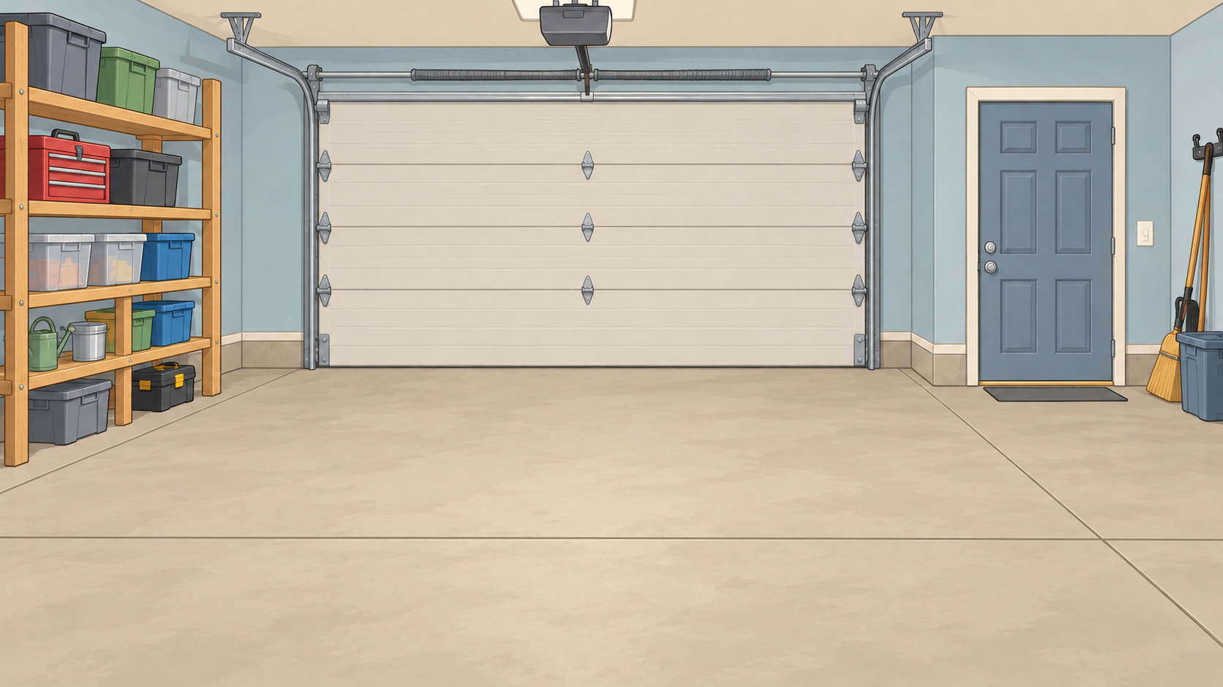
Catherine puts her wolf inside the garage.

Slide 7
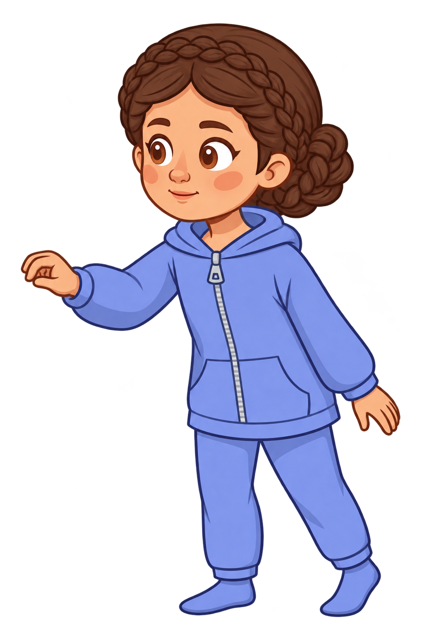
Catherine locks the door and checks the lock.

Slide 8
Andy puts his cookies on the ground and walks away.

Slide 9
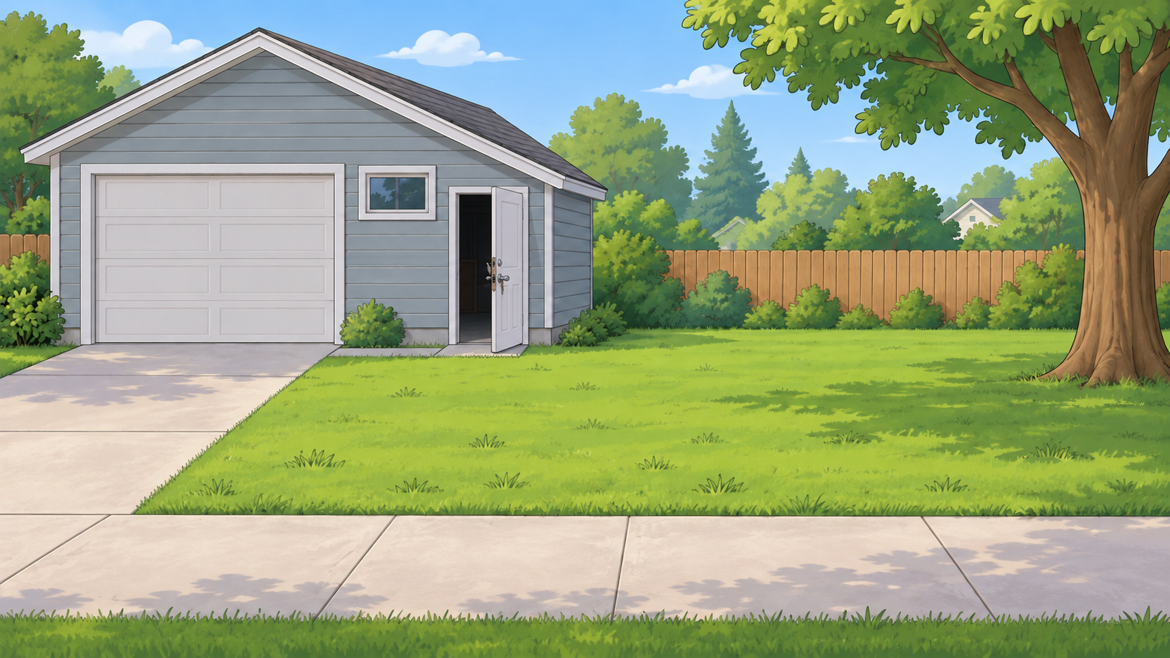
Oh no! The wolf breaks out of the garage!

Slide 10
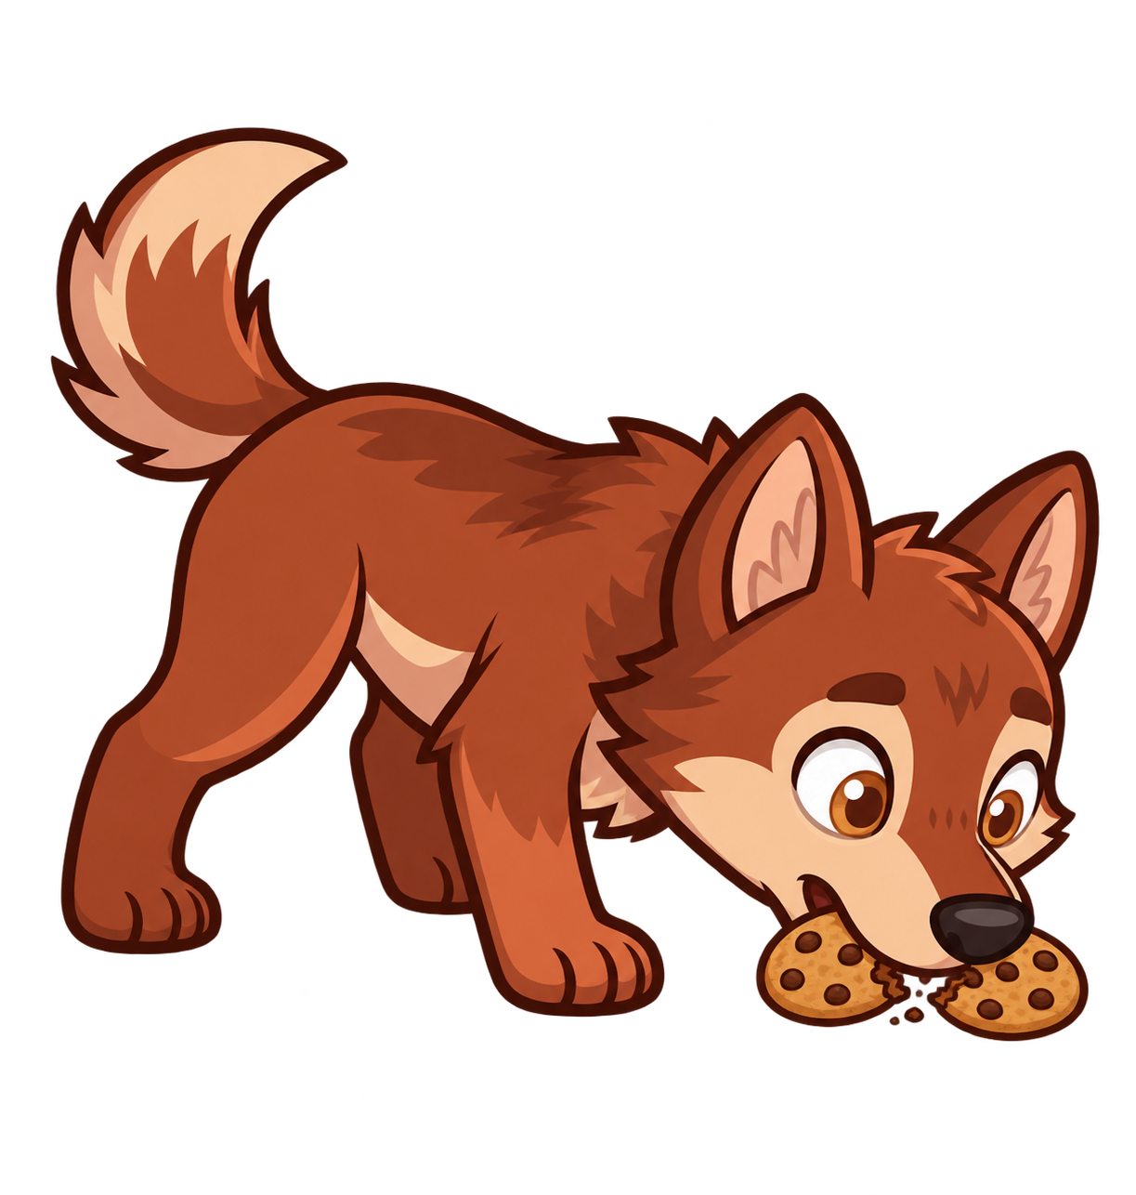
The wolf eats 2 of Andy’s cookies!

Slide 11
Catherine still has 8 cookies. Andy now has 0 cookies.

