Slide 1
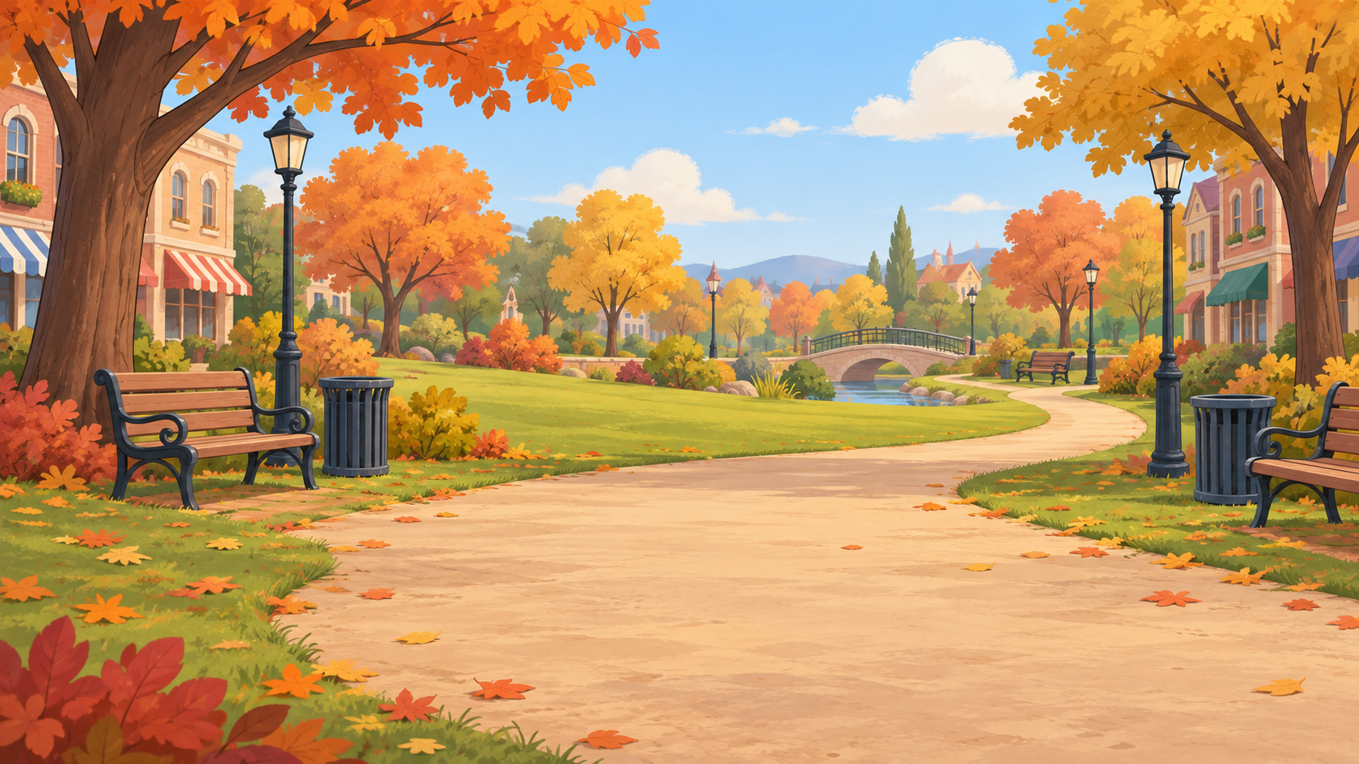
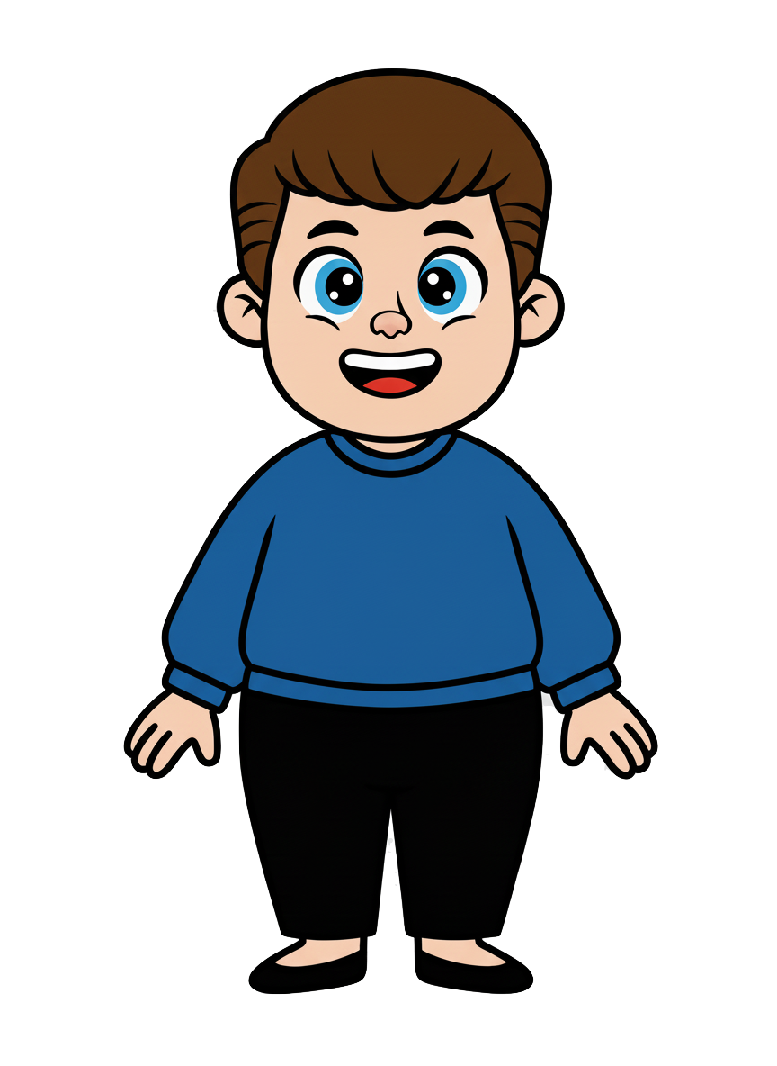
This is Kai.

Slide 2


Kai has 8 cookies.

Slide 3
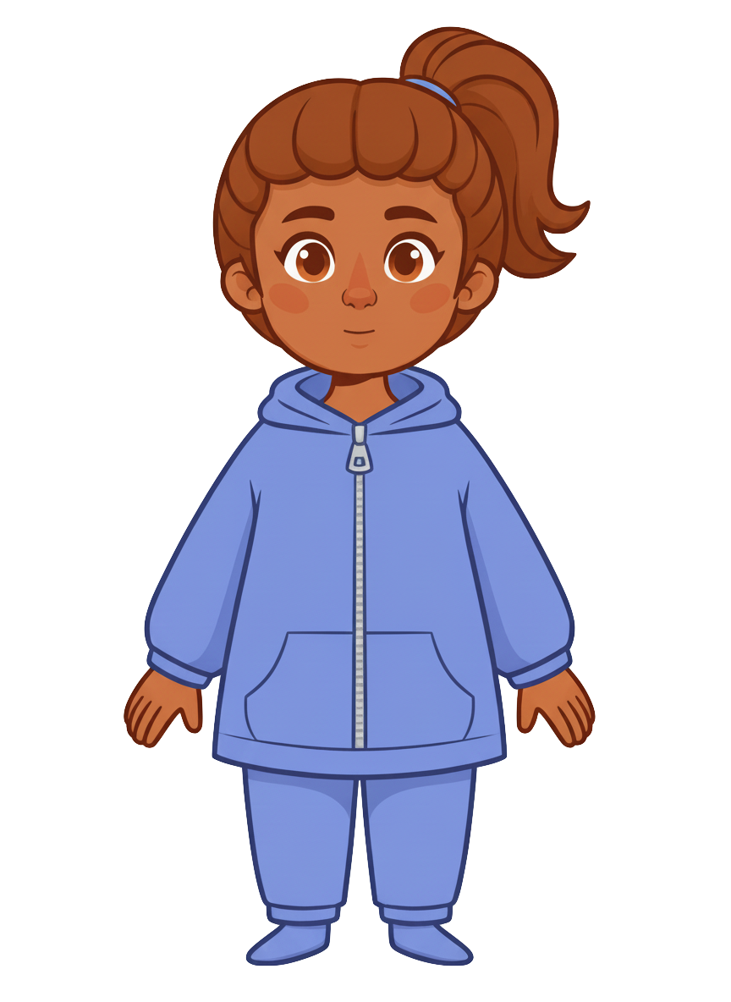
This is Ruby.

Slide 4
Ruby has 2 cookies.

Slide 5
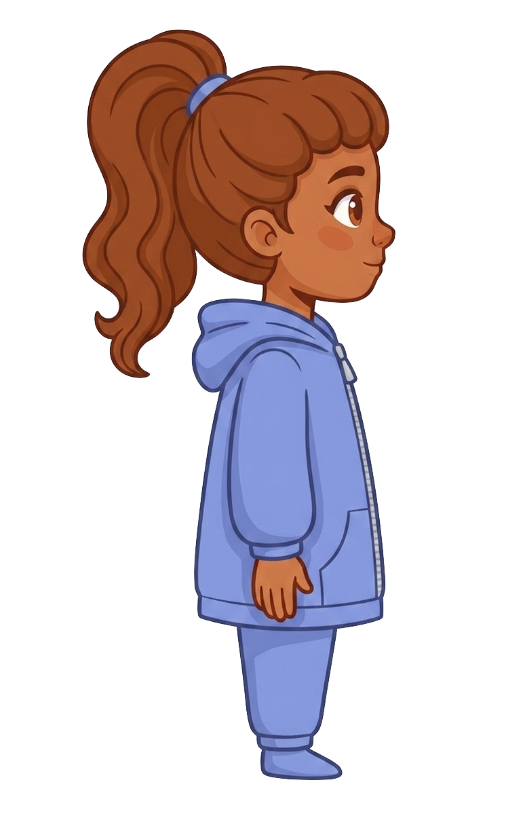
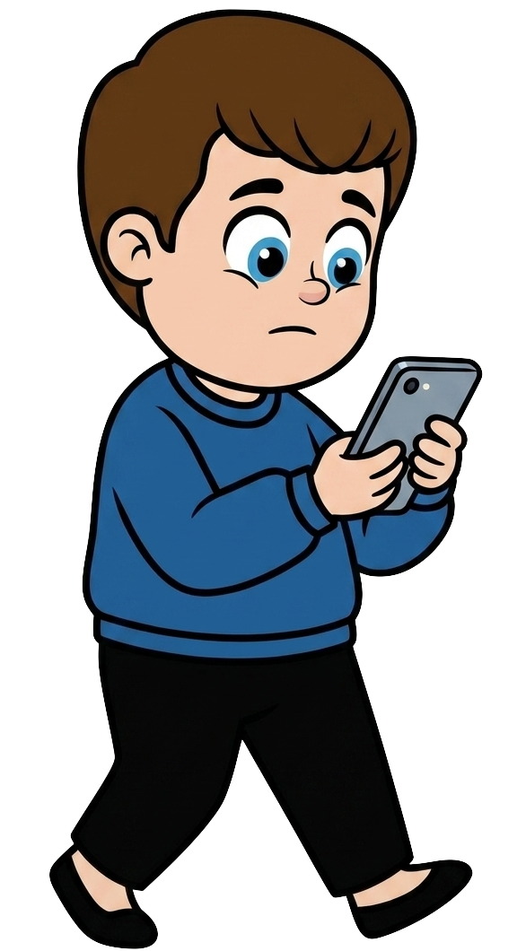
Kai is walking and staring at his phone.

Slide 6
Ruby tells Kai, “I know you could bump into me while looking at your phone and knock my cookies onto the ground.”

Slide 7
Ruby tells Kai, “I’m okay with that.”

Slide 8
Kai is walking and staring at his phone.

Slide 9
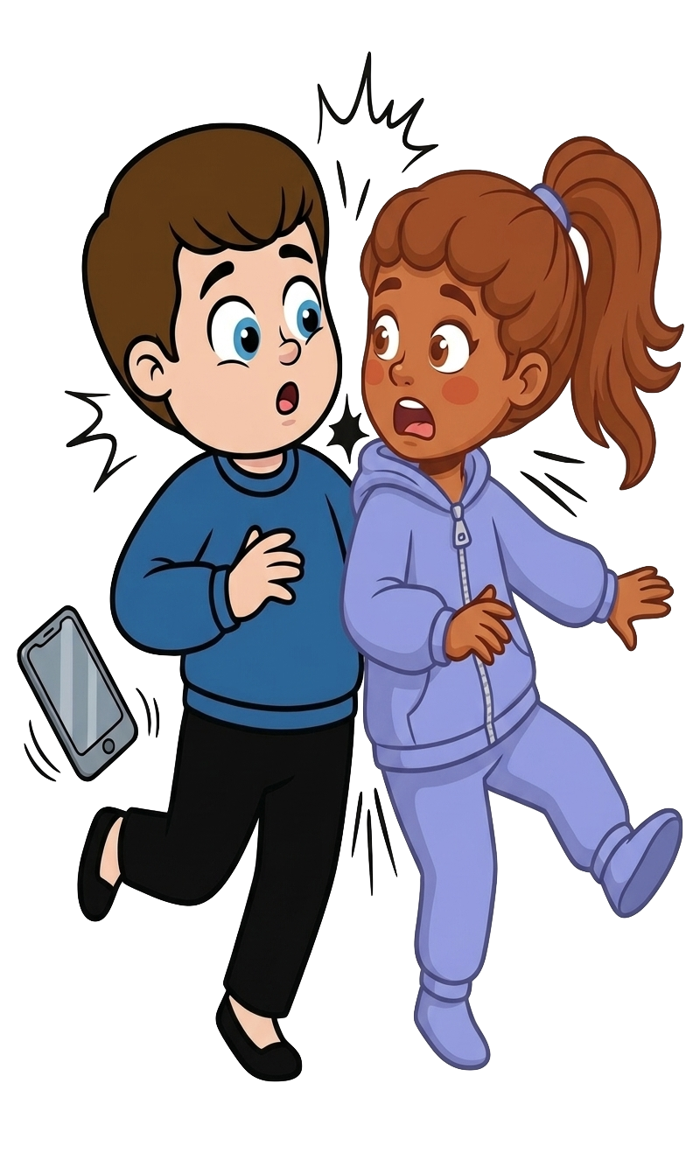
Oh no! Kai bumps into Ruby!

Slide 10
2 of Ruby’s cookies fall!

Slide 11

Kai still has 8 cookies. Ruby now has 0 cookies.

